Slide 1
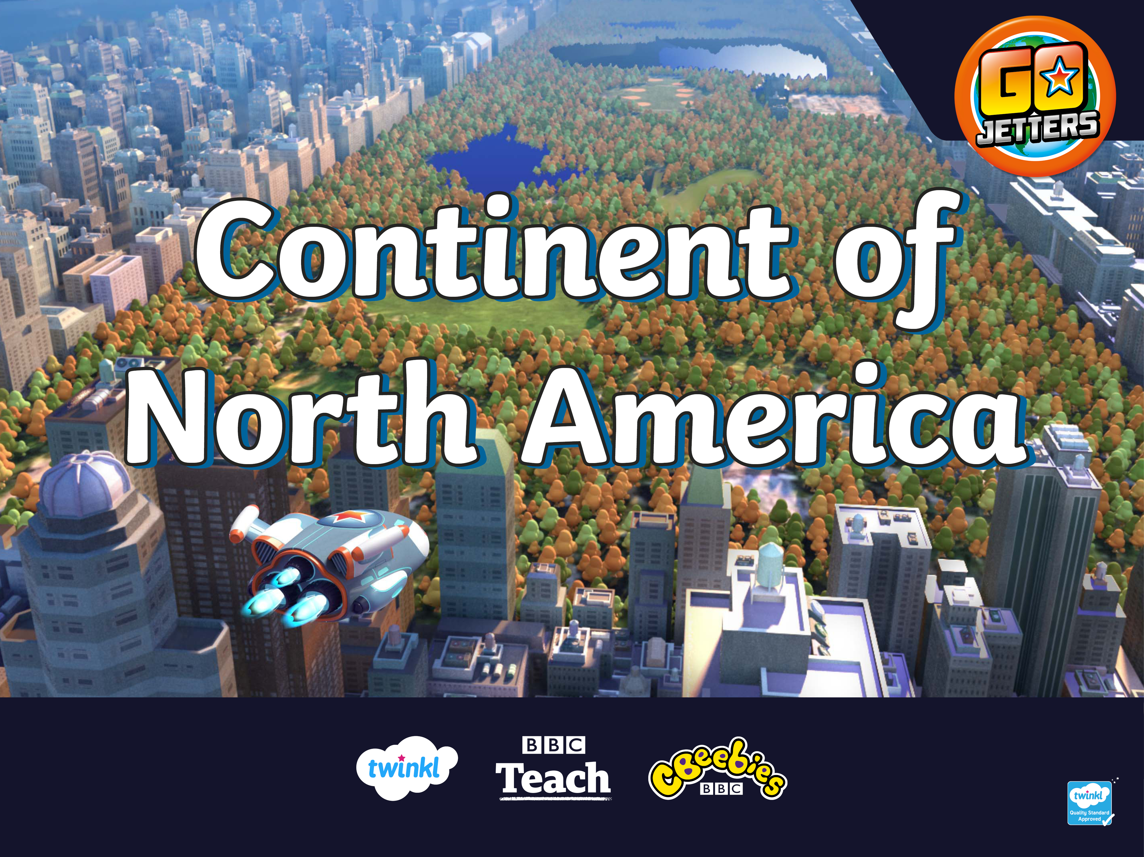

Slide 2
What Is a Continent?
Here are the seven continents of Planet Earth. A continent is a massive piece of land that is often separated from other areas of land by water, or another feature, such as mountains.
Europe
North America
Asia
Africa
South America
Oceania
Antarctica

Slide 3
North America
North America
This is the continent of North America.
It is joined to the continent of South America by a narrow strip of land.
South America

Slide 4
North America

Slide 5
What Is a Landmark?
Can you remember what a landmark is?
A landmark is something that stands out in an area. For example, it could be a building, a bridge, a lake, a river or a sculpture. It might be special because of its age or size.
A landmark makes a place recognisable. This means you could look at a picture of a landmark and know straight away where it is.

Slide 6

USA
America, or United States of America (USA), is split into states. You’ll see 50 stars on the American flag, one for each state. The country’s capital city is Washington DC.

Slide 7
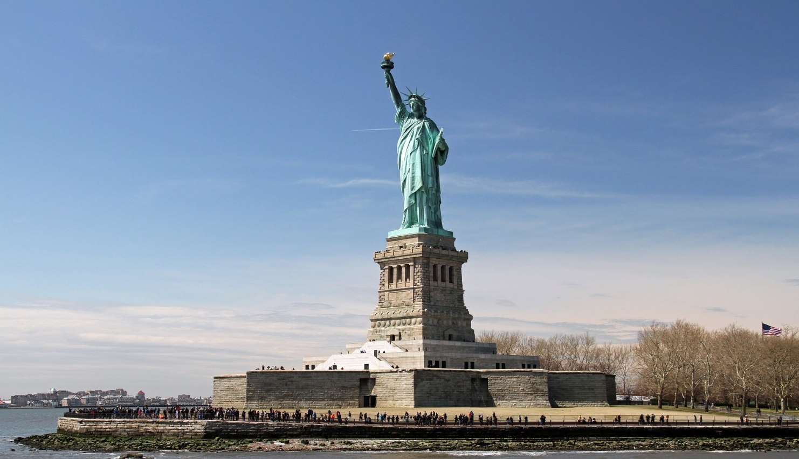
Statue of Liberty
This is the Statue of Liberty in New York, USA. Liberty means ‘freedom’. Listen to Ubercorn’s Funky Facts about the statue that is sometimes called ‘Lady Liberty’!

Slide 8
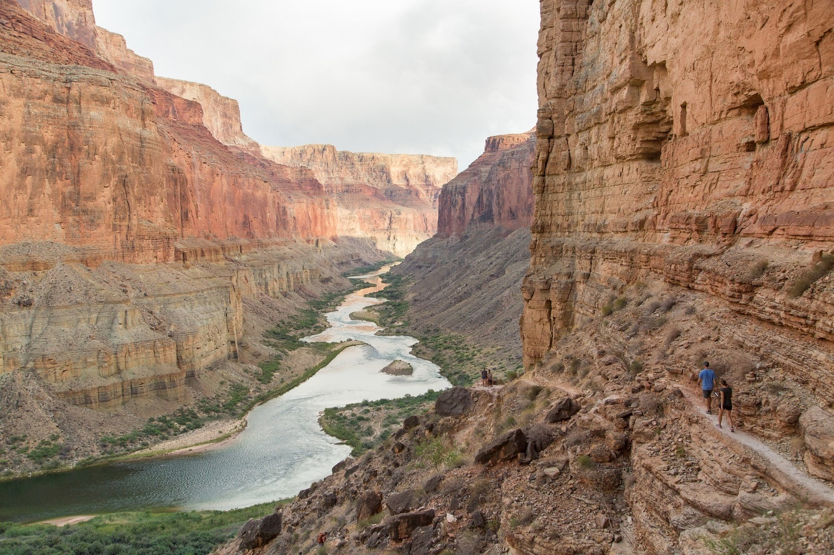
Grand Canyon
Right across the other side of the USA, you’ll find the Grand Canyon in Arizona. Here is Ubercorn with the Funky Facts.

Slide 9
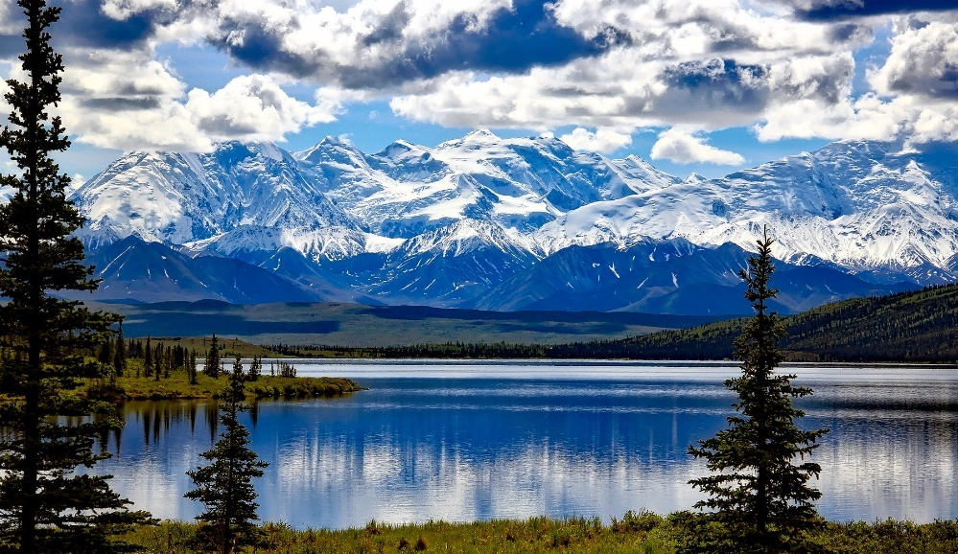
Alaska
Although Alaska isn’t within or next door to USA, it is one of the American states!
This is Denali National Park and Preserve in Alaska.

Slide 10
Canada
Canada is the second largest country in the world! Canada has two official languages: English and French.

Slide 11
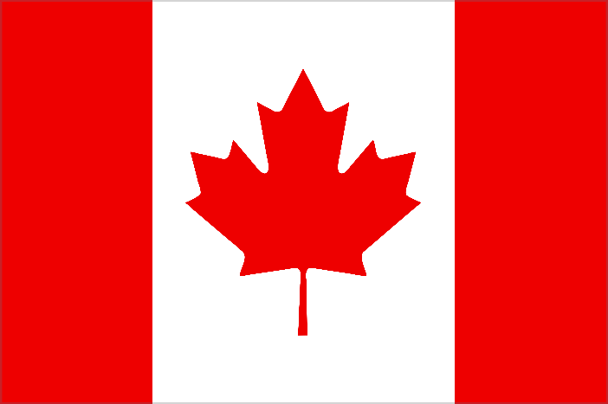
Canada
The maple leaf on Canada’s flag is the
country’s national symbol because it is
a distinctive feature of Canada’s nature.
Toronto is the most populated city in Canada with over 5 million people!

Slide 12
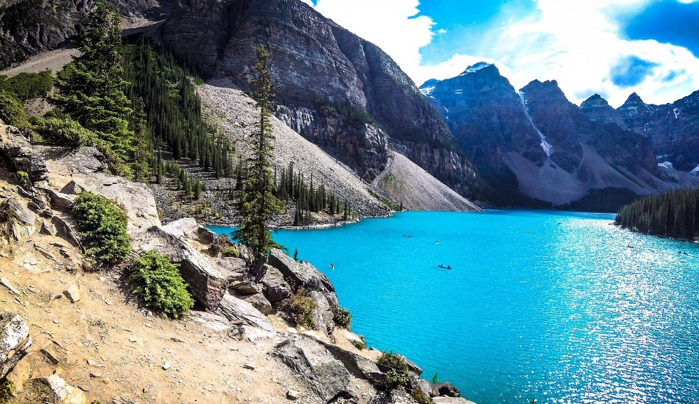
Banff National Park
Moraine Lake
Canada’s oldest national park is in Alberta, in the Rocky Mountains. People come here to visit the beautiful scenery including Moraine Lake, Lake Louise and Mount Norquay.
Tourists enjoy skiing, kayaking, cycling and hiking here.

Slide 13
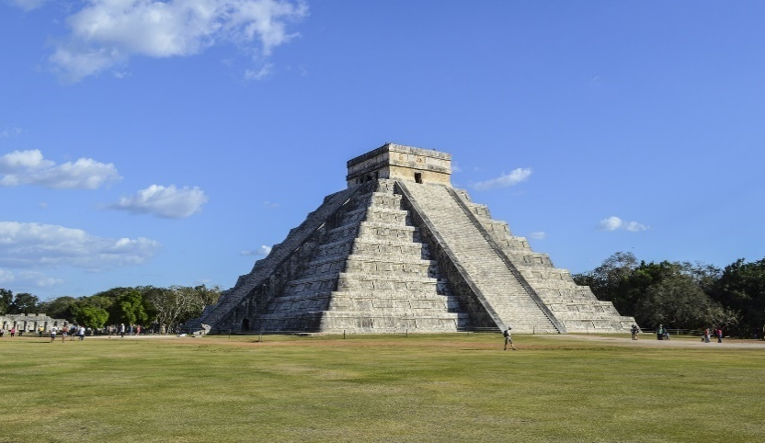
Mexico
Chichen Itza was a large city built by the Maya people. The ancient Maya were a civilisation that lived long ago in parts of North America. This landmark is one of the world’s most visited archaeological sites. It is over 1,000 years old.
El Castillo is the name given to the large pyramid temple there which has many steps on each side of the building.

Slide 14
