Slide 1
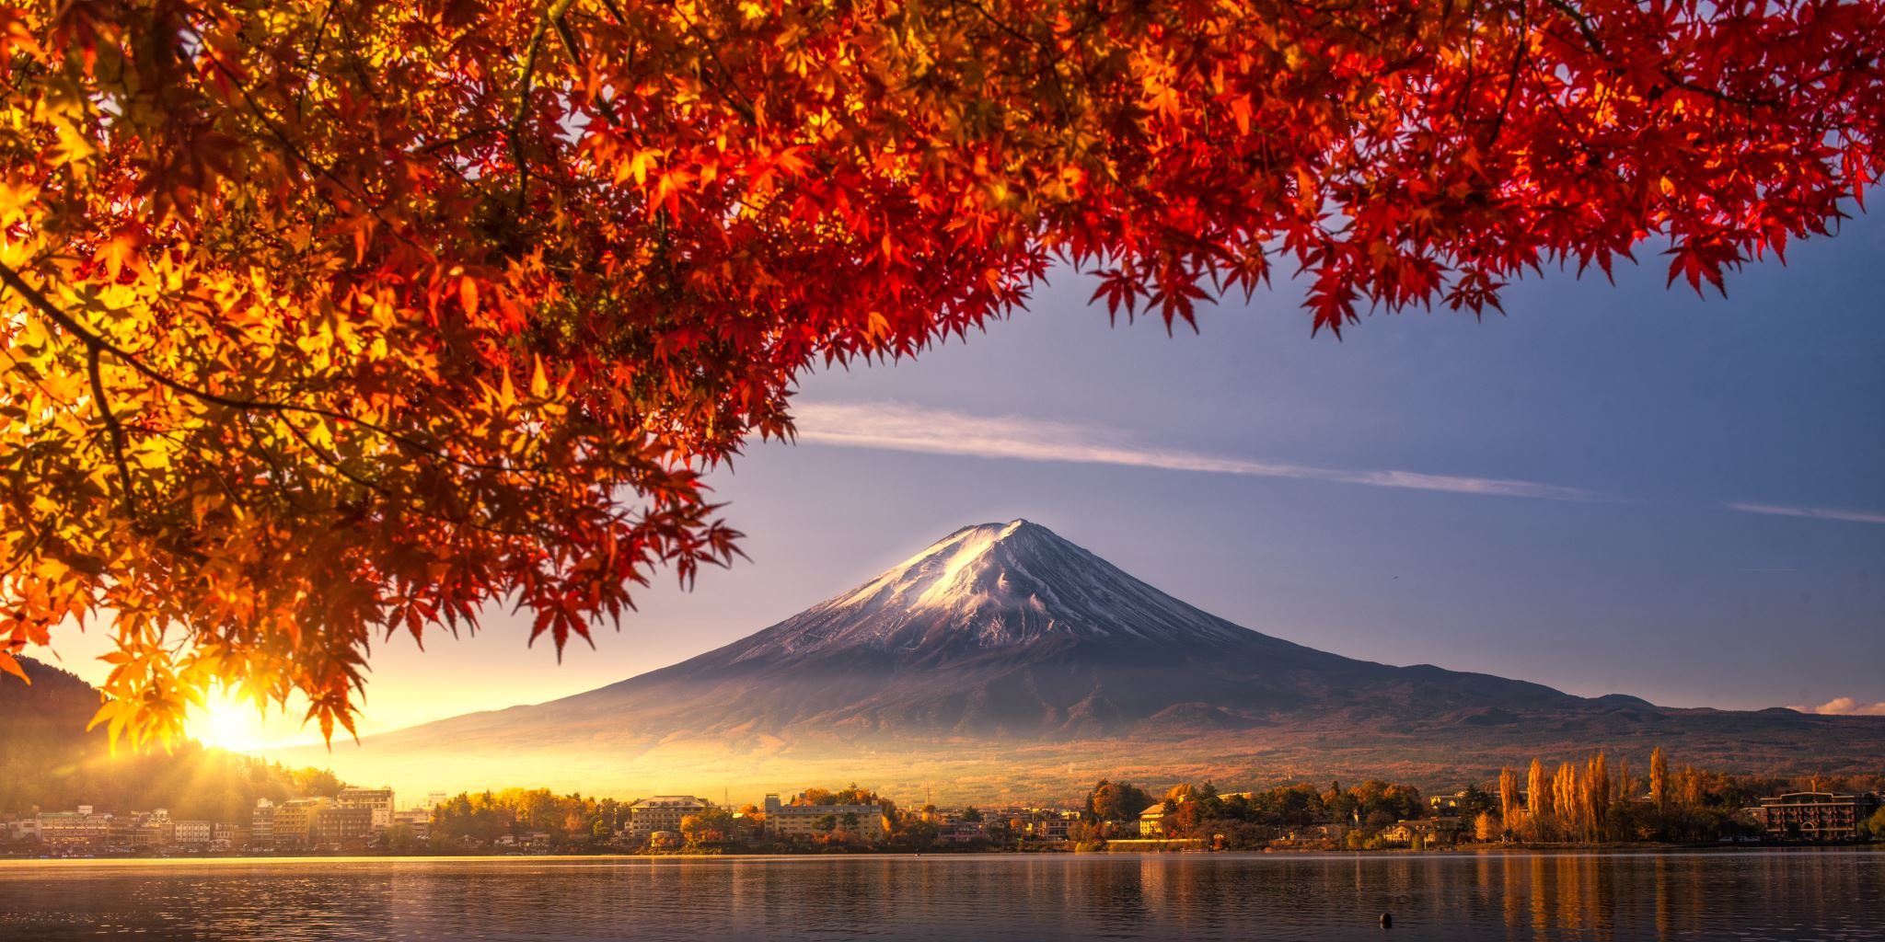

Mauna Loa
Mountain!
By
Analeece Buckley & Sienna Shaw
&
Ameila-Rae Flynn
By
b
7

Slide 2
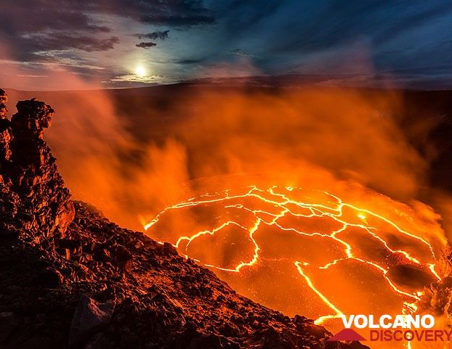
Mauna Loa Volcano
Mauna Loa, world's largest mountain and volcano, is a archetype of a basaltic shield volcano in its late mature stage of life, and only about 600,000-1,000,000 years old. Although not erupting as frequently as its younger neighbour Kilauea, it is also one of the most active volcanoes of the world. When it erupts, its eruptions are usually huge and produce large rivers of lava that have repeatedly threatened the town of Hilo.
Mauna Loa rises almost 9 km above the sea floor and the weight of the massive mountain has depressed the oceanic crust down by about 8 kilometres, so the whole pile of volcanic rocks produced from Mauna Loa is probably about 8+5+4=17 kilometres! It has eruptions both from its summit, occupied by a large caldera, and its NE and SW rift zones on the flanks. Almost 90% of Mauna Loa's surface is is covered by lavas less than 4000 years old, while about 50% of its surface is covered by lavas no older than about 1500 years old, while about 25% are covered by lava flows younger than about 750 years, i.,e. emplaced after the formation of the Mokuaweoweo summit caldera.

Slide 3
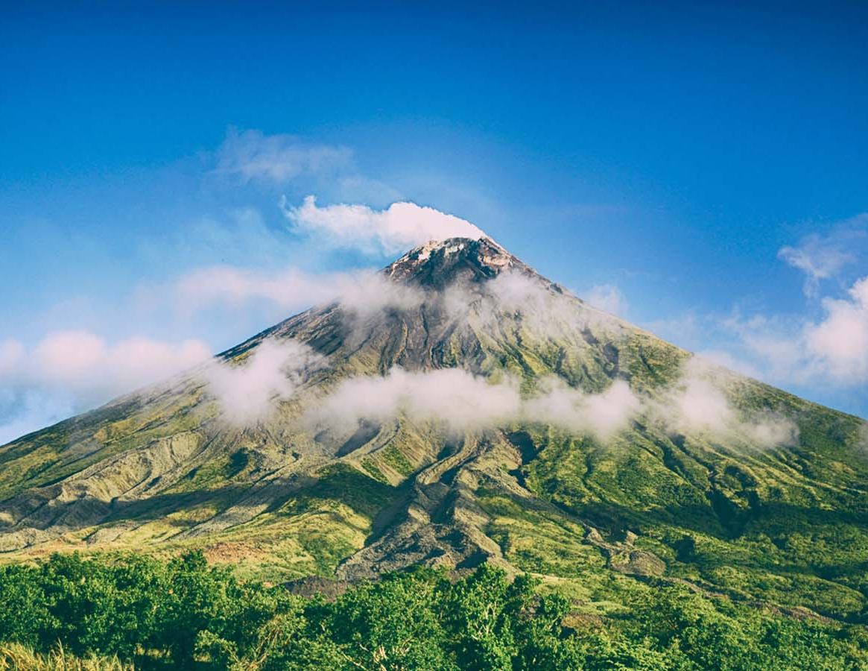
Formation of Mauna Loa
You might think all volcanoes are cone-shaped mountains that erupt by exploding molten lava into the air. The Hawaiian volcanoes, including Mauna Loa, are different. The Hawaiian volcanoes are shield volcanoes that were formed by lava slowly spilling out from a crack or fissure in the earth’s crust. Because of this, shield volcanoes are wide with gently sloping sides, and their eruptions aren't violent. Scientists believe Mauna Loa began to form over a million years ago when red hot lava spilled out from a crack in the ocean floor. The lava cooled and formed a raised area on the bottom of the ocean. This process continued over thousands of years until a sea mount or underwater mountain was formed. Eventually, the mountain became tall enough to rise above the surface of the ocean and become an island.

Slide 4
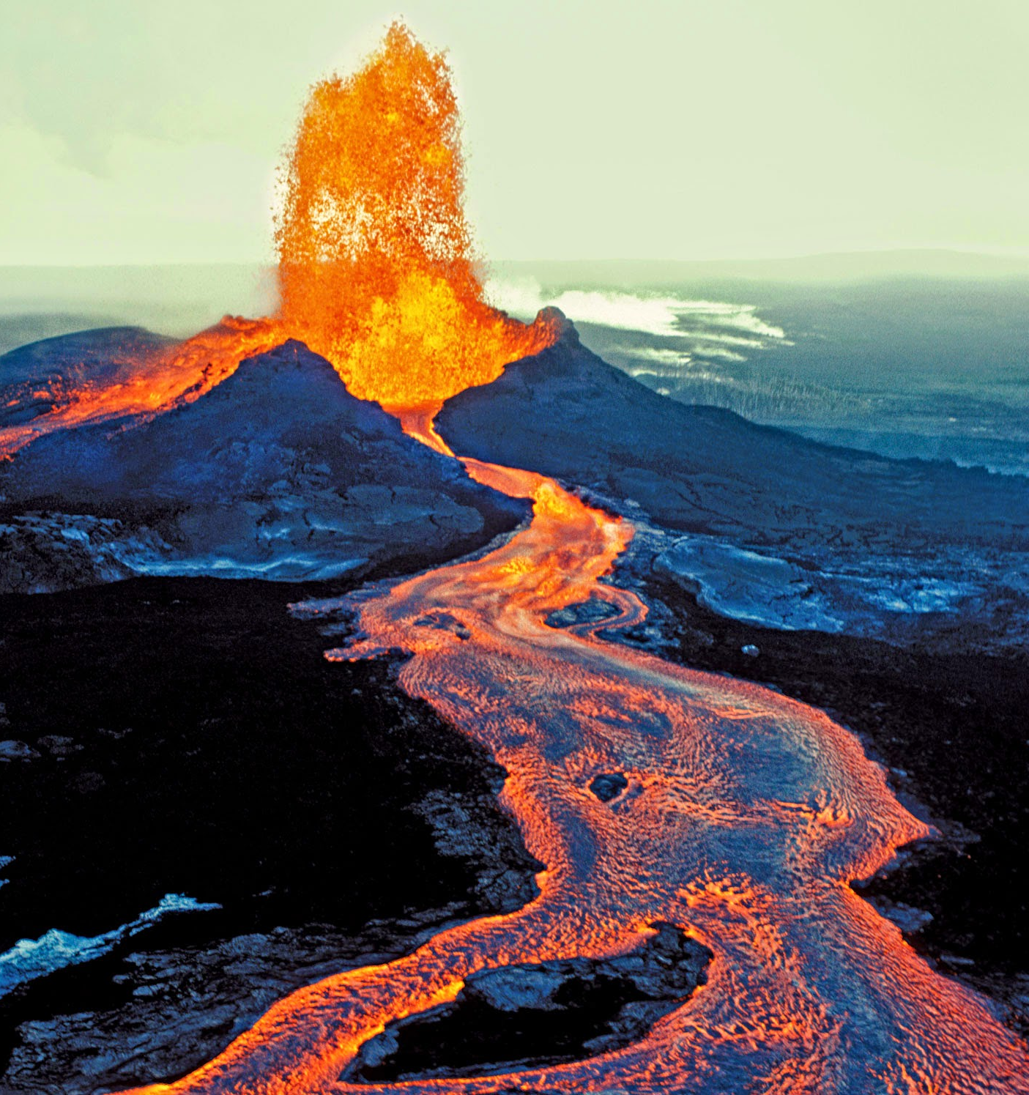
Eruption History
Mauna Loa is one of the most active volcanoes in the world, meaning it erupts frequently. According to the Hawaiian Volcano Observatory, Mauna Loa has erupted 33 times since 1843. Mauna Loa's last eruption was in March of 1984. Volcanologists, scientists who study volcanoes, carefully watch Mauna Loa for signs of volcanic activity. They also study the mountain to determine what path the lava flow might follow so they can issue specific warnings in case of another eruption.

Slide 5
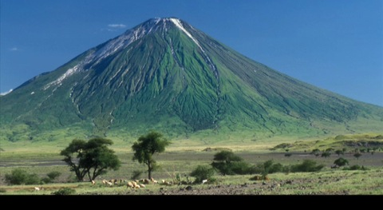
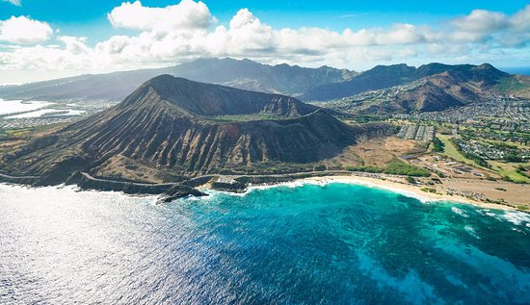
One Big Mountain
Mauna Loa is a long, wide mountain, shaped somewhat like a warrior’s shield. According to the Hawaii Centre for Volcanology, Mauna Loa is 60 miles long, 30 miles wide and rises 13,680 feet above sea level. However, much of Mauna Loa’s true height is masked by the sea. Mauna Loa’s long, sloping flanks or sides descend to the ocean floor more than 16,000 feet below sea level. When measured from the ocean floor, Mauna Loa is actually more than 30,000 feet tall, making it slightly taller than Mt. Everest.

Slide 6
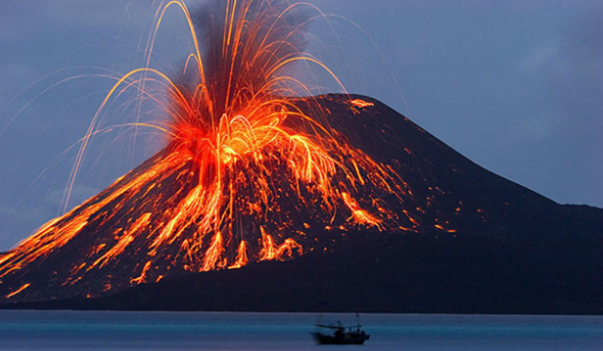
Hawaiian Legends
Legends are stories, not necessarily based on truth, that are handed down from one generation to another to explain certain events. According to Hawaiian legend, Mauna Loa was formed by the volcano goddess Pele when she was fleeing her jealous sister Na-maka-o-kaha'i. Pele made the mountain tall and large so her sister could not send ocean waves to put out the fires of Pele’s volcano. One story says that when a Hawaiian volcano is about to erupt, Pele sends a white dog from her home on Mauna Loa to warn villagers below.

