Slide 1

Welcome
to
Penistone St John’s Primary School
Multiplication Tables Check 2026 – Parent information evening
Tuesday 21st April 2026

Slide 2
Aims:
To understand what the statutory Multiplication Check is (MTC)
To find out when the check takes place
To understand what we’re doing in school to help prepare for the check
To encourage ways in which you can support at home
To highlight the importance of encouraging your children to practice their
times tables frequently.
Notes:
Hi, I’m Miss Marsh and I am maths lead in school here at St Johns where we have a whole school approach to times tables. We hope you will find tonight informative. We will be covering…..

Slide 3
Multiplication Tables Check (MTC)
The Multiplication Tables Check (MTC) is a statutory maths test for all year 4 pupils in England. The test measures how well pupils can recall their times tables from 1 to 12.
All primary school-aged children are expected to know their times tables up to 12 x 12 by heart. In fact, they are expected to have mastered their times tables by the end of Year 4.
Purpose of the check :
The purpose of the check is to determine whether your child can fluently recall their times tables up to 12, which is essential for future success in mathematics.
It will also help staff in school to identify if your child may need additional support, so they can access the demands of the year 5 and 6 curriculum.
Notes:
In terms of the word fluency, children need to be able to quickly recall the answer without the need for counting on their fingers or in their head. They need to have learnt and memorised the times tables fact so that they are able to answer instantly.

Slide 4
Multiplication Tables Check (MTC)
What is it:
It is an on-screen check consisting of 25 times tables questions. Your child will be able to answer 3 practice questions before taking the actual check.
They will then have 6 seconds to answer each question.
Each question will be worth 1 mark and will be presented to the children in the format:
____ x ____ = _____
On average, the check should take no longer than 5 minutes to complete and is similar to other checks already used. TTrockstars soundcheck is very similar.
Notes:
A list of pupils who should not take the test can be found in the administration guidance of the MTC documentation.

Slide 5
Multiplication Tables Check (MTC)
How is it administered?
The check will be completed on I-pads.
Teachers will administer the check in small groups.
It will automatically be scored and the results will be available to schools once the assessment period closes.

Slide 6
Multiplication Tables Check (MTC)
During the check:
Each pupil will be assigned a random set of questions.
Children will only face multiplication questions during the check (no division related facts).
Children will not see their individual results when they complete the check.
The 6, 7, 8, 9 and 12 times tables are more likely to be asked.
Reversal of questions (e.g. 8 x 6 and 6 x 8) will not be asked in the same check.

Slide 7
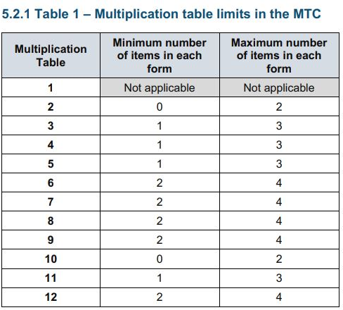
Multiplication Tables Check (MTC)
The Standards and Testing Agency (STA) state that they are classifying the multiplication tables by the first number in the question. For example, 8 x 3 would fall within the 8 times table.
Notes:
1x table will not appear

Slide 8
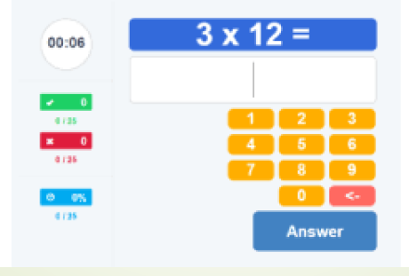
Multiplication Tables Check (MTC)
Before the check
Children will be able to practice before taking the check.
There will be a ‘try out’ area the children will use to become familiar with the timings and layout of the check.

Slide 9
Multiplication Tables Check (MTC)
After the check:
DFE have not issued an ‘official’ pass mark. Therefore, children will not be expected to re-sit the check.
School-level results and individual pupil results will be available to schools. This will allow schools to provide additional support for those who need it.
As is the case with the phonics-check (KS1), school-level results will be available to selected users such as Ofsted. They will not be published in a performance table.
National and local authority results will be reported by the Department of Education (DFE) to track standards over time. They will create a report about the overall results across all schools in England, not individual schools.

Slide 10
Multiplication Tables Check (MTC)
When is it?
It will be taken by children in year 4 in the summer term. This year the dates the check need to be completed are between Monday 1st June and Friday 12th June 2026.
Schools will decide which days the check will be administered.

Slide 11
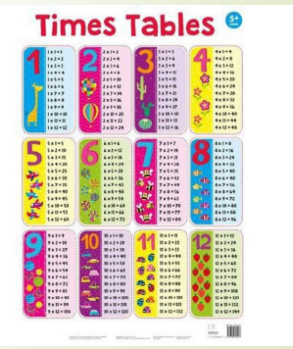
Multiplication Tables Check (MTC)
Preparations do not begin in year 4:
Year 1 – count in multiples of 2, 5, 10
Year 2 – Learn their 2, 5 and 10 times tables. Count in multiples of 3.
Year 3 – Learn their 4, 8, 3 and 6 times tables.
Year 4 – Learn their 7, 9, 11 and 12 times tables. Review of all times
tables.
Notes:
Whole school approach to times tables. Doesn’t stop in year 4 – they continue to practice, embed and apply those facts in year 5 and 6.

Slide 12
Multiplication Tables Check (MTC)
What we are doing in school to prepare your child:
NCETM programme - Mastering Number daily
Times tables practice sessions and precision programme for target children
Use of Times Tables Rock Stars (TTRS)
Weekly sound checks using TTRS
Half termly TTRS tournaments
Officially Unofficial Multiplication Tables Check (OUMTC) in Autumn, Spring and Summer
Notes:
Mastering Number in Year 4 is a programme we started last year. It enables children to develop fluency in multiplication and division facts and a confidence and flexibility in number.

Slide 13
Multiplication Tables Check (MTC)
How can you help prepare your child?
Use of TTRS – daily for 10-15 minutes
Encourage children to take part in the half termly tournaments
Listen to and learn times tables songs
Play online maths games
Games such as, snap and matching card games
Focus on one times table per week and ask random questions then move to another the following week – in the car, at meal times….. rewards

Slide 14
Multiplication Tables Check (MTC)
Useful websites:
https://www.gov.uk/government/collections/multiplication-tables-check
https://www.youtube.com/watch?v=GhAJMJUsAac
https://ttrockstars.com/
https://www.topmarks.co.uk/
https://maths-games.org/times-tables-games.html
https://www.coolmathgames.com/

Slide 15
Multiplication Tables Check (MTC)
Questions?
Notes:
Children eligible for access arrangements are:
Children with an EHC plan
Children who have provisions made in school using the SEND support system.
Children with behavioural, emotional or social difficulties
Children with EAL
Schools do not need to request permission to use access arrangements. The support should be based on the support provided in school and should not advantage or disadvantage individual children.
A child can be assigned more than one access arrangement, if required.
Colour contrast;
Font size adjustment;
‘Next’ button (alternative to 3-second pause);
Removing on-screen number pad;
An adult to input answers;
Audio version;
Audible time alert.

Slide 16
Thank you
Multiplication Tables Check 2025 – Parent information evening

