Slide 1
Penistone St John’s CE Primary School
Parent Information
Year 5

Slide 2
School Vision Statement
As a Church of England school and according to Jesus’ promise of “Having life in all its fullness” we endeavor to inspire all “to become the best versions of themselves through our shared Christian values of Love, HonEsty, FAithfulness, FoRgiveness and KiNdness- LEARN
Our school’s vision is summarised by our mission statement: “working together in friendship and faith, learning for life”

Slide 3
Main Priorities 24-25
Improve the quality of education by;
Further refining teaching and learning writing so more children make accelerated progress.
Continue to strengthen the provision for children working below the expected standard

Slide 4
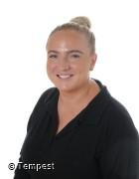
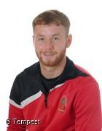
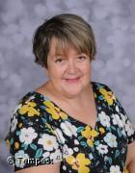
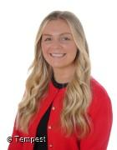
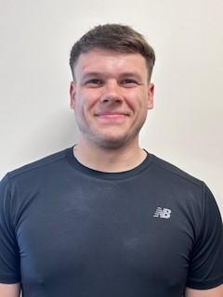
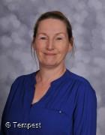
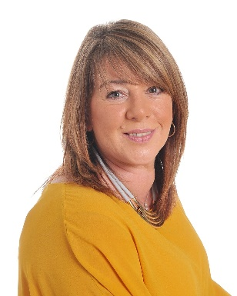
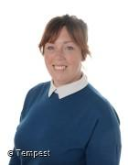
Meet the Team
Jaguars
Leopards
Miss Wainwright
Mr Heath
Could be subject to change
Mrs Jones
Mrs Campbell
Mr Utley
Miss Ryan
Mrs Rusby
Miss Plant

Slide 5
Curriculum
English
Transcription
During Autumn term, the children will be practising spelling and handwriting each day. In order to support the learning of spellings, all children have an individual Spelling Shed log in and are encouraged to go on their account to practise the Y3/4 common exception. We will send further information regarding spelling tests.
Reading
During Autumn term, the children will be recapping and refining their knowledge of a range of reading skills. They will be reading a variety of genres linked to their writing cycles; all with different contexts to broaden their understanding of different text types.
The genres include: Biographies, Non-Chronological Reports, Persuasive Adverts, Playscript, Diaries, Narratives
Writing
During Autumn term, the children will produce a variety of writing, all with different purposes and audiences, which will be inspired by class novels or wider curriculum subjects.
This will include: Biographies, Non-Chronological Reports, Persuasive Adverts, Narratives, Diary Entry

Slide 6
Curriculum
Mathematics
During Autumn term, the children will be learning the following maths concepts:
Decimal Fractions
The children will learn to identify, describe, write and order tenths and hundredths as a decimal fraction. They will learn to round decimal numbers to the nearest whole and covert between metres and centimetres.
Money
The children will be taught to:
Explain and represent whole pounds and pence as a quantity of money.
Compare amounts of money.
Convert quantities of money between pounds and pence.
Add and subtract amounts of money.
Negative Numbers
The children will be taught to:
Interpret numbers greater than and less than zero in different contexts.
Read and write negative numbers
Place negative numbers on a number line
Calculate intervals between positive and negative numbers.
The children will also continue to develop their arithmetic skills through daily 5 in 5, weekly arithmetic tests and TTRockstars challenges. Children should continue to enhance their recall of multiplication and division facts by accessing the TTRockstars website as part of their home learning.
www.ttrockstars.com

Slide 7
Curriculum
Science:
Our science topic this half term is all about forces. Children will learn about the different types of forces and their effect on objects, carrying out experiments and investigations. In the second half term, the children will be learning about separating materials.
Wider Curriculum:
Geography Project – Natural Disasters
This half term, the children will be learning about Natural Disasters and Italy. In this topic, they will explore:
The locational geography of Italy
Volcanoes within Italy e.g Mt Etna
Structure of the Earth
How earthquakes, volcanoes and tsunamis occur and the effects of them

Slide 8
Curriculum
RE
During this half term, the children will be looking at the ‘Early Islamic Civilisation’. The children will look at the following questions:
- Who is Muhammed and how did he start Islam?
- What were the four caliphs? What is a caliphate?
- What are the two main groups of Muslims called?
- Where had the Islamic Empire grown into?
- Where is Baghdad? Why is it significant in early Islamic civilisation?
PSHE
During Autumn term, the children will be exploring the theme of ‘What decisions can we make with money?’

Slide 9
Curriculum
PE
Each week, the children will take part in PE.
Children should come wearing their PE kit on their PE day. This includes: black short/jogging bottoms, white-shirt, trainers, plain dark jumper/hoody.
PE days are as follows:
Jaguars– Friday afternoons
Leopards– Friday afternoons
If, for some reason, the PE day changes one week, a text will go out to inform parents.

Slide 10
Curriculum
Homework
Each half term, a homework grid will be sent home with the children. The grid includes:
Spellings Practice
Handwriting
Wider Curriculum choices
Reading
Grammar
TT Rockstars
Children have a Spelling Shed log in and therefore, can practise their spellings on this online platform.
Children can bring physical copies of their homework into school or they can post it on class dojo. This will be celebrated in class.

Slide 11
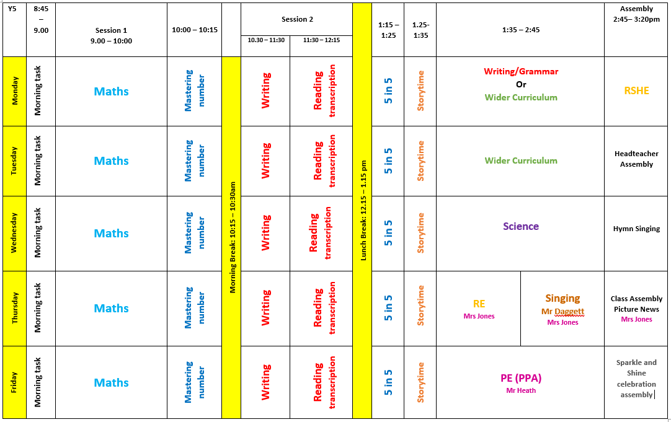
Timetable: Jaguars

Slide 12
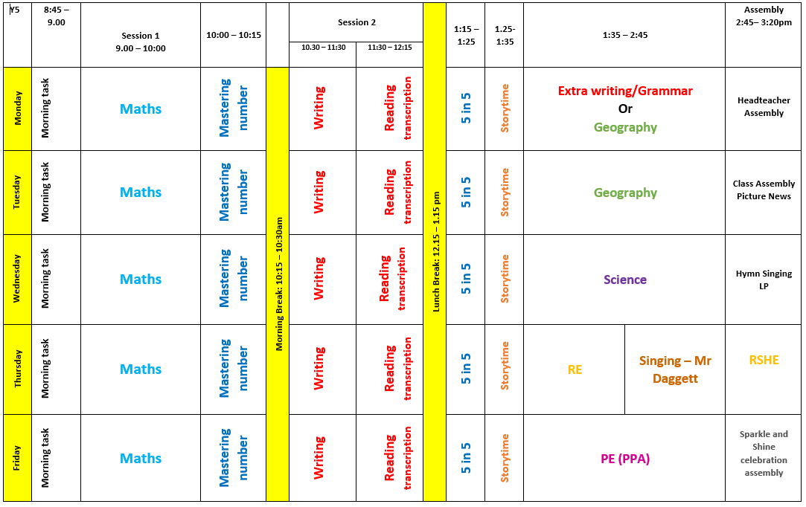
Timetable: Leopards

Slide 13
Trips and visits:
Robinwood:
Wednesday 17th September – Friday 19th September

Slide 14
Communication
School Gateway
Office –email
Class WhatsApp
Website

