Slide 1
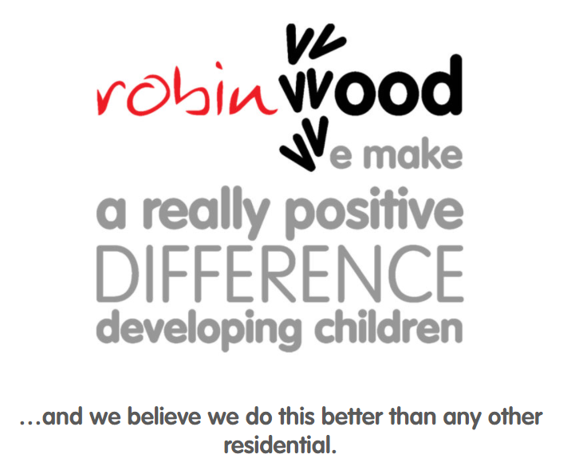

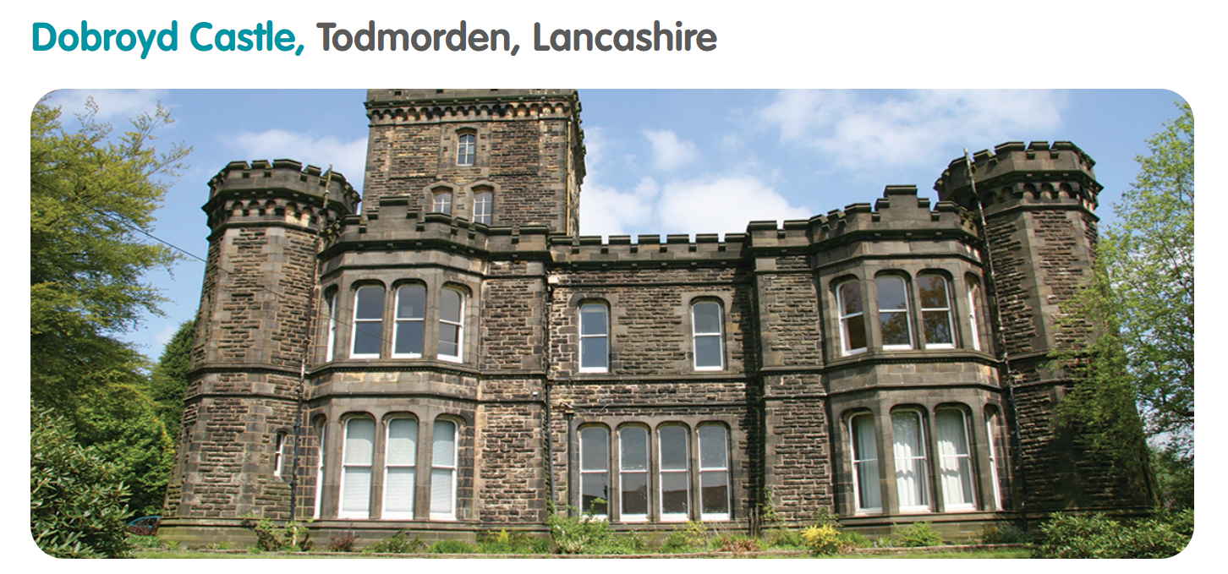
17th – 19th Sep

Slide 2
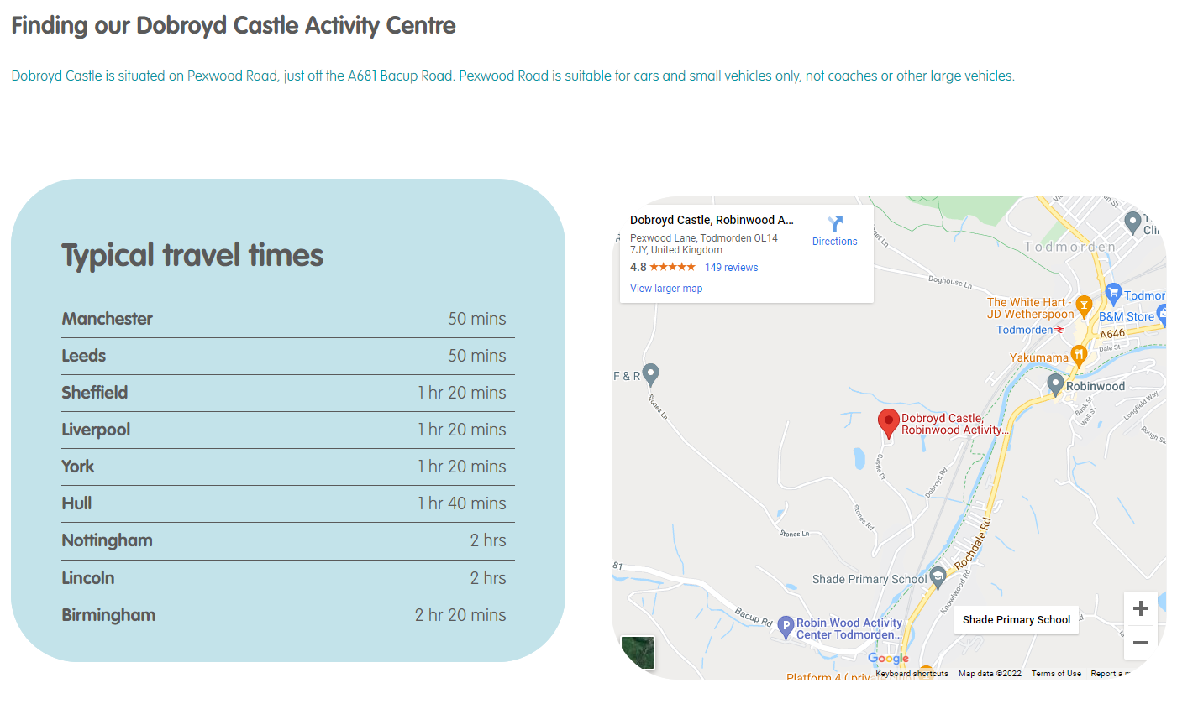
Penistone 1 hour 20 mins
Times. On 17th Sep, please arrange to have your child in school by 8.30 am as we intend on leaving at 9:00 am.
We plan to be back for 3:30pm on Friday 19th Sep.

Slide 3
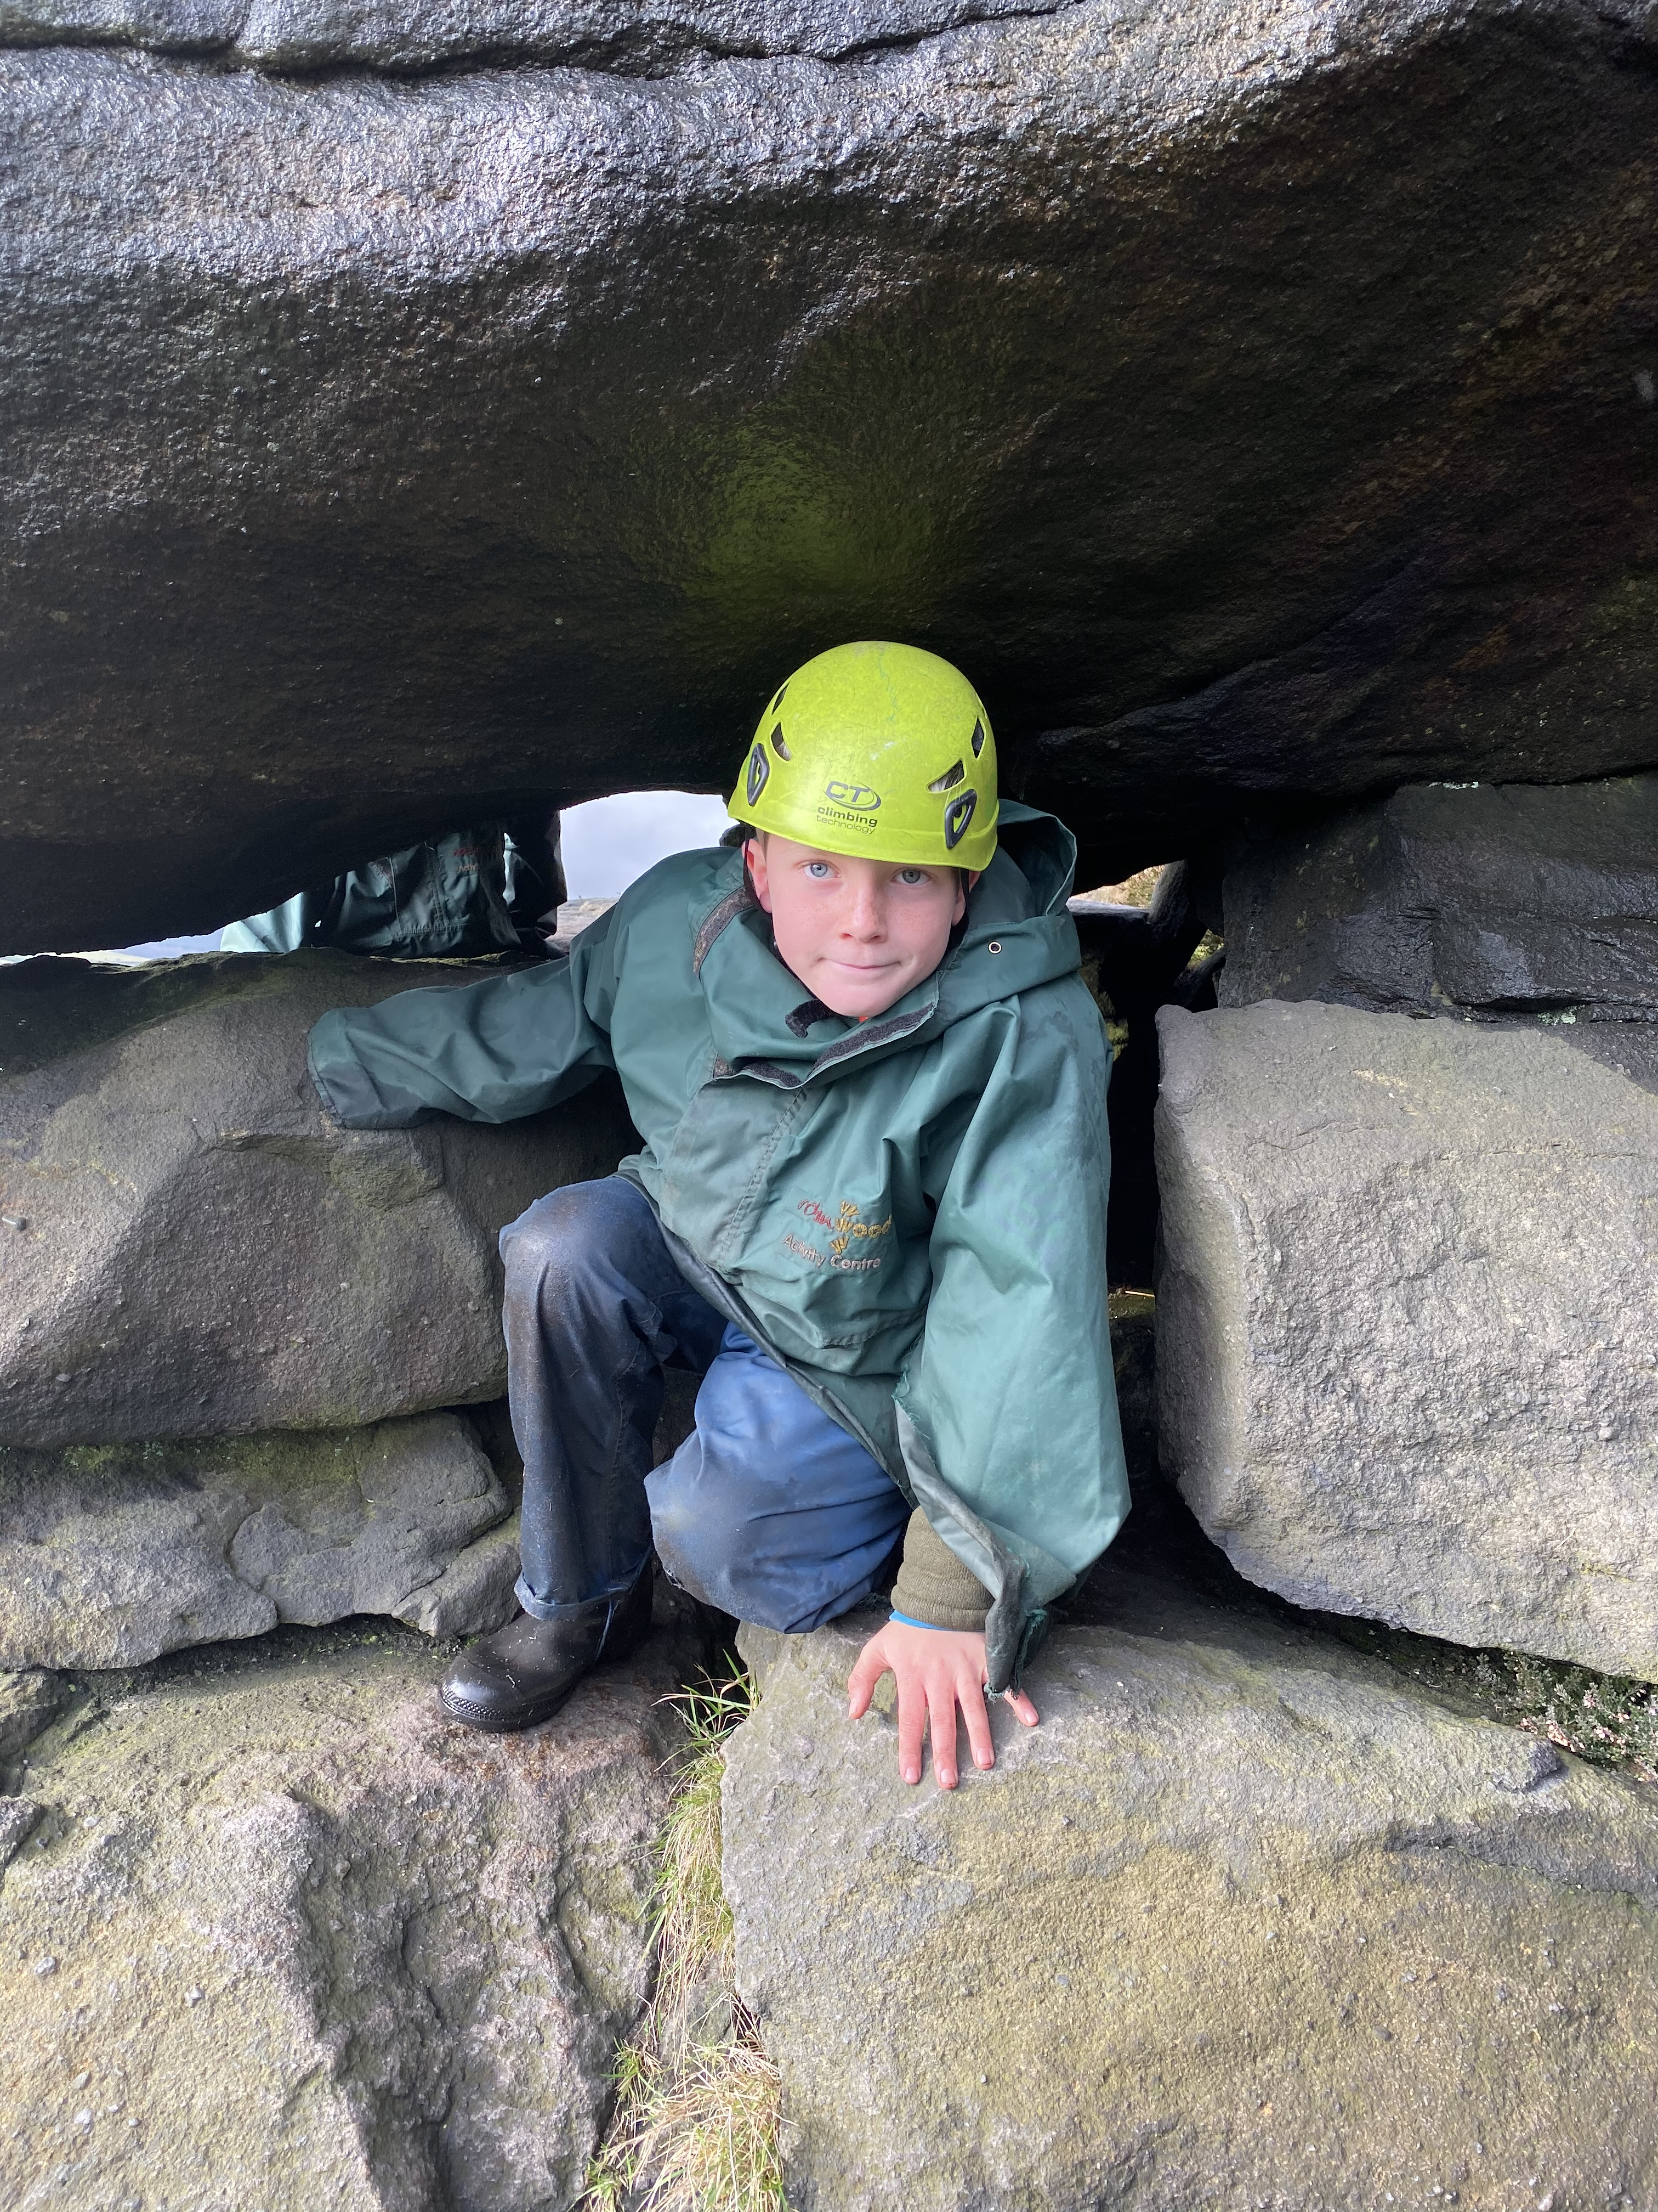
Children have really busy days at Robinwood with activities starting at 9.00am and finishing at 8.20pm, lights out at 9:20pm.
In a 3 day course we typically pack in 15 different activity sessions
Throughout their time at Robinwood, children:
challenge themselves to overcome fears
improve their listening skills
take on leadership roles
become more confident speaking out in a group
support others in challenging situations
become great team members and help their group work more as a team
work successfully with children they would not normally work with
become more aware of the needs of others
improve their problem solving skills
develop new skills
overcome physical challenges

Slide 4
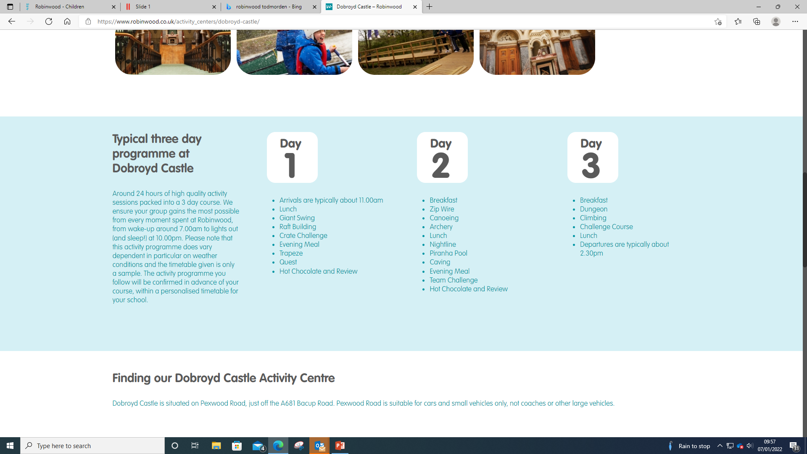
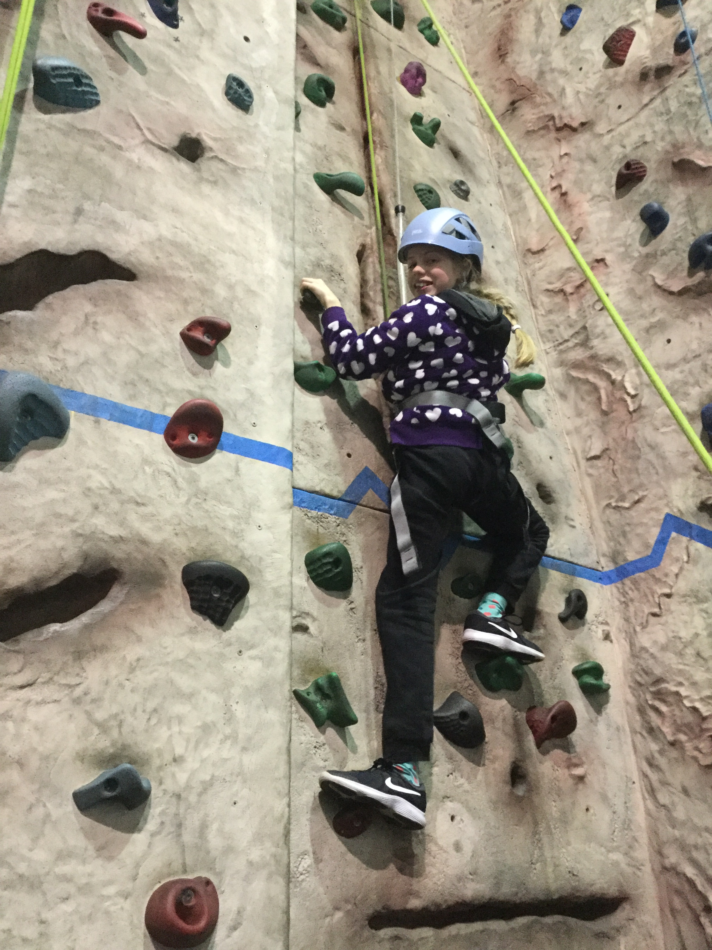
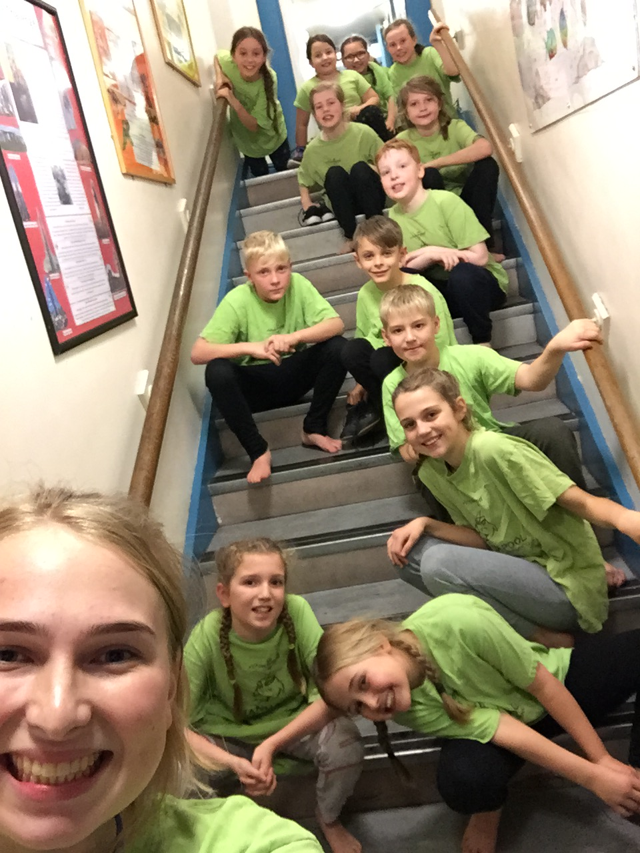
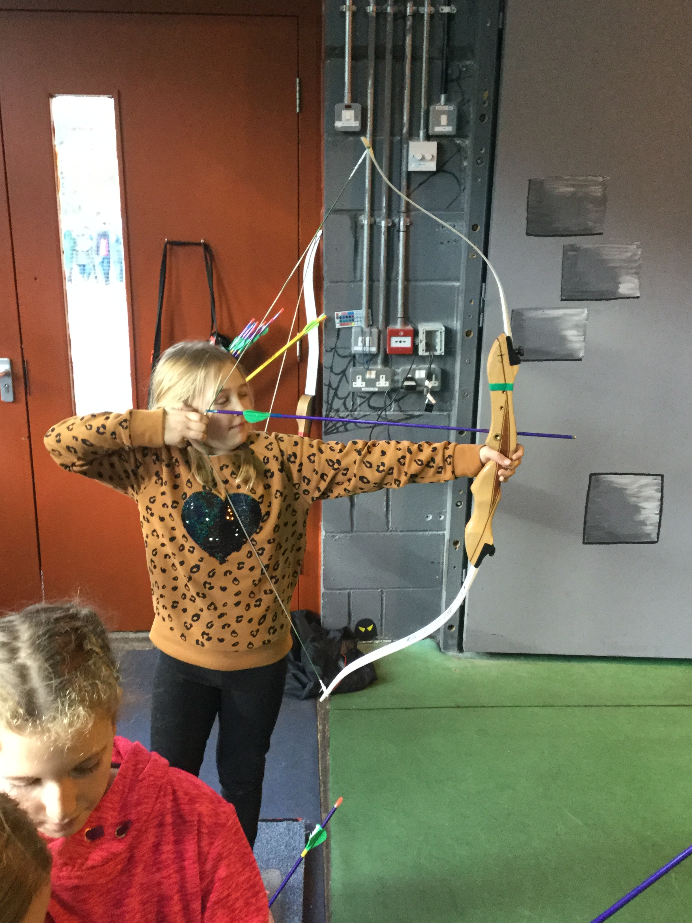
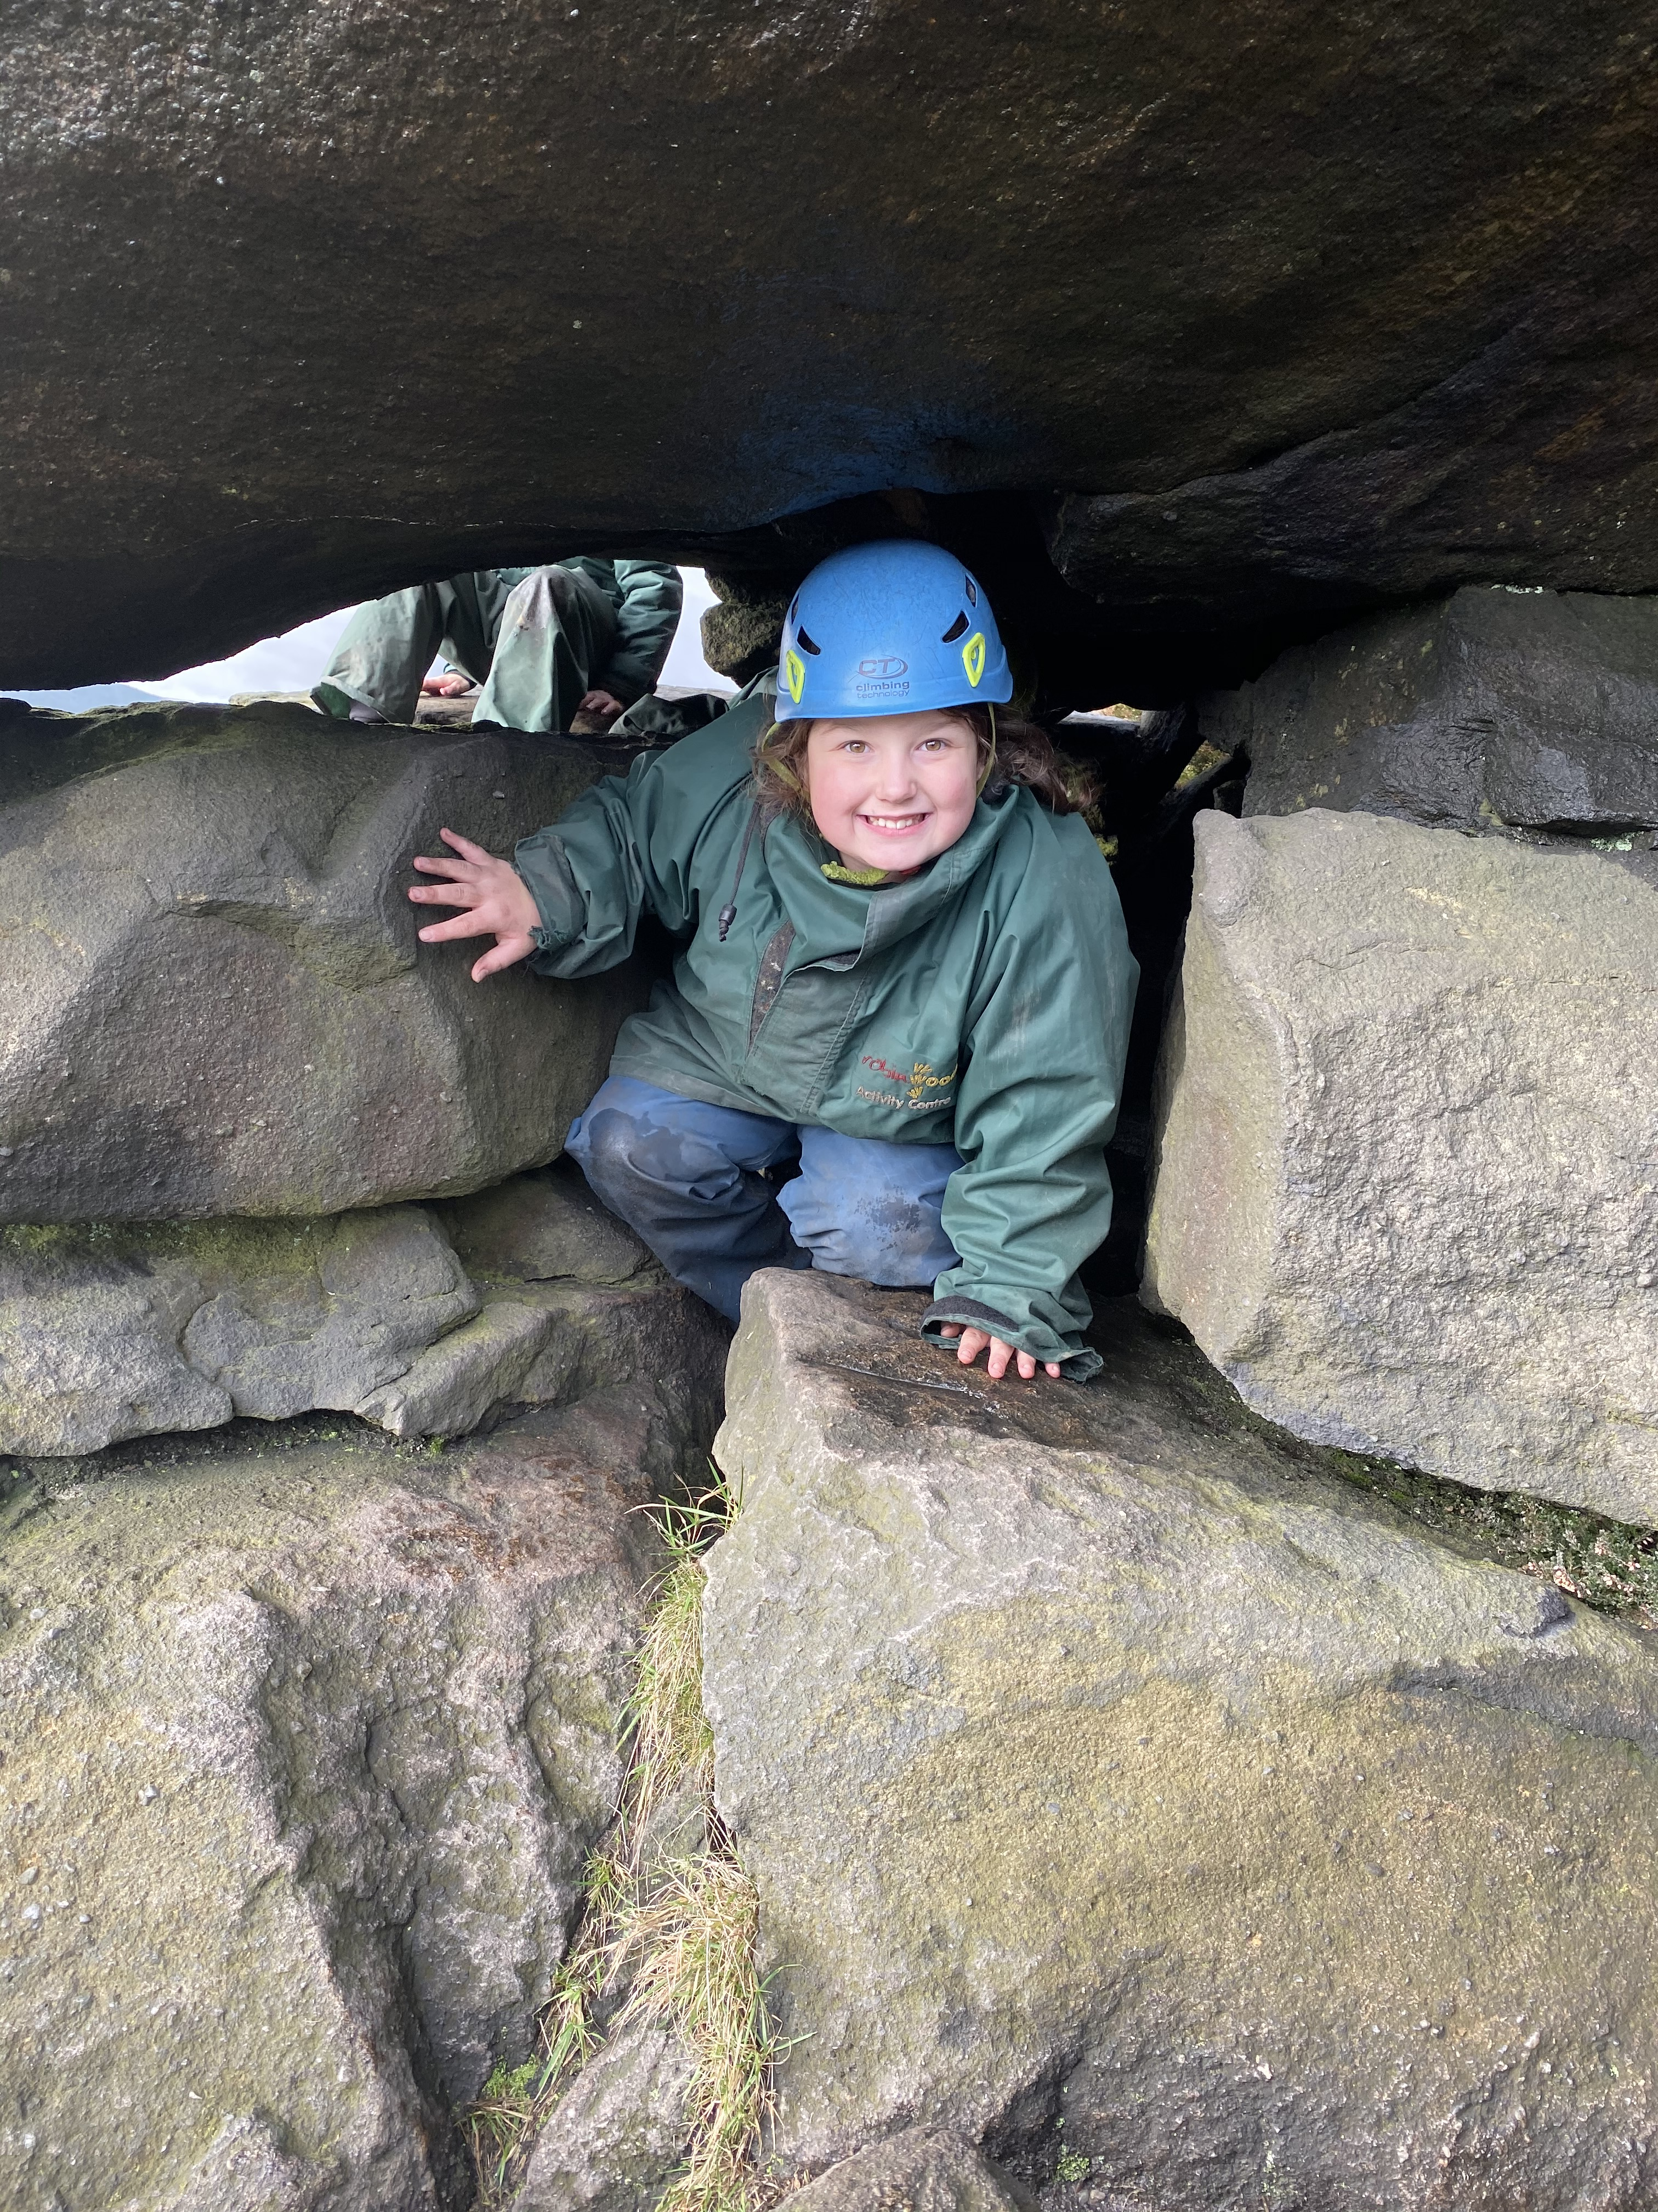
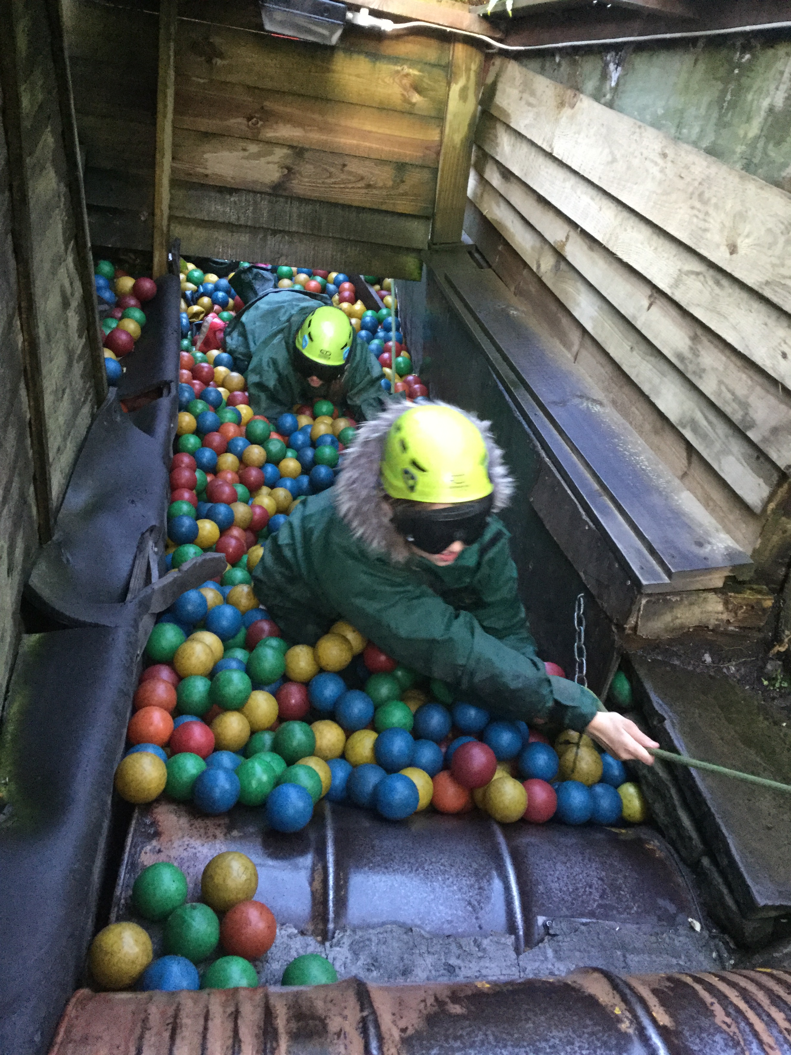

Slide 5
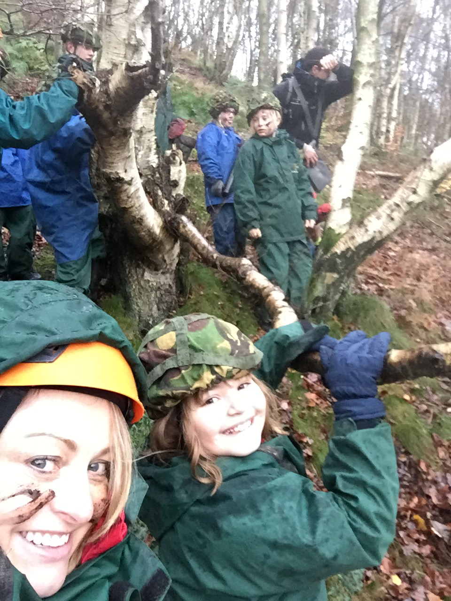
Each activity group has the same group leader for all 15 activity sessions. Robinwood group leaders are able to tailor your course to develop the key qualities that you feel are most important for your group and for each individual child in your group. Group leaders spend around 30 hours, over 3 days, with their group.
Within this time, they get to know the children so well, that they can work to develop each child as an individual, helping them to gain the most possible from their Robinwood experience. Teachers have grouped the children to get the best experience. Each group will have at least 1 member of staff from St John’s.
Staff attending
Miss Wainwright (Group leader), Mrs Campbell, Miss Coldwell, Mr Heath, Mr Utley, Miss Plant and Mrs Holley.
They will be in a group with a familiar adult, some groups will have two St John’s staff members with it.

Slide 6
After we have input all the information from your medical/dietary forms we will be informed of the dormitories we have been allocated
• Dormitories are heated, have toilets and call buttons for emergencies
• There are separate dormitories for boys and girls
• Dormitories sleep 4 – 12 children in bunk beds
• All the bedding is provided
Staff bedrooms on the same corridor
Teachers will allocate dormitories
• Night shift on duty throughout the night and is in constant contact with group leader

Slide 7
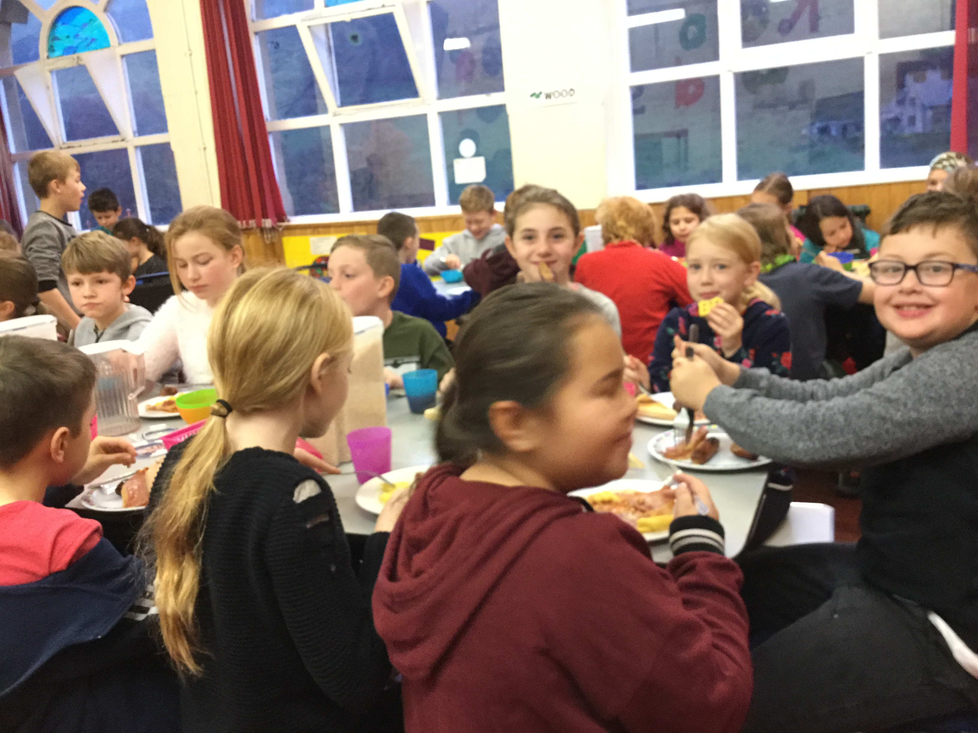
FOOD
•Breakfast – cooked breakfast, toast, fruit and cereal
•Lunch choice of sandwiches/wraps, fruit, pudding
•Evening meal choice 2 – 3 options
•Cater for dietary requirements
•Snacks such as pieces of fruit and drinks of juice/ water throughout the day as and when needed.
Allowed to bring a SMALL bag of sweets/choc – nothing containing nuts.
Bring a water bottle with name on

Slide 8
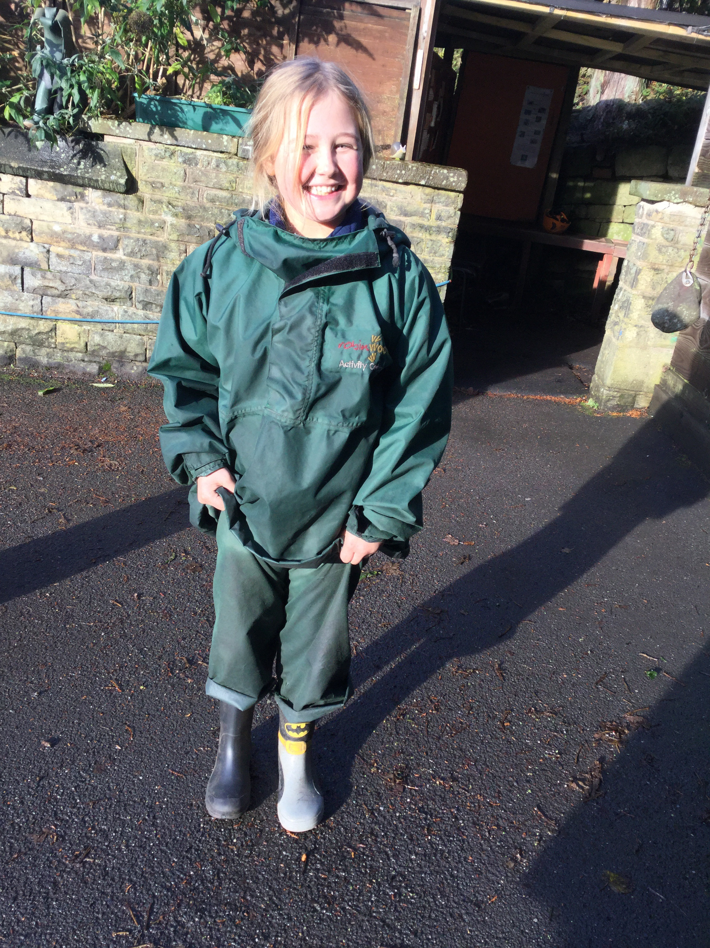
Clothing
Drying room and a laundry facility for children’s clothing at Robinwood. Wet and/or dirty clothing will be washed on a 30 degree cycle and dried in a tumble drier. Please do not bring any new or expensive items, or any items which cannot be tumble dried. Please note that on the last day we cannot always offer this service.
As a result of the provision of specialist Robinwood clothing and the laundry facility offered, children do not need to bring much additional clothing with them. Keeping the clothing brought by children to a minimum helps us to reduce lost property.
Due to the nature of the activities it is possible that clothes may occasionally get damaged. All clothing should be suitable for use in an outdoor, and often muddy, environment. Old clothes are best, not new or expensive clothing.
Outdoor shoes/boots. Walking boots are great for this, but a strong pair of shoes would be suitable and trainers would be O.K. in fine, dry weather. You definitely don’t need to buy walking boots especially for the Robinwood trip.
Jeans are not suitable for our activities, they are cold and restrictive when wet and difficult to dry. Tracksuits or jogging bottoms are Ideal, but other trousers would also be fine.
Medicals
Food

Slide 9
In cold weather it would be good idea to bring some warm gloves and a warm hat.
Please ensure, wherever possible, that ALL items brought to Robinwood are marked with the child’s name. It is really helpful if the school name can also be indicated. We do our very best to return all property to the children that it belongs to. This is made much easier if items are named.
Bobbles – children with long hair are required to tie it back for some activities.
Allowed to bring a small cuddly toy, a book, magazines, comics, etc.
Please do not bring valuable items such as cameras, mobile phones, computer games, personal stereos, mp3 players etc. A good rule is: Don’t bring anything with a battery. It is Robinwood’s policy that children are not allowed to bring any cameras or phones.
Please do not bring any aerosol sprays. Fire alarms are sensitive.

Slide 10
Medication: Everyone has completed a medical or dietary requirement form.
Any current medication must be brought to school in a bag or box clearly marked with your child’s name, the name of their doctor and the required dosage. Please ensure that the usual pharmacy label is still attached. You will need to complete a medical form from the Local Authority to give us permission for this medicine to be administered by us. These are available in the office or on our website. Bring it in advance to the office if you can.

Slide 11
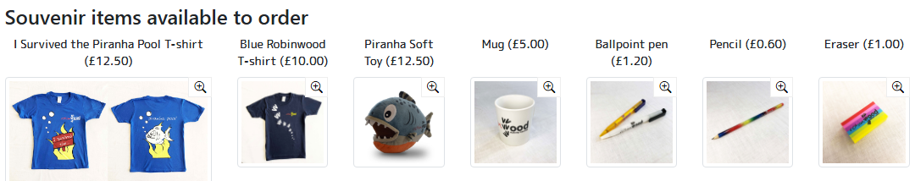
Souvenirs
Office (Mrs Holley) has sent an email with details for you to choose and pay for what you want (by 11th Sep). The order will be given out when we get back

Slide 12
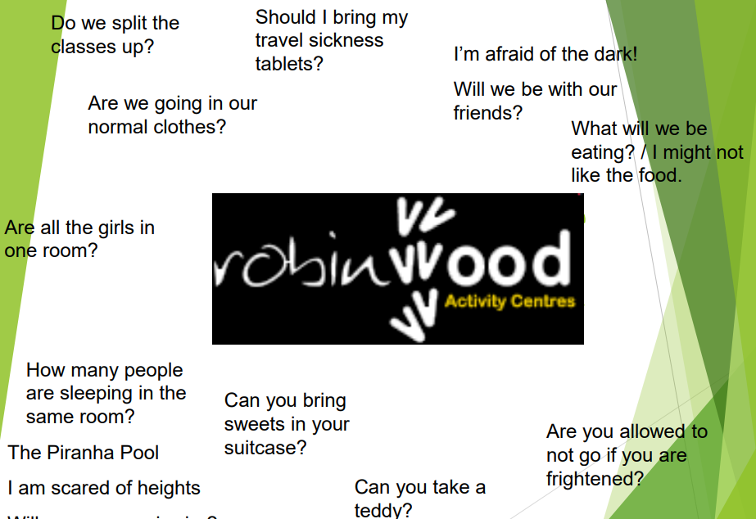
Any other general questions?

Slide 13
If there is anything that is concerning you or your child about the trip, please talk to us so that we can put everyone's minds at rest.
Please let us know of anything you think may affect your child when they are away from home.

