Slide 1


Year 2
Handbook
2026-2027

Slide 2
Contents…all you need to know about your child’s year group
Meet the Team
Daily Routine & Timetable
Attendance & Punctuality
Ready to learn…uniform & equipment
Our Golden Values
Behaviour Expectations
Keeping Safe & Being Happy
Learning at Home
A Typical Day
Brilliant Learners
Reading, Writing, Maths
Curriculum
Trips & Experiences
Unique to Year
How to contact us
Year _

Slide 3

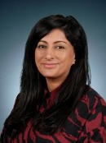
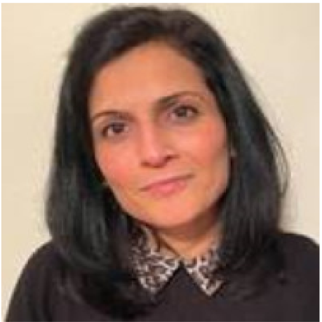
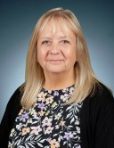
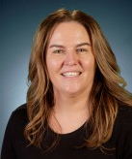
Meet the Team
Ms Pfitzman Mrs Cloake
Teaching Assistant Teaching Assistant
Miss Hopkins
Year 2 teacher
Assistant Head
Mrs Dhaliwal Mrs Abbas
Year 2 teacher Year 2 teacher
Year 2

Slide 4
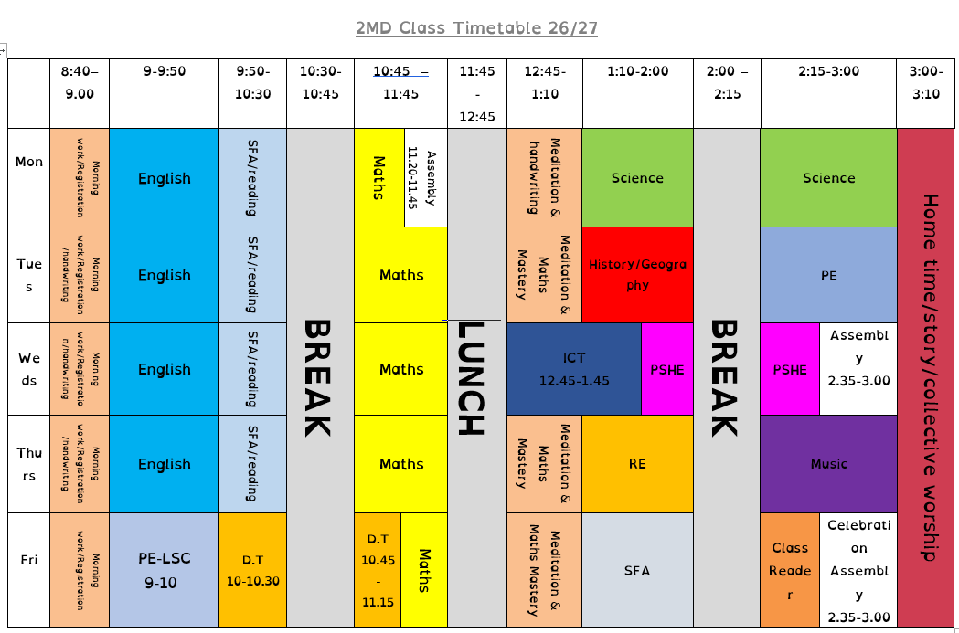
Daily Routine & Timetable
Year 2MD

Slide 5
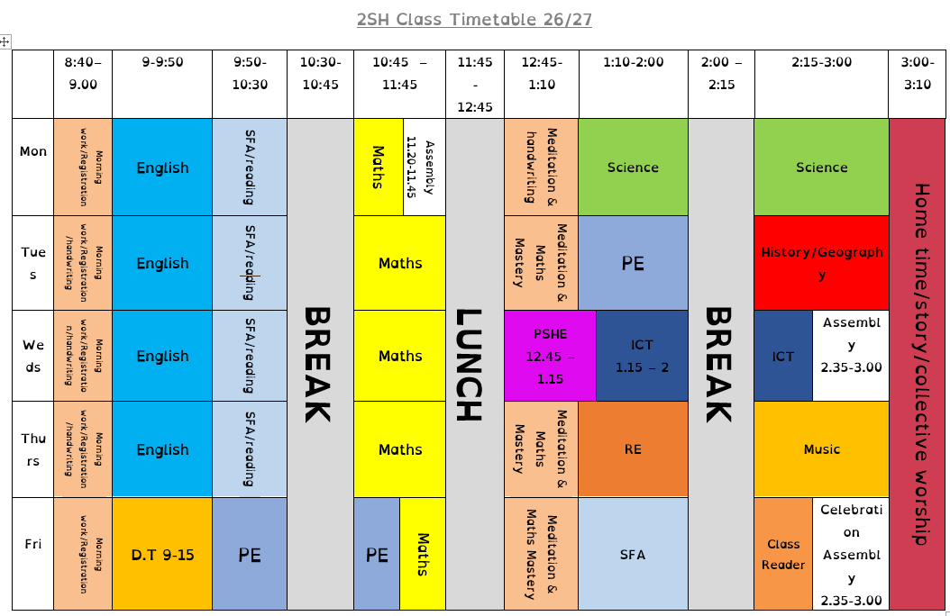
Daily Routine & Timetable
Year 2SH

Slide 6
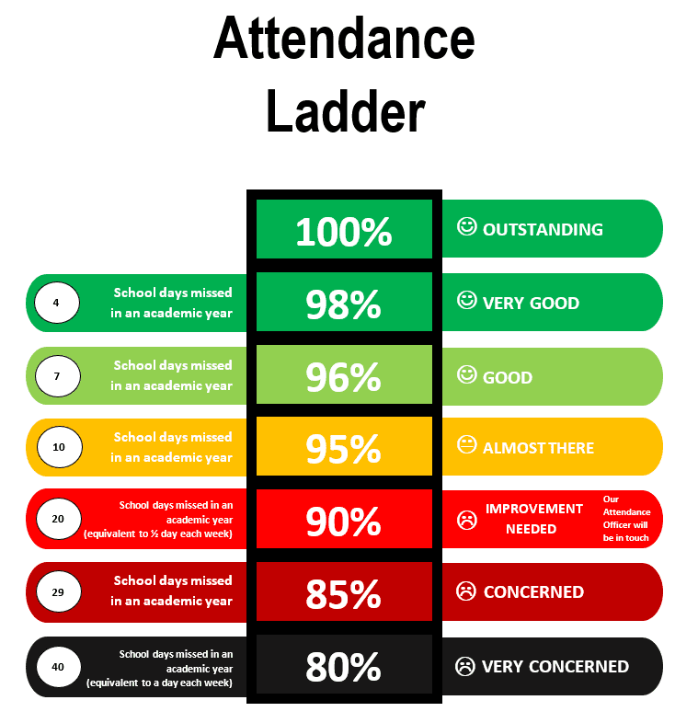
Attendance & Punctuality
ATTENDANCE MEANS ACHIEVEMENT GREAT DEVELOPMENT
Please arrive on time (8.35 gates open, register is at 8.40am) this can have an impact on learning time and how children feel about the start of the day.
All information and our Attendance Policy is on our website
You must inform us if your child is going to be absent from school for any reason- school office before 9am on 0161 445 1815, option 1.
If attendance were to drop below 90%, this may trigger contact from school, where we would be asking how we could support you in improving attendance for your child.
Year 2

Slide 7
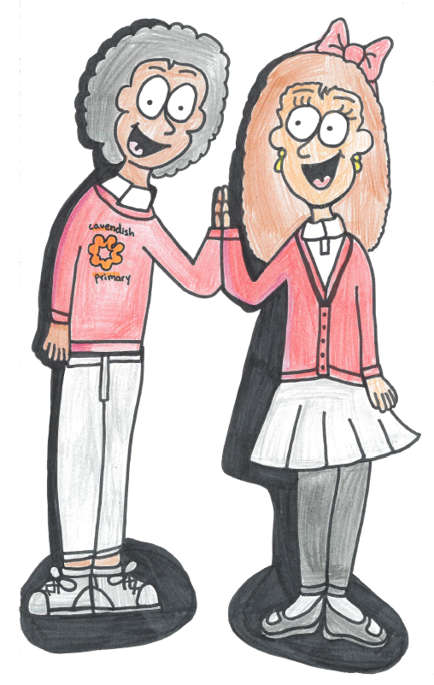
Ready to Learn…
Uniform & Equipment
Red sweatshirt or jumper, with or without logo
plain white school shirt
grey or black school trousers, shorts or skirt,
red & white school summer dress
Black shoes (sensible!) – these can be plain black trainers if preferred.
Other uniform reminders -
Sensible hair bands/slides/scrunchies
Plain headwear for religious or medical reasons (black, grey, white, navy) – eg hijab, topi, bandana
No jewellery except small stud earrings – these must be removed for all P.E. activities.
No make up or nail varnish
No heeled shoes or sandals/flip flops/crocs
P.E. uniform
Black shorts/leggings/tracksuit bottoms
Plain white t-shirt
Plimsolls/trainers
Year 2
Please ensure that all uniform is clearly labelled with your child’s name and class.
This enables us to sort out lost property more quickly and effectively.

Slide 8
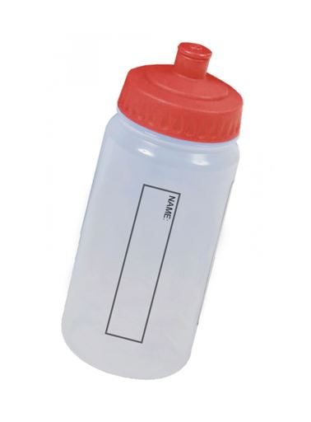
Ready to Learn…
Uniform & Equipment
Equipment for the day -
Labelled water bottle
School bag
Coat (even if it is not forecast for rain)
Reading diary and reading book
Other reminders -
No smart watches – wristwatches only please
School provide all stationery equipment and resources, no need for the children to bring their own from home
We ask that the children leave personal toys and items at home as this is difficult for staff to monitor
Year 2
Please ensure that all items are clearly labelled with your child’s name and class.
This enables us to sort out lost property more quickly and effectively.

Slide 9

Our Golden Values
Year 2

Slide 10
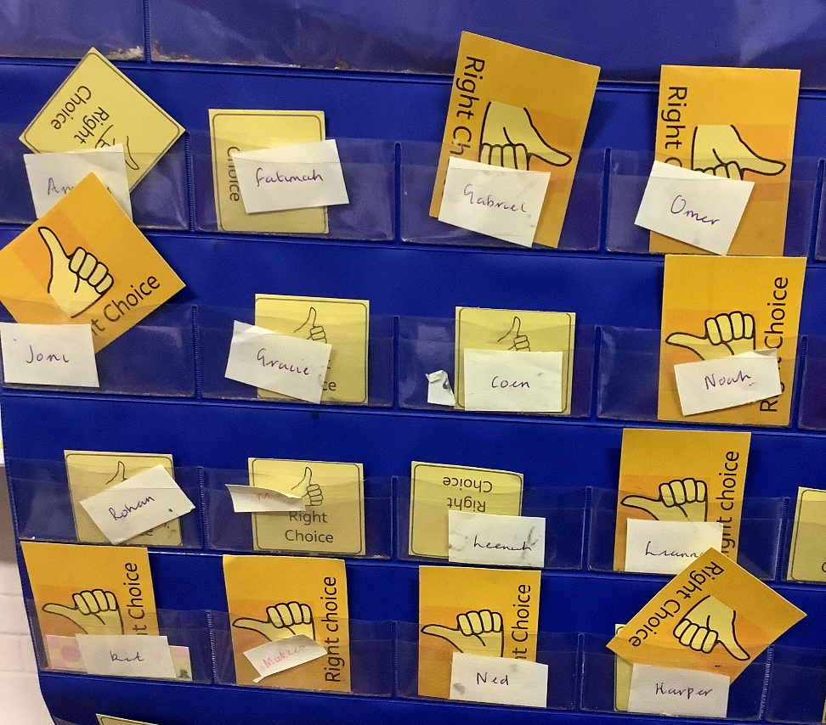
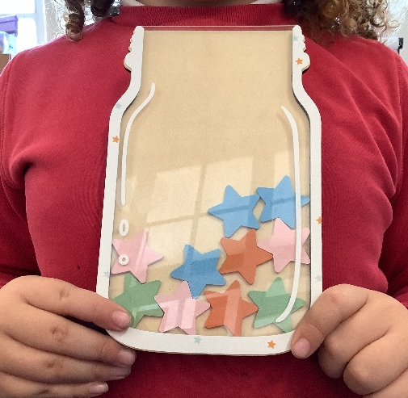





Behaviour Expectations
Children are praised and rewarded in lots of ways…
Dojos
Class Compliments
Good to be Gold treats
Class wall chart with GOLD cards – RIGHT CHOICES
Right Choices recognised
B Awards (lunchtime)
Brilliant Citizen & Learner Award
Postcard Home
Class mascot
CLASS CHARTERS
Rights of the Child
Year 2

Slide 11
Behaviour Expectations
Cavendish Approach to Behaviour
Child focused - child at the heart of decisions, reflects the needs & views of the Children’s Rights, children are heard with respect & dignity
Relationship focused approach
Restorative Practice – balanced boundaries and support with reflection as a learning tool for behaviour
Fostering a sense of belonging – inclusion & equality
Emotional Regulation strategies utilised as well as co-regulation opportunities
Values based – Cavendish Golden Values
Year 2

Slide 12

Behaviour Expectations
Cavendish’s approach to behaviour is in accordance with the school’s 6 Golden Values:
EQUALITY: we treat everyone fairly, acknowledge and celebrate our differences and stand up for what is right.
KINDNESS: we are thoughtful towards others, care for our school community and value ourselves.
RESPECT: we show everyone politeness, use our manners and listen carefully.
POSITIVITY: we work hard, encourage others, show effort and persevere when faced with a challenge.
COURAGE: we are honest, make good choices and enjoy challenging ourselves so that we grow.
RESPONSIBILITY: we look after our school environment, think about our actions and know we can make a difference.
Year 2

Slide 13
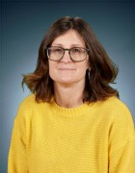
Keeping Safe & Being Happy
Wellbeing at Cavendish
Meditation Masters
PSHE (personal, social, health & economic) curriculum
Check in boards
Drop in sessions
Other 1:1 interventions
Miss Childs
(Wellbeing Mentor)
Learning about safety
Online Safety lessons & assemblies
Safety assemblies
Anti Bullying Pledge
Safety Protectors
Year 2

Slide 14
Learning at Home
Expectations…
Reading (library book + SFA)
Times Tables Rock Stars (passwords to come for this)
Mymaths
Spellings
We also encourage any additional learning done at home, is shared with the class teacher and class so that we can celebrate achievements and a love of learning.
Year 2

Slide 15
A typical day in Year 2
Arrive
Morning Activity
Sessions
Break
Sessions
Lunch
Meditation Masters/handwriting
Sessions
Home time
Year 2

Slide 16

BRILLIANT LEARNERS
We remind the children that…
- learning is a life long
- everyone is on a learning journey
- everyone is different and learns differently
- learning skills are key to life long success
- learning how to be a BRILLIANT citizen is just as important as all other areas of learning
- all brains are different, we respectfully learn alongside each other
- being a good friend and classmate is important by showing, reminding & supporting each other
Year 2

Slide 17
Trips & Experiences
Autumn- Manchester linked to geography.
Spring- Great Fire of London workshop - Lowry
Summer 1- The Lake District linked to geography.
Summer 2- Wythenshawe Park – science
Year 2

Slide 18

How to contact us…
We are always happy to communicate with families and will try to be available, when possible, at drop off and pick up times for a face to face chat.
Otherwise, please contact our school office who are happy to help with questions or queries.
Tel: 0161 445 1815 Email: office@cavendish.manchester.sch.uk
CLASS DOJO – this is a great way of sharing learning, updates and messages.
This should be kept just for brief, non-urgent messaging.
Please be mindful that teachers are not able to monitor Dojo messages when they are teaching.
Teachers will aim to reply within working hours.
If it is urgent please call the school office.
Please arrange to have a meeting with class teacher if you wish to discuss something.
Year 2

