Slide 1



Slide 2
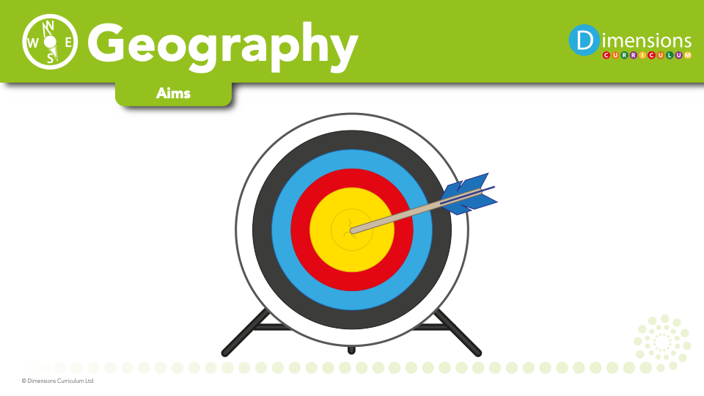

Slide 3

Geography develops pupils’ understanding and appreciation of places and their importance to us, of our impact on them and how we can manage and develop them sustainably.

Slide 4
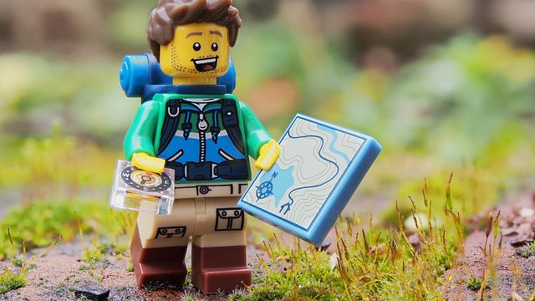
Geography introduces pupils to the role and value of maps in observing, understanding, interpreting and valuing the world, from local to global perspective.

Slide 5
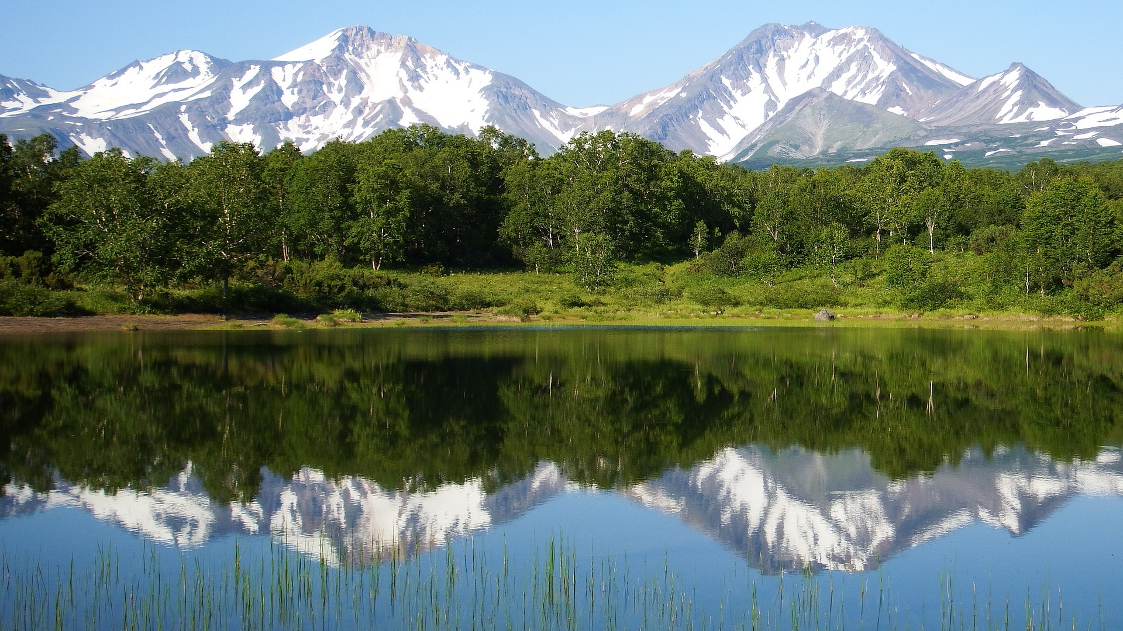
Geography helps pupils recognise how and why changes to places and the environment happen and affect us, both as a result of natural processes and through human activity.

Slide 6
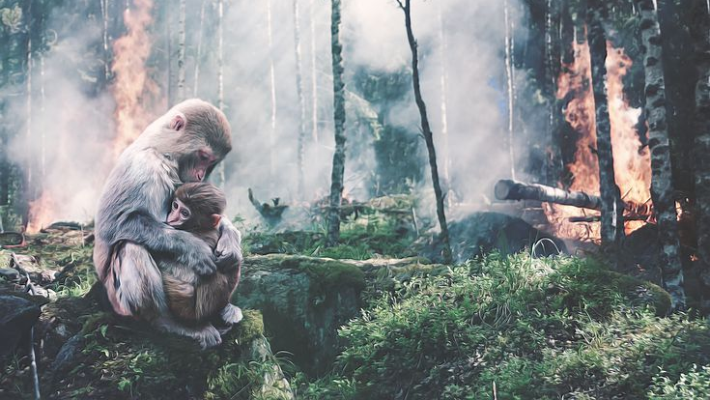
Geography stimulates pupils to explore emotional responses through studying themes such as climate change, food, water and energy.

Slide 7
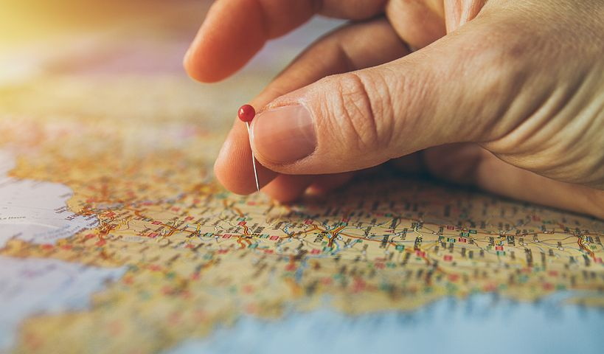
Pupils’ geographical understanding helps them make sense of the world and prepares them to play an active role as informed, responsible citizens.

Slide 8
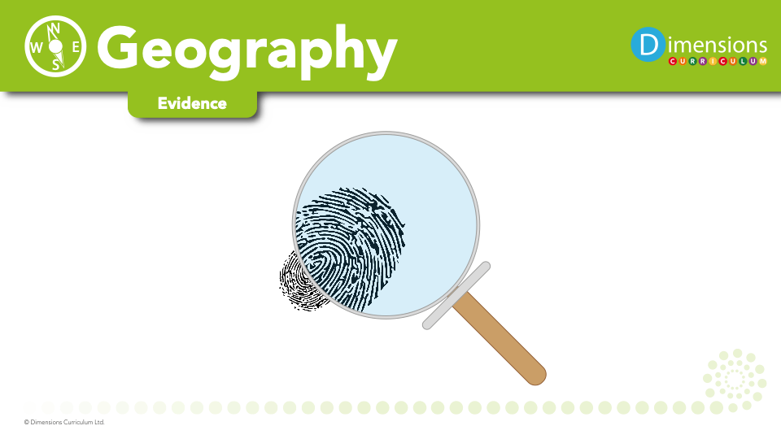

Slide 9


