Slide 1




Slide 2
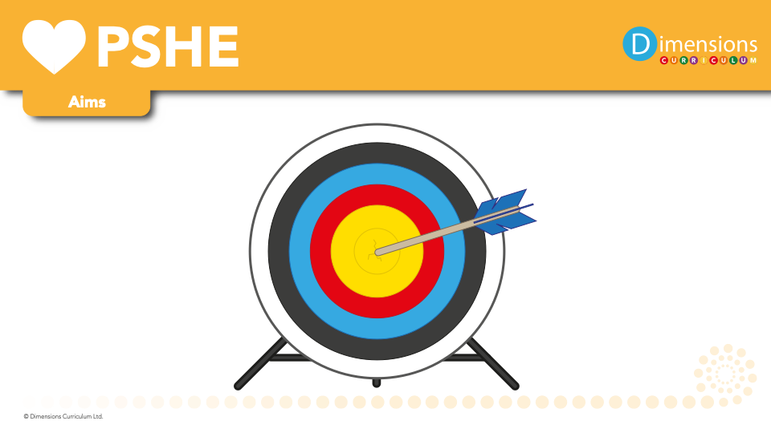

Slide 3

PSHE is a vital part of pupils’ preparation for life and lessons offer a safe space to explore more complex issues.

Slide 4
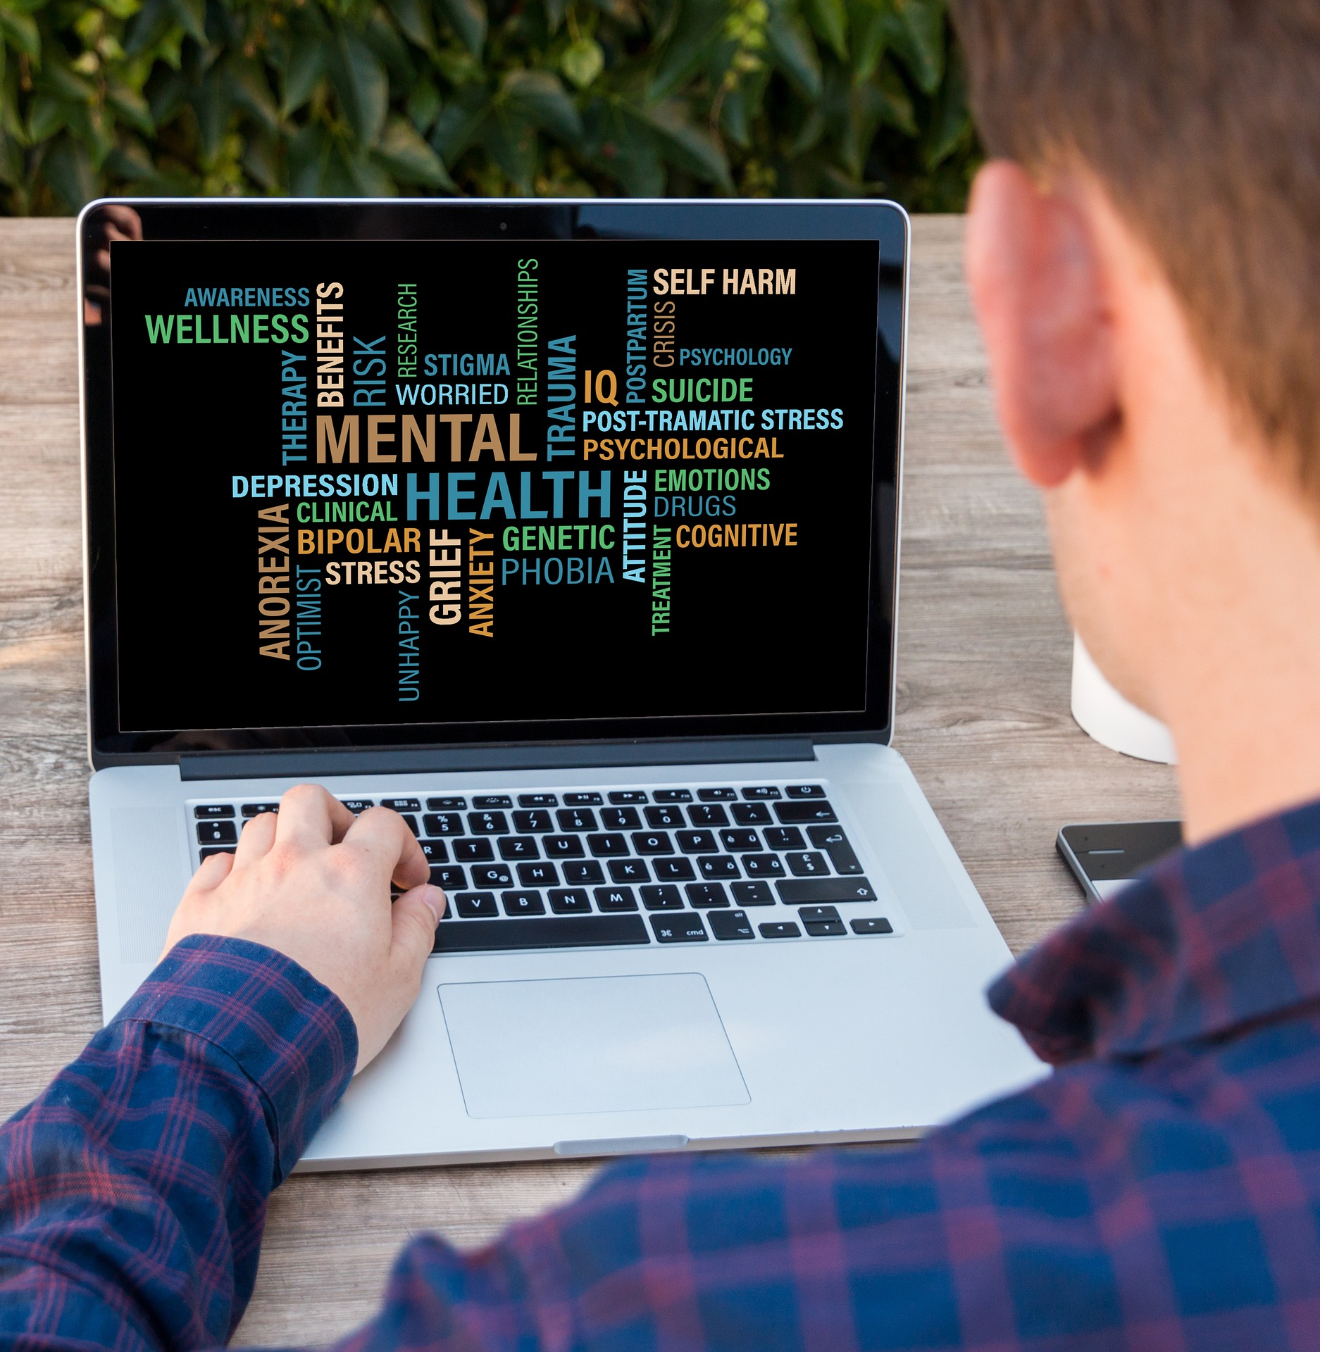
PSHE education actively promotes the moral, cultural, mental and physical development of pupils.

Slide 5
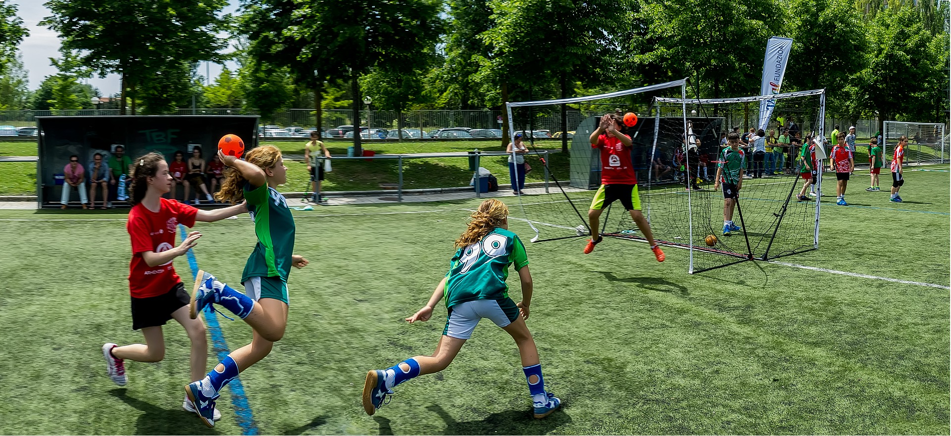
PSHE educations helps pupils to develop skills and aptitudes, such as teamwork, communication and resilience.

Slide 6
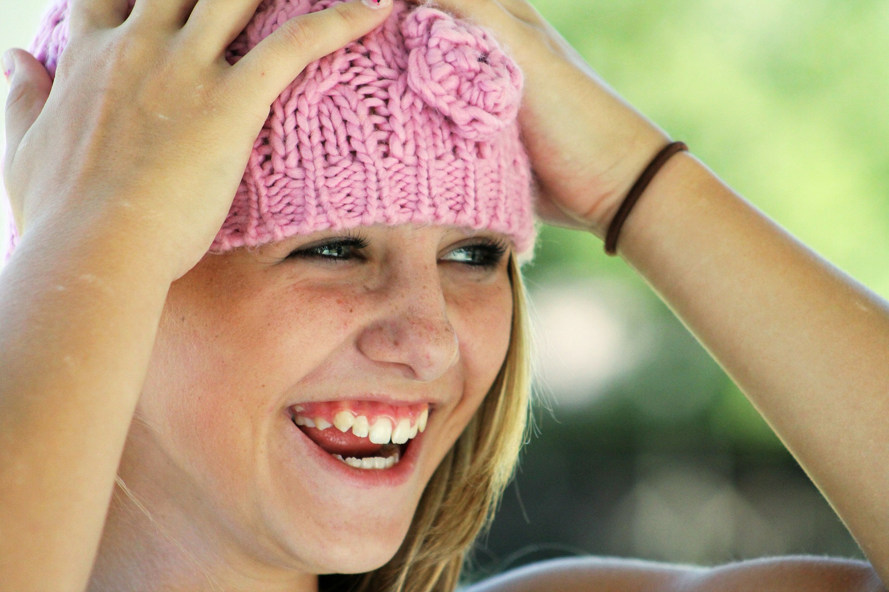
PSHE education helps to foster pupil wellbeing and develop character and personal attributes that we believe are fundamental to pupils being happy, successful and productive.

Slide 7
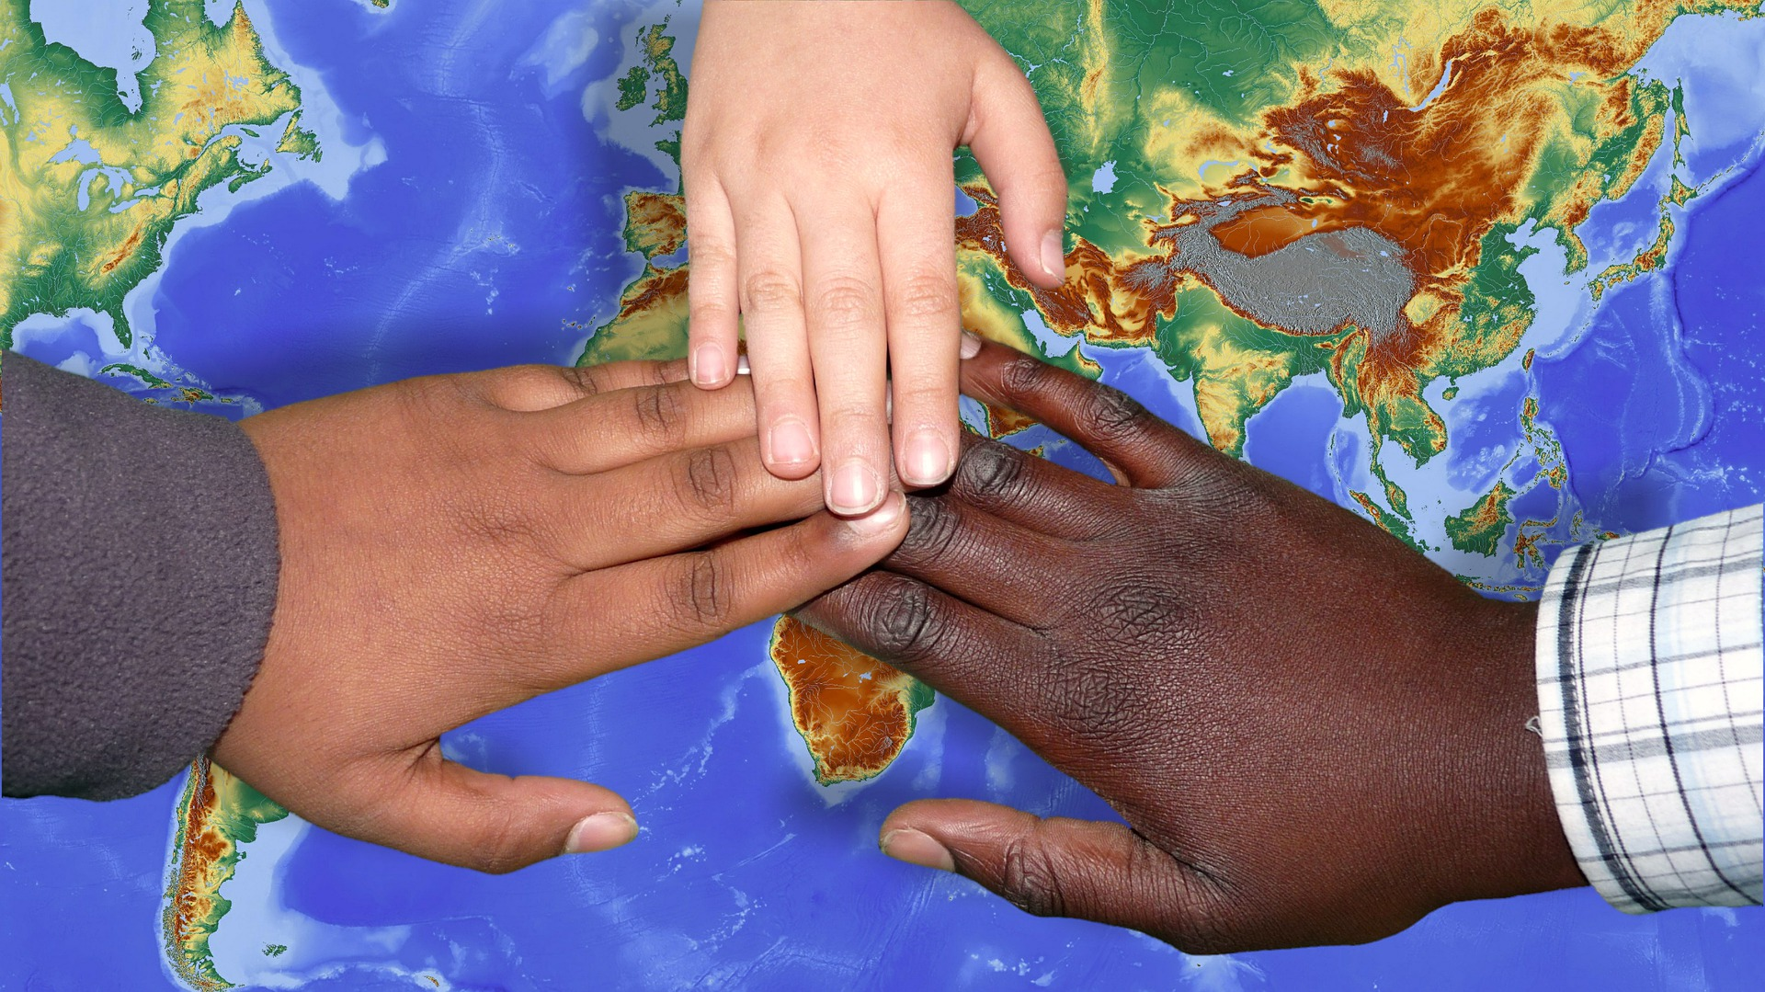
PSHE education helps pupils to develop the knowledge, skills and attributes they need to thrive as individuals, family members and members of society.

