Slide 1
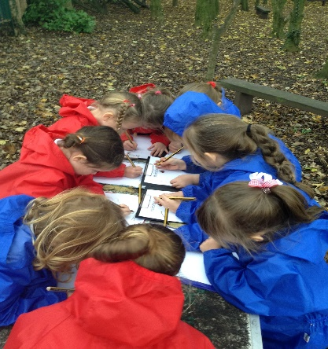
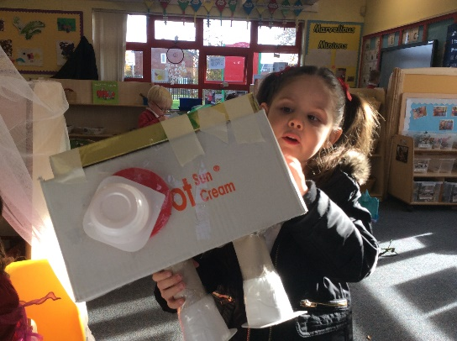
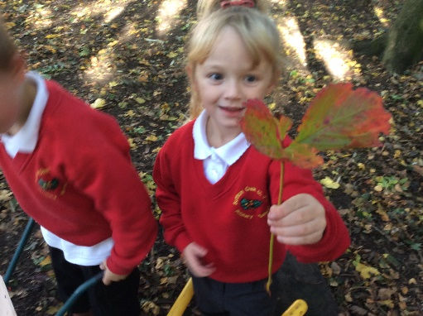

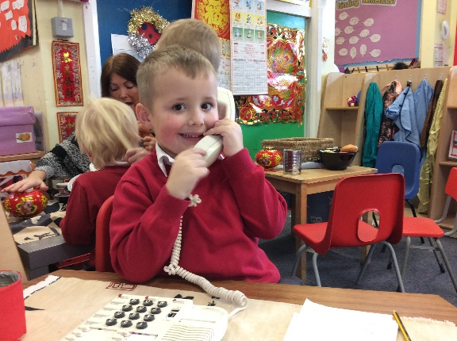
Welcome to Reception
2026

Slide 2
Our Mission
Inspiring a love of learning, love for one another and faith in God.
Our Vision
Believe, achieve and grow together in Christ.

Slide 3

Telephone: 01744 671788
Email: childrenscentres@sthelens.gov.uk

Slide 4
Reception
Our Reception Unit is a happy, safe and stimulating environment where children are cared for, nurtured and encouraged to learn and reach their full potential. We work in partnership with parents to enable our children to learn in a fun and exciting way through their play.

Slide 5
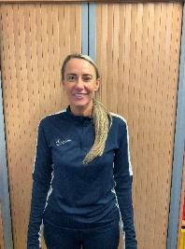
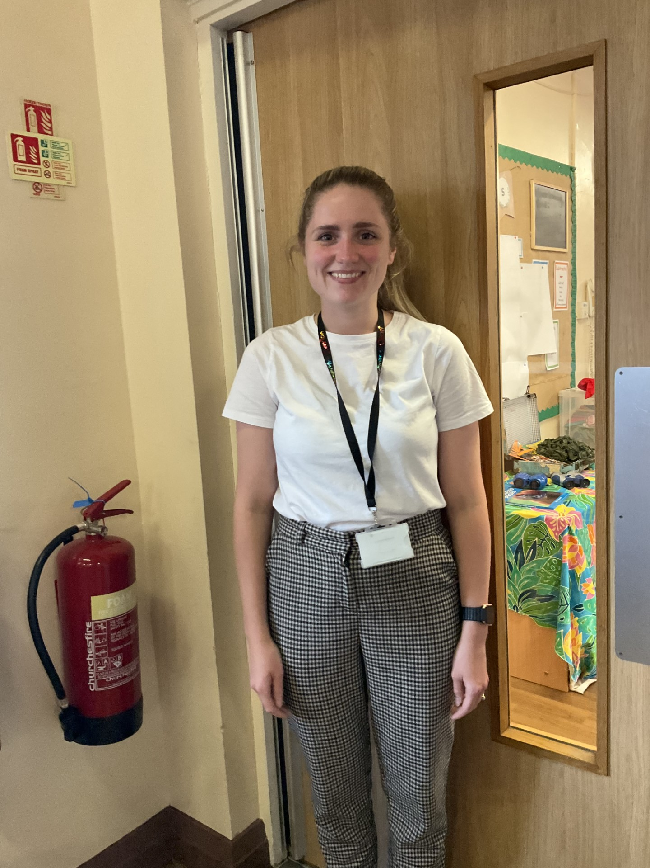
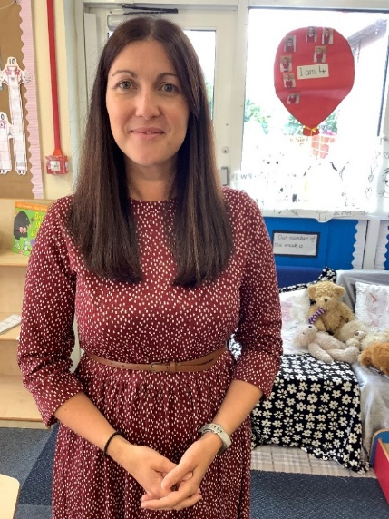
Reception Class Teachers
Mrs Devereux
Mrs Griffiths
Mrs Barton
Headteacher: Mr. I. Williams
Assistant Headteacher: Mrs. S. Green
Notes:
There are two reception classes in our school, a Reception class and a Reception Year One mixed class. Mrs Devereux teaches Reception, Miss Kilgallon and Mrs Barton teach Reception/Y1.

Slide 6
Transition
Transition begins with calls, chats, visits in your child’s current Nursery setting.
During the final Summer term we will hold transition visits for your children to have a ‘Stay and Play’ in their new classrooms.
If your child already attends our School Nursery these will be within their normal Nursery sessions.
If they currently attend a different provision your letter will state a date and time for their visit. If they cannot make this date please speak to one of our team.
Packs – All about me – complete with child/ Information to help staff – complete and return to school

Slide 7
Starting in September
The children will have a ‘staggered’ start in September. They will start school over the first few days in September between the 2nd and the 4th of September. This allows the staff to spend quality time with individual children to help them settle into their new environment.
The children will begin the staggered days, and their first full week by attending until 1pm. They will stay for lunch and be collected at the Reception Class entrance.
Most children will start full time from Monday 14th September.
We understand not all our families will be able to support this transition, please see a member of the team if your child has accessed 30 hour provision in Nursery and you are a working parent unable to facilitate this at the end of the meeting.
Some children will require a more personalised transition plan that will take longer and cater to their individual needs. If you feel your child would benefit from this please speak to a member of the Reception team.
Please see your child’s individual welcome pack for their individual start and visit dates.

Slide 8
Starting our school day
Reception children start at 8.45am. Your child enters school through the Green Reception Gate near the KS1 entrance.
Please bring a suitable coat, bookbag, waterbottle, spare clothing if you think they need it and your completed ‘All about Me’ Booklet.
All children have their own tray and peg in the classroom for their things.
We understand it can be a worrying time but we strongly encourage you to leave the children come into the class independently. If they are upset we will contact you via seesaw or phonecall to reassure you they are settled.

Slide 9
Our Rhythm of the Day
8.50-9.10am– Register/Morning Challenge
9.10-9.25am – Whole Class Literacy
9.25-10.20am - Continuous Provision Indoor and Outdoor and Focused Group Learning
10.20-10.40 - Phonics and Snack
10.35-11.30am – Continuous Provision Indoor and Outdoor and Focused Group Learning
11.30-11.45am – Story time
11.45am-1pm – Lunch and Outdoor Provision
1-1.20 pm– Whole Class Maths
1.20-2.30pm – Continuous Provision Indoor and Outdoor and Focused Group Learning plus interventions including Speech therapy and language groups
2.30-3pm – Whole Class Undertstanding of the World/ RE/ Topic/ Expressive Arts and Design
3pm – Hometime Routines.

Slide 10
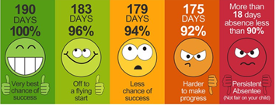
Attendance
We aim for 96%!
If your child is unwell please contact the school on 01744 678690 on the first day of absence before 9am. You can also report your child’s absence on our school website, www.suttonoak.co.uk or via email suttonoak@sthelens.org.uk

Slide 11



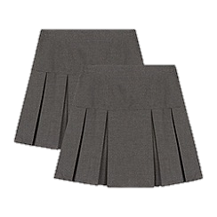

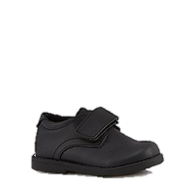

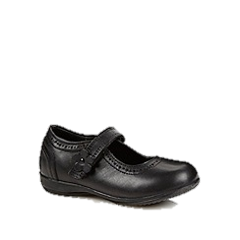
School Uniform
It is expected that your child comes to school every day wearing the correct uniform. Please label ALL items with permanent marker (biro will wash out!)
Boys
Girls
P.E Kit
White t shirt
Grey or black tracksuit
Dark coloured or
white trainers
Your child should come to school in their PE kit on their PE day. You will find this out in September.
Red cardigan or jumper with or without school emblem
White polo shirt with or without school emblem or white shirt with a red tie
Grey trousers or skirt
White/grey socks or plain red/grey tights
Sensible black school shoes
Red jumper with or without school emblem
White polo shirt with or without school emblem or white shirt with a red tie
Grey trousers
Sensible black school shoes
Notes:
Also – no nail varnish, hoop earrings, tattoos etc

Slide 12
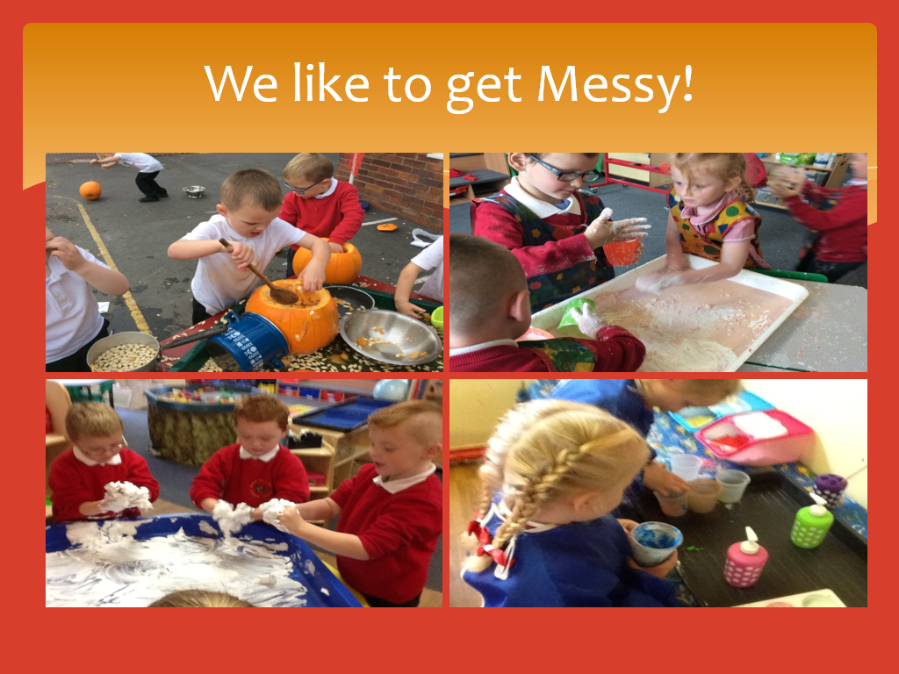


Slide 13
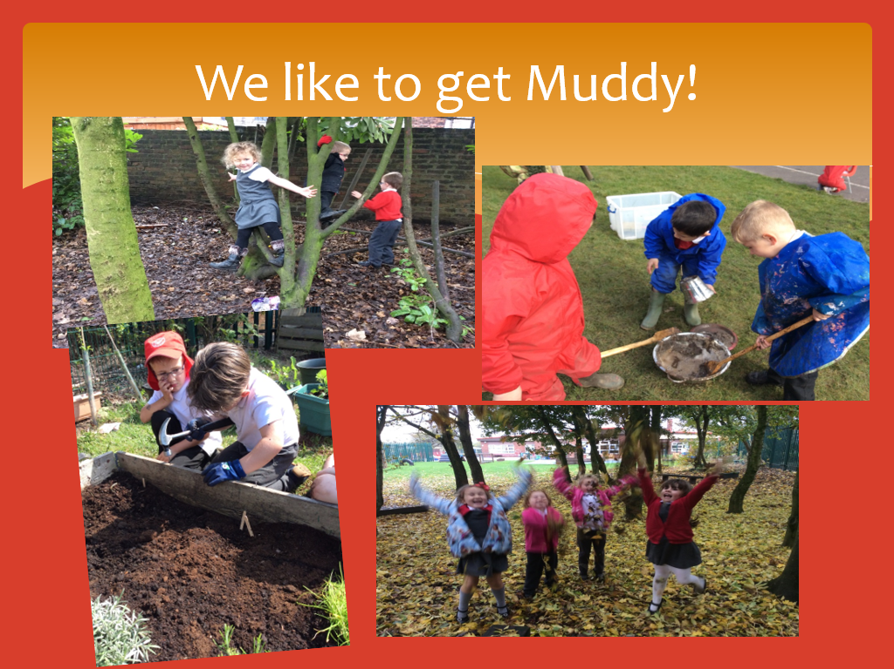

Slide 14
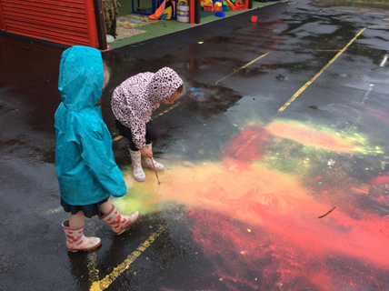
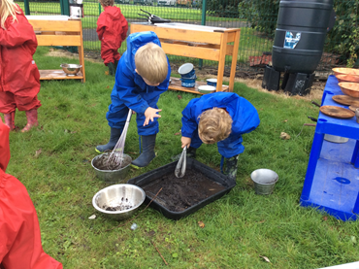
Outdoor Play
The outdoor area is seen as an integral part of the early years provision and it has been planned to enable those children who prefer to learn outside for some or most of the time to engage in the same quality of learning as they would indoors.
We do provide a small number of wetsuits and wellies for playing outdoors and in our mud kitchen, but you are welcome to bring in an individual pair of wellies for your child to keep in school if you wish.
The children will play outside in all weathers, please make sure they have appropriate coats and footwear. They will need hats, gloves and scarves in cold weather, and suncream and sunhats in the hot weather.

Slide 15
Prime Areas of Learning
There are 7 areas of learning in the Early Years Foundation Stage. We deliver the curriculum through planned, purposeful play that is based upon the individual interests and learning needs of each individual child.
Personal, Social and Emotional Development
This enables children to develop self-worth and respect for others, forming positive relationships with their peers and adults. Children learn to socialise, manage and identify their feelings, differentiate between choices in behaviour, understand appropriate behaviour and gain confidence in their approach.
Communication and Language
Children are given opportunities which enable them to develop skills in expressing themselves confidently, listen to others and speak in a range of situations. A range of activities are initiated which support vocabulary extension.
Physical Development
This involves developing a range of fine and gross motor skills, co-ordination, control and movement, through the provision of opportunities for children to be active and interactive. The children are supported to understand the importance of keeping healthy by being physically active and choosing foods which promote health.

Slide 16
Specific Areas of Learning
Literacy
Children begin to learn to read and write. Through our daily Read Write Inc lessons and phonics activities children are encouraged to link sounds and letters and to begin to read and write. In our class children have access to a wide range of reading materials (books, poems, and other written materials) to ignite their interest. They put their new skills into practice by exploring a print rich environment with a wealth of opportunities to read and write. We give children the confidence, opportunity and encouragement to use the skills in a range of situations and for a range of purposes. Children are given adult directed and free writing opportunities. All their efforts are valued as they are supported to develop writing skills.
Mathematics
We support the children to develop their understanding of numbers, calculations, shapes, space and measures in a broad range of contexts in which they can explore, enjoy, learn, practise and talk about their developing understanding.
Understanding the World
The children develop crucial knowledge, skills and understanding that help them to make sense of the world. This involves guiding our children to make sense of the physical world, the local community, people, places, technology and the environment through exploration, observation, discussion and investigation. We support children's learning by offering opportunities for them to use a range of tools safely, encounter creatures, people, plants and objects in their natural environments and in real-life situations, undertake practical experiments and work with a range of materials.
Expressive Arts and Design
The children’s creativity is extended by supporting their curiosity, exploration and play. Children are provided with a wide range of media and materials, as well as providing opportunities and encouragement for sharing their thoughts, ideas and feelings through a variety of activities in art, music, movement, dance, role play, and design and technology.

Slide 17
Reading
We teach daily synthetic phonics through Read Write Inc.
All children will learn their initial sounds first before moving on to blending sounds in words and then onto simple sentences.
Children will bring home sounds to practice, books with single words to blend, paper ditty sheets, reading books.
Children will also bring home a reading for pleasure book for you to share together at home.
Rewards are earnt for all the reading the children do at home. Please remember to record their reads in their yellow reading diaries so they can earn prizes and certificates.

Slide 18
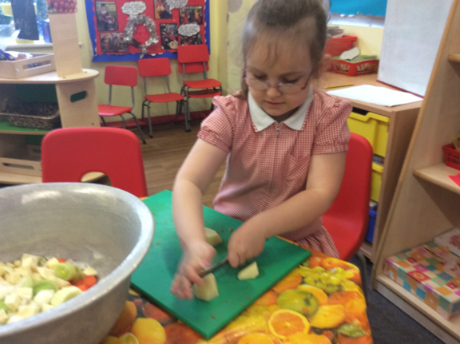
Snack
The children have milk and a snack every morning.
Milk is payable only once a child turns 5 and is £2 a term.
Snack is £1 a week payable at the beginning of each half term.
Children will also be offered a range of fruit or vegetables from our free fruit initiative.

Slide 19
Lunches
Children up to Year Two receive a universal free school meal.
Forms in pack to be completed for if your child is a FSM/ Pupil Premium child, entitled to additional funding throughout school, including vouchers for food over the holiday periods.
No pressure approach to food, children are encouraged to make healthy choices and eat their lunch by supportive adults.
Lunches ordered on the School Grid app in advance, if you do not pre order before 9.30 they will receive the cold sandwich option. We will keep you informed of your child's preferences as we get to know them.
Packed lunches – specific guidance to preparation of these meals due to choking risks etc, no nuts/ nut based products due to allergies, and must be healthy and balanced – no sweets/ chocolate/ fizzy drinks/ sugary products. We have ½ an hour for lunch, longer in the first few weeks but anything not eaten/ opened will be returned so be mindful of amount of content. Please look at the packed lunch guidance in the packs.

Slide 20
Helping your child to settle
These are a few ways that you can prepare your child for the first few weeks at school:
Ensure that they can dress and undress themselves - especially for dressing up, putting on and off coat and shoes.
Help them to master basic cutlery skills.
Think about packaging in lunchboxes, for example, yoghurt tubes can be tricky to open.
Help them to be independent with their toileting skills.
Encourage them to sit and listen to stories.
Help them to develop the confidence to communicate
with new people.
Practise sharing and taking turns.
See Packs for what is expected when children start Reception – challenge for Summer

Slide 21
Behaviour Policy
In Reception we are learning how to follow our school rules. Reception staff will help us to learn how to share and play with others co-operatively, listen and learn effectively, and follow our school rules.
We use strategies such as visual timetables, modelling, timers and positive reinforcement to support children to follow all the school rules and to develop their friendships. We will be encouraging all children to persevere, work together, try their best at all times and realise it’s ok to make and learn from mistakes.
The children are introduced to the school behaviour system, including the zones of regulation during their time in Reception as and when it is appropriate for their individual development (the full behaviour policy can be found on the website).

Slide 22
Toileting
There are toilets in the classroom and children are allowed to go to the toilet at anytime.
Children starting Reception are expected to be toilet trained. If your child is not yet toilet trained you can refer yourself to the school nurse, your health visitor, or the continence team to seek further support in supporting this. Please let a member of our team know today if your child has any issues in this area.
If you anticipate accidents in school please send in amble sets of spare clothes including shoes, and any hygiene products, nappies, nappy bags, wipes etc with your child each day.
Accidents in those first few weeks are common, even with children who are fully toilet trained, please wash and return any spares that are sent home.

Slide 23
Health/Medical Issues
Staff need to be aware of your child’s medical background, in particular any allergies (e.g. bee stings, dairy food), any dietary restrictions (e.g. vegetarian or Halal) and any medical conditions that are important for us to know (e.g. asthma or eczema). It may delay your child's start date if the data collection forms are not returned by the deadline in time for us to process this information.
Children already attending our Nursery do not need new data collection, but please update all contacts/ information on Arbor.
Children can suddenly become ill and therefore it is important that we know we can contact you or another adult relative/friend at all times. It is useful if your emergency contact lives near to school, so it may be more appropriate to choose a friend instead of a family member for us to contact if we cannot reach you. It is now a requirement for us to hold at least 3 emergency contact numbers for children in the Early Years.

Slide 24
Sensory Diets
What does this look like in practice?
Some children may feel overwhelmed or overloaded and need to get to a calmer state; some may feel lethargic or sluggish and need some activities to feel alert.
Understanding a child’s sensory profile and the activities which create calmness and regulation can really help when a child feels overwhelmed and out of control. Engaging children in sensory experiences on a regular schedule can support focus, attentiveness and interaction. Children may feel less anxious when they feel comfortable and in control.
These activities can be within the classroom, sensory room, hall or outdoor provision. They include a range of activities that target individual sensory seeking behaviours and help emotional regulation.
They are completed in short bursts throughout the day and work best when completed at home and in school with a team approach.

Slide 25
We have a number of children who require additional support with emotional and sensory regulation.
Staff in Reception have received recent sensory diet training and are experienced in meeting these additional needs.
In Reception we have access to a Sensory room and a daily sensory diet.
Children already receiving a sensory diet will continue this from September.
If you are concerned about sensory needs we will work together with you to complete the seedlings programme in the Autumn term.

Slide 26
Working together
Class Dojo
Stay and Plays across the year
2 x Parents’ Evenings
Homework
Sutton Family Hub

Slide 27
Home time
School finishes at 3:10pm for Reception children. We do open the gate a little earlier. Children are to be collected from the Reception Gate. Members of the Reception team will always be at the gate to welcome the children and ensure all children leave safely. Please let us know if someone different is collecting your child. Please be patient as we are just getting to know faces and names.
We have an open door policy and you are always welcome to discuss any issues with us before or after school but ask you are patient and wait until we have dismissed all the children safety before giving you dedicated time to discuss issues.

Slide 28
If you have any problems please make an appointment to speak to your child's class teacher or if appropriate our SENCO Mrs McGovern via the school office.
Visit our website www.suttonoak.co.uk for all the latest news and events.

