Slide 1
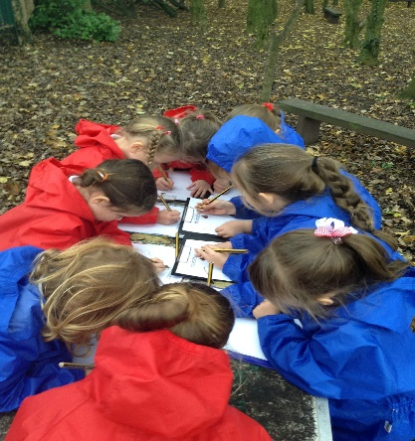
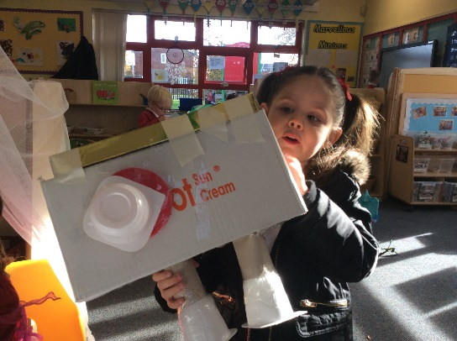
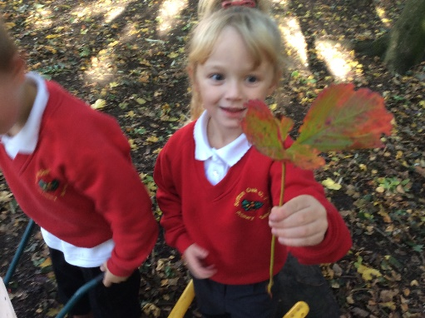

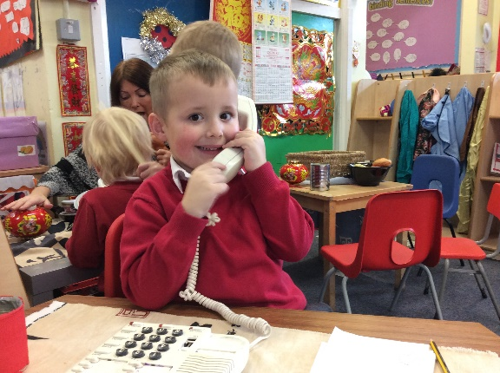
Welcome to Reception

Slide 2
Our Vision
Believe, achieve and grow together in Christ.
Our school is a safe, nurturing and caring family, where children and adults thrive together within the love of God. We value every person and their unique and individual needs. At Sutton Oak, we celebrate the differences in our community and support all to develop resilience, compassion and self-worth. We aspire for everyone to be the best that God intended them to be.

Slide 3
Reception
At Sutton Oak Church of England Primary School it is our intent that children who enter our EYFS begin their lifelong journey by developing physically, verbally, cognitively and emotionally whilst also embedding a positive attitude to school, respect for others and a love of learning.
Our EYFS curriculum is designed to encourage our children to become independent, inquisitive and happy learners. Every child is recognised as a unique individual, and we acknowledge and promote children’s interests to provide them with the opportunities to follow their imagination and creativity. We celebrate the differences in our school community and always strive to promote a love for learning for all. We teach our children how to listen, speak and meet the high expectations for behaviour by working together and being kind.
In Reception, we invest time and energy into helping pupils set and reflect on their own goals by aiming high and developing a love of reading, writing and number. We value imagination and creativity and seek to create a sense of enjoyment and fascination in learning through a vibrant continuous indoor and outdoor provision alongside additional visits and trips.
We aim to prepare our children to achieve the Early Learning Goals at the end of the foundation stage. We ensure all children have made good or better progress from their individual starting points. Our ultimate aim is prepare our children with the knowledge and skills needed for the next stage of their learning journey in KS1. This is so important as we know that what our children learn in these first few years of life will stay with them forever and children’s early education is the best investment we can make in ensuring their future success.

Slide 4
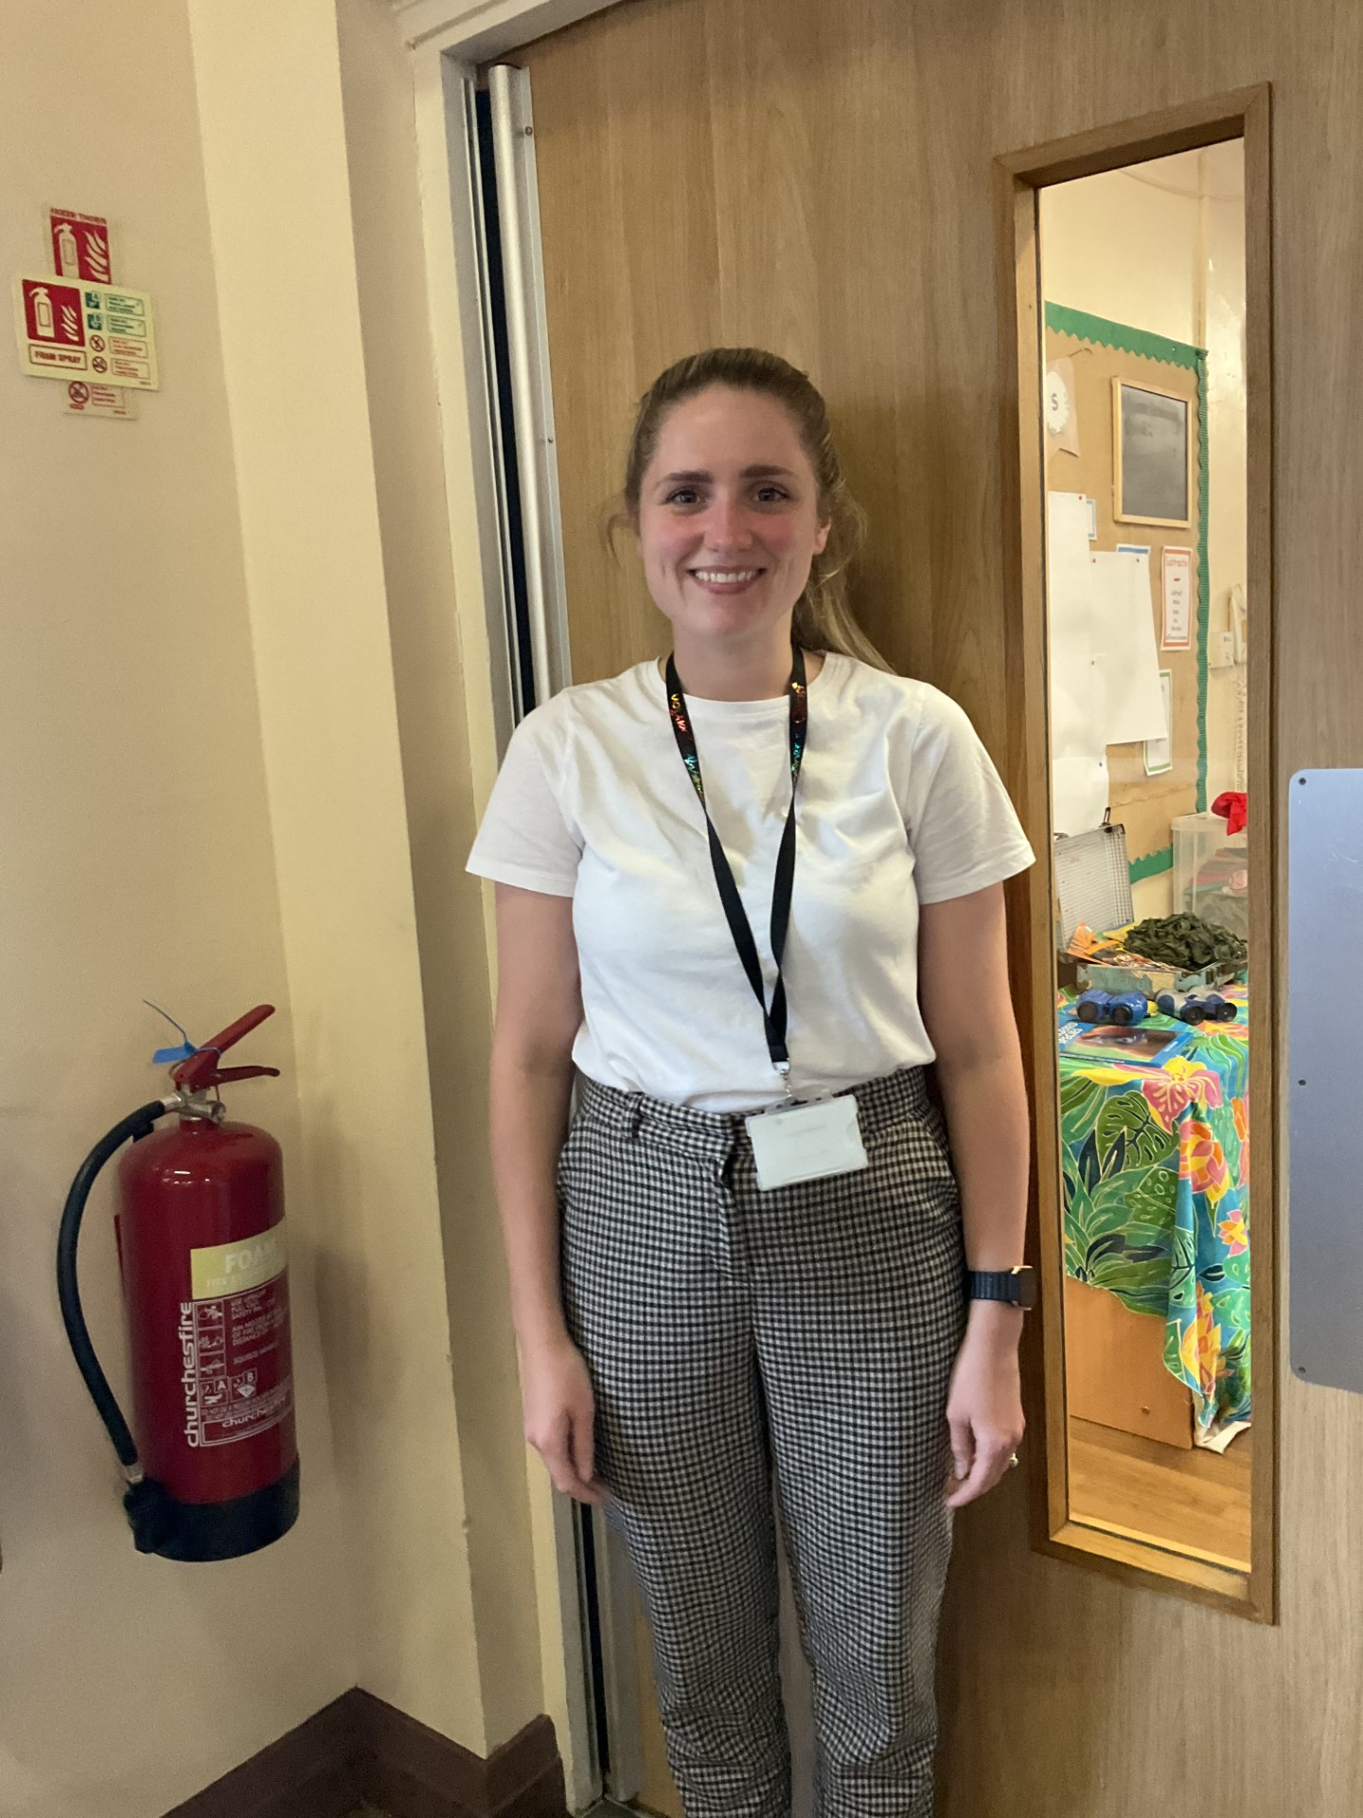
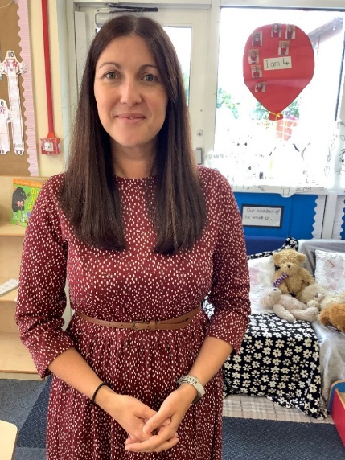
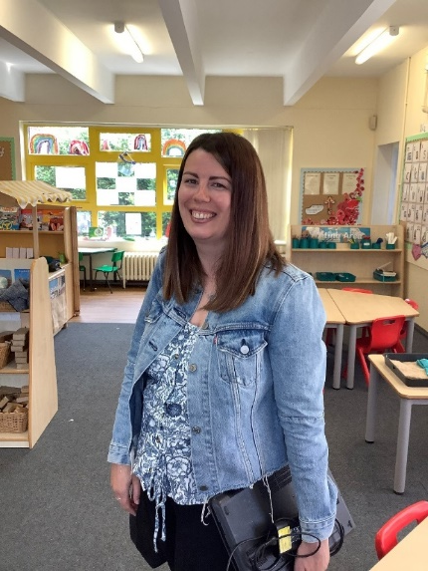
Reception Class Teachers
RLD - Mrs Devereux
RKB -Miss Kilgallon
RKB -Mrs Barton

Slide 5
Transition
Transition will begin with calls, chats, visits in your child’s current Nursery setting.
During the Summer term we will hold transition visits for your children to have a ‘Stay and Play’ in their new classrooms. If your child already attends our School Nursery these will be within their normal Nursery sessions. If they currently attend a different provision your letter will state a visit date. If you cannot make this date please speak to one of our team.

Slide 6
Starting in September
The children will have a ‘staggered’ start in September. They will start school over the first few days in September between the 6th and the 9th of September. This allows the staff to spend quality time with individual children to help them settle into their new environment.
The children will begin their first two weeks by attending until 12.45pm. They will stay for lunch and be collected at the Reception Class entrance.
Most children will start full time from Monday 18th September.
Some children will require a personalised transition plan that will take longer and cater to their individual needs. If you feel your child would benefit from this please speak to a member of the Reception team.
Please see your child’s individual welcome pack for their individual start and visit dates.

Slide 7
Starting our school day
Reception children start at 8.45am. Your child enters school through the Green Reception Gate near the KS1 entrance.
We aim for 96% attendance!
If your child is unwell please contact the school on 01744 678690 on the first day of absence before 9am. You can also report your child’s absence on our school website, www.suttonoak.co.uk or via email suttonoak@sthelens.org.uk

Slide 8



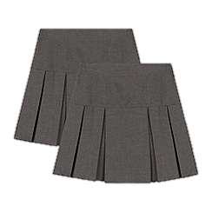

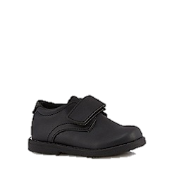

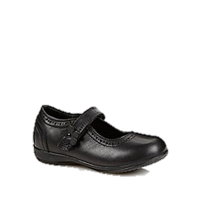
School Uniform
It is expected that your child comes to school every day wearing the correct uniform. Please label ALL items with permanent marker (biro will wash out!)
Boys
Girls
P.E Kit
White t shirt
Grey or black tracksuit
Dark coloured or
white trainers
Your child should come to school in their PE kit on their PE day. You will find this out in September.
Red cardigan or jumper with or without school emblem
White polo shirt with or without school emblem or white shirt with a red tie
Grey trousers or skirt
White/grey socks or plain red/grey tights
Sensible black school shoes
Red jumper with or without school emblem
White polo shirt with or without school emblem or white shirt with a red tie
Grey trousers
Sensible black school shoes

Slide 9
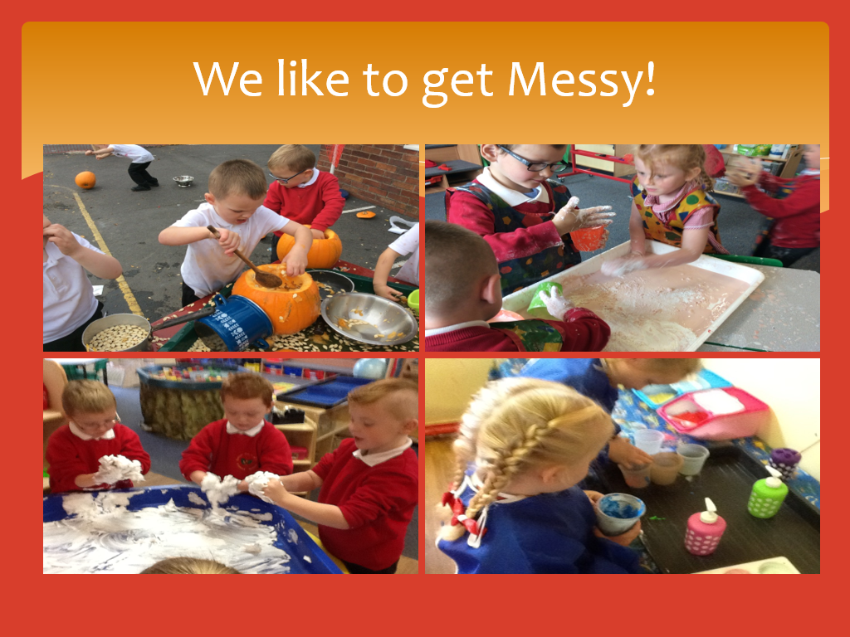


Slide 10
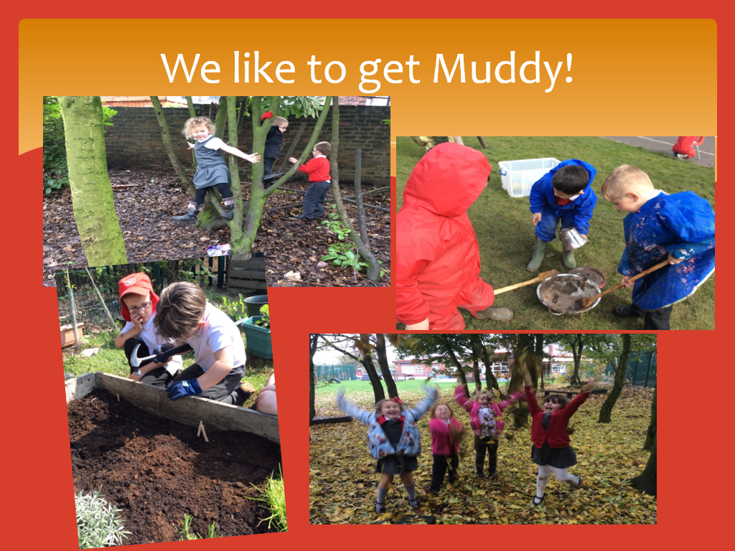

Slide 11
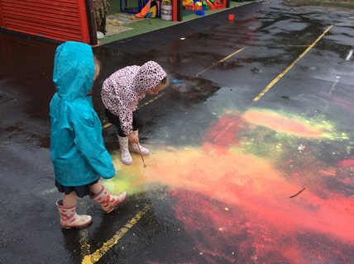
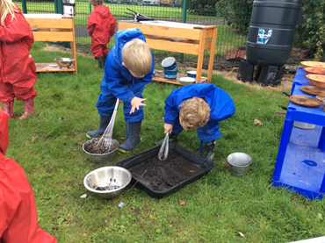
Outdoor Play
The outdoor area is seen as an integral part of the early years provision and it has been planned to enable those children who prefer to learn outside for some or most of the time to engage in the same quality of learning as they would indoors.
We do provide a small number of wetsuits and wellies for playing outdoors and in our mud kitchen, but you are welcome to bring in an individual pair of wellies for your child to keep in school if you wish.
The children will play outside in all weathers, please make sure they have appropriate coats and footwear. They will need hats, gloves and scarves in cold weather, and suncream and sunhats in the hot weather.

Slide 12
Prime Areas of Learning
There are 7 areas of learning in the Early Years Foundation Stage. We deliver the curriculum through planned, purposeful play that is based upon the individual interests and learning needs of each individual child.
Personal, Social and Emotional Development
This enables children to develop self-worth and respect for others, forming positive relationships with their peers and adults. Children learn to socialise, manage and identify their feelings, differentiate between choices in behaviour, understand appropriate behaviour and gain confidence in their approach.
Communication and Language
Children are given opportunities which enable them to develop skills in expressing themselves confidently, listen to others and speak in a range of situations. A range of activities are initiated which support vocabulary extension.
Physical Development
This involves developing a range of fine and gross motor skills, co-ordination, control and movement, through the provision of opportunities for children to be active and interactive. The children are supported to understand the importance of keeping healthy by being physically active and choosing foods which promote health.

Slide 13
Specific Areas of Learning
Literacy
Children begin to learn to read and write. Through our daily Read Write Inc lessons and phonics activities children are encouraged to link sounds and letters and to begin to read and write. In our class children have access to a wide range of reading materials (books, poems, and other written materials) to ignite their interest. They put their new skills into practice by exploring a print rich environment with a wealth of opportunities to read and write. We give children the confidence, opportunity and encouragement to use the skills in a range of situations and for a range of purposes. Children are given adult directed and free writing opportunities. All their efforts are valued as they are supported to develop writing skills.
Mathematics
We support the children to develop their understanding of numbers, calculations, shapes, space and measures in a broad range of contexts in which they can explore, enjoy, learn, practise and talk about their developing understanding.
Understanding the World
The children develop crucial knowledge, skills and understanding that help them to make sense of the world. This involves guiding our children to make sense of the physical world, the local community, people, places, technology and the environment through exploration, observation, discussion and investigation. We support children's learning by offering opportunities for them to use a range of tools safely, encounter creatures, people, plants and objects in their natural environments and in real-life situations, undertake practical experiments and work with a range of materials.
Expressive Arts and Design
The children’s creativity is extended by supporting their curiosity, exploration and play. Children are provided with a wide range of media and materials, as well as providing opportunities and encouragement for sharing their thoughts, ideas and feelings through a variety of activities in art, music, movement, dance, role play, and design and technology.

Slide 14
Reading
We teach daily synthetic phonics through Read Write Inc.
All children will learn their initial sounds first before moving on to blending sounds in words and then onto simple sentences.
Children will bring home sounds to practice, followed by books with single words to blend, followed by reading books.
Children will also bring home a reading for pleasure book for you to share together at home.
Rewards are earnt for all the reading the children do at home. Please remember to record their reads in their reading diaries.

Slide 15
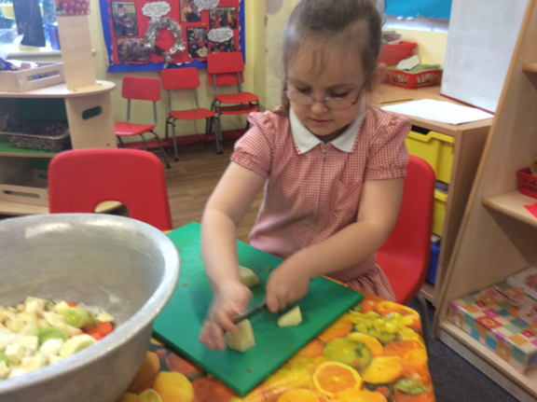
Snack
The children have milk and a snack every morning.
Milk is £2 per term, payable once your child turns 5.
Snack is £1 a week payable at the beginning of each half term.
Children will also be offered a range of fruit or vegetables daily from our free fruit initiative.

Slide 16
Behaviour Policy
In Reception we are learning how to follow our school rules. Reception staff will help us to learn how to share and play with others co-operatively, listen and learn effectively, and follow our school rules.
We use strategies such as visual timetables, modelling, timers and positive reinforcement to support children to follow all the school rules and to develop their friendships.
Attitude to learning is important to us at Sutton Oak. We will be encouraging all children to persevere, work together, try their best at all times and realise it’s ok to make and learn from mistakes.
The children are introduced to the school behaviour system including our zones of regulation, during their time in Reception as and when it is appropriate for their individual development (the full behaviour policy can be found on the website).

Slide 17
School Rules
1.Listen to instructions given by staff.
2.Show respect at all times.
3.Tolerate each other because we are all different.

Slide 18
Toileting
There are toilets in the classroom and children are allowed to go to the toilet at anytime.
Children starting Reception are expected to be toilet trained. If your child is not yet toilet trained, you can refer to the continence team for further support in supporting this via your child’s current Nursery or health visitor to create a personalised plan. Please let a member of our team know if your child has any issues in this area and we can work together to support you.
If you anticipate accidents in school, please send in a set of spare clothes with your child each day.
Accidents in those first few weeks are common, even with children who are fully toilet trained, please wash and return any spares that are sent home.

Slide 19
Sensory Diets
What does this look like in practice?
Some children may feel overwhelmed or overloaded and need to get to a calmer state; some may feel lethargic or sluggish and need some activities to feel alert.
Understanding a child’s sensory profile and the activities which create calmness and regulation can really help when a child feels overwhelmed and out of control. Engaging children in sensory experiences on a regular schedule can support focus, attentiveness and interaction. Children may feel less anxious when they feel comfortable and in control.
These activities can be within the classroom, sensory room, hall or outdoor provision. They include a range of activities that target individual sensory seeking behaviours and help emotional regulation.
They are completed in short bursts throughout the day and work best when completed at home and in school with a team approach.

Slide 20
Sensory Diets
We have a number of children who require additional support with emotional and sensory regulation.
Staff in Reception have received recent sensory diet training and are experienced in meeting these additional needs.
In Reception we have access to a Sensory room and a daily sensory diet.
Children already receiving a sensory diet will continue this from September.
If you are concerned about sensory needs we will work together with you to complete the seedlings programme in the Autumn term.

Slide 21
Working together
Seesaw
Stay and Plays
2 x Parents’ Evenings
Homework

Slide 22
Home time
School finishes at 3:10pm for Reception children. Children are to be collected from the Reception Gate. Members of the Reception team will always be at the gate to welcome the children and ensure all children leave safely.
We have an open door policy and you are always welcome to discuss any issues with us before or after school but ask you are patient and wait until we have dismissed all the children safety before giving you dedicated time to discuss issues.

Slide 23
If you have any problems please make an appointment to speak to your child's class teacher or if appropriate our SENCO Mrs McGovern via the school office.
Visit our website www.suttonoak.co.uk for all the latest news and events.

