Slide 2
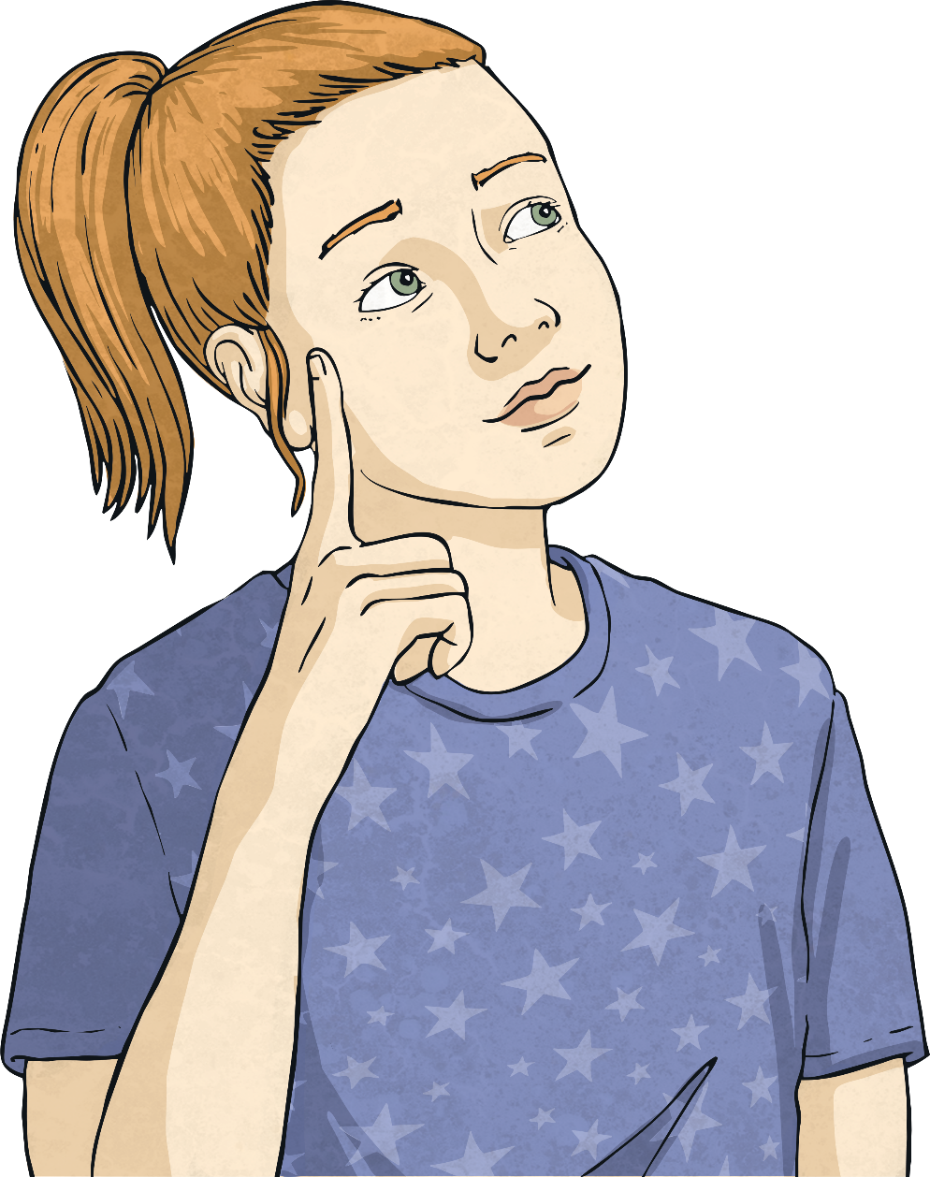
Rhetorical Questions
What is a rhetorical question?
A rhetorical question is a question which does not require an answer.

Slide 3
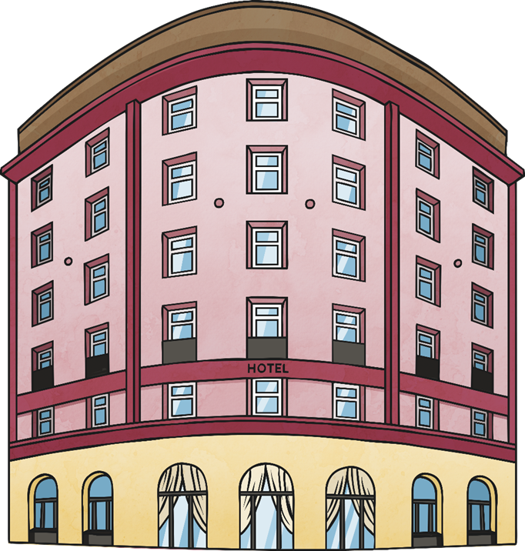
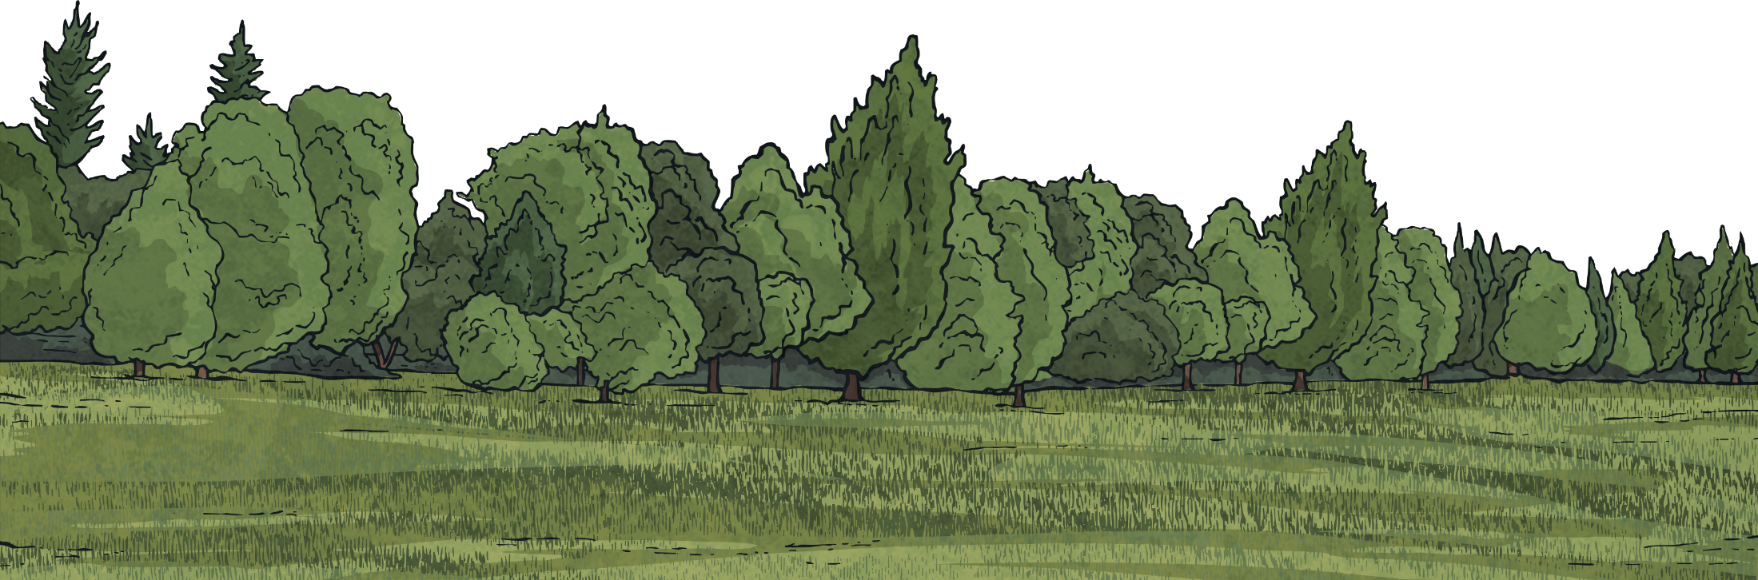

Rhetorical Questions
Rhetorical questions are often used in advertisements to persuade people.
They are often used at the beginning of an advertisement to draw readers in.
Who wouldn’t want to stay here?

Slide 4
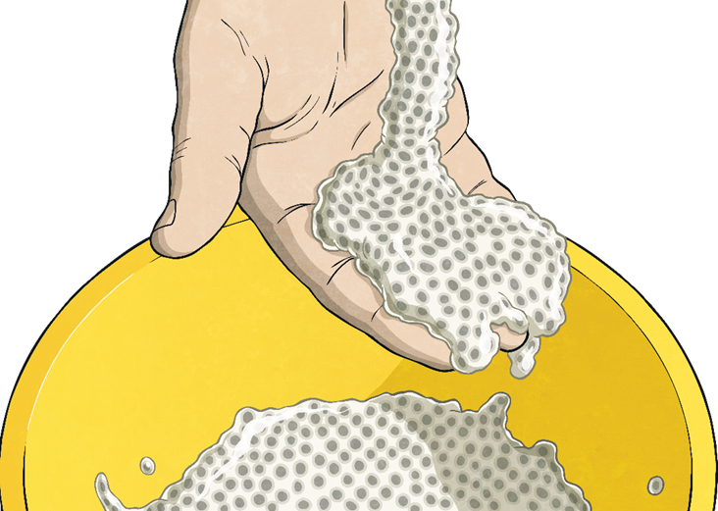
Rhetorical Questions
They are used to make or emphasise a point.
Sounds amazing, right?

Slide 5

Rhetorical Questions
They are used at the end of a piece to conclude.
Do we need to tell you twice?

Slide 6
Rhetorical Questions
Spot the rhetorical questions in this passage and write them on your whiteboards.
Why not visit our most horrid hotel? You’ll be surprised at what an awful time you will have! Love sleeping in lumpy beds? Then look no further for your ultimate break. Lie-ins are overrated anyway, aren’t they?
Why not book today? Who doesn’t want a night in the horrid hotel?
Why not visit our most horrid hotel? You’ll be surprised at what an awful time you will have! Love sleeping in lumpy beds? Then look no further for your ultimate break. Lie-ins are overrated anyway, aren’t they?
Why not book today? Who doesn’t want a night in the horrid hotel?

Slide 7
Rhetorical Questions
You will often see rhetorical questions begin with:
Do you really…?
Are you…?
Why not…?
Who can deny…?
Who doesn’t…?
Love…?

Slide 8
Rhetorical Questions
Turn these statements into rhetorical questions.
Visit the most vile hotel in the world.
Who doesn’t want to visit the most vile hotel in the world?
You’ll have the holiday of a lifetime.
Do you fancy the holiday of a lifetime?

Slide 9
Rhetorical Questions
Turn these statements into rhetorical questions.
Shower in our cold, slimy showers.
Love showering in cold, slimy showers?
Enjoy being served by our disgusting staff.
Who can deny that they will enjoy being served by our disgusting staff?

Slide 10
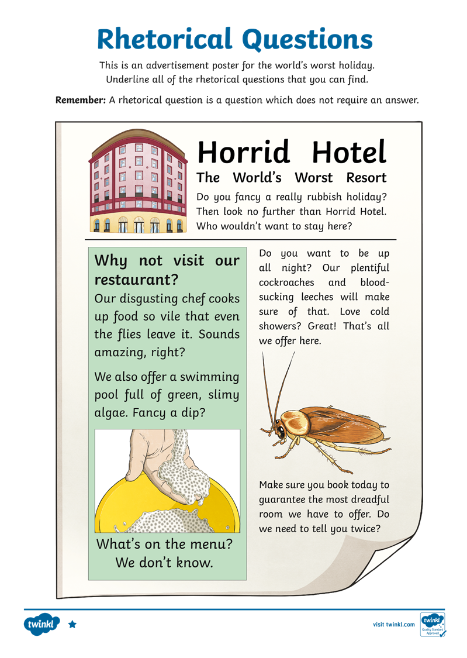
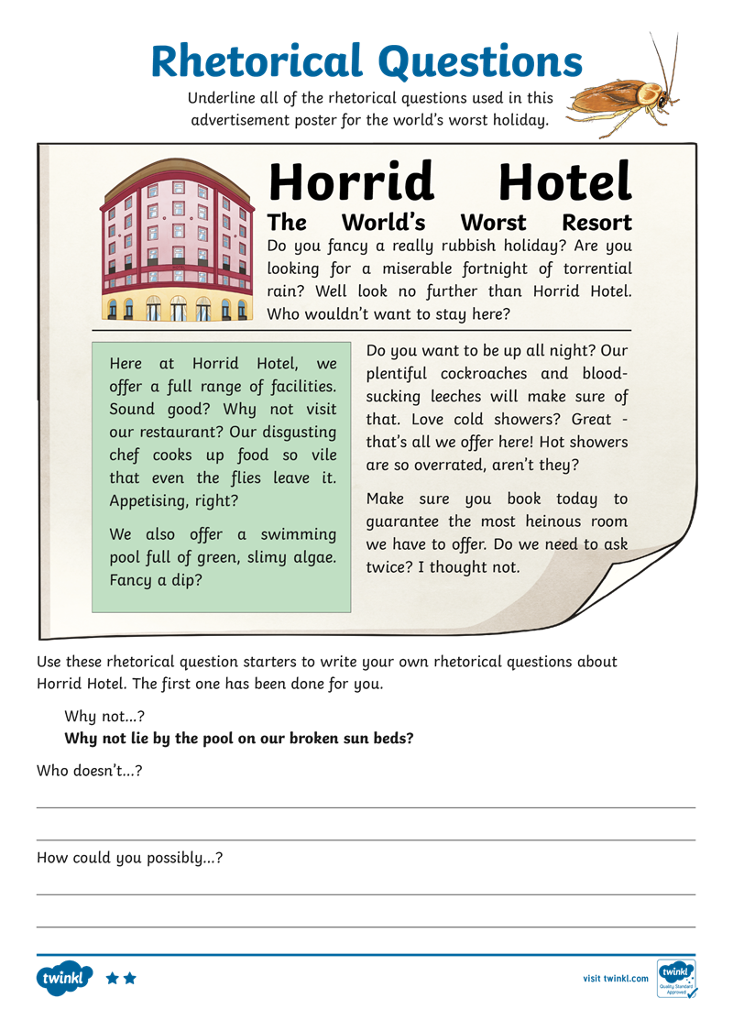
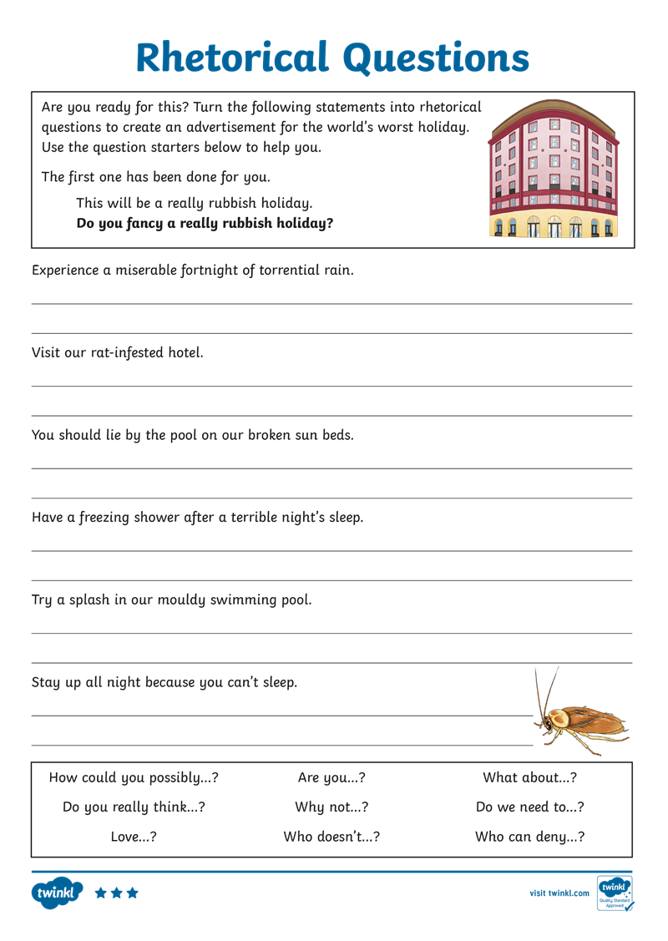
Rhetorical Questions
Now have a go at the Rhetorical Questions Differentiated Activity Sheets.

