Slide 1
Logo quiz

Slide 2
1

Slide 3

2

Slide 4

3

Slide 5

4

Slide 6

5

Slide 7
6

Slide 8

7

Slide 9
8

Slide 10

9

Slide 11
10

Slide 12
11

Slide 13

12

Slide 14
13

Slide 15
14

Slide 16
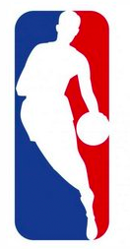
15

Slide 17
16

Slide 18

17

Slide 19

18

Slide 20
19

Slide 21
20

Slide 22
21

Slide 23
22

Slide 24
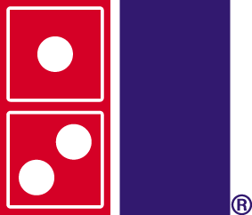
23

Slide 25
24

Slide 26
25

Slide 27
1. wikipedia

Slide 28
2. Michelin

Slide 29
3. Mc donalds

Slide 30
4. Mitsubishi

Slide 31
5. shell

Slide 32
6. LAcoste

Slide 33
7. wwf

Slide 34
8. hello kitty

Slide 35
9. pepsi

Slide 36
10. ferrari

Slide 37
11. unicef

Slide 38
12. kfc

Slide 39
13. nike

Slide 40
14. batman

Slide 41
15. nba

Slide 42
16. mercedes

Slide 43
17. adidas

Slide 44
18. renault

Slide 45
19 lG

Slide 46
20. apple

Slide 47
21. xbox

Slide 48
22. starbucks

Slide 49
23. dominos pizza

Slide 50
24. google

Slide 51
25. superman

Slide 52
what is your score?

