Slide 1
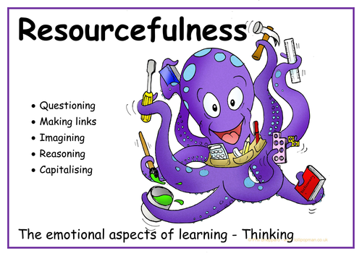

Slide 2
What is resourcefulness?
https://www.youtube.com/watch?v=Wqb6iVXwJ7c

Slide 3

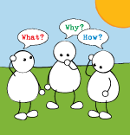
1.Questioning
Being curious
Wanting to get to the
bottom of things
Puzzling things out
Often wondering and asking “Why?”

Slide 4
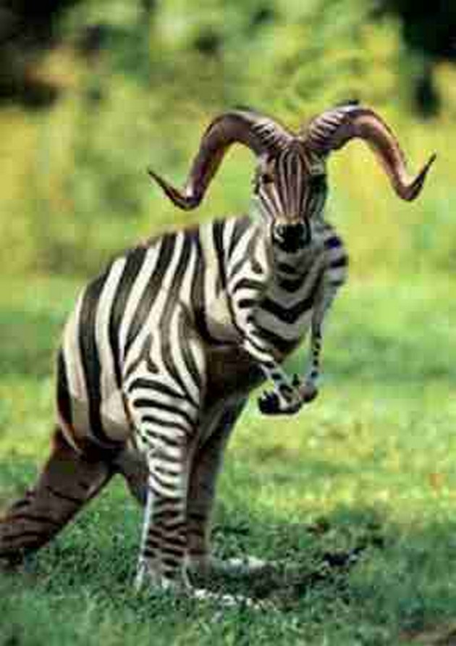


Slide 5
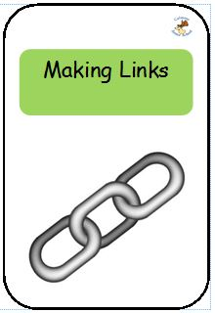
2.Making Links
https://www.youtube.com/watch?v=5Ui21oHvOXA

Slide 6
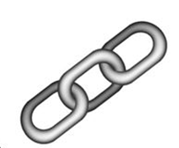
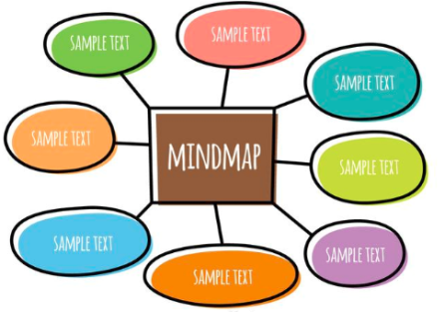

Build up this learning muscle
Connecting ideas, looking for patterns
Create mind maps to
show linked ideas
Think to yourself:
“What do I already know?”
“How could this new idea fit in?”

Slide 7
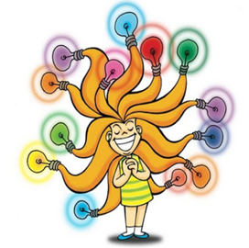

3.IMAGINING

Slide 8

This is what imagining means
Letting your mind explore and play
with possibilities and ideas
Picturing how things might look, sound and feel
Building up stories around objects, facts…anything!
Rehearsing things in your mind before doing them for real

Slide 9

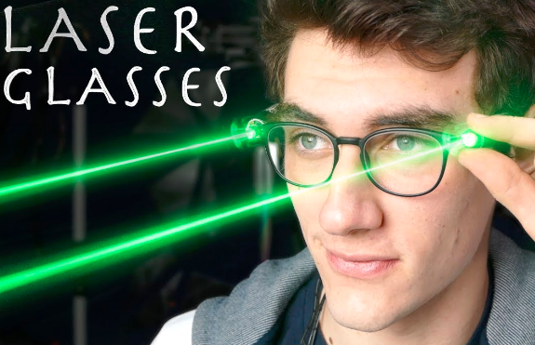
Use your imagination – what could these become?

Slide 10

4. Reasoning- What does it mean?
To create logical arguments.
To spot flaws in other people’s arguments.
To realise what might happen.
To look for evidence.
https://www.youtube.com/watch?v=tIUPW2ARTso

Slide 11

Building up our reasoning by asking:
How many reasons can we find for that?
What evidence can you find to support your argument?
How have you come to that conclusion?

Slide 12
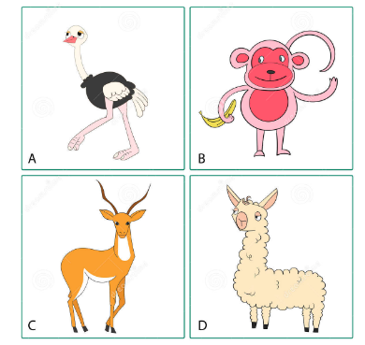
Use reasoning to work out the odd one out…give your evidence

Slide 13
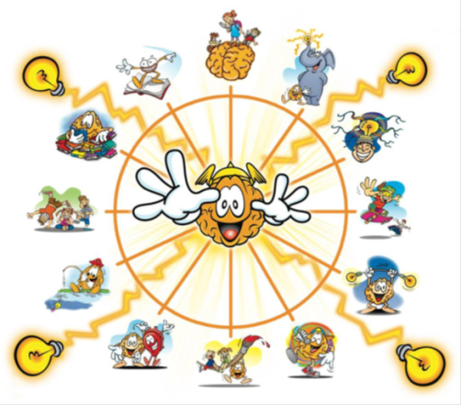
Finally….5. Capitalising
It means you learn from many different sources – people, books, the internet and music.
Making intelligent use of all kinds of things to build up your
learning
https://www.youtube.com/watch?v=Nuby-vJm_fE

Slide 14


Build up your capitalising skills…
Asking “What can we use to help us
with this?”
Reading books, listening to others and even by listening to music.
Using information books, dictionaries and the Internet.

Slide 15
