Slide 1
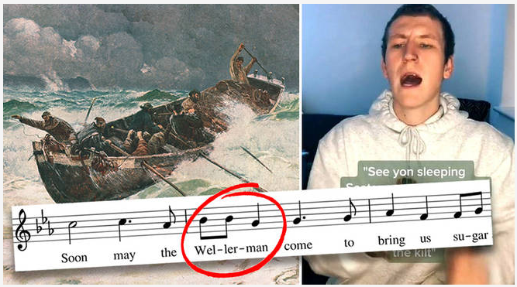
Sea Shanties and Folk Songs

Slide 2

“Wellerman” is a well-known whaling song, believed to have been written in New Zealand around 1860 – 1870!

Slide 3
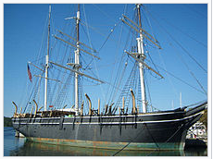
The song often refers to the ‘Wellerman’; these were people who worked for the English-born Weller brothers (Edward, George and Joseph). They migrated to Sydney in 1829 and set up their company which owned ships (eg Billy of Tea) and sold provisions to whalers (whaling stopped in New Zealand in 1960).

Slide 4
The song was first published in a book of New Zealand folk songs in 1973. Its content is a genuine cultural expression by exploited workers for whom ‘sugar and tea and rum’ gave a much-needed break from the drudgery and toll of their daily lives (workers at the whaling-bay stations were paid not in wages but in clothing, sugar, tea, alcohol and tobacco).
In 2020 and 2021, versions of the folk song by The Longest Johns and Scottish postman / musician Nathan Evans became viral hits on TikTok (a social media site) leading to a social media craze around sea shanties.

Slide 5
Sea shanties were usually sung by a captain or leader and his crew and often involved call-and-response phrases with strong rhythms and steady beat to keep sailors in time when doing their chores.
They were a great way to make lighter work of the heavy, repetitive tasks of hoisting the sails, dragging in the sails, rowing and scrubbing the decks and took their mind off the work’s repetitive nature.
So, shanties were ‘work songs’, in essence.

Slide 6
There were different types of shanty for different kinds of work, with musical accents placed carefully to coordinate merchants on specific tasks. Tempo (speed) was also important and varied to match the speed required for the chore.
Some of you may recognise Blow the Man Down (it forms the theme tune for SpongeBob Square Pants and also appears in Popeye cartoons). You can clearly hear the ‘response’ of ‘Wey hey, blow the man down’ being sung: https://www.youtube.com/watch?v=QzMedq1Y-Vo

Slide 7
Also, remember that in those days, there was no radio, TV, phones, iPads etc to provide entertainment, so folk songs would have been a great way to spend the evening, all gathered on deck, providing friendship and comradery.
Spanish Ladies is a folk song that describes a voyage from Spain to England, with sailors trying to gauge how far they were from home. This is by The Longest Johns: https://www.youtube.com/watch?v=70wkdqX8HP0
This version of the Wellerman includes fabulous harmonies from opera singers: https://www.youtube.com/watch?v=LpaDQB1xDyQ
Click here to listen to the Wellerman by Nathan Evans:
https://www.youtube.com/watch?v=SLiNQhQr4G4&pbjreload=101

Slide 8
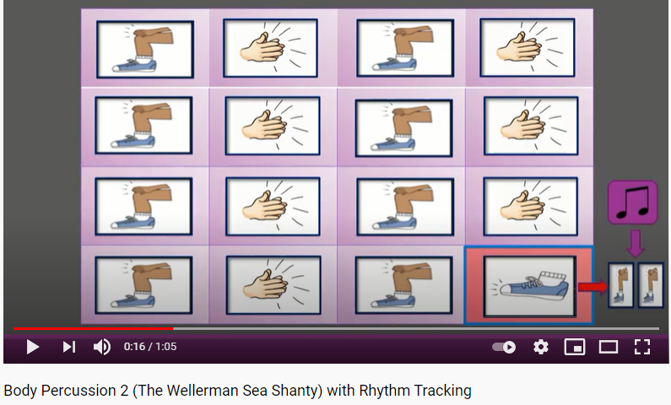
Body percussion time!
The piece has 4 beats in each bar (each row is a bar).
Most are crotchets but some are quavers and the video tells you when they are coming up!

Slide 9
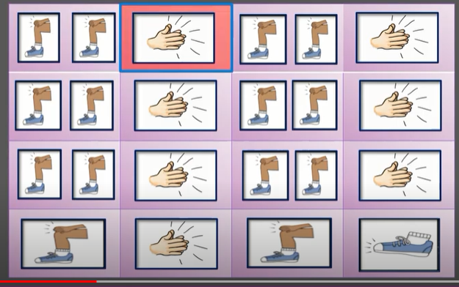
This means you have to pat your knees twice, fitting it in to 1 beat. So each pat on the knee is worth ½ a beat (a quaver). Remember, each bar (row) adds up to 4.
Now click on the link and have a go at the following piece of music which has a very strong, clear beat:
https://www.youtube.com/watch?v=sF7oj_l1CVM

Slide 10
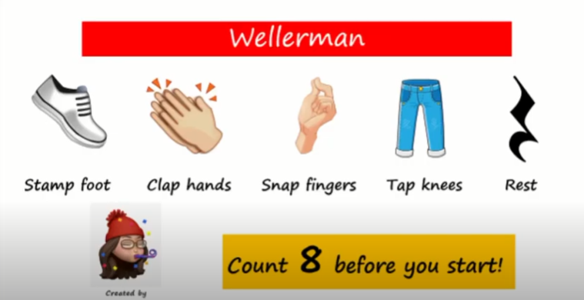
Challenge!
This version has more body percussion and includes rests:
https://www.youtube.com/watch?app=desktop&v=S0dF6Ns-Pl0&feature=youtu.be

