Slide 1

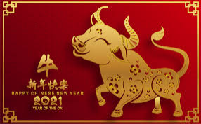
LO: To appreciate and classify Chinese instruments

Slide 2

Chinese New Year is on Friday 12th February 2021.
Each new year in China is named after a different animal. 2021 will be the year of the Ox!
There are many traditions associated with this time of year: fireworks, dragon dances and concerts that feature traditional Chinese instruments.
The new year’s concert on Chinese TV can have as many as a billion people watching it!
Click here to see a Dragon Dance: https://safeshare.tv/x/JoZUR2dOQPk

Slide 3

Chinese intruments can be classified into woodwind, string and percussion.
The string instruments can be plucked or bowed.
Some woodwind instruments have reeds (like the clarinet and saxophone) and others don’t (like the flute).
Listen again to the Dragon Dance – which family of instruments can you hear?

Slide 4
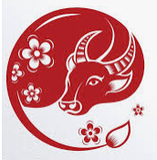
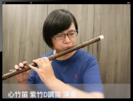
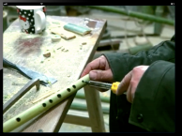
Let’s look at a bamboo flute called a dizi (pronounced ‘deetsu’).
Listen to a dizi:
https://safeshare.tv/x/RTUpdOmpSGU
Watch how a dizi is made:
https://safeshare.tv/x/QB2jUZ5bwzI

Slide 5
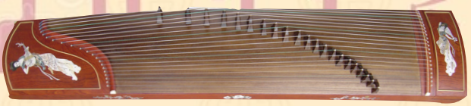
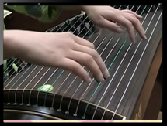
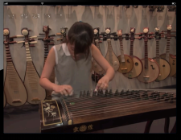
Let’s look at a string instrument called a guzheng (pronounced ‘goojong’).
Listen to a guzheng:
https://safeshare.tv/x/ss601126506a5ca
How a guzheng is played:
https://safeshare.tv/x/ss6006e8ef4e194

Slide 6

Which 2 families of instruments are being played here?
https://safeshare.tv/x/ss60103604a109f
String and woodwind, well done!

Slide 7
Which 2 families of instruments are being played in this video?
https://safeshare.tv/x/ss60103575f25ed
Percussion and String!

Slide 8
What did you notice about the tempo (speed) in the 2nd performance compared to the 1st?

Slide 9
The tempo was faster in the 2nd performance.
Well done!

Slide 10

Do you recognise this piece of music? Enjoy!
https://safeshare.tv/x/ss6011308660590

