Slide 2
Aim
I can recognise and use subordinating conjunctions.
Success Criteria
I can recognise that subordinating conjunctions are used to create subordinate clauses.
I know that subordinate clauses are used within complex
(multi-clause) sentences.
I can use ‘I SAW A WABUB!’ to remember the main subordinating conjunctions.
I can write my own complex (multi-clause) sentences using different subordinating conjunctions.

Slide 3
Getting Started
What is a conjunction?
A conjunction links two or more words, phrases or clauses together.
There are two main types of conjunctions we use within sentences.
Do you know what they both are?
co-ordinating conjunctions (e.g. and) link two main clauses together as an equal pair to create a compound sentence. We usually remember these words using the acronym ‘FANBOYS’.
subordinating conjunctions (e.g. when) introduce a subordinate clause. You can remember some of the most useful subordinating conjunctions by...

Slide 4
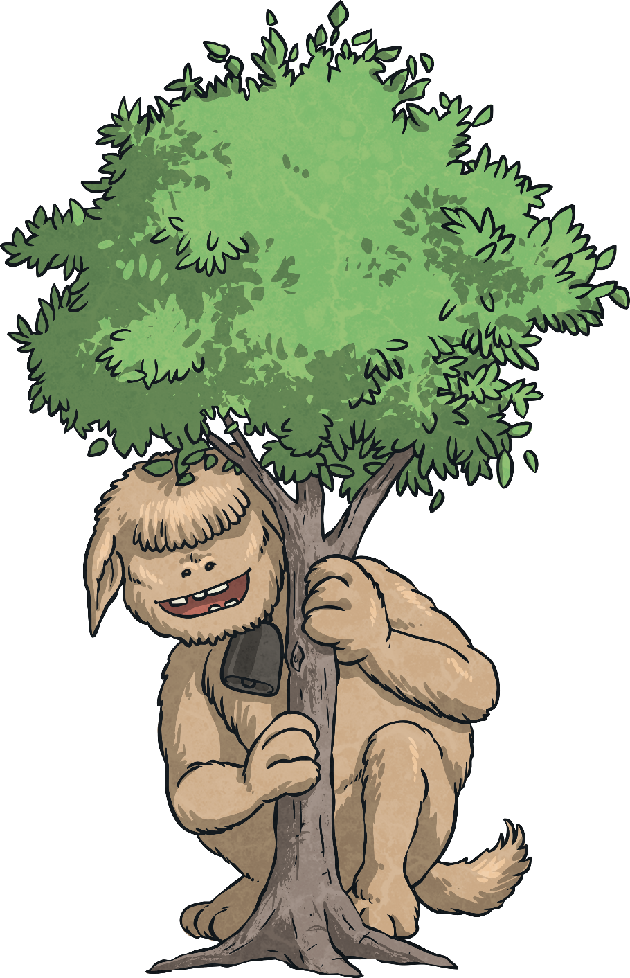
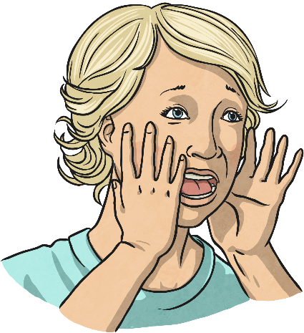
…spotting one of the rarest monsters on the planet, a wabub, and shouting...
I SAW A WABUB!

Slide 5
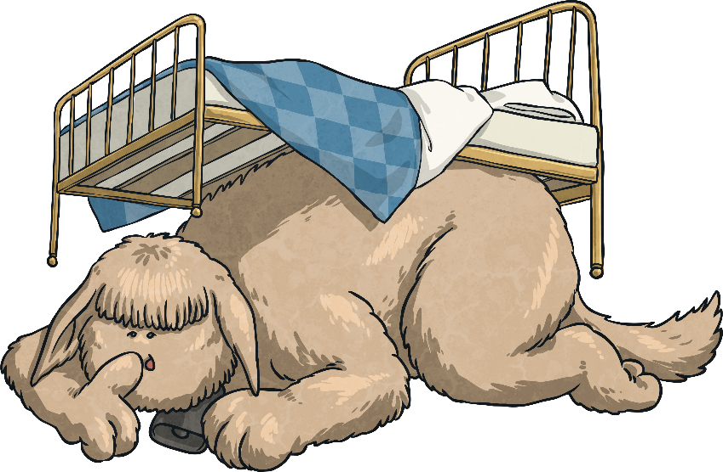
…is an acronym to help you remember the first letters of some of the most important subordinating conjunctions.
I Saw a Wabub…
If
Since
As
When
Although
While
After
Before
Until
Because
I
S
A
W
A
W
A
B
U
B!

Slide 6
So, how do we use subordinating conjunctions?
Next Steps
Subordinating conjunctions are the first words within a subordinate clause. Subordinate clauses do not make sense on their own but, when they are used with a main clause, they create a complex (multi-clause) sentence.
Subordinate clauses will always have a subject and verb within them, e.g.
after she smiled
after Christmas
subordinating conjunction
subject
verb
Here ‘after’ is being
used as a preposition.
is a subordinate clause
is not a subordinate clause

Slide 7
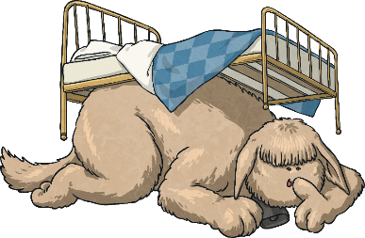
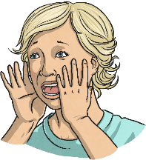
Can you spot the subordinate clause and the subordinating conjunction in this sentence?
Next Steps
I SAW A WABUB!
The eager pupils sped into school when the bell rang.
The eager pupils sped into school when the bell rang.

Slide 8
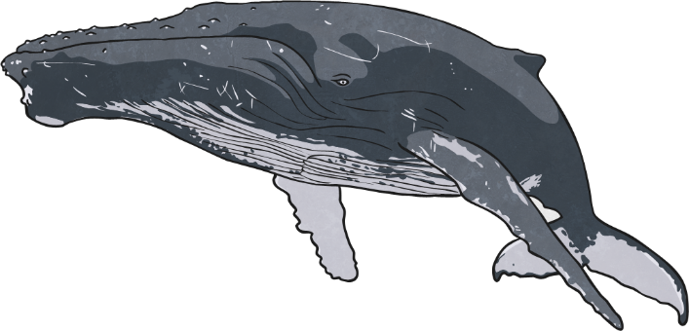
Can you spot the subordinate clause and the subordinating conjunction in this sentence?
Next Steps
I SAW A WABUB!
Whales give birth to live young
as they are mammals.
Whales give birth to live young
as they are mammals.

Slide 9
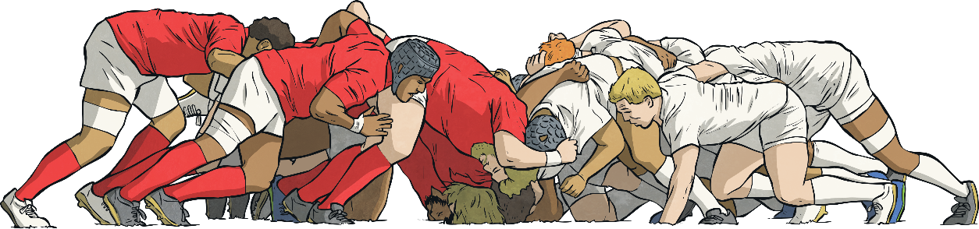
Can you spot the subordinate clause and the subordinating conjunction in this sentence?
Next Steps
I SAW A WABUB!
The hopeless rugby team lost the game because they hadn’t trained.
The hopeless rugby team lost the game because they hadn’t trained.

Slide 10
In the sentences we have looked at so far, the subordinate clause has always come after the main clause but watch...
Next Steps
I SAW A WABUB!
When the bell rang, the eager pupils sped into school.
The eager pupils sped into school when the bell rang.

Slide 11
Subordinating conjunctions can also be used as the first word in a sentence. When the subordinate clause comes before the main clause, make sure you remember to use a comma to mark where the subordinate clause ends.
Next Steps
I SAW A WABUB!
When the bell rang, the eager pupils sped into school.

Slide 12
Next Steps
I SAW A WABUB!
Can you swap these sentences around so that the subordinate clause comes before the main clause?
Don’t forget your commas!
As they are mammals, whales give birth to live young.
Whales give birth to live young as they are mammals.
The hopeless rugby team lost the game because they hadn’t trained.
Because they hadn’t trained, the hopeless rugby team lost the game.

Slide 13
Can you spot the subordinating conjunctions in this piece of text? Where have they been used in these sentences?
I SAW A WABUB!
Subordinating
Conjunction Hunt
As he walked closer, Cleo could see the crocodilius in the cave entrance. The beast was hurriedly eating the remains of its last unlucky victim because it was ravenous. Cleo examined its bright red eyes, huge smoking nostrils and razor-sharp teeth while the beast was occupied. Although Cleo was standing quite a distance away, the terrible stench of the gruesome beast was still making him feel nauseous. Cleo took a deep breath before he tiptoed bravely forward. It was time for battle.
As he walked closer, Cleo could see the crocodilius in the cave entrance. The beast was hurriedly eating the remains of its last unlucky victim because it was ravenous. Cleo examined its bright red eyes, huge smoking nostrils and razor-sharp teeth while the beast was occupied. Although Cleo was standing quite a distance away, the terrible stench of the gruesome beast was still making him feel nauseous. Cleo took a deep breath before he tiptoed bravely forward. It was time for battle.

Slide 14
Now, it’s your turn.
Which subordinating conjunction would fit best at the start of this subordinate clause?
Is there more than one possibility?
I SAW A WABUB!
Practise Your
Skills
I am sending you a letter
I am your biggest fan.

Slide 15
Now, it’s your turn.
Which subordinating conjunction would fit best at the start of this subordinate clause?
Is there more than one possibility?
I SAW A WABUB!
Practise Your
Skills
I eat lunch, I am going
to an important meeting.

Slide 16
Now, it’s your turn.
Which subordinating conjunction would fit best at the start of this subordinate clause?
Is there more than one possibility?
I SAW A WABUB!
Practise Your
Skills
he was thrown from his saddle,
Henry was wary of riding his horse.

Slide 17
Now, it’s your turn.
Which subordinating conjunction would fit best at the start of this subordinate clause?
Is there more than one possibility?
I SAW A WABUB!
Practise Your
Skills
The two chemicals should cause a reaction you have used them in the right quantities.

Slide 18
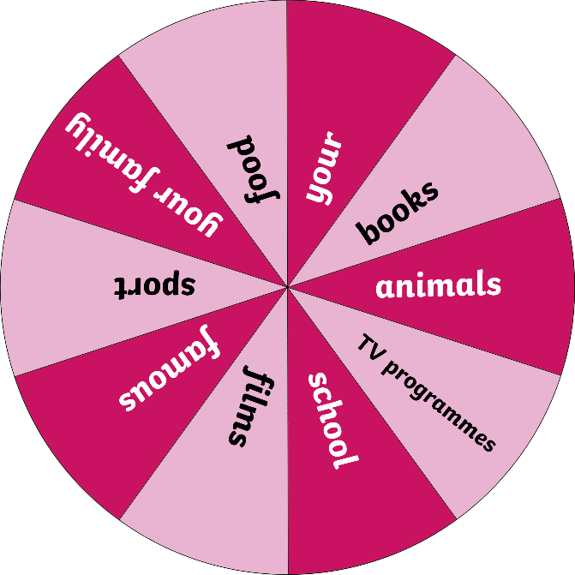
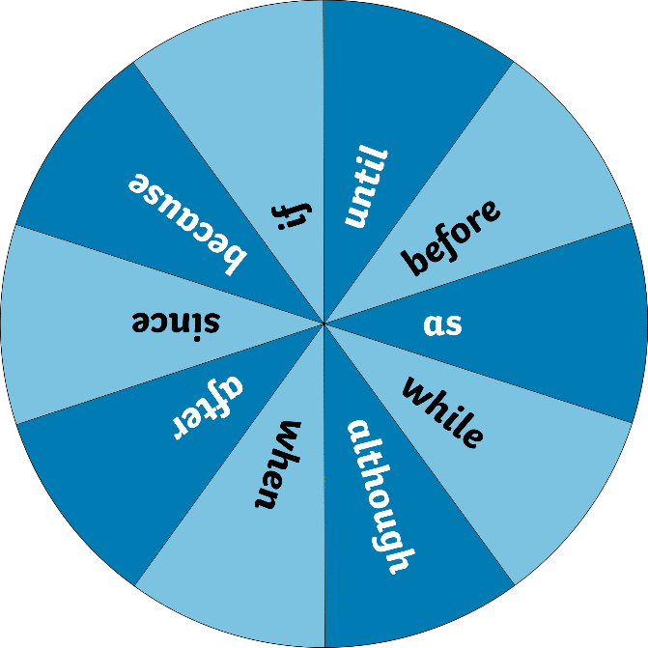
Can you use different subordinating conjunctions accurately in sentences about certain topics? Spin the two spinners to give you a topic and a subordinating conjunction. Write your sentences on a whiteboard. Try to vary the position of your subordinating conjunctions.
Let’s Play
Spin
Spin

Slide 19
Can you spot the subordinating conjunctions in these sentences?
I SAW A WABUB!
Quick Quiz:
Question 1
a)
b)
c)
Until she tried, Daphne didn’t know that she could whistle.
Heavy snow poured from the skies while the children made a snowman.
Although it was expensive, the couple enjoyed their meal at the award-winning restaurant.
Until she tried, Daphne didn’t know that she could whistle.
Heavy snow poured from the skies while the children made a snowman.
Although it was expensive, the couple enjoyed their meal at the award-winning restaurant.

Slide 20
Complete the sentences below by writing the subordinating conjunctions from the box in the correct places to form complex sentences. Use each conjunction only once.
I SAW A WABUB!
Quick Quiz:
Question 2
a)
b)
c)
The greenhouse got smashed the boys were playing football.
they were in trouble, they had to go inside the house.
they were well-behaved, they could have their ball back next week.

Slide 21
Can you remember all of the subordinating conjunctions using the ‘I SAW A WABUB’ acronym?
I SAW A WABUB!
Quick Quiz:
Question 3
If
Since
As
When
Although
While
After
Before
Until
Because

Slide 22
Aim
I can recognise and use subordinating conjunctions.
Success Criteria
I can recognise that subordinating conjunctions are used to create subordinate clauses.
I know that subordinate clauses are used within complex
(multi-clause) sentences.
I can use ‘I SAW A WABUB!’ to remember the main subordinating conjunctions.
I can write my own complex (multi-clause) sentences using different subordinating conjunctions.

