Slide 1


Pronouns and Determiners (Cohesion)
I can’t say why he chose to sleep in our pantry.

Slide 2
Cohesion
A cohesive text:
flows smoothly
makes links between ideas
makes clear how meanings fit together
When a text has cohesion, it fits together as a unit of meaning.
It is not just a list of random sentences.
Cohesive devices can help to create cohesion.
Pronouns make links to what has already been said and help avoid repetition.
Determiners make links to what has already been said.

Slide 3
Pronouns
Pronouns are used in the place of a noun.
Pronouns replace the nouns Eric and hat
Eric had a hat. Eric put the hat on.
Eric had a hat. He put it on.
me
she
hers
I
mine
his
it
him
he
her
yours
its

Slide 4
Cohesive devices – Pronouns
Pronouns can be used as cohesive devices.
They avoid repetition and make links to what has already been said..
Eric had found a hat. The hat was a large one. The hat was far too large to fit on Eric’s head. But Eric liked the hat. “The hat is Eric’s hat,” Eric said.
Eric had found a hat. It was a large one. It was far too large to fit on his head. But he liked the hat. “It is mine,” he said.
his
The word in pink is a determiner. It comes before and specifies the noun (head) telling us whose head it is.

Slide 5
Determiners
Determiners go before a noun.
They show if a noun is specific or general.
Determiners tell us more about the nouns.
a
your
those
the
my
her
some
an
that
this
its
his
any
Eric saw an elephant - any old elephant
Eric was amazed at the elephants - the elephants in the zoo
Children love elephants - children in general love elephants generally
The children loved those elephants – the specified children loved the elephants we know about.
Notes:
The determiners are grouped into: articles, possessives, demonstratives, and quantity. This does not need to be shared with chn but it may be helpful to know that they can be grouped.

Slide 6
Cohesive devices – Determiners
Determiners can be used as cohesive devices.
They provide cohesion because they make links to what has already been said.
the friends that were mentioned earlier
the trick that Eric performed with his hat
Those friends who had watched the trick asked Eric how he had done it. Eric smiled and shook his head. He would never reveal his secret.
Those friends who had watched the trick asked Eric how he had done it. Eric smiled and shook his head. He would never reveal his secret.
Eric’s secret about the trick in particular
Eric shook his own head, where the frog had been
Can you spot the determiners? How do they make links to other parts of the text?

Slide 7

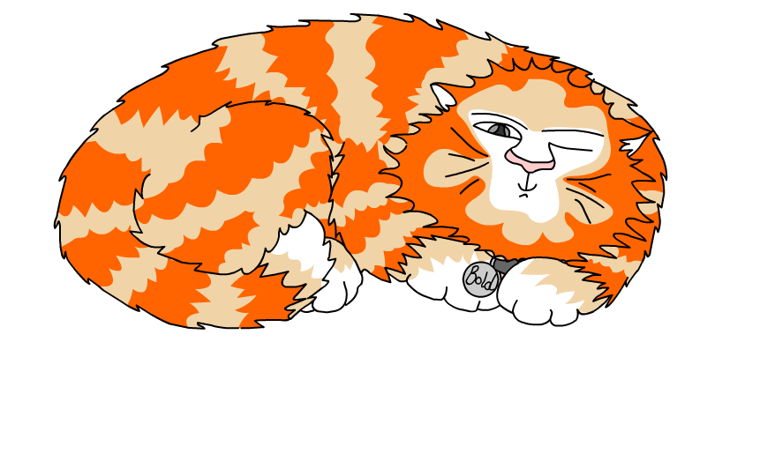
Explore more Hamilton Trust Learning Materials at https://wrht.org.uk/hamilton/ .

