Slide 1
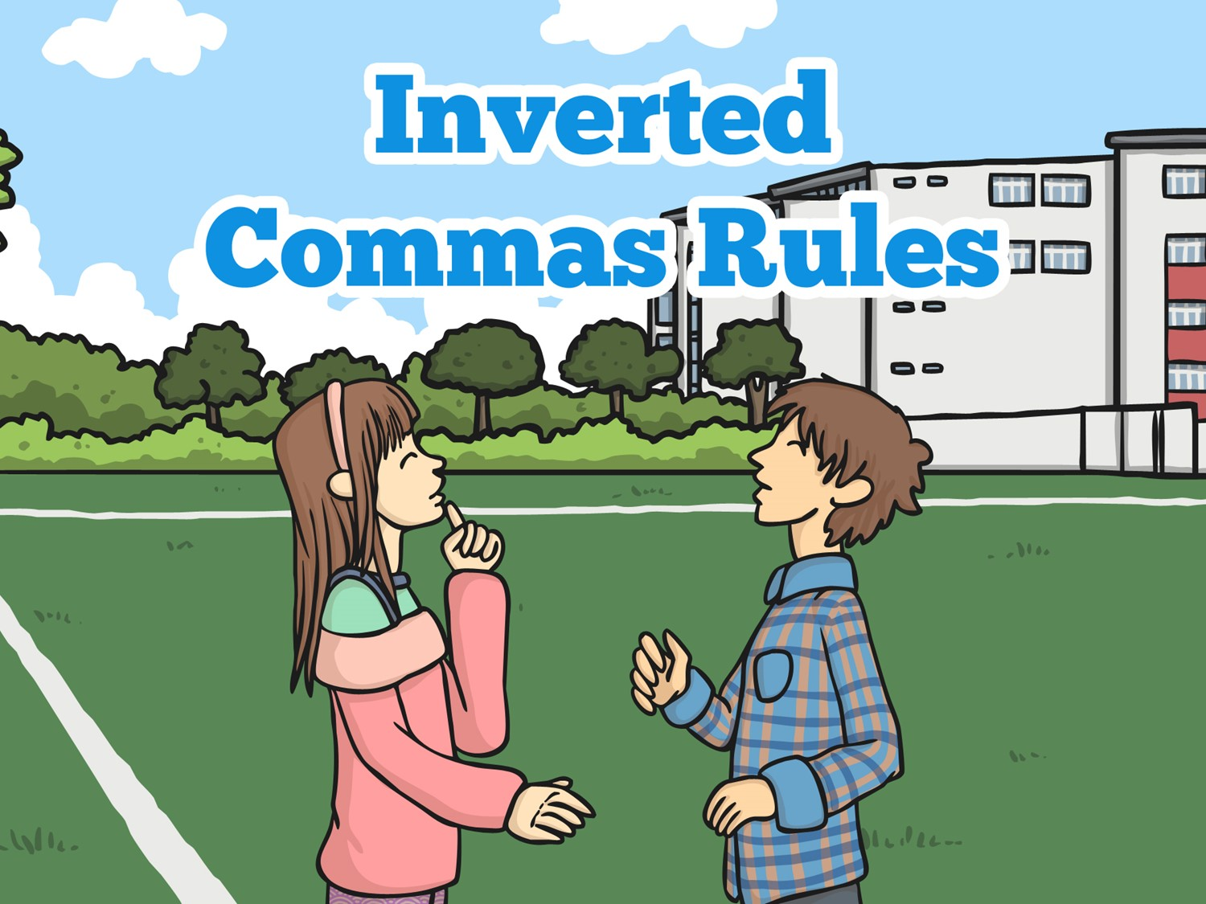


Slide 2
Different Names
Inverted commas can also be called:
Speech marks
Quotation marks
“ ”

Slide 3
Beginning and End
Keep your speech marks at the beginning and
the end of the words being spoken.
“Lower please!” I said.
“ ”

Slide 4
New Speaker, New Line
Start a new line whenever someone new speaks.
“How are you doing today?” asked Henry.
“I’m great!” said Ashton.
“ ”

Slide 5
Capital Letters
Begin the direct speech with a capital letter.
“What an amazing day!” he announced.
“ ”

Slide 6
Punctuation
Make sure your speech is correctly punctuated.
This includes a piece of punctuation before closing the inverted commas.
“There are times, I feel that you are a little cold,”
I said.
“ ”

Slide 7
Reporting Clause
Include in your sentences information about who is speaking and even how they are speaking. This is called the reporting clause.
“There are times, I feel that you are a little cold,” I said.
“ ”

