Slide 1


English
Dashes to Indicate Parenthesis
Year One
English | Year 5 | Spelling, Punctuation and Grammar - SPaG | Dashes to Indicate Parenthesis

Slide 2
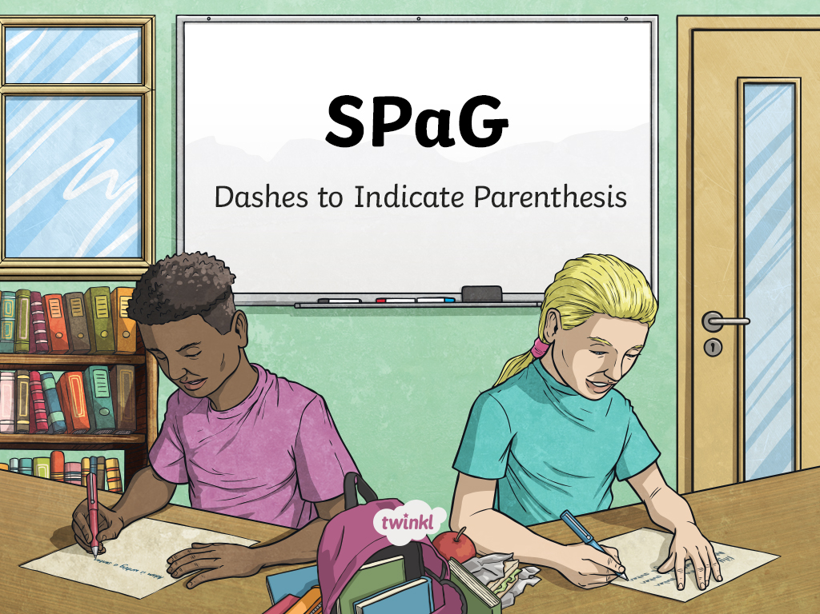

Slide 3
Aim
To use dashes to show parenthesis.
Success Criteria
I can explain that dashes surround additional information in a sentence.
I can explain how dashes can be used on their own or in pairs.
I can identify where dashes belong.
I can create my own sentences which use dashes to show parenthesis.
I can explain the difference between dashes, paired commas and brackets.

Slide 4
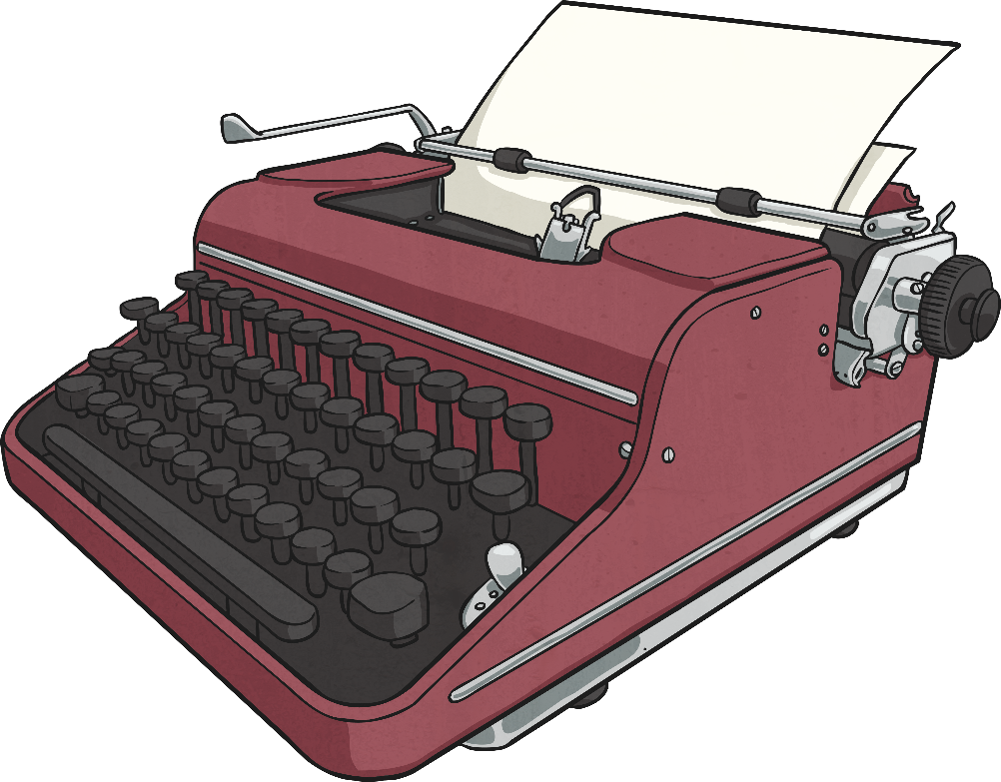
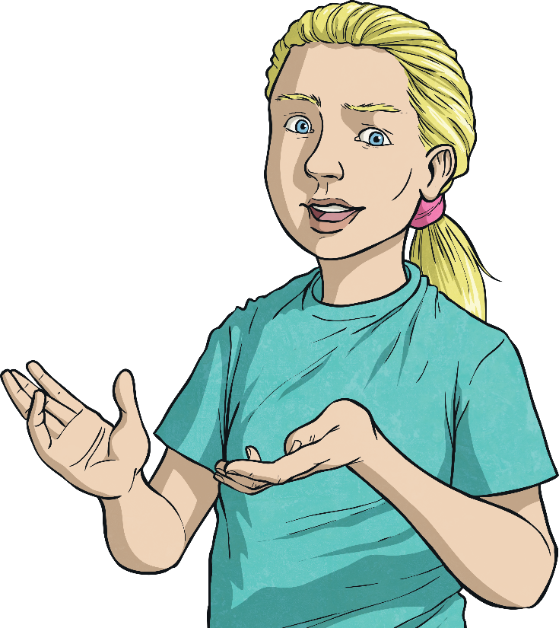
The Double Dash
Definition of a Dash
Dashes can perform a similar function to brackets, surrounding additional information in a sentence.
Example: The train – which was late – was heading to Paris.
Take care not to confuse dashes and hyphens.
Interesting Fact
On old-fashioned typewriters, two hyphens typed one after the other were used instead of a dash.
Dashes are long marks (–). They are used between words, with a space either side.
Hyphens are short marks (-). They are used in the middle of words with no spaces.

Slide 5
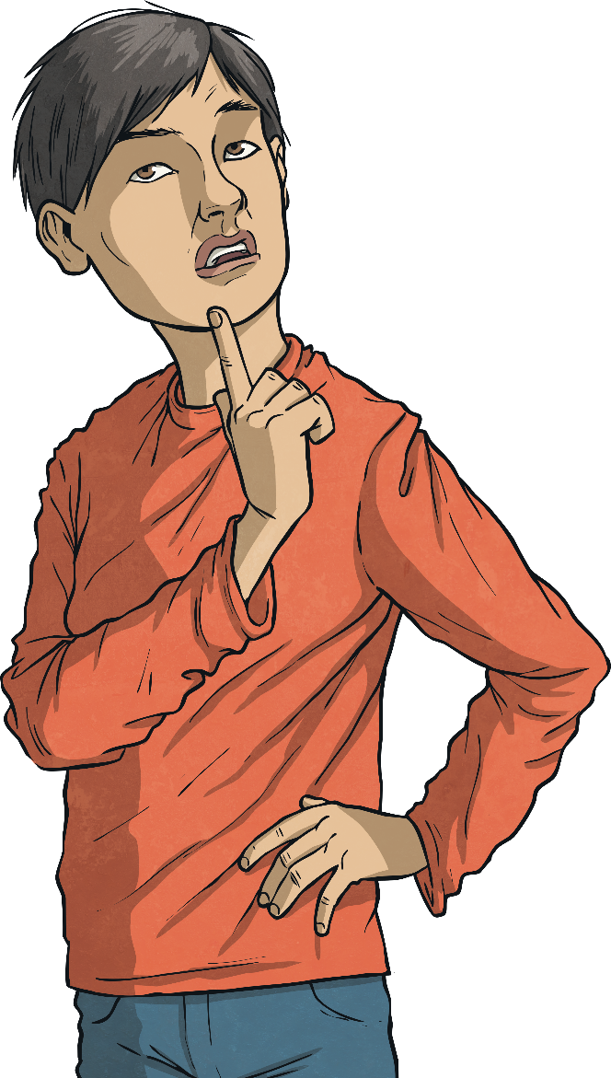
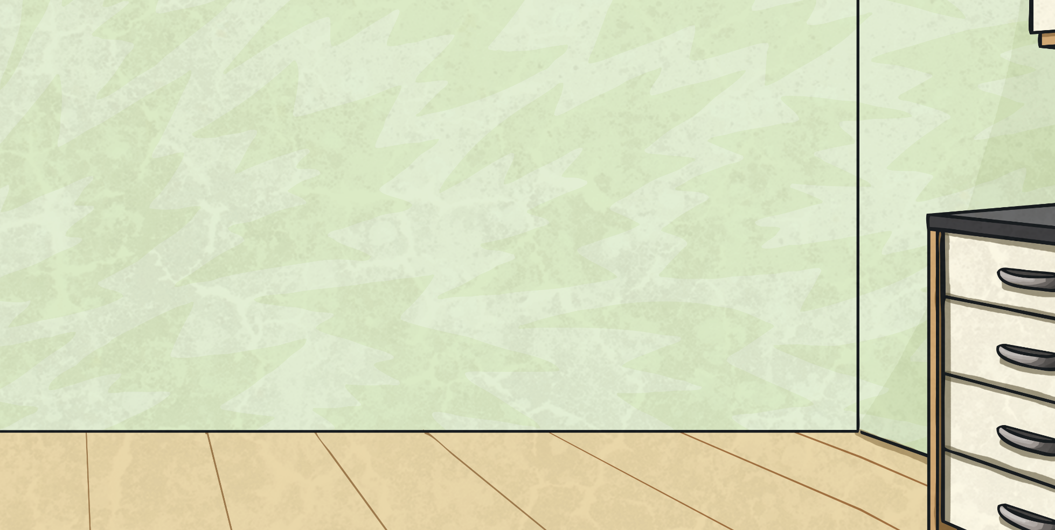
The Double Dash
We use a dash to add additional information. This extra information is called a parenthesis.
There is a space on either side of the dash.
When a parenthesis is completely removed, the sentence is still grammatically correct.
Example
The man was plainly dressed – so he would not be noticed – in a black suit.
Example:
The man was plainly dressed in a black suit.
This part of the sentence gives extra information that could be removed.
A parenthesis can be separated from the rest of the sentence by commas, dashes, or brackets (all called parentheses).
The sentence would still make sense without the part within the dashes.

Slide 6
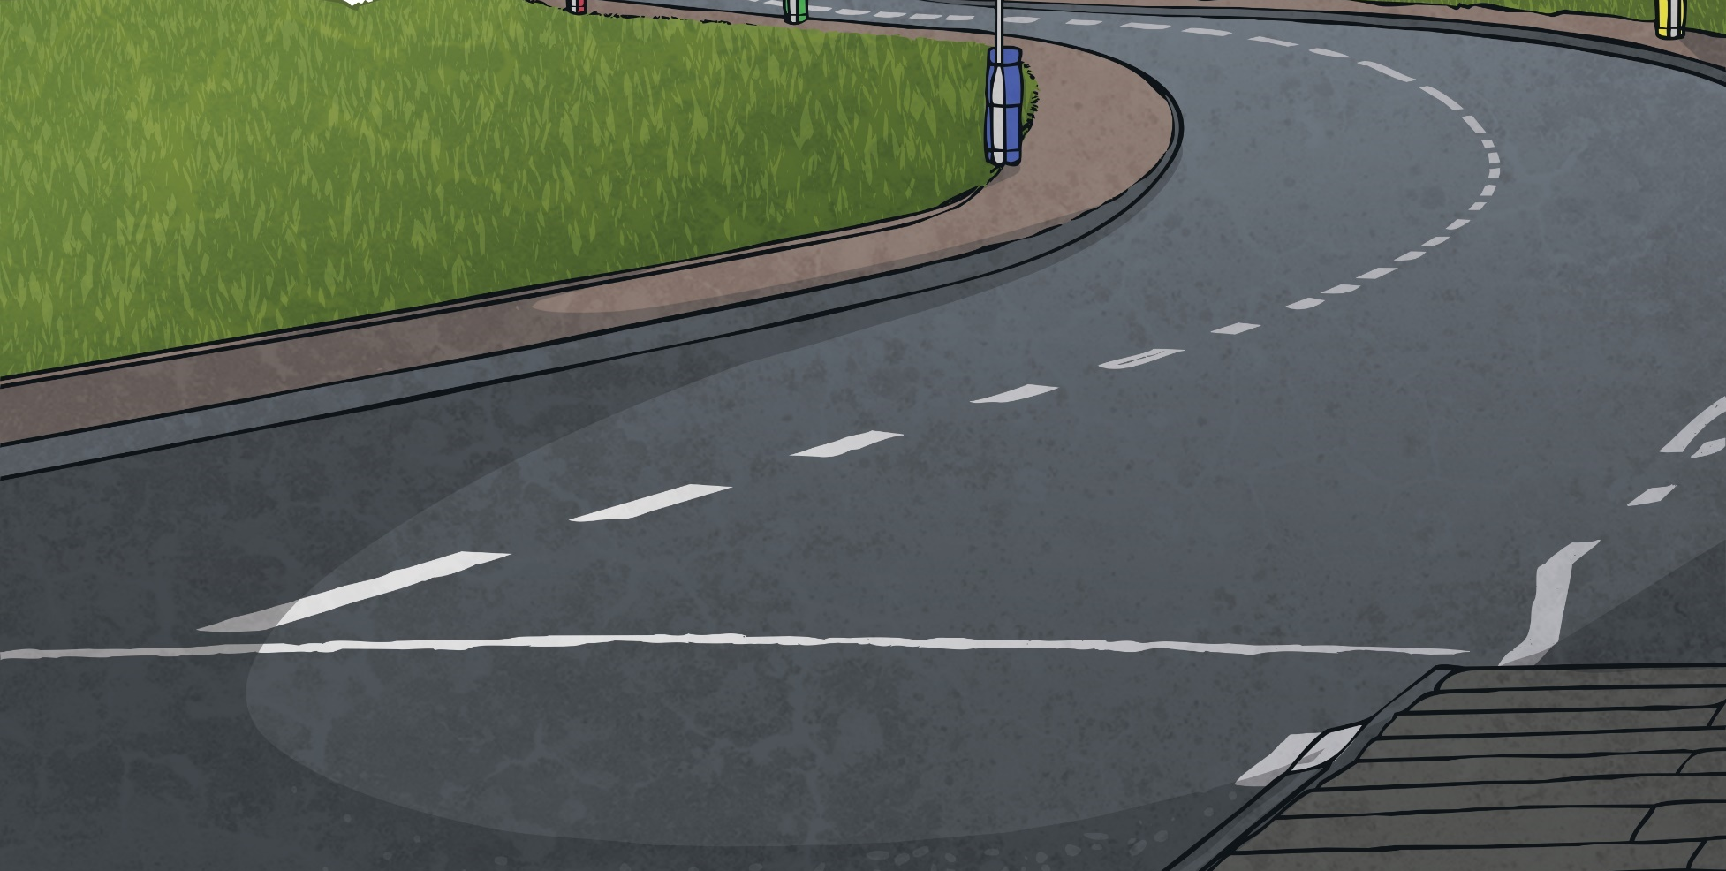
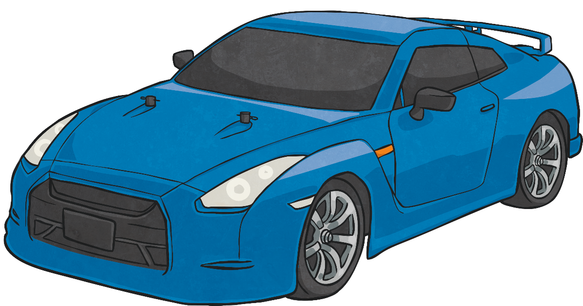
The Double Dash
Two dashes can mark out extra information inserted into a sentence which is grammatically complete without it, similar to brackets.
Example
James Bond – though I can’t quite believe how – jumped
straight over the car, rolled and ran off into the woods.
The dashes here add extra information to the sentence like brackets would, but they draw more attention to
what has been added.
Have a go at using a dash in this way on your whiteboard.
Task: Create a sentence about James Bond which uses dashes to add parenthesis.

Slide 7
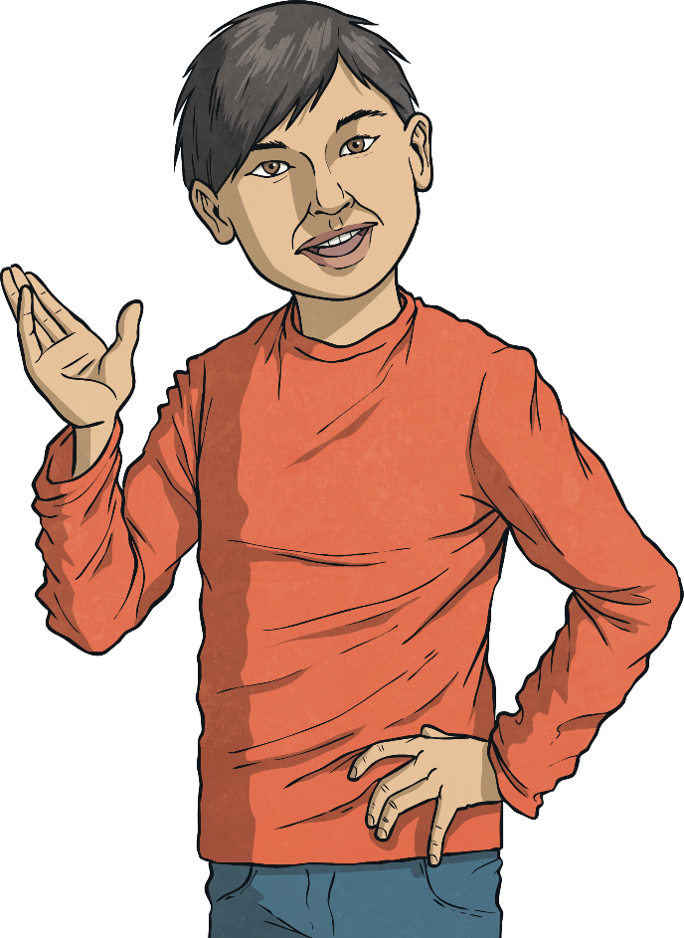

The Double Dash
Now, let’s play the Dashes for Parenthesis Quiz.
Show the answers to the questions on your whiteboard/piece of paper. Write the correct letter on your board to show the correct answer – a, b or c.
a

Slide 8


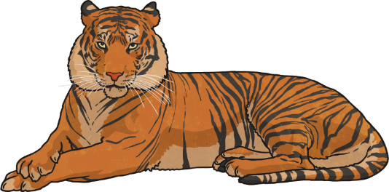
Which sentence correctly uses dashes for parenthesis?
Click to see if each sentence correctly uses dashes for parenthesis.
a) Sumatran tigers sadly now in danger of extinction – can swim very well because – their paws are webbed.
b) Sumatran tigers sadly now – in danger of extinction – can swim very well because their paws are webbed.
c) Sumatran tigers – sadly now in danger of extinction – can swim very well because their paws are webbed.

Slide 9
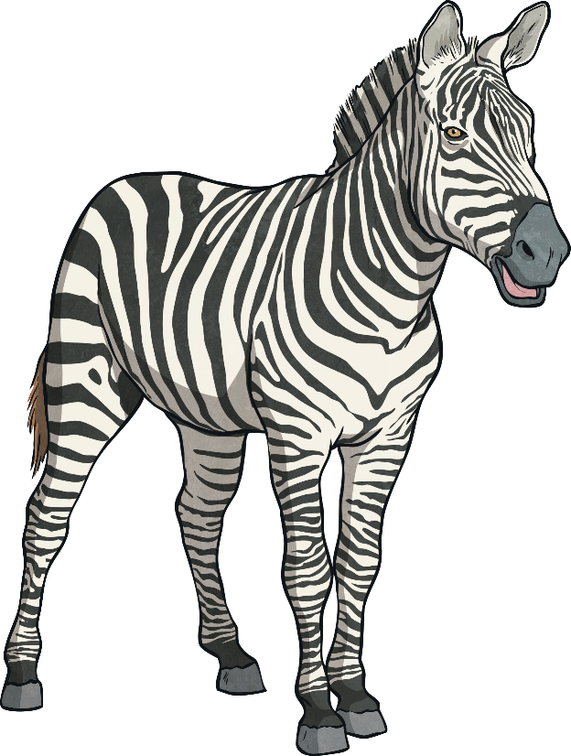
Which sentence correctly uses dashes for parenthesis?
Click to see if each sentence correctly uses dashes for parenthesis.
a) Zebras – well known for their black and white stripes – can reach speeds of 40 miles per hour when running.
b) Zebras well known for their black and white stripes – can reach speeds of 40 miles per hour – when running.
c) Zebras well known – for their black and white stripes – can reach speeds of 40 miles per hour when running.

Slide 10
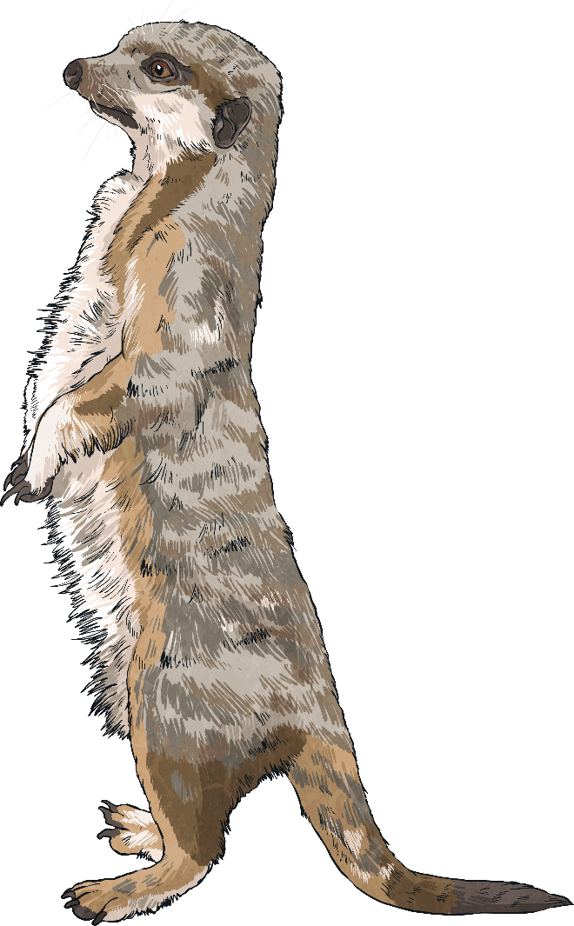

Which sentence correctly uses dashes for parenthesis?
Click to see if each sentence correctly uses dashes for parenthesis.
a) Meerkats those extraordinary digging creatures – live together – in large groups.
b) Meerkats – those extraordinary digging creatures – live together in large groups.
c) Meerkats – those extraordinary digging creatures live together – in large groups.

Slide 11
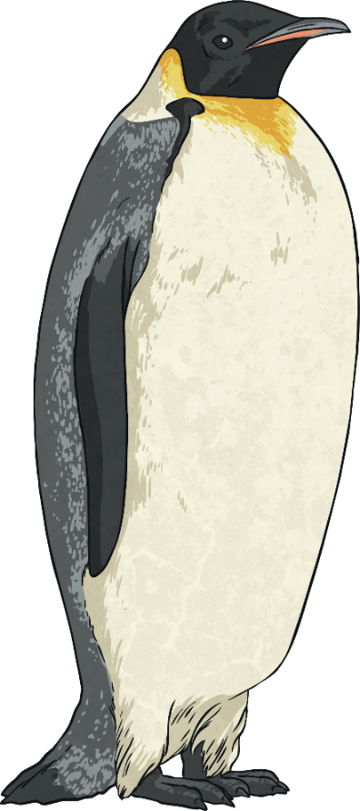
Which sentence correctly uses dashes for parenthesis?
Click to see if each sentence correctly uses dashes for parenthesis.
a) Penguins – despite being unable to breathe underwater – spend very little time on land.
b) Penguins – despite being unable to – breathe underwater spend very little time on land.
c) Penguins despite being unable to breathe – underwater – spend very little time on land.

Slide 12
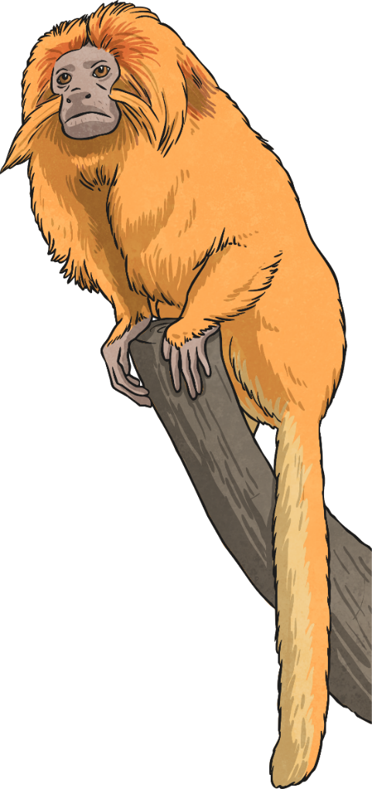
Which sentence correctly uses dashes for parenthesis?
Click to see if each sentence correctly uses dashes for parenthesis.
a) Many types – of monkey such as howler monkeys, spider monkeys, squirrel monkeys and marmosets – live in the Amazon rainforest.
b) Many types of monkey – such as howler monkeys, spider monkeys, squirrel monkeys and marmosets – live in the Amazon rainforest.
c) Many types of monkey such as howler monkeys – spider monkeys, squirrel monkeys and marmosets live – in the Amazon rainforest.

Slide 13
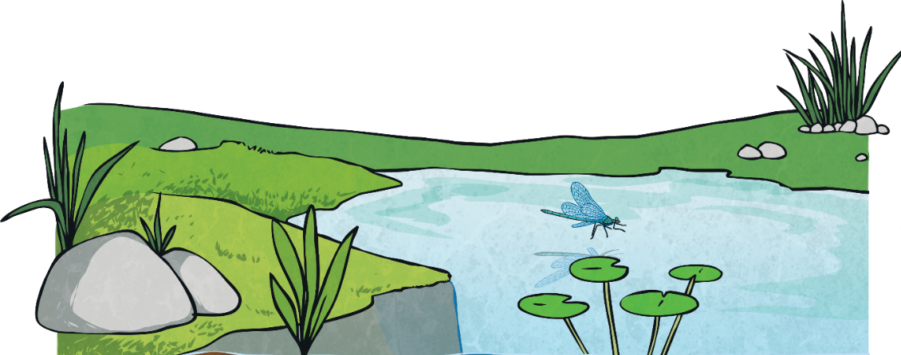
Which sentence correctly uses dashes for parenthesis?
Click to see if each sentence correctly uses dashes for parenthesis.
a) Damp environments compost heaps are perfect – are the best – places for toads to live.
b) Damp environments compost heaps – are perfect are the best places – for toads to live.
c) Damp environments – compost heaps are perfect – are the best places for toads to live.

Slide 14
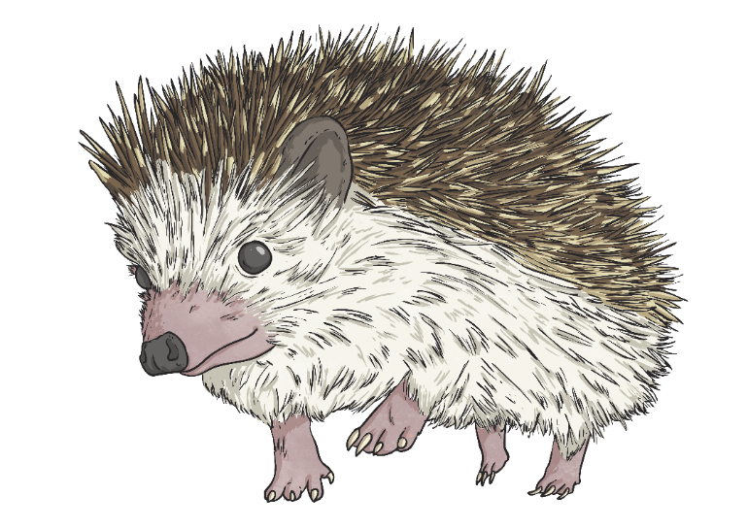
Which sentence correctly uses dashes for parenthesis?
Click to see if each sentence correctly uses dashes for parenthesis.
a) My favourite animal – and there are many animals which I adore – would have to be a hedgehog!
b) My favourite animal and there are many animals – which I adore – would have to be a hedgehog!
c) My favourite animal and – there are many animals which I adore would have to be – a hedgehog!

Slide 15
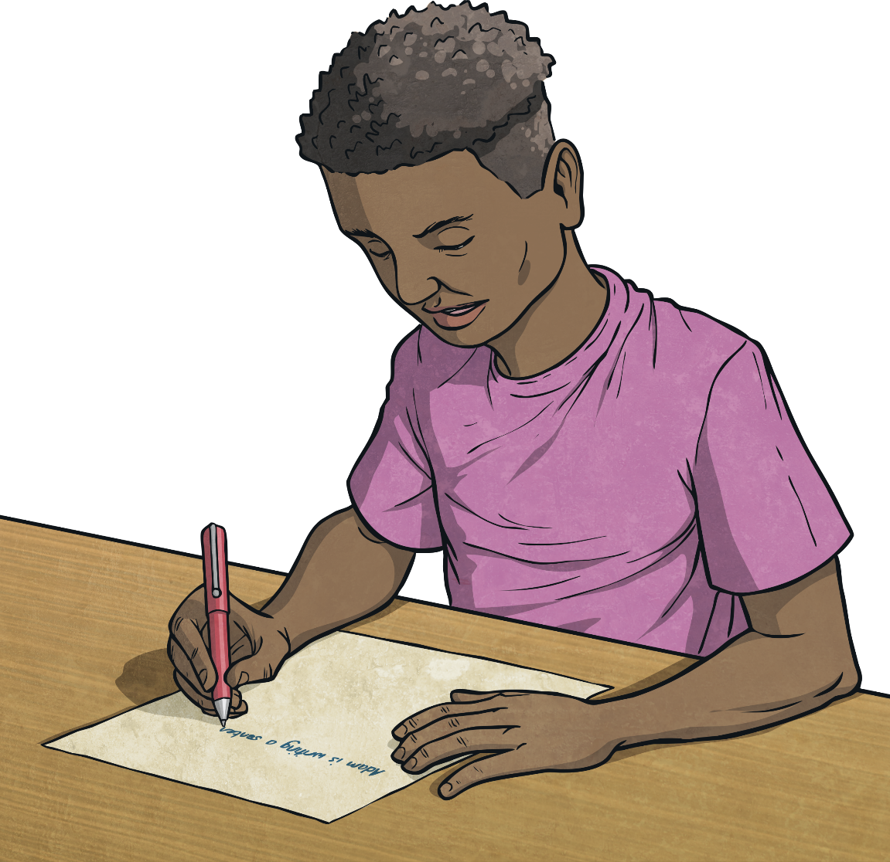
Independent Focused Activity

Slide 16
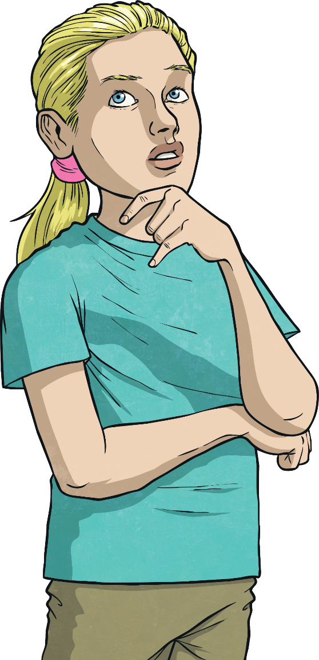
The Dramatic Dash
The dash is a punctuation mark which can be used when you want to emphasise additional information.
Example
We have already learnt about using a dash in pairs to surround additional information that we want to emphasise.
It was a long wait – perhaps the longest of his life.
Whereas brackets must always be used in pairs, only one dash is required if the parenthesis comes at the end of a sentence. A dash found by itself can be used to separate something dramatic (and usually contrasting) at the end of a sentence from the start of the sentence.
The sentence would still make sense without the part after the dash.
There should be a space before and after the dash.
This information creates a surprise at the end of the sentence.
The idea is to shock or surprise the reader at the very end of the sentence.

Slide 17
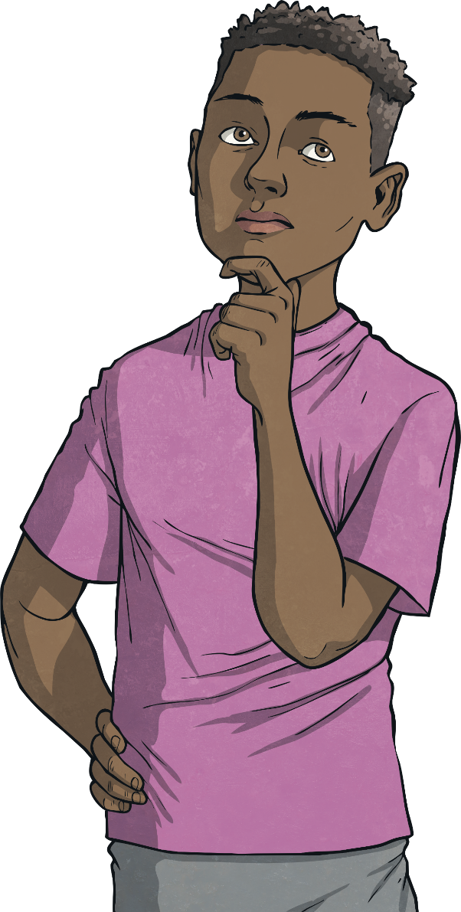
The Difference Between Dashes,
Brackets and Paired Commas
Think about these three sentences:
How do you know whether to use brackets, dashes or paired commas?
Miss Moneypenny (who had travelled from America to England to see James) said the mission was a huge success.
Miss Moneypenny, who had travelled from America to England to see James, said the mission was a huge success.
Miss Moneypenny – who had travelled from America to England to see James – said the mission was a huge success.
What is the difference between the three?

