Slide 1


Science
Electricity
Year One
Science | Year 4 | Electricity | Electrical Circuits | Lesson 3

Slide 2
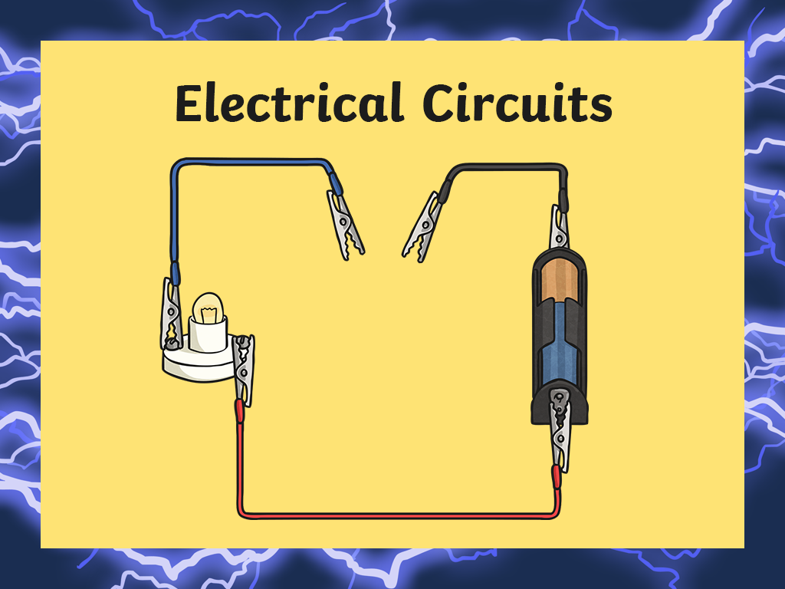


Slide 3
Aim
I can make predictions about complete and incomplete circuits.
Success Criteria
I can label an electric circuit.
I can identify what makes a circuit complete.
I can identify complete and incomplete circuits.

Slide 4
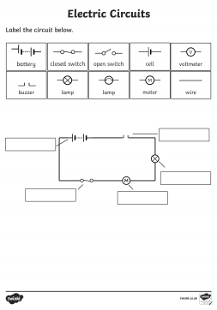
Task 1 - Label the electric circuit.
Task Instructions:
On your activity sheet, you will see symbols used to label an electric circuit.
You will need to use these to label the circuit below.
Check your work with the answers on the second page .

Slide 5

Electricity
Discuss the following questions about electricity with a partner if you can. Click each answer box to reveal the answers!
Can you give an example of how electricity is found naturally?
Lightning, static electricity and bioelectricity.
What is 'current electricity'?
The flow of electrical charge through a material.
Mains electricity is one type of electrical current. Can you name another type?
Battery powered electricity.
Can you name a non-renewable method of generating electricity?
Burning fossil fuels such as coal, oil or natural gas.

Slide 6
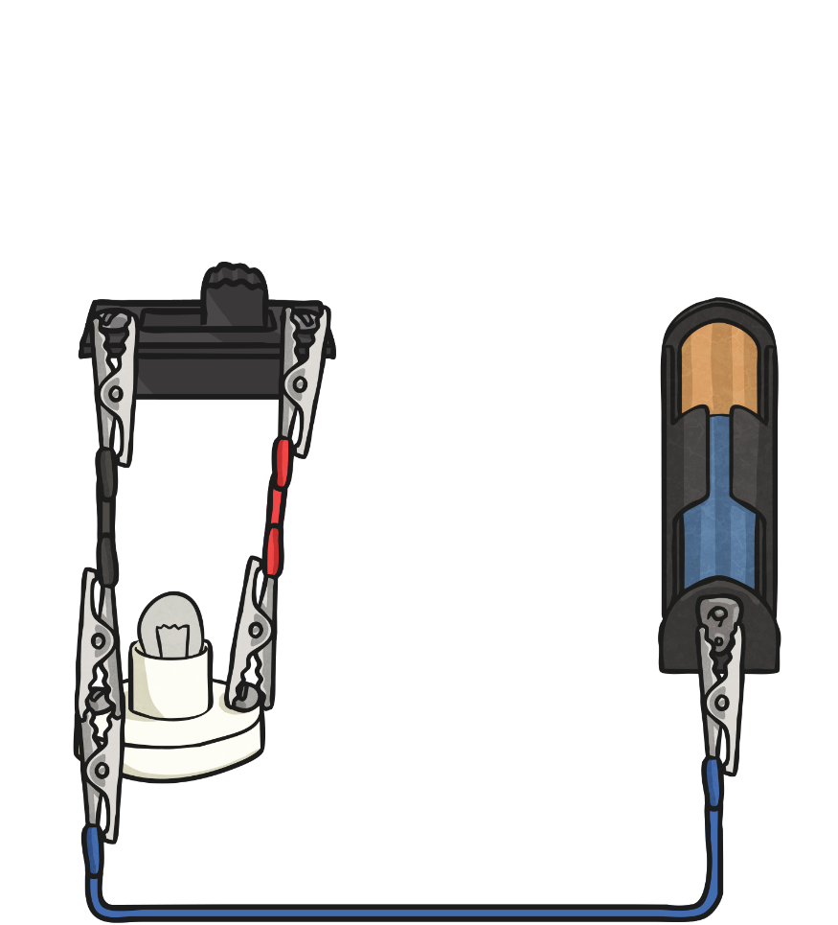
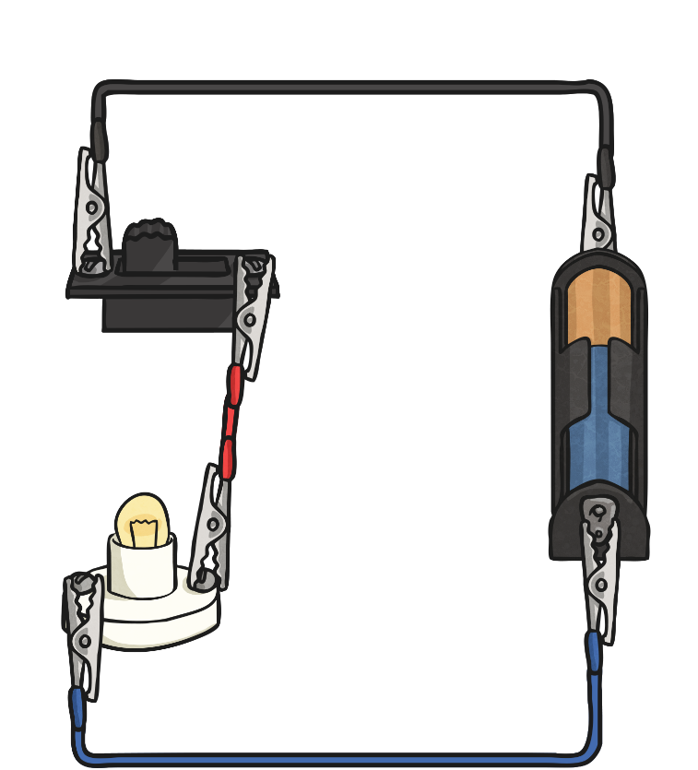
Complete and Incomplete Circuits
An electrical circuit can be complete or incomplete.
Incomplete Circuit
Complete Circuit

Slide 7
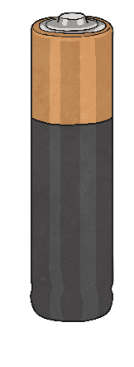
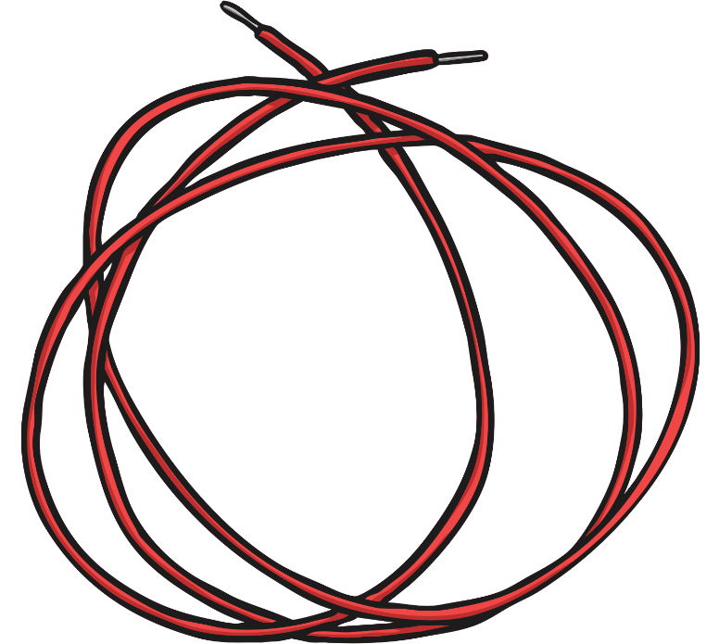
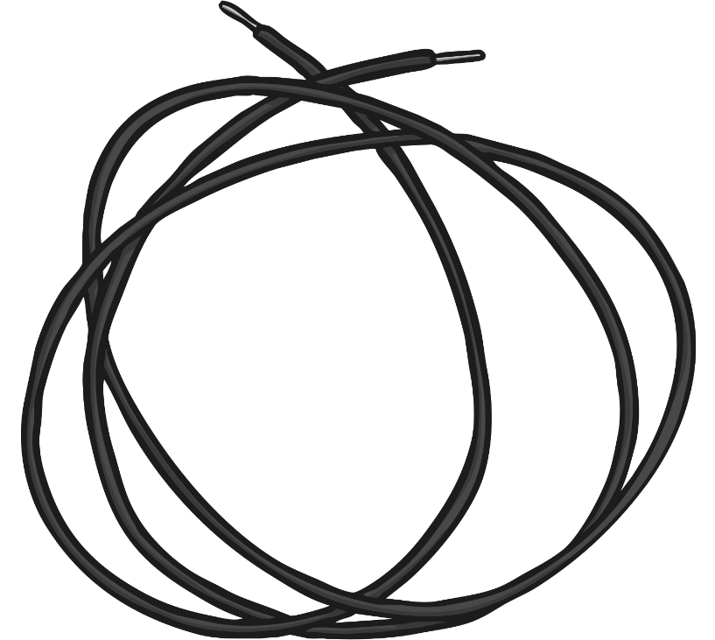
Complete and Incomplete Circuits
Current electricity is the flow of electrical charge though materials.
Every complete circuit must have a power supply. The power supply could be the mains, or it could be a battery.
For a circuit to be complete, there must be wires connected to both the positive and negative ends of the power supply.
Electricity can only flow around a complete circuit that has no gaps.

Slide 8
Complete and Incomplete Circuits
Incomplete Circuit
This circuit is incomplete.
There is a gap in the circuit, so the electrical current cannot flow around it.
The wires do not connect to the positive and negative ends of the power supply (the battery).

Slide 9
Complete and Incomplete Circuits
Complete Circuit
This is a complete circuit.
There is a power supply (the battery).
There are no gaps anywhere, so the electrical current can flow around the entire circuit.
The wires connect to both the positive and negative ends of the battery.

Slide 10

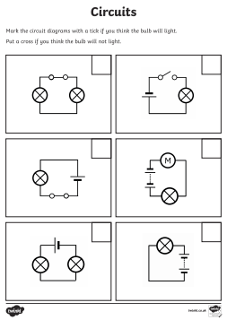
Task 2 - Complete or
Incomplete Circuit?
Task Instructions:
On your activity sheet, you will see pictures of circuits.
Do you think the circuit will be complete or incomplete? If it is complete, it will light up.
Put a tick in the box next to the circuit if you think it will light up or put a cross if you think it will not light up.
Check your work with the answers page.

Slide 11

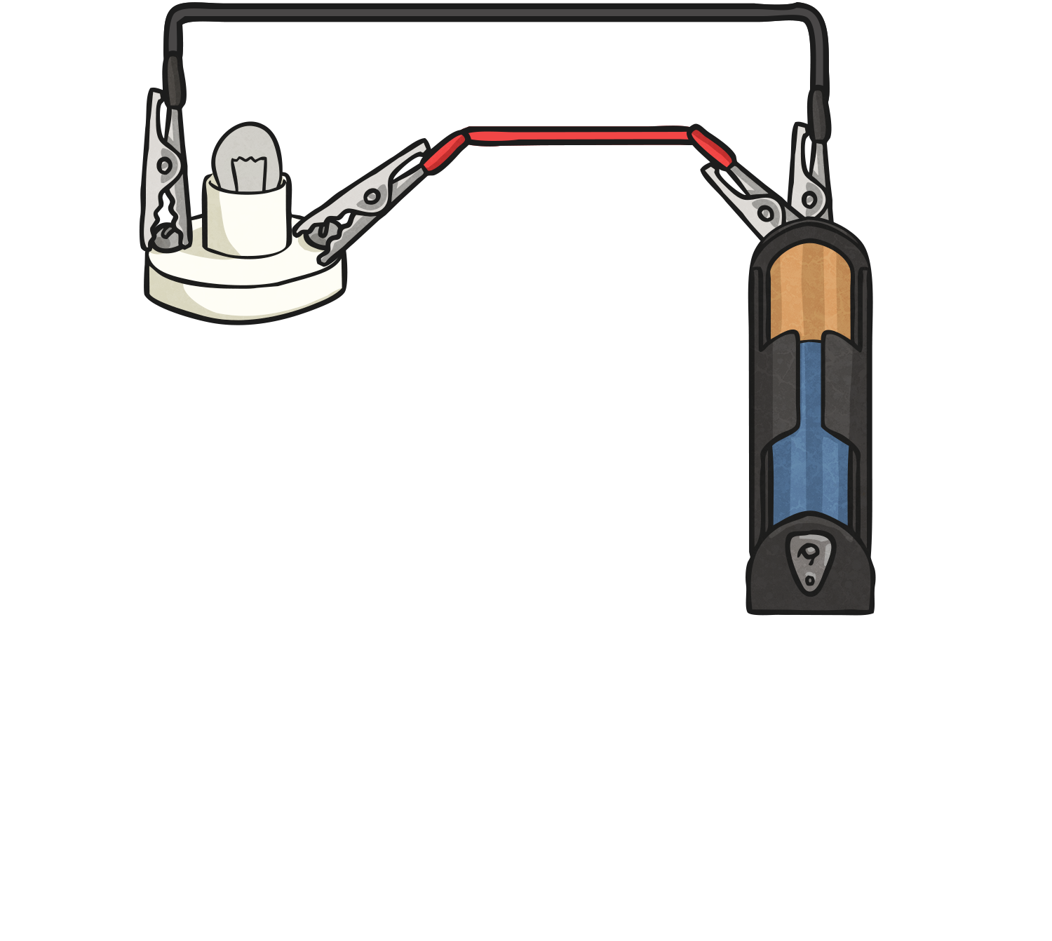
Complete or Incomplete?

Slide 12
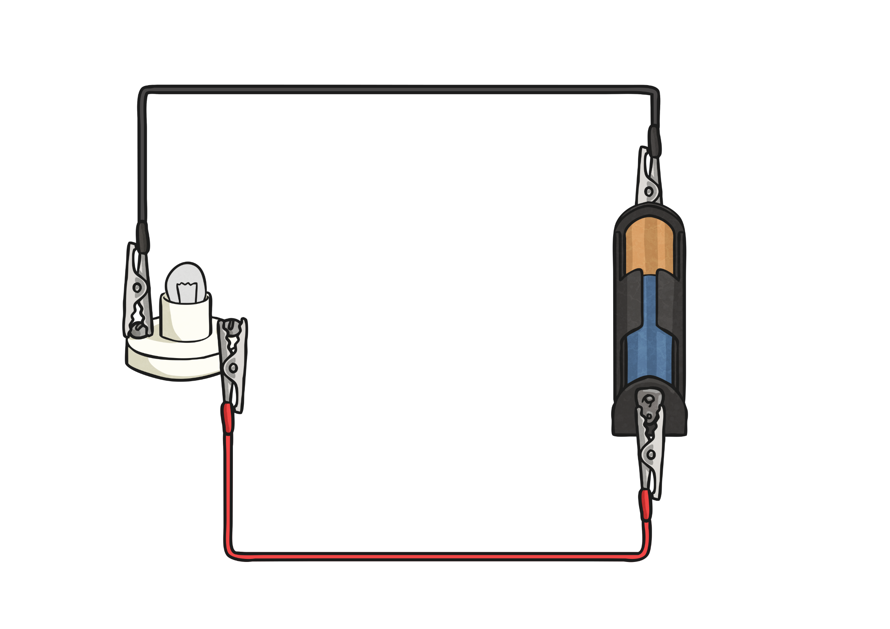
Complete or Incomplete?

Slide 13
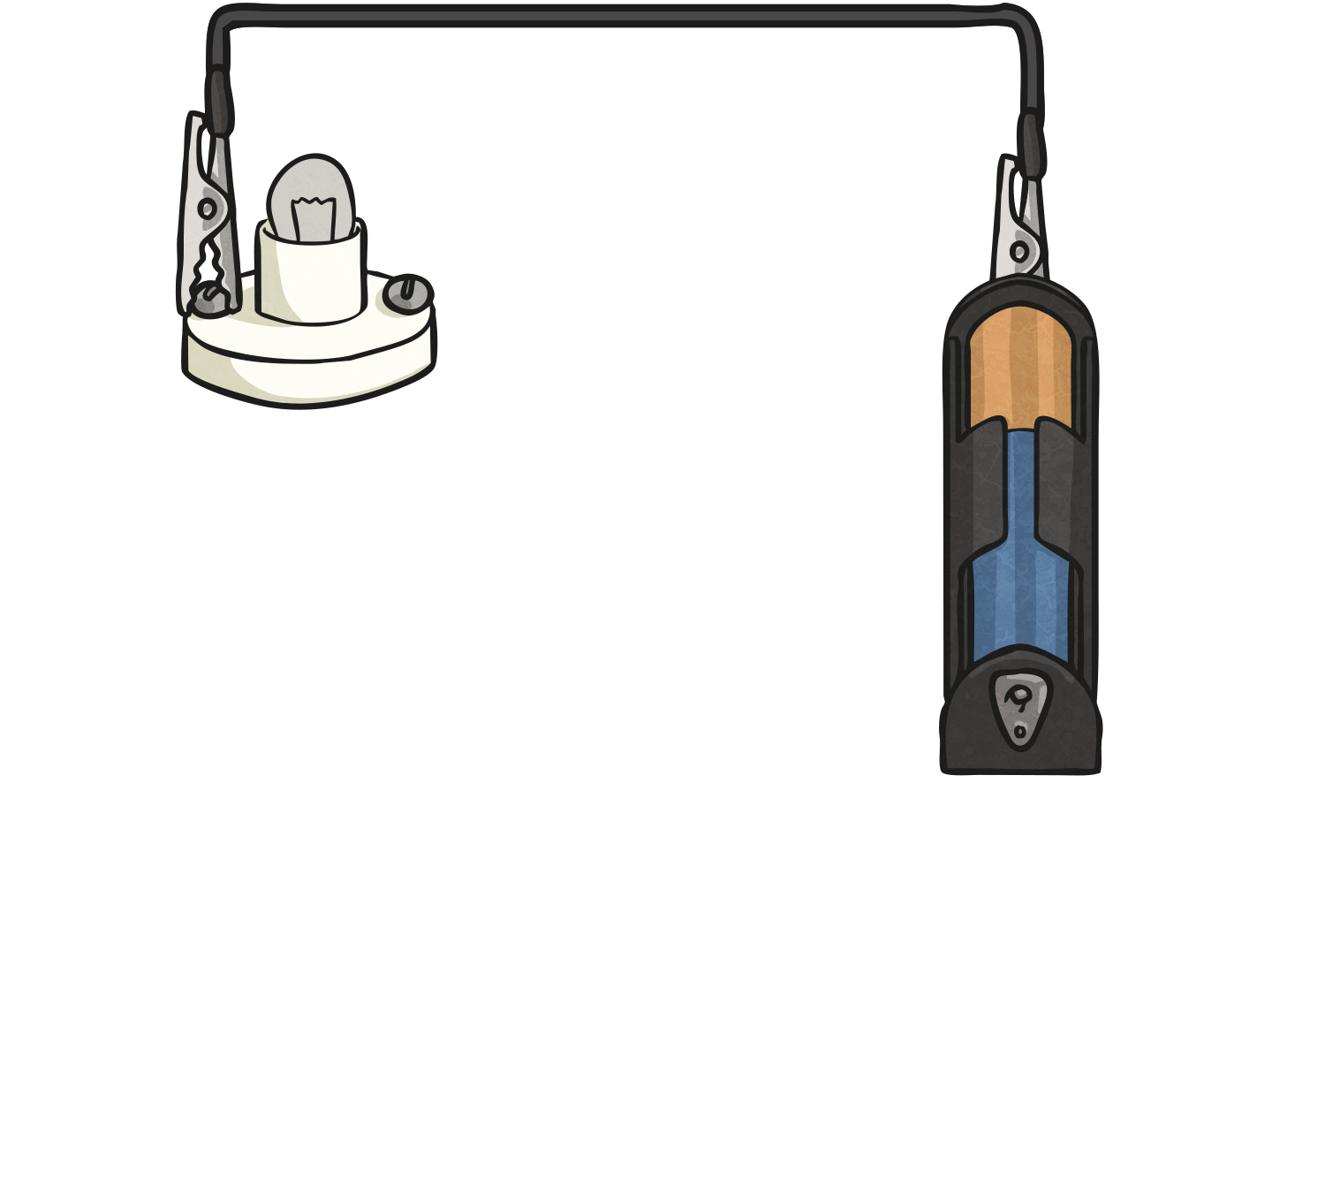
Complete or Incomplete?

Slide 14
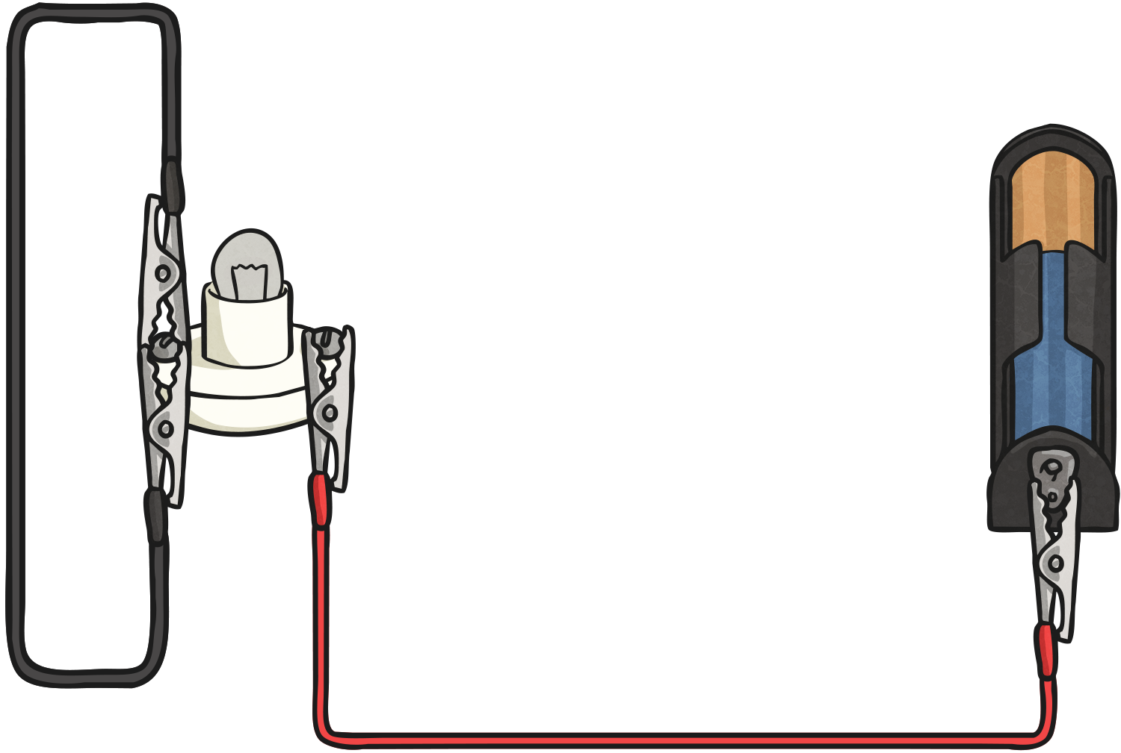
Complete or Incomplete?

Slide 15
Aim
I can make predictions about complete and incomplete circuits.
Success Criteria
I can label an electric circuit.
I can identify what makes a circuit complete.
I can identify complete and incomplete circuits.

Slide 16
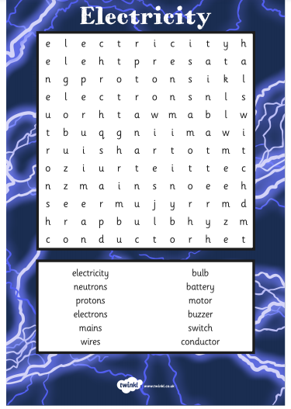
Task 3 - Complete the word search.
Task Instructions:
Find the words in the word search and draw a straight line through them.
Check your work with the answers page underneath.

