Slide 1
9 TIMES-TABLE AND DIVISION FACTS

Slide 3


1) How many grapes?
9 $×$ 2 ones $=$
9 $×$ 2 tens $=$
9 $×$ 2 hundreds $=$
9 $×$ 2 $=$
9 $×$ 20 $=$
9 $×$ 200 $=$
4) 210 $−$ 21 $=$

Slide 4



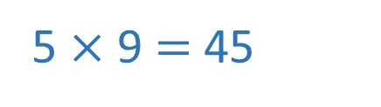
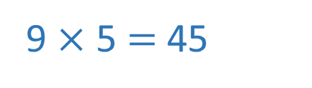
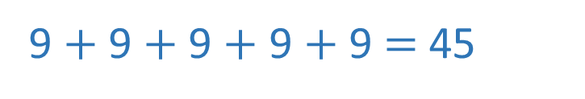
1) How many grapes?
9 $×$ 2 ones $=$
9 $×$ 2 tens $=$
9 $×$ 2 hundreds $=$
9 $×$ 2 $=$
9 $×$ 20 $=$
9 $×$ 200 $=$
4) 210 $−$ 21 $=$
9 $+$ 9 $+$ 9 $+$ 9 $+$ 9 $=$ 45
9 $×$ 5 $=$ 45
5 $×$ 9 $=$ 45
18 ones
18 tens
18 hundreds
18
180
1,800
189

Slide 6



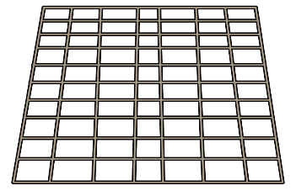



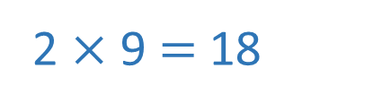
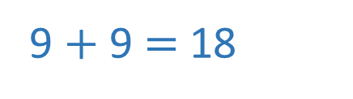
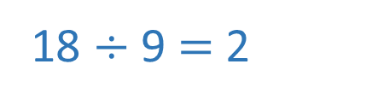
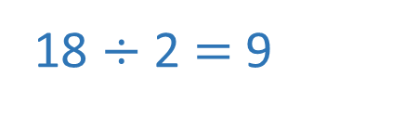
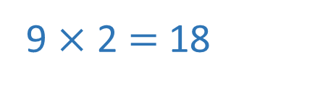
9 $+$ 9 $=$ 18
2 $×$ 9 $=$ 18
9 $×$ 2 $=$ 18
18 $÷$ 9 $=$ 2
18 $÷$ 2 $=$ 9

Slide 7





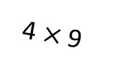



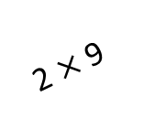



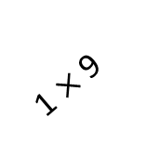



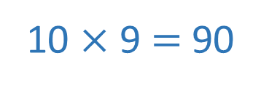
Tens Ones
9
8
7
0
6
1
2
3
0 $×$ 9 $=$ 0
Tens
Ones
Ones
Ones
1 $×$ 9 $=$ 9
Tens
Tens
3 $×$ 9
2 $×$ 9
4 $×$ 9
2 $×$ 9 $=$ 18
Ones
3 $×$ 9 $=$ 27
Tens
1 $×$ 9
4 $×$ 9 $=$ 36
5 $×$ 9 $=$ 45
6 $×$ 9 $=$ 54
7 $×$ 9 $=$ 63
8 $×$ 9 $=$ 72
9 $×$ 9 $=$ 81
Have a think
10 $×$ 9 $=$ 90

Slide 8

9
18
27
36
45
54
63
72
81
90
99
108
9
18
27
36
45
54
63
72
81
90
99
108

Slide 9
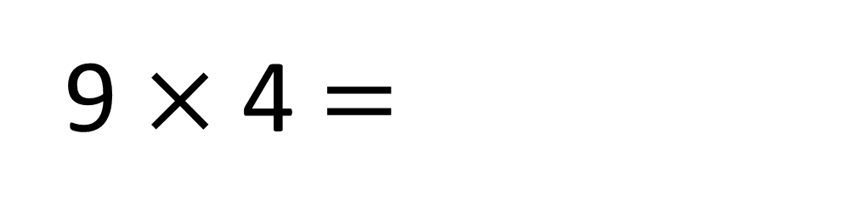
45
90
9 $×$ 4 $=$
36

Slide 10
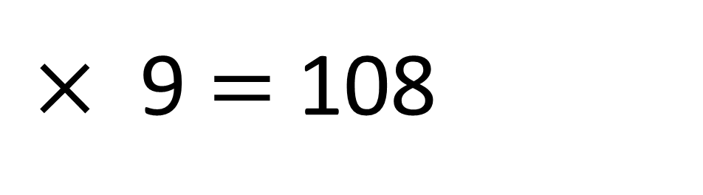
45
90
12
$×$ 9 $=$ 108

Slide 11

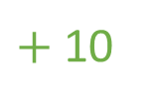
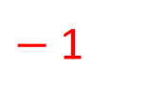



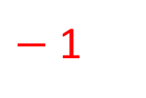
$+$ 10
9
18
27
36
45
54
63
72
81
90
99
108
19
Have a think
9 | 18 | 27 | 36 | 45 | 54 | 63 | 72 | 81 | 90 | 99 | 108
$−$ 1
$+$ 10
What patterns do you notice?
46
$−$ 1
So to find the next multiple of 9 I can add 10 and subtract 1
Ones decrease by 1
Tens increase by 1
Is this always the case?
Why is this the case?
$+$ 10
109
$−$ 1

Slide 12
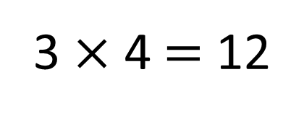
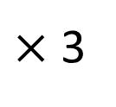
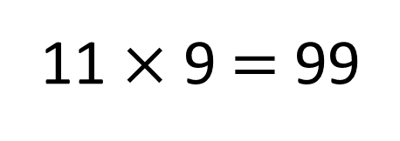
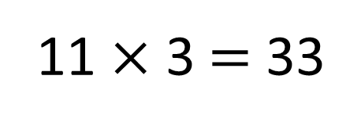
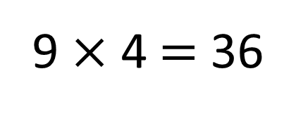
3 | 6 | 9 | 12 | 15 | 18 | 21 | 24 | 27 | 30 | 33 | 36
$×$ 3
9 | 18 | 27 | 36 | 45 | 54 | 63 | 72 | 81 | 90 | 99 | 108
3 × 4 $=$ 12
So if I know my 3 times-table I can multiply that by 3
11 × 3 $=$ 33
9 × 4 $=$ 36
11 × 9 $=$ 99

Slide 13
























$×$1
$×$2
$×$3
$×$4
$×$5
$×$6
$×$7
$×$8
$×$9
$×$10
$×$11
$×$12
10 | 20 | 30 | 40 | 50 | 60 | 70 | 80 | 90 | 100 | 110 | 120
$−$1
$−$2
$−$3
$−$4
$−$5
$−$6
$−$7
$−$8
$−$9
$−$10
$−$11
$−$12
9 | 18 | 27 | 36 | 45 | 54 | 63 | 72 | 81 | 90 | 99 | 108
So I can multiply
by 10 and then subtract 1 lot
What do you notice?
Have a think

Slide 14

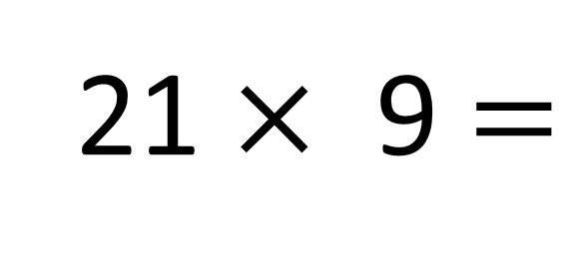

I know that 21 $×$ 10 $=$ 210
210 $−$ 21 $=$ 189
Using what you know about multiplying by 9, how could you solve this?
Have a think
21 $×$ 9 $=$
21
9
10

Slide 15

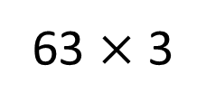
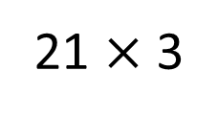
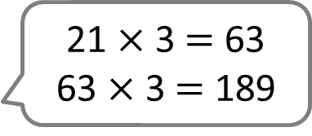
I know that 21 $×$ 10 $=$ 210
210 $−$ 21 $=$ 189
21 $×$ 3 $=$ 63
63 $×$ 3 $=$ 189
21 $×$ 9 $=$
21
21 $×$ 3
9
63 $×$ 3

Slide 16

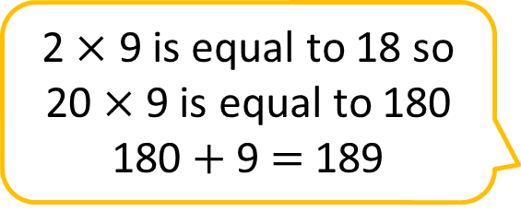
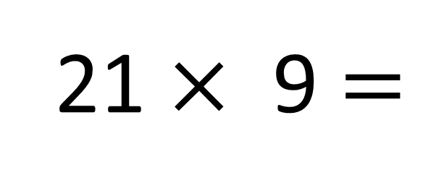
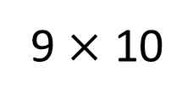
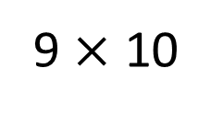
I know that 21 $×$ 10 $=$ 210
210 $−$ 21 $=$ 189
2 $×$ 9 is equal to 18 so 20 $×$ 9 is equal to 180
180 $+$ 9 $=$ 189
21 $×$ 3 $=$ 63
63 $×$ 3 $=$ 189
21 $×$ 9 $=$
189
21
9
9 $×$ 10
9 $×$ 10

Slide 17
Have a go at the questions on the worksheet

