Slide 1


Slide 3


1) How many fish?
2) 6 $×$ 4 $=$ 4 $×$
3) 30 $+$ 6 $=$ 30 $−$ 6 $=$
4) Complete the number track.
3 | 6 |  | 12 |  | 18 | 21 |  |  | 30 |  | 36

Slide 4


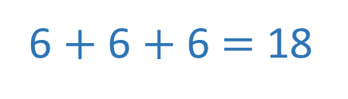
1) How many fish?
2) 6 $×$ 4 $=$ 4 $×$
3) 30 $+$ 6 $=$ 30 $−$ 6 $=$
4) Complete the number track.
6 $+$ 6 $+$ 6 $=$ 18
3 $×$ 6 $=$ 18
6 $×$ 3 $=$ 18
6
36
24
3 | 6 |  | 12 |  | 18 | 21 |  |  | 30 |  | 36
9
15
24
27
33

Slide 6
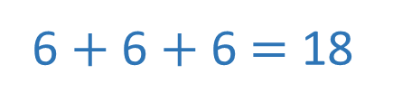




6 $+$ 6 $+$ 6 $=$ 18
3 $×$ 6 $=$ 18
6 $×$ 3 $=$ 18
18 $÷$ 6 $=$ 3
18 $÷$ 3 $=$ 6

Slide 7
Have a go at questions
1 – 2 on the worksheet

Slide 8

6
12
18
24
30
36
42
48
54
60
66
72
6
12
18
24
30
36
42
48
54
60
66
72

Slide 9
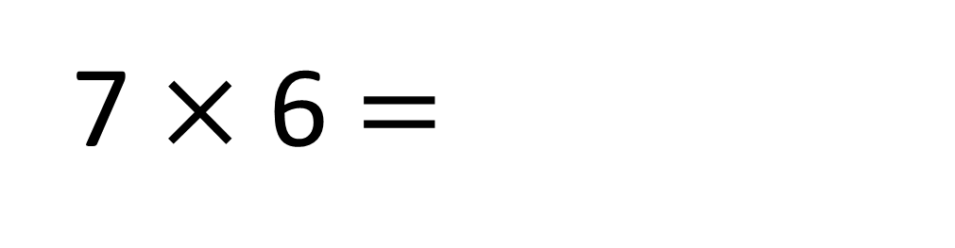
30
60
7 $×$ 6 $=$
42

Slide 10
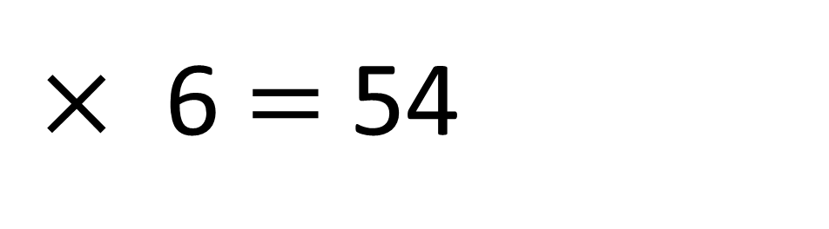
30
60
9
$×$ 6 $=$ 54

Slide 11
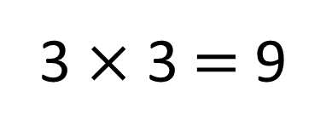
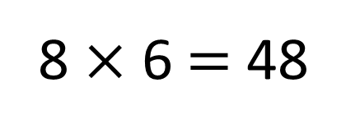
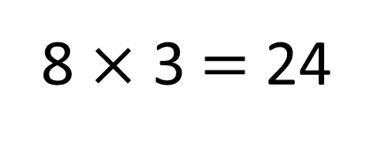
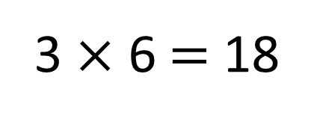
3 | 6 | 9 | 12 | 15 | 18 | 21 | 24 | 27 | 30 | 33 | 36
6 | 12 | 18 | 24 | 30 | 36 | 42 | 48 | 54 | 60 | 66 | 72
3 × 3 $=$ 9
8 × 3 $=$ 24
3 × 6 $=$ 18
8 × 6 $=$ 48

Slide 12
Have a go at questions
3 – 4 on the worksheet

Slide 13


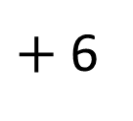
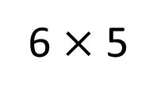
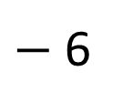
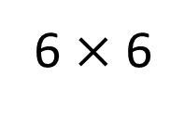
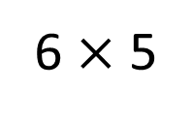
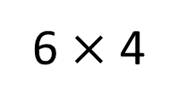
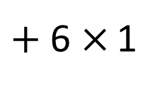
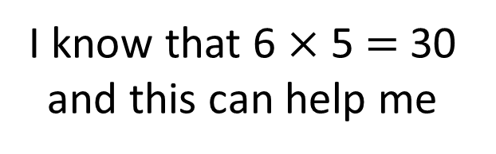
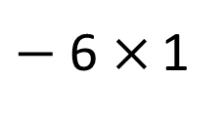
6 $×$ 4 $=$
24
6 $×$ 6 $=$
36
I know that 6 $×$ 5 $=$ 30 and this can help me
Have a think
6 $×$ 5
$+$ 6 $×$ 1
$−$ 6 $×$ 1
$−$ 6
$+$ 6
24
30
36
6 $×$ 4
6 $×$ 5
6 $×$ 6

Slide 14



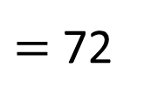
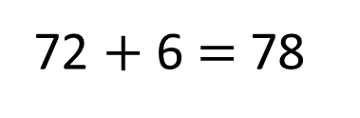
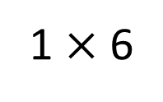
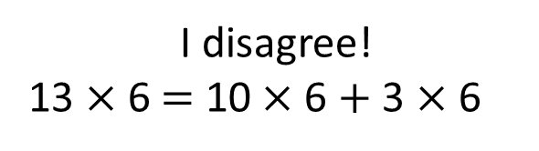
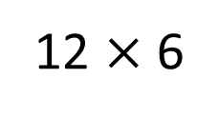
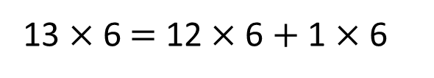
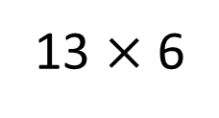
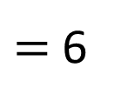
I disagree!
13 $×$ 6 $=$ 10 $×$ 6 $+$ 3 $×$ 6
13 $×$ 6 $=$
78
13 $×$ 6 $=$ 12 $×$ 6 $+$ 1 $×$ 6
13 $×$ 6
Have a think
72 $+$ 6 $=$ 78
12 $×$ 6
$=$ 72
1 $×$ 6
$=$ 6

Slide 15
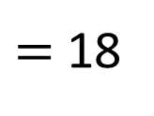
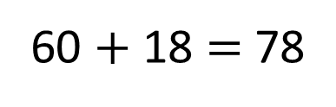
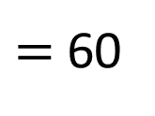
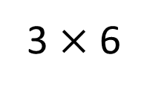
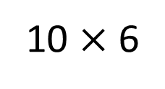
I disagree!
13 $×$ 6 $=$ 10 $×$ 6 $+$ 3 $×$ 6
13 $×$ 6 $=$
78
13 $×$ 6 $=$ 12 $×$ 6 $+$ 1 $×$ 6
13 $×$ 6
60 $+$ 18 $=$ 78
10 $×$ 6
$=$ 60
3 $×$ 6
$=$ 18

Slide 16

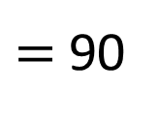
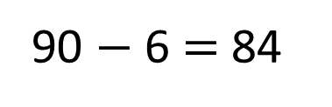
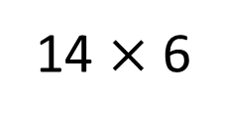
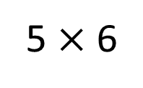
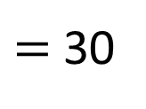
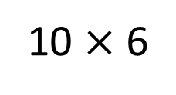
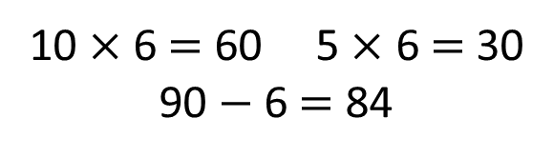
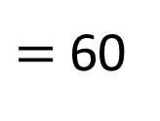
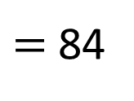
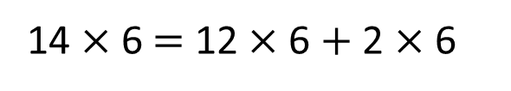
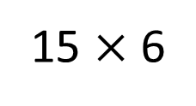
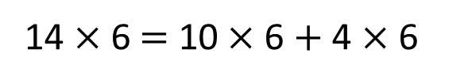
14 $×$ 6 $=$
84
14 $×$ 6 $=$ 10 $×$ 6 $+$ 4 $×$ 6
14 $×$ 6 $=$ 12 $×$ 6 $+$ 2 $×$ 6
10 $×$ 6 $=$ 60 5 $×$ 6 $=$ 30
90 $−$ 6 $=$ 84
15 $×$ 6
$=$ 90
Can you use counters to prove these different methods are correct?
90 $−$ 6 $=$ 84
Have a think
10 $×$ 6
$=$ 60
14 $×$ 6
$=$ 84
5 $×$ 6
$=$ 30

Slide 17
Have a go at the rest of the worksheet

