Slide 1


Slide 2
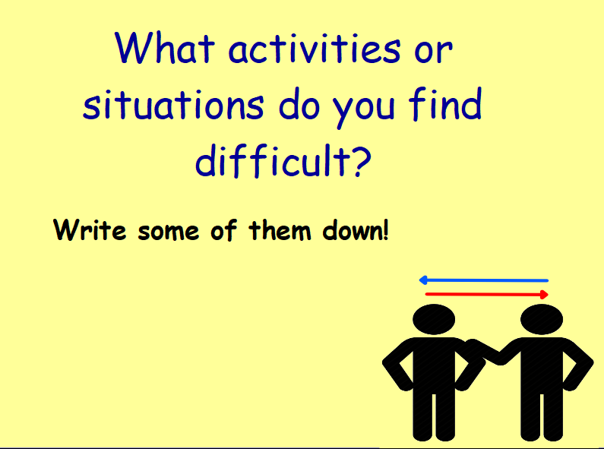
Examples:
Maths
Running
Making new friends

Slide 3
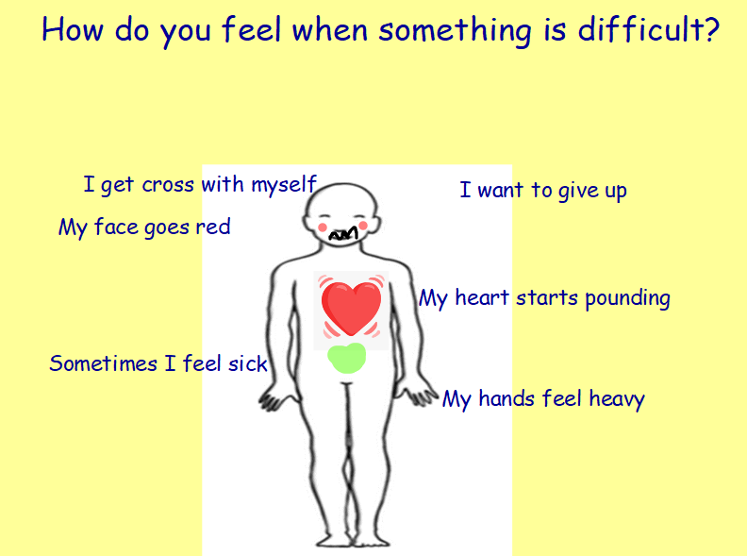

Slide 4


Slide 5
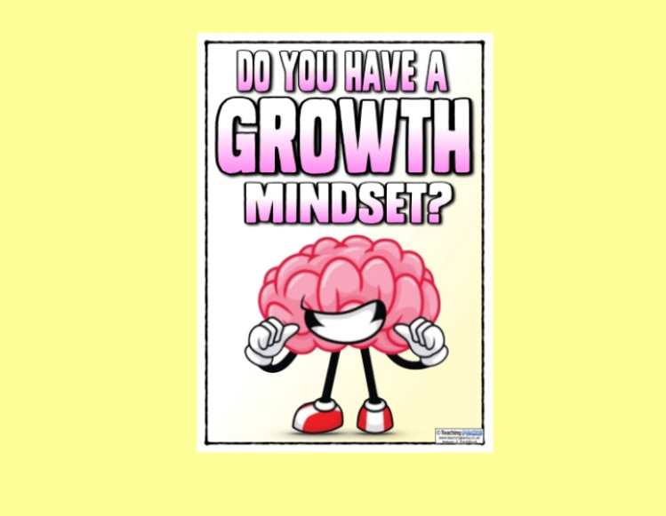

Slide 6
Growth mind-set vs fixed mind-set
https://www.bbc.co.uk/teach/class-clips-video/pshe-ks2-growth-mindset-how-your-mindset-can-affect-approach-to-challenges/zrjwf4j
https://www.bbc.co.uk/teach/class-clips-video/pshe-ks2-growth-mindset-how-to-develop-a-positive-mindset/z6gb2sg

Slide 7
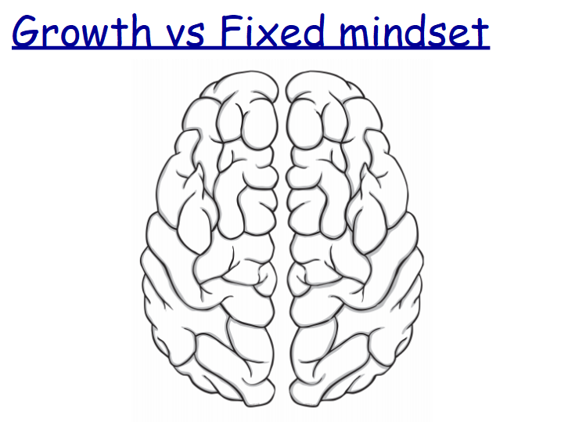
On your sheet, use pencil/black pen to write on the left hand side fixed mind - set thoughts and then use colourful crayons on the right hand side to show growth mind – set thoughts!
I can`t do this
I can do this

Slide 8
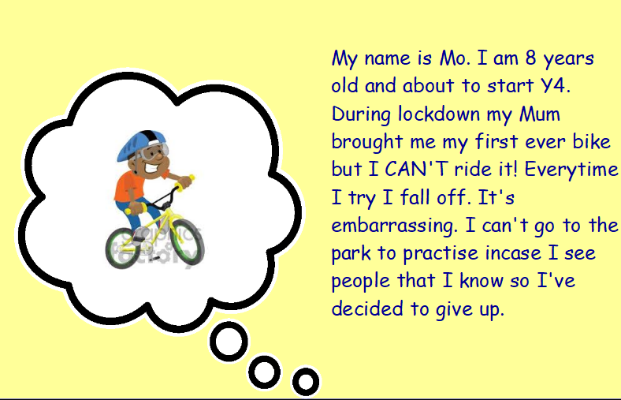
What advice
would you give Mo?
Write it down ☺

