Slide 1
Date: L.O.: To write sentences with relative clauses.

Slide 2
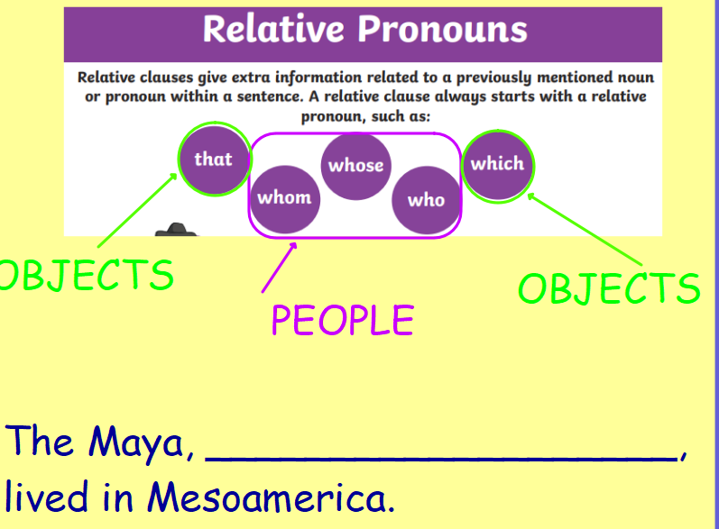

Slide 3
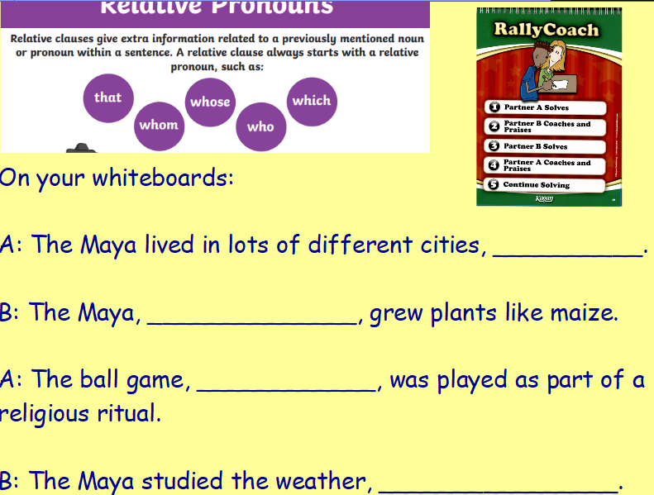

Slide 4
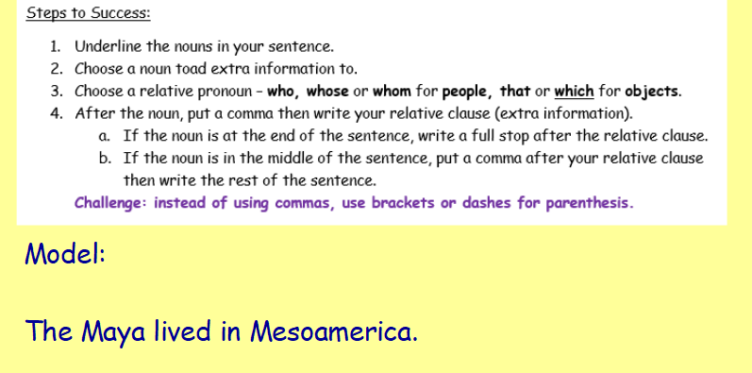

Slide 5
