Slide 1
L.O.: To sort information into paragraphs.

Slide 2
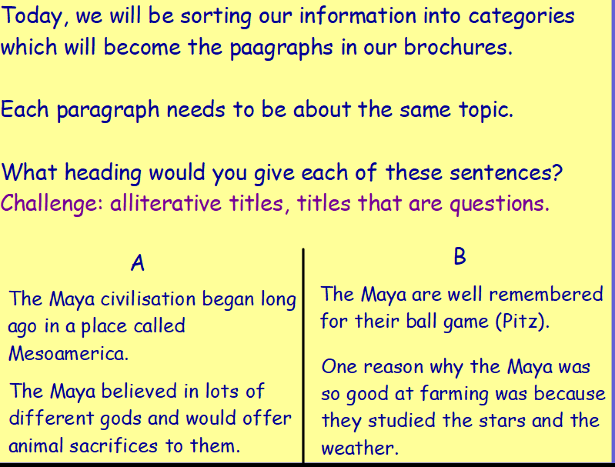

Slide 3
