Slide 1
L.O.: To research facts about the Ancient Maya.

Slide 2
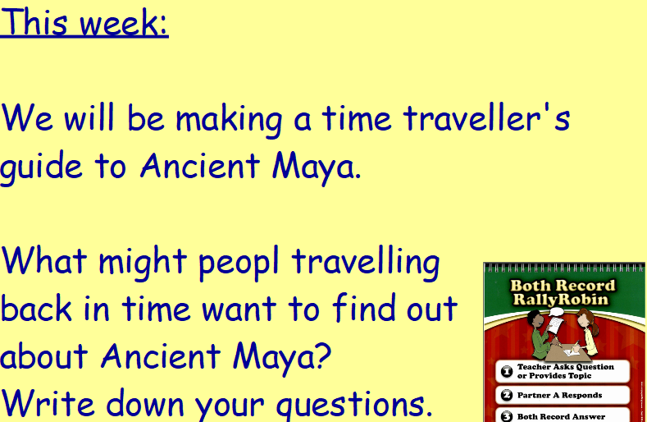

Slide 3
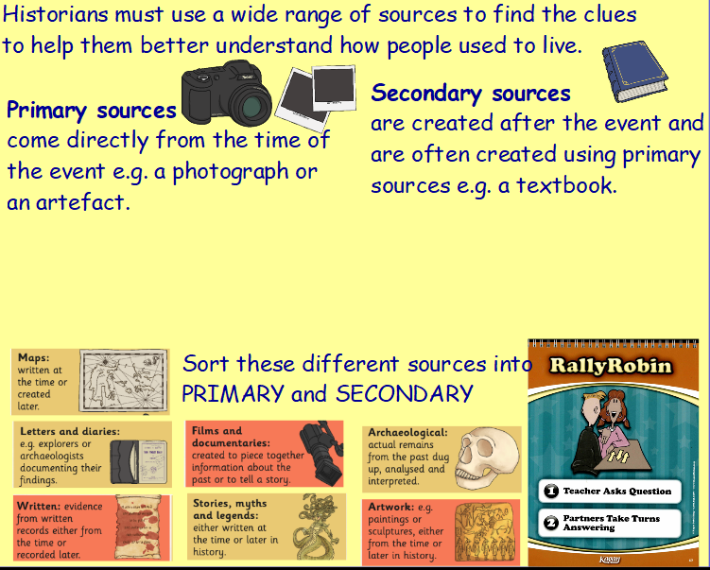

Slide 4
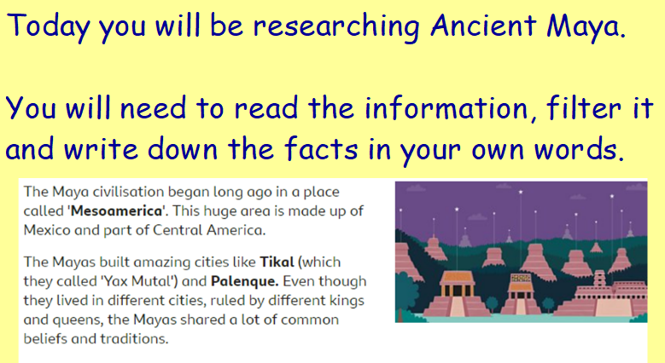

Slide 5
