Slide 1
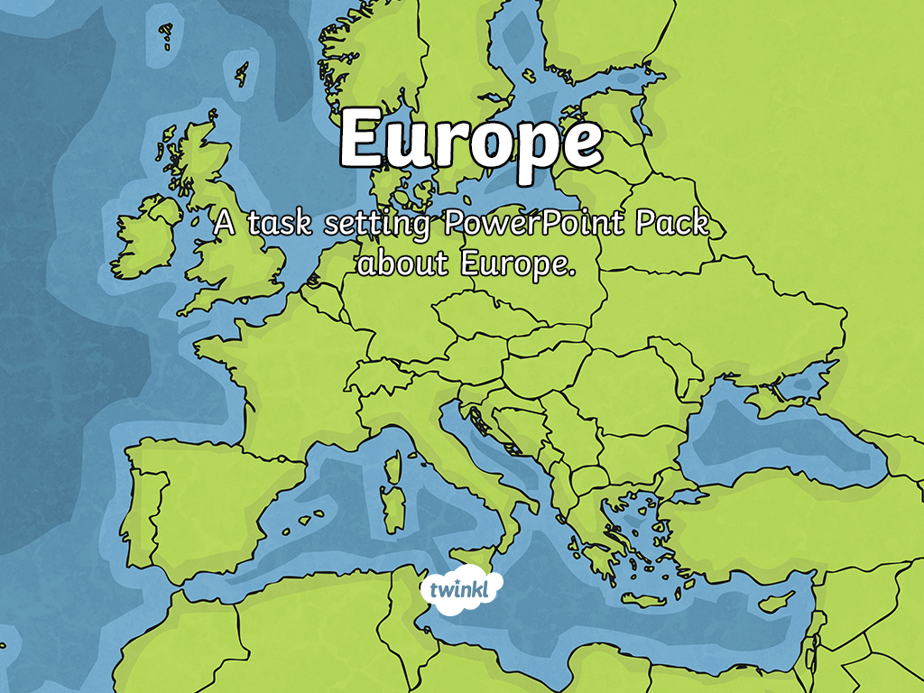

Slide 2
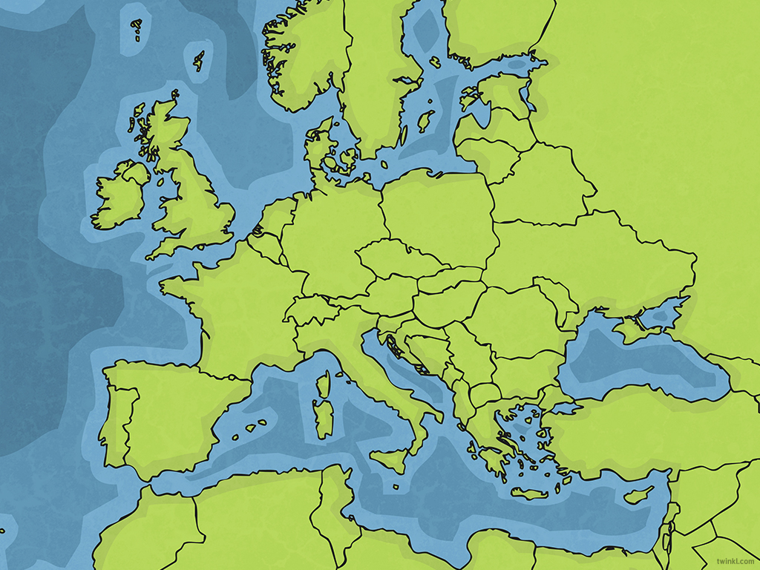
LO: To use a map to find countries and major cities in Europe (and Russia), exploring their human and physical characteristics.
Success Criteria
I can locate Europe and the countries and capital cities within it, using a map.
I know about Europe’s human characteristics – population, currency, capital cities.
I know about physical features of Europe – climate, mountain ranges, rivers.

Slide 3
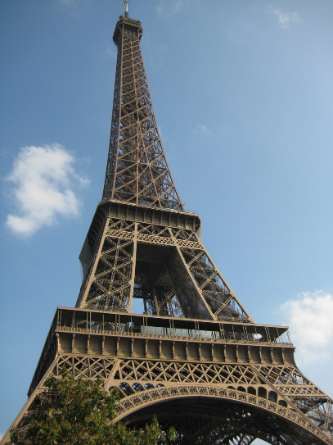
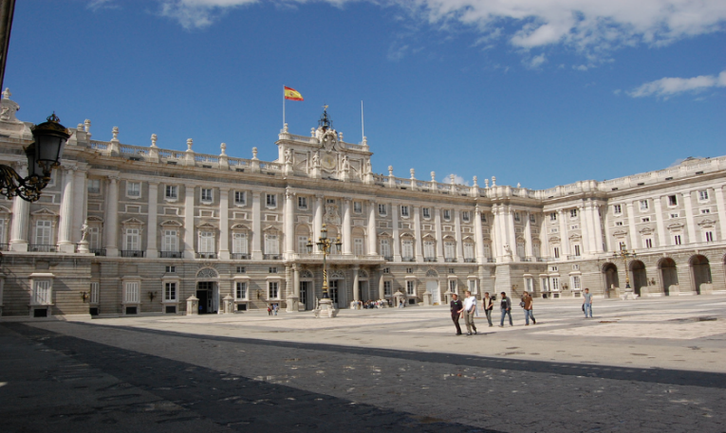
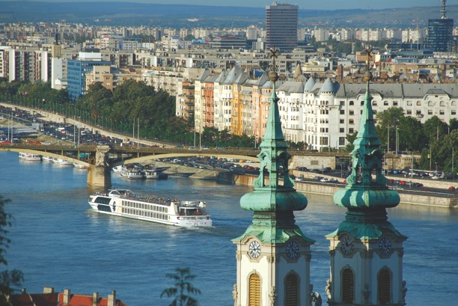
What do you already know?
In which European country would you find these famous landmarks?
Photo courtesy of Terrazzo, longplay, and S. Sosnovskiy, (@flickr.com) - granted under creative commons licence - attribution

Slide 4
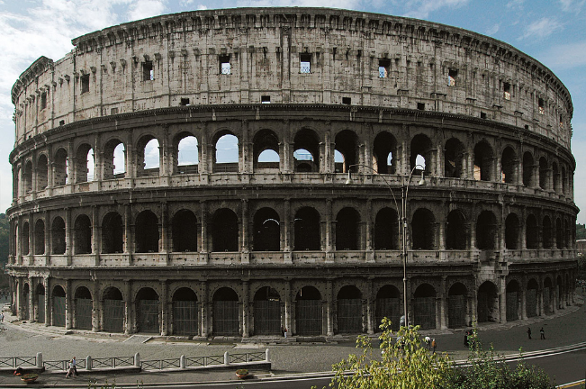
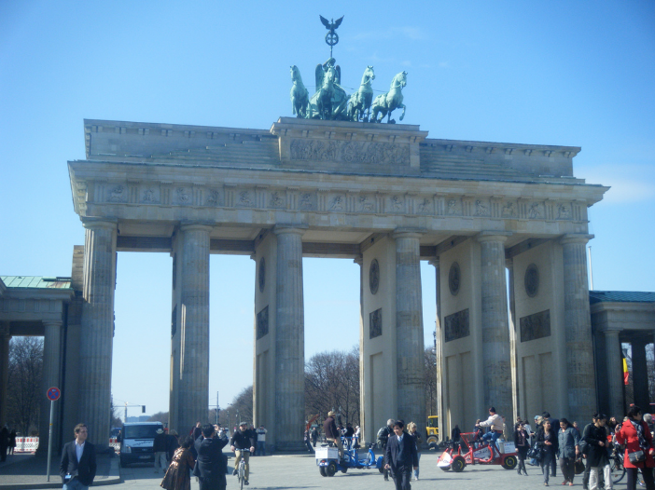
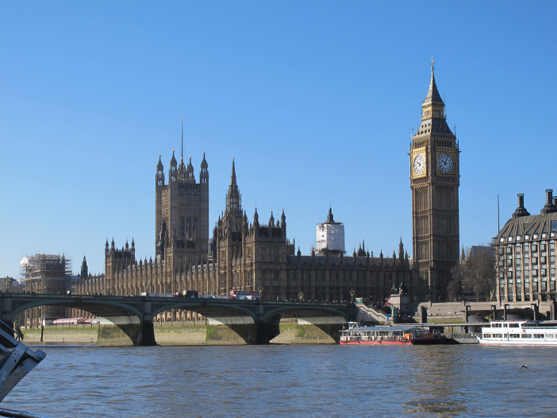
What do you already know?
In which European country would you find these famous landmarks?
Photo courtesy of Creative Kat, Aviation and Nature and Tauck Tours (@flickr.com) - granted under creative commons licence - attribution

Slide 5
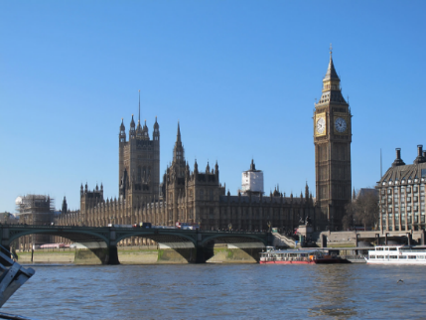

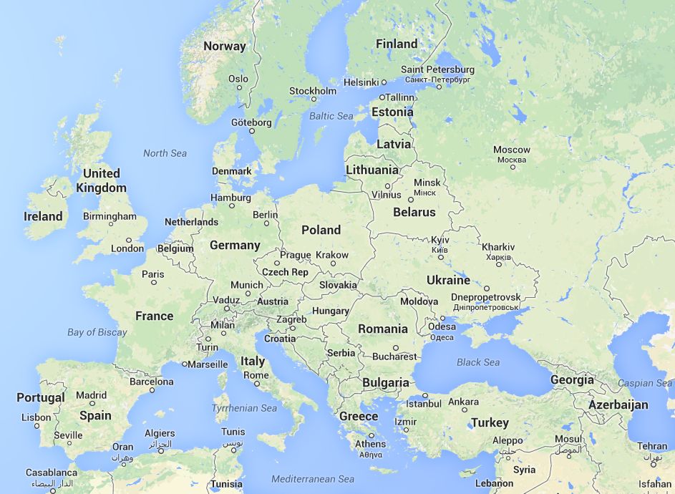
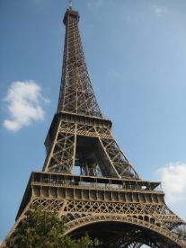

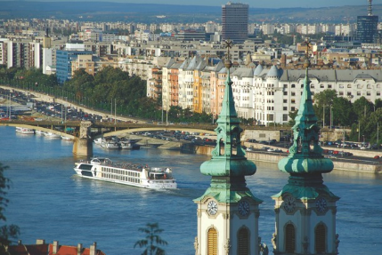

European Landmarks
Houses of Parliament, London
Eiffel Tower, Paris
Brandenburg Gate, Berlin
Royal Palace, Madrid
River Danube, Hungary
Colosseum, Rome
Source: Google Maps data 2014 Basaroft,
google, ORION-ME
Photo courtesy of Terrazzo, longplay, S. Sosnovskiy, Creative Kat, Aviation and Nature and Tauck Tours (@flickr.com) –
granted under creative commons licence - attribution

Slide 6
Map of Europe
Now it’s your turn to make a map of Europe.
If a country is too small to write on, make a key and give it a number.
Key:
1 – Belgium
2 - Switzerland
1
2
Source: Google Maps data 2014 Basaroft,
google, ORION-ME
Photo courtesy of Terrazzo, longplay, S. Sosnovskiy, Creative Kat, Aviation and Nature and Tauck Tours (@flickr.com) –
granted under creative commons licence - attribution

Slide 7
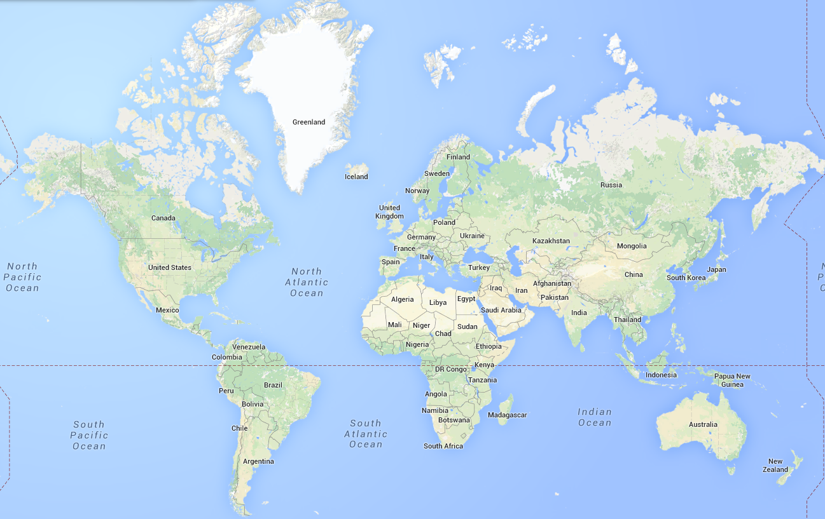
Population and Life Expectancy
The population of Europe was recorded at just over 740 million people in 2016. The average life expectancy of a European is 78.9 years.
Research : How does this compare with another continent?
North
America
Europe
Asia
Africa
South America
Oceania
Source: Google Maps

Slide 8
European Climate
Northern Europe (Denmark, Finland, Iceland, Norway and Sweden) has a temperate climate. Winters are generally cold. However, the further south you go, the milder the winter weather, with average temperatures around 0°C.
In the summer, temperatures don’t usually reach above 26°C
Source: Google Maps data 2014 Basaroft, google, ORION-ME
Central and Eastern Europe (Austria, Bulgaria, the Czech Republic, Estonia, Germany, Hungary, Latvia, Lithuania, Poland, Romania, Slovakia, Slovenia, Switzerland and Ukraine) have temperate, cool summers with temperatures around 25°C and cold,
cloudy, humid winters.

Slide 9
Western Europe (Belgium, Britain, France, the Netherlands, Ireland and Luxembourg) is known for its mild winters, with short bursts of cold towards the east and heavier rainfall in the west. Summers are moderate and become cooler as you move north.
Source: Google Maps data 2014 Basaroft, google, ORION-ME
Southern and Mediterranean European countries (Croatia, Cyprus, southern France, Greece, Italy, Malta, Monaco, Portugal, Spain and Turkey) are bright and sunny during most of the year. The winters are usually mild but the summers are hot and dry with some rain in autumn and spring.
Research – At the moment, which is the hottest/coldest country in Europe?

Slide 10
Major Rivers of Europe
Volga
Vistula
Don
Rhine
Loire
Dnieper
Source: Google Maps data 2014 Basaroft, google, ORION-ME
Rhone
Po
Danube
Tagus
Source: Google Maps data 2014 Basaroft, google, ORION-ME

Slide 11
Major Rivers of Europe
The Volga is the longest river in Europe at 2,294 miles long. It flows through central Russia into the Caspian Sea. It is widely known as the national river of Russia.
River Danube begins in the Black Forest region of Germany and flows across central Europe. It is the second longest river in Europe.
The river finishes in the Black Sea and is 1,771 miles long.
Research - What is the third longest river in Europe?
Source: Google Maps data 2014 Basaroft, google, ORION-ME
Source: Google Maps data 2014 Basaroft, google, ORION-ME

Slide 12
Mountain Ranges of Europe
Pyrenees (491km long) – located in southwestern Europe. The highest point is Aneto.
Alps (1,200km long) – stretches across 8 Alpine countries. The highest point is Mont Blanc.
Carpathians (1,500 km long)– located in Central/Eastern Europe. The highest point is Gerlachovský štít.
Apennines (1,200km long) – located in Italy. The highest point is Corno Grande.
Urals (2,500km long) – runs through western Russia. The highest point is Mount Narodnaya.
Balkan Mountains (560km long) – stretches through central Bulgaria. The highest point is Botev Peak.
Which is the largest of these mountain ranges?
Which is the smallest mountain range in Europe?
Your task : Can you use an atlas to locate one of these mountain
ranges then mark it on your blank map of Europe?

Slide 13
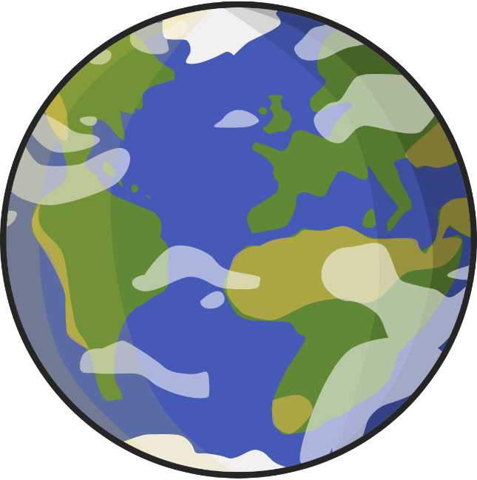
Countries and Capitals Match Up
France
Spain
Switzerland
Italy
Germany
Greece
Rome
Berlin
Athens
Paris
Bern
Madrid

Slide 14
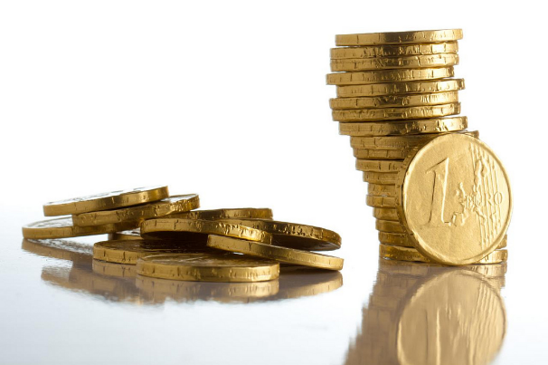
The Euro Debate
The following 19 countries use the Euro as their currency:
Austria, Belgium, Cyprus, Estonia, Finland, France, Germany, Greece,
Ireland, Italy, Latvia, Lithuania, Luxembourg, Malta, The Netherlands, Portugal,
Slovakia, Slovenia and Spain.
€
Your task: Using the map of Europe, colour in the countries which use the Euro.
Make a key at the side of your map.
*Challenge: Do you think Britain should use the Euro?
Why?
Photo courtesy of TranceDrumer (@flickr.com) - granted under creative commons licence - attribution

Slide 15
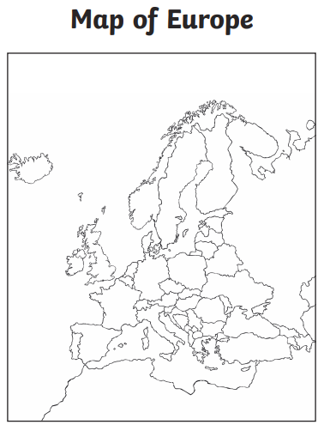
Key
Countries who use the Euro
Photo courtesy of TranceDrumer (@flickr.com) - granted under creative commons licence - attribution

Slide 16
What have you learned?
1. Which countries share a border with Italy?
2. Name 1 mountain range in Europe.
3. Which ocean touches Portugal and Ireland?
4. Name 3 European countries that use the Euro.

Slide 17
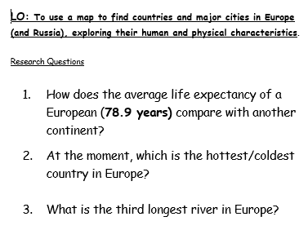
Research Questions
Can you google these questions to find out the answers?

Slide 18


