Slide 2
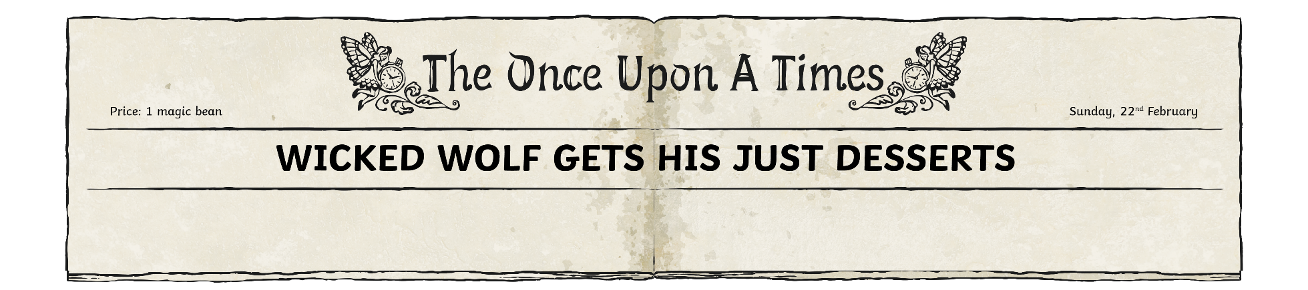
What date was this newspaper printed?
Why do you think no year is written?
What is the name of the newspaper?
Can you point to the headline?
Which word here is spelt wrong and why?

Slide 3

Which characters are mentioned here but were not in the original story?
Yesterday afternoon, a young girl and her grandmother miraculously survived a run-in with a ravenous wolf. Little Red Riding Hood was visiting her grandmother’s cottage in the forest when both were swallowed alive by the creature. However, luck was on their side, as a local woodcutter was on hand to cut them free.
At approximately 1:15 p.m. on 21 February, witnesses claimed that they saw Miss Riding Hood, a young girl aged 10, skip into the forest carrying a basket of cupcakes. The path from the village through the forest is a
well-trodden route, used by everyone from school children to village elders. Local resident Goldilocks (12) of Porridge Drive said, “I’ve used that path hundreds of times and it’s always seemed perfectly safe.” Mr Hansel (35), who runs the village orphanage, commented, “Of course, I warn the children not to approach any gingerbread houses. But avoid the woods entirely? Nonsense.”
Can you find an example
of a relative clause?
What do the numbers in brackets tell you?

Slide 4
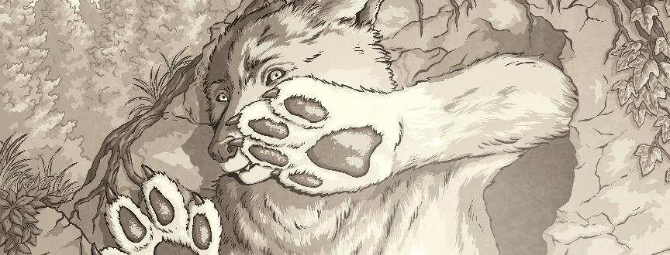
Can you find two
synonyms for says?
Mr B.B. Wolf would not ‘paws’ to comment.
Miss Riding Hood claims that she was nearly at her granny’s cottage when she was approached by a wolf posing as a polite gentleman. She reports that the wolf acted kindly at first, and even pointed out a shortcut to her granny’s cottage. However, all was not as it seemed. Miss Riding Hood explained that from the moment she arrived at her granny’s cottage, she could sense that something was not quite right.
Once inside, Riding Hood found her granny in her nightgown, tucked up in bed, apparently ill.
However, after a short bout of questioning, Red soon realised that the person to whom she was speaking was not her granny at all, but the wolf in disguise.
Can you point to the caption? What is this for? Why is ‘paws’ in inverted commas?
Can you find some examples of formal writing?

Slide 5
There are two more
synonyms for says here.
Can you find them?
Miss Riding Hood alleges that both she and her granny were gobbled whole by the cunning beast. “I found Granny alive, but very uncomfortable, inside the wolf’s stomach,” she told The Once Upon a Times. After ten traumatic minutes inside the wolf, the pair were freed by an axe-wielding woodcutter.
“As soon as I saw the wolf on the bed, I knew that something was wrong,” stated the heroic woodcutter. “You didn’t have to be a genius to work out where Granny and Red had ended up. He’d had the old lady for starters and her granddaughter for the main course.”
Miss Riding Hood and her grandmother are now staying with Miss Riding Hood’s mother in the village, where they are said to be recovering well. Meanwhile, Mayor Gretel has announced plans for an investigation into the cunning, wolfish activity in Fairytale Forest. If she fails to act, could our beloved forest be lost forever?
What is a rhetorical question? Can you find one?
Can you spot any examples of biased writing in this extract?
Pinocchio, Junior Correspondent

