Slide 1
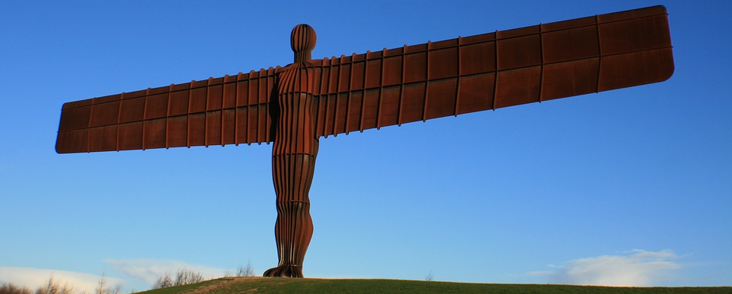
Talk About It
What do you think this is?
Where do you think this is?
Who do you think created this?

Slide 3
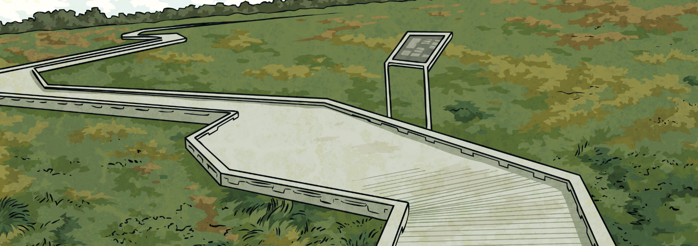
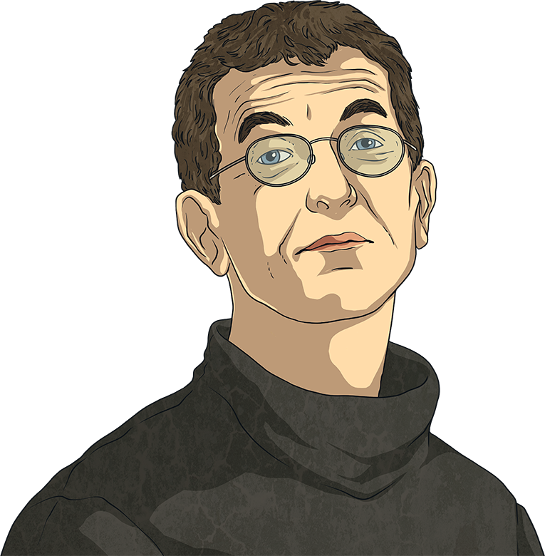

Antony Gormley
sculptor – An artist who creates sculptures. Sculpture is three-dimensional art made by carving, modelling, making casts or constructing.
Antony was born on 30th August 1950 in London. He was the youngest of seven children. Antony went to boarding school in Yorkshire and then Cambridge University. After university, Antony studied art at several art colleges in London.
Antony Gormley is a British sculptor. His work has been displayed across the globe and many of his sculptures are world-famous.

Slide 4
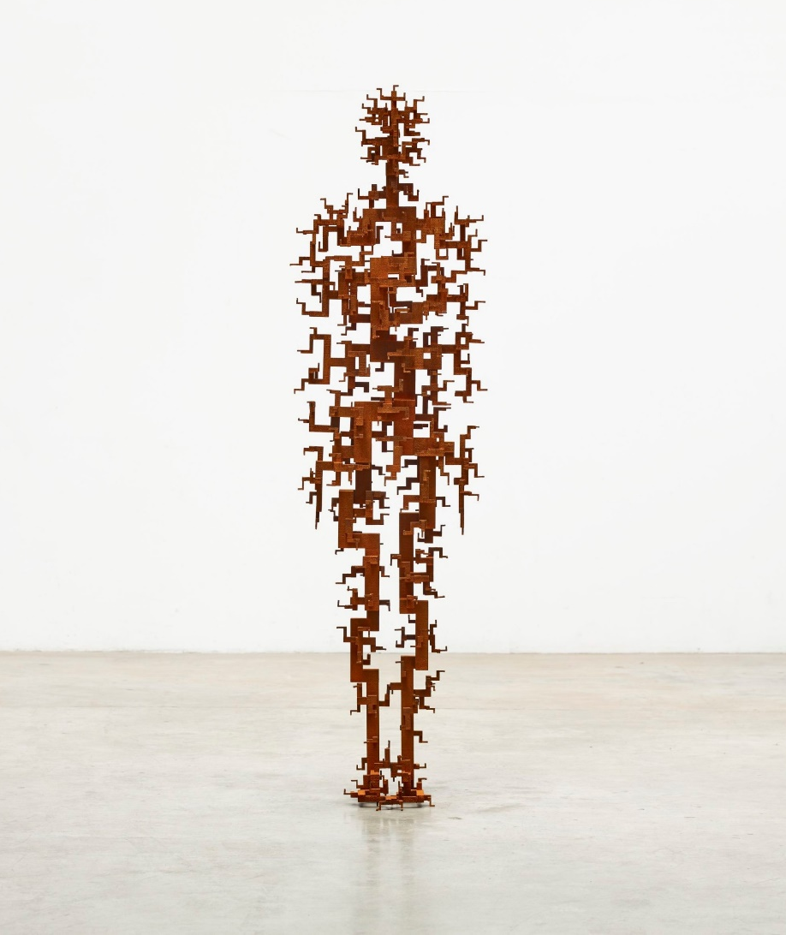
Antony Gormley
Antony is married to the artist Vicken Parsons. They have three children: Ivo, Paloma and Guy.
In 1994, Antony won the Turner Prize, one of the most important awards in art. In 1997, he was given an OBE (Order of the British Empire) and in 2004 he was given a knighthood. This means his full title is Sir Antony Gormley, OBE, and his wife’s title is Vicken Parsons, Lady Gormley.
Talk About It
If you won an award, what do you
think it would be for?

Slide 5
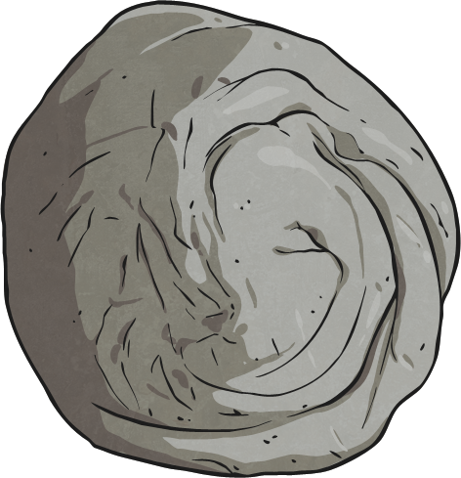
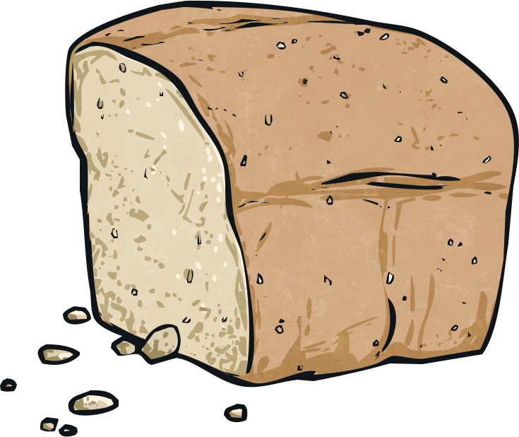
Antony Gormley’s Sculpture
Antony’s sculptures are mainly based on the human body.
Many of Antony’s sculptures are based on his own body. He makes casts of his body to create the shape. He does this by wrapping parts of himself in cling-film (avoiding his face) and then covering this in a quick-drying material, such as clay. Once the material is dried, it is cut in half. This is then used as a mould for Antony to fill with different materials to create body shapes.
One example of Antony using body shape in sculptures is a piece called ‘Bed’, which was part of his first public art show. ‘Bed’ was made up of 8640 pieces of bread laid out in the shape of a bed. Antony then ate some of the pieces of the bread, leaving two body-shaped impressions in the bread, as if people had been lying on a bed.
Notes:
Note: Ensure you have a discussion with your children on the dangers of using this ‘body casting’ method on the face.

Slide 6
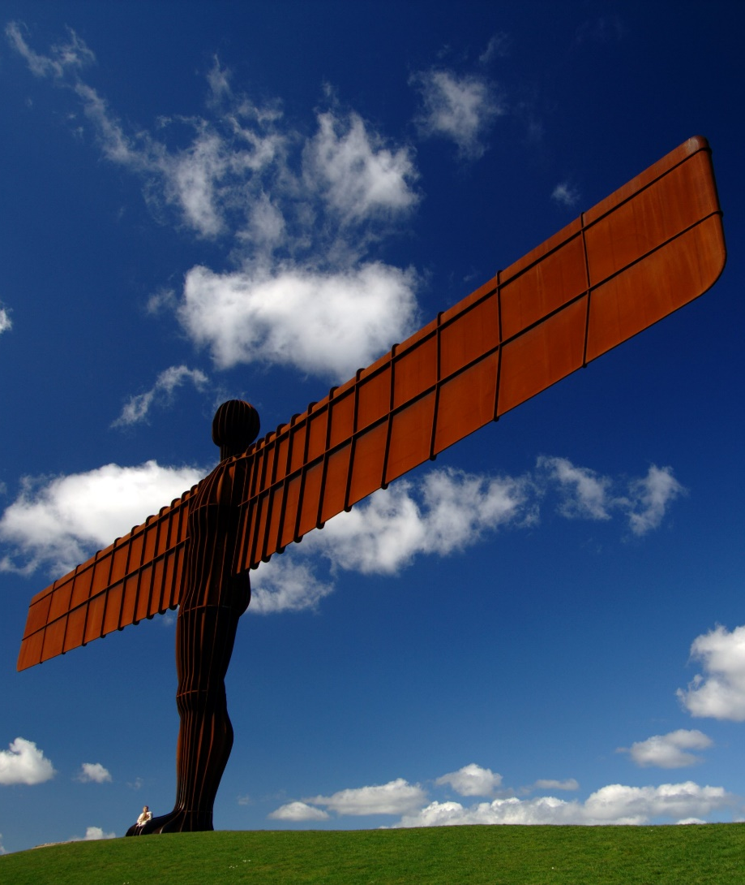
The Angel of the North, 1998
Explaining why he chose to make a sculpture of an angel, he said, “No one has ever seen one and we need to keep imagining them.”
This is one of Antony’s most famous sculptures. It is on the top of a hill next to the A1 in Gateshead in the north east of England.
It is 20 metres high and its wingspan is 54 metres. It weighs 200 tonnes. Underneath the hill are concrete piles 20 metres deep to keep the angel
in place.
Did You Know?
The angel’s wingspan is the same
size as that of a jumbo jet plane!

Slide 7
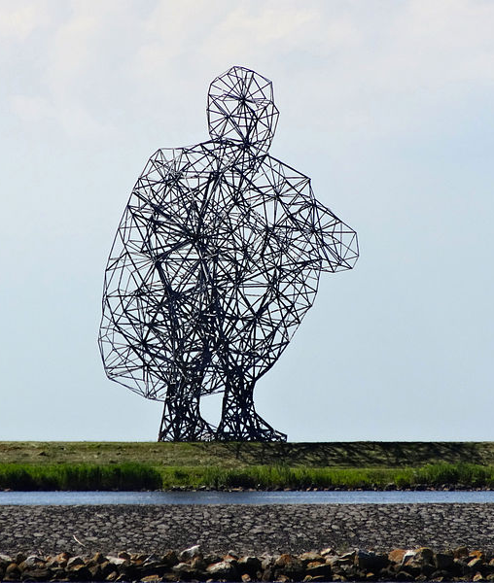
Exposure, 2010
This sculpture is in the Netherlands.
It is 26 metres tall, although if the figure was standing up, it would be over 100 metres. It weighs 60 tonnes.
The different lengths of metal were made by a company that usually makes pylons (the tall structures that hold up electrical wires). Each piece was cut by hand.
‘Exposure’ took 6 years to build.
Did You Know?
Some people say it looks like the figure is sat on the toilet!

Slide 8
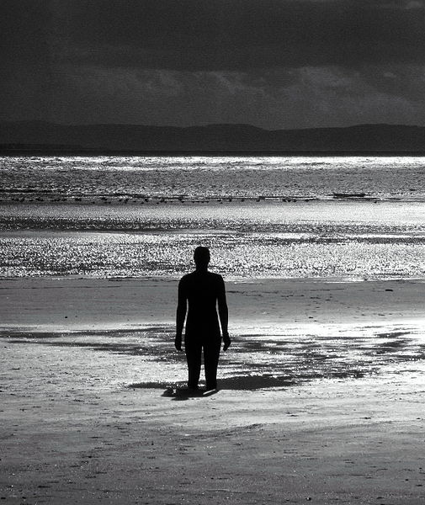
Another Place, 1997
This isn’t someone wading in the sea! This is one of the iron figures that makes up the piece called ‘Another Place’.
‘Another Place’ is 100 iron figures (all made from casts of Antony’s body) spread out over 3km of Crosby Beach in the north west of England. Some of the figures go far out to sea and are often covered in water
Antony created the sculptures to explore humans’ relationship
with nature.
Did You Know?
Crosby Beach is a non-bathing beach and visitors are told not to try to swim out to the figures.

Slide 9
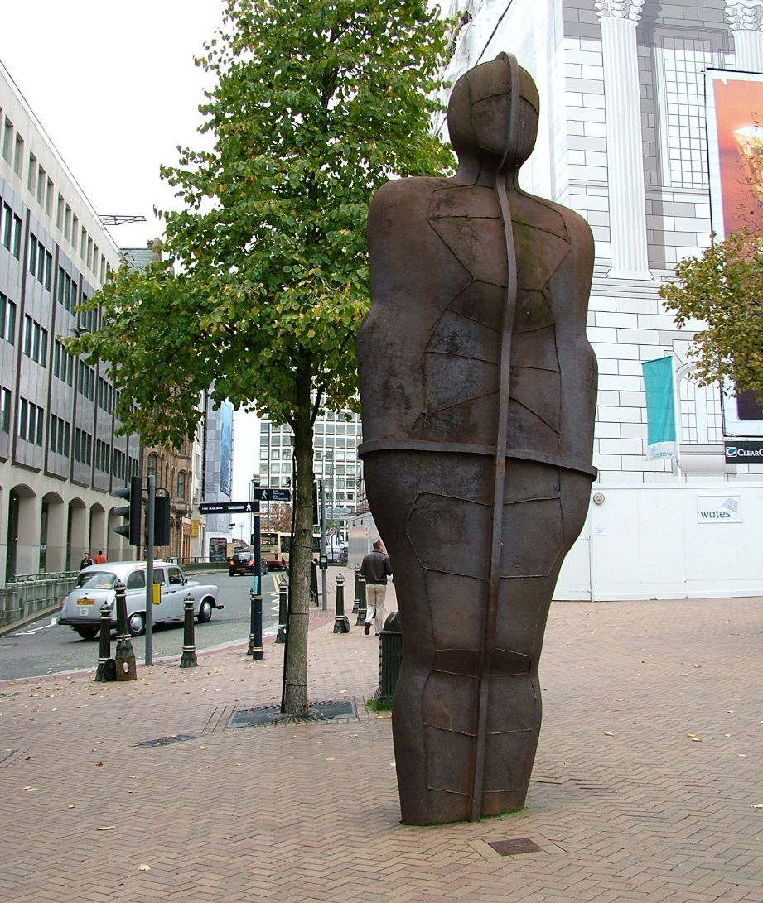
Iron:Man, 1993
‘Iron:Man’ is in Victoria Square in Birmingham city centre.
It is 6 metres tall but that doesn’t include the statue’s feet which are actually underground. ‘Iron:Man’ weighs 6 tonnes.
When the sculpture first arrived, some people didn’t like it especially as it looks like it is rusty. However, it is now a much loved part of Birmingham.
Did You Know?
It is rumoured that when Diana, Princess of Wales, reopened Victoria Square in 1994, some people wanted the statue hidden from her in case she didn’t like it!

Slide 10
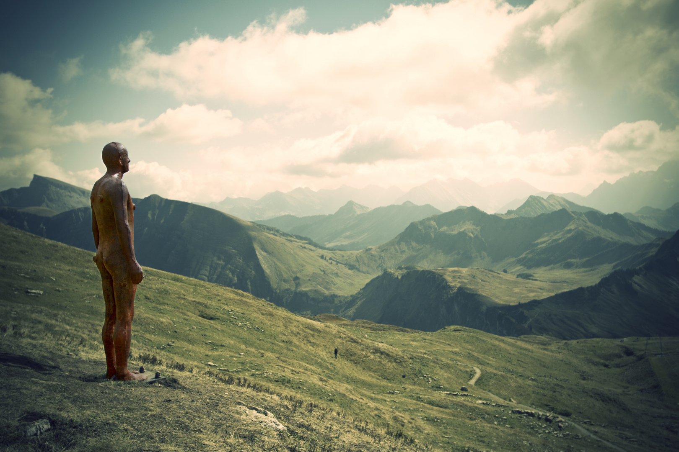
Other Work
Antony has created many other well-known sculptures that have often been exhibited in unusual ways. ‘Event Horizon’ is a series of sculptures that look similar to the ones on Crosby Beach, except these figures were placed on the top of buildings. The exhibition was shown in London, New York and two cities in Brazil. At first, the sculptures worried some people, as from far away, they looked like real people balancing dangerously on the edge of tall buildings!
Talk About It
If you were going to create pieces of art made up of statues, where would you put them and why?

Slide 11
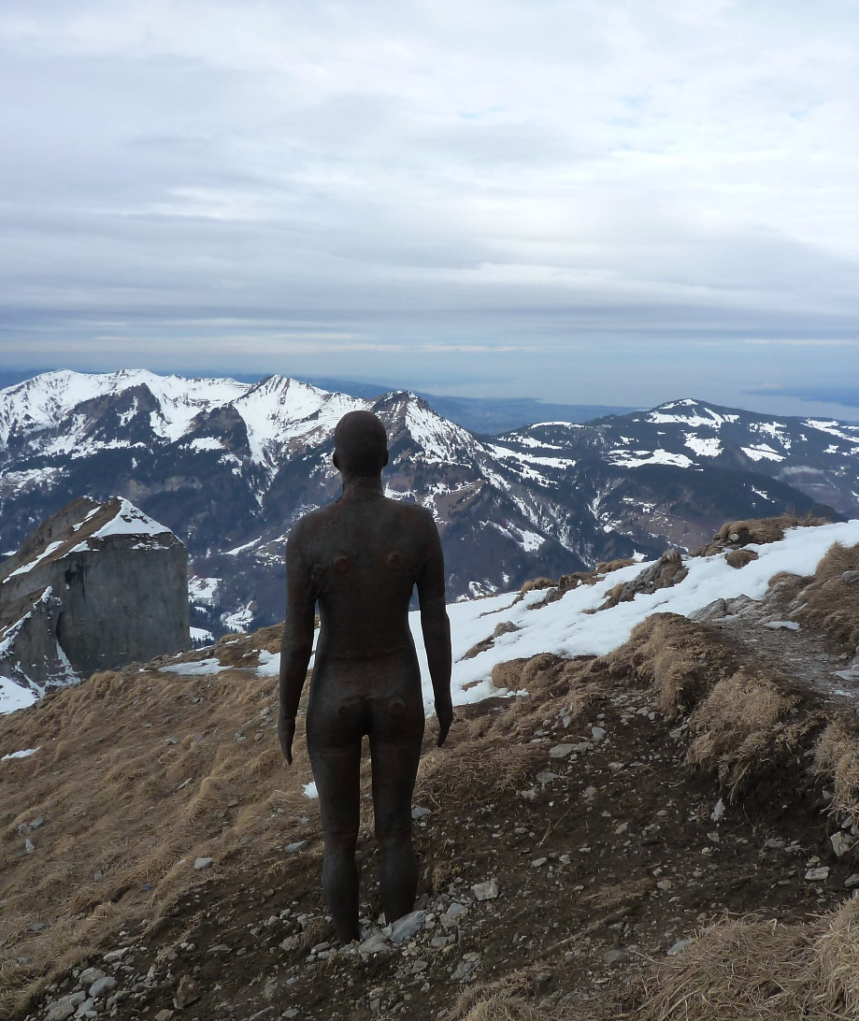
Try It Yourself
Why not try creating your own sculptures inspired by the work of Antony Gormley?
You could use different material, such as clay or playdough, to make body shapes. Experiment with grouping them in different numbers and putting them in different places. You could add wings to make your own angels of the north, south, east or west!

