Slide 1
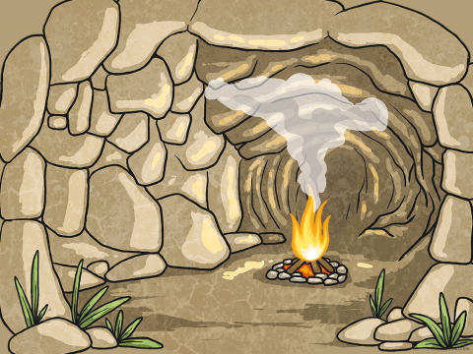
Year 3 step into.……..
The Stone Age.

Slide 2
Learning Objective:
Learning Objective :
To arrange events from the past in chronological order.
Vocabulary clarification – What does chronological order mean?

Slide 3
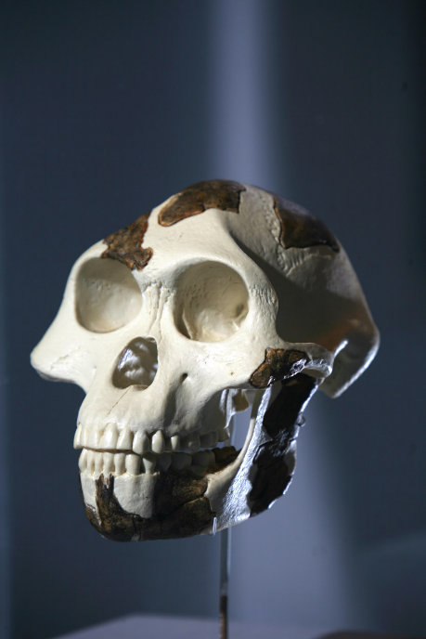
Vocabulary we may come across:
Pre-historic
Prehistoric comes from ‘pre-history’.
It means a time before written records existed.
There is no recorded history of this time that we can read, just clues left behind that archaeologists have to interpret.

Slide 4
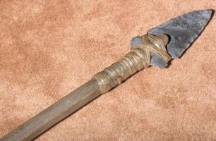
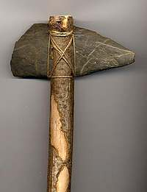
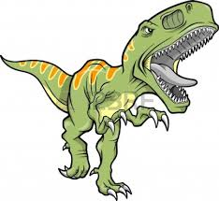
Learning Objective:
The stone age is the first period of human history. It is called the stone age because stone was used to make tools and other objects during this time period. The first humans existed about 2.6 million years ago.
Harpoon
Axe

Slide 5
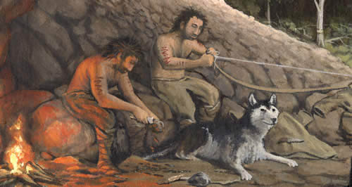
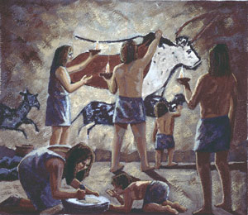
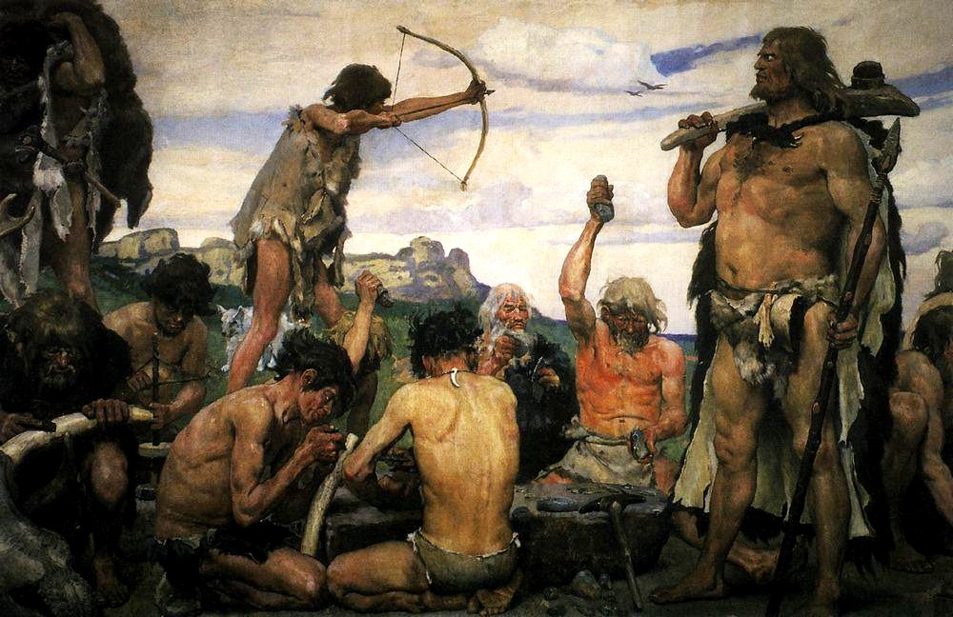
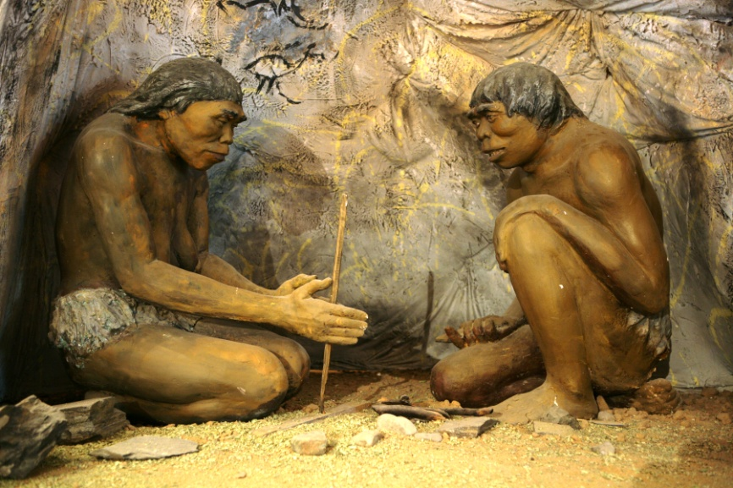
Learning Objective:
What was it like in The Stone Age?

Slide 6
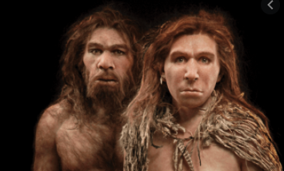
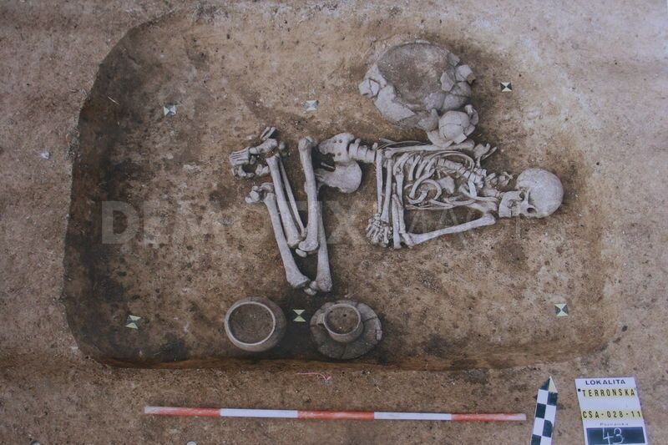
Learning Objective:
How do we know about The Stone Age?
Archaeologists are like detectives, they have discovered what the first hunter-gathers lived like by digging up skeletons and weapons. They have used these as clues to try to understand the how these lived in 120,000BC. Neanderthals.
Archaeologists have discovered cave
Paintings which show how the Neanderthals might have lived and communicated in the Stone Age. The painting of a Bison was found in the caves at Altamira in Spain.
Neanderthals.

Slide 7
Learning ObThe stone age is the longest period of human history (it is be split into three stages).
Palaeolithic period (About 2.6 million years ago)
First stone tools invented
Mesolithic period (10,000BC)
Tools, bow and arrows to hunt deer.
Neolithic period (8000BC)
The start of farming
:

Slide 8
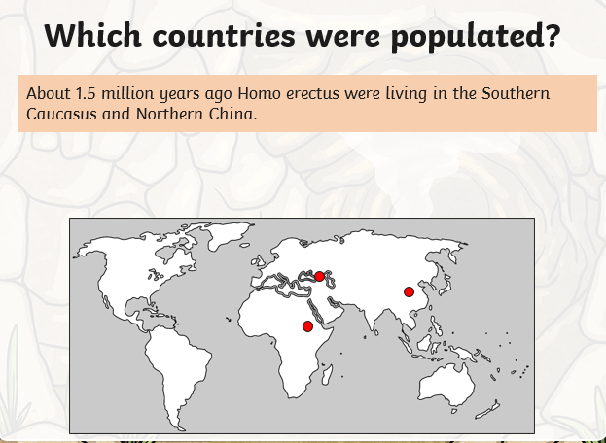
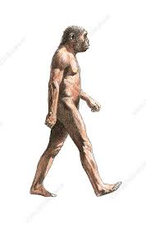

Slide 9
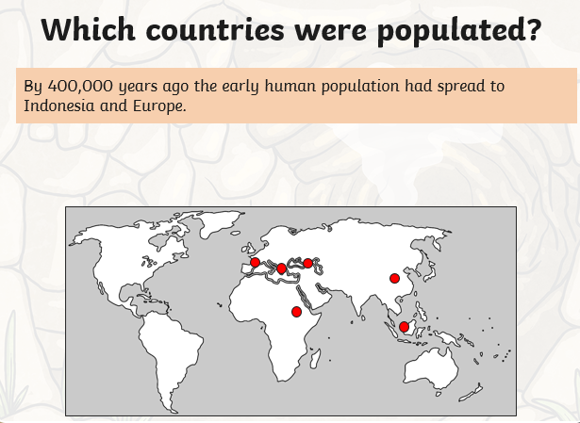

Slide 10
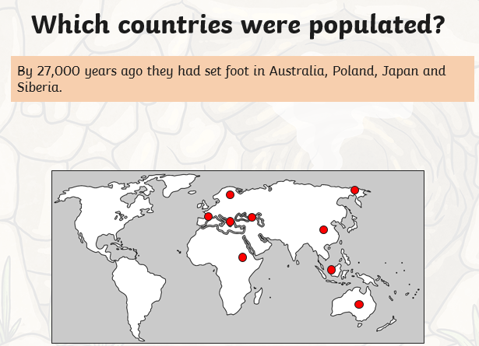

Slide 11
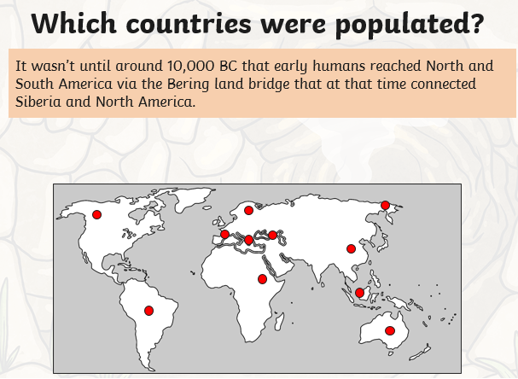

Slide 12
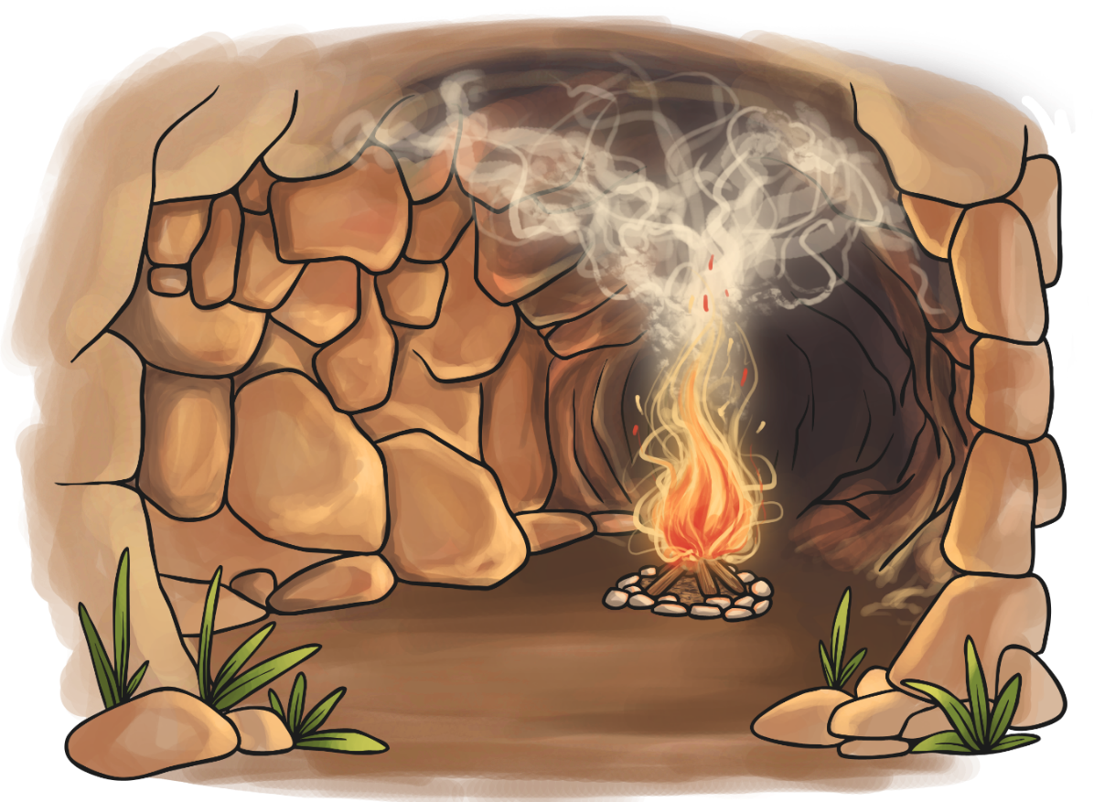
What type of houses did they live in?
During the Palaeolithic time period when the ice came, some early humans sheltered from the cold in caves. Why build your own house when there's one already available!
Vocabulary:
Paleolithic –
The Paleolithic, (or Palaeolithic),
refers to the prehistoric period
when stone tools were made
by humans.

Slide 13
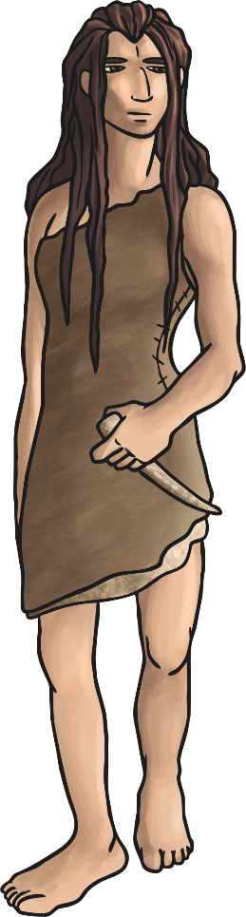
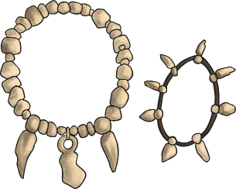
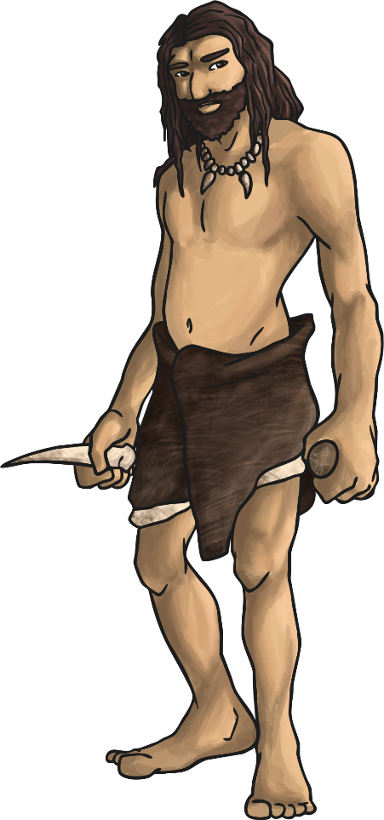
What clothes did they wear?
People wore animal skins to keep them warm, sewn together using bone needles.
The fine bone needles that have been found were probably used for embroidery as well. The bodies of a boy and a girl buried around 28,000 years ago in Russia were found with thousands of ivory beads and fox teeth covering them, work that would have taken years to complete.
We also know that people were weaving fabric back then (which could have been used for clothes) and dying spun plant fibres different colours, so maybe fashion started a lot earlier than you might think!

Slide 14
Today we are going to focus on ordering events from The Stone Age in chronological order. Let`s have a go with some things we may already know about.
Can you put these events into chronological order?
Moana
came out
You started DJS.
Children in Y3 were born.
Your teacher was born.

Slide 15
ANSWERS
EARLIEST
LATEST
Your teacher was born.
Children in Y3 were born.
Moana
came out
You started DJS.

Slide 16
What about these?
Romans invade Britain
Usain Bolt wins 100m gold at the Olympics
Dinosaurs lived on earth
Queen Elizabeth II is born

Slide 17
Can you put these events into chronological order?
Answer
Dinosaurs lived on earth
Romans invade Britain
Queen Elizabeth II is born
Usain Bolt wins 100m gold at the Olympics

Slide 18
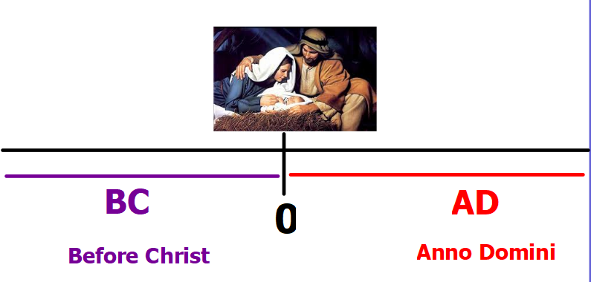
The earth is around 4,500,000,000 (4.5 billion) years old. We can't possibly know exactly how old, so we wouldn't know when to start counting from.

Slide 19
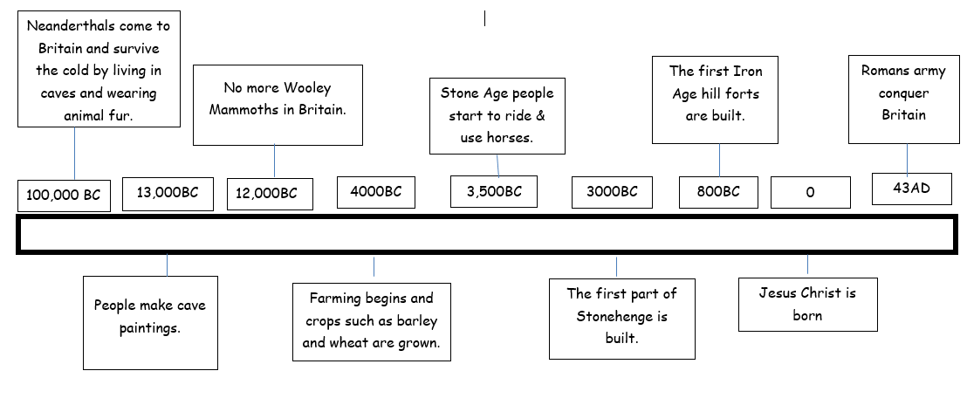
In what year was Jesus born?
What does BC mean?
What happened in 3500 BC?
When did people first start making cave paintings?
In what year did woolly mammoths become extinct in Britain?
Which event happened after Jesus was born? (AD).
Have a go at answering
the questions.
Try and answer using full sentences.

Slide 20
TASK
Put the Stone Age events into chronological order.
Stick them into your book.
Challenge – Work out the time difference between events.

