Slide 1


L.O: understand the importance of keeping personal information safe

Slide 2

What is personal information?
https://www.bbc.com/bitesize/articles/zwbq7ty

Slide 3
When do you contact people online?

Slide 4
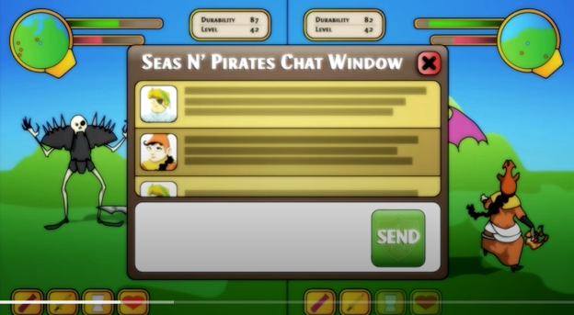
Watch:
Smart Crew 3: Personal Information
https://www.childnet.com/resources/the-adventures-of-kara-winston-and-the-smart-crew/chapter3

Slide 5
Have you ever been asked a personal question by someone online?
Which of the following questions are worrying?
- What’s your real name?
- How are you?
- What games do you like?
- Where do you live?
- Can you send me a picture of you?
- Do you like unicorns?

Slide 6
Activity: Sort Personal Information
Sort these words in order, with “never share” at one end and “fine to share” at the other.
Never share
Ok for adults to share
Fine to share

Slide 7
Activity: Sort Personal Information
Sort these words in order, with “never share” at one end and “fine to share” at the other.
Never share
Ok for adults to share
Fine to share
what school you go to
your country
your email address
your nickname
where you parents work
a picture of yourself
what you want to be when you are older
your city
your address
your real name
your username
your telephone number
how many brothers and sisters you have
your password
your pet's name
where you play football on Saturdays
your favourite sport
the books you read

