Slide 1

How to make the perfect……..

Slide 2
“
Step 1 – bread – open inverted commas, ready to contain your speech sentence.
“

Slide 3
2) Butter – capital letter to start your speech sentence.
3) Your filling – the meaty part – the speech sentence.
4) Add garnish – mark it – full stop, comma, exclamation mark, question mark to finish off the speech filling
“I
!
t’s easy when you know how

Slide 4
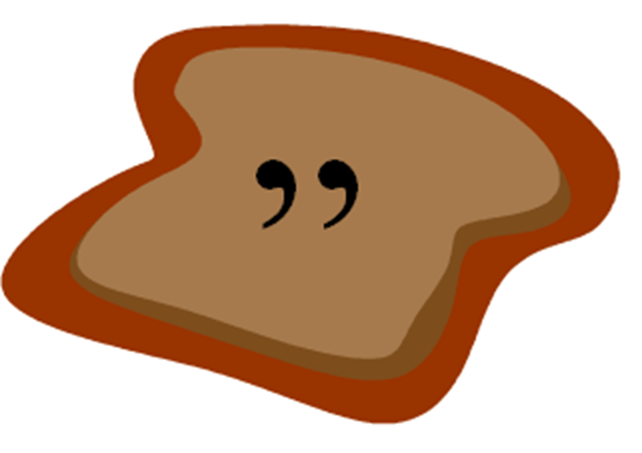
5) Top it off with more bread – close the speech marks so that the filling is contained.
“It’s easy when you know how!
”

Slide 5
Finally, label your sandwich(speech sentence) so that you know whose it is.
“It’s easy when you know how,”
promised Mrs Kirk.

Slide 6


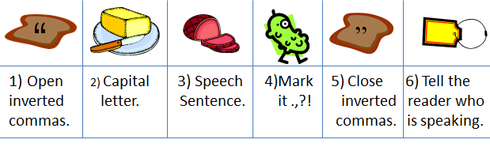
“
ABC
Open 2) Capital 3) Speech 4)Mark 5) Close 6) Tell the
inverted letter. Sentence. it .,?! inverted reader who
commas. commas. is speaking.
ABC

