Slide 1
Notes:
Teacher Note - Please check the content in this link, including any comments, is suitable for your educational environment before showing. Twinkl accepts no responsibility for the content of third-party websites.

Slide 2
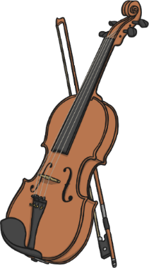
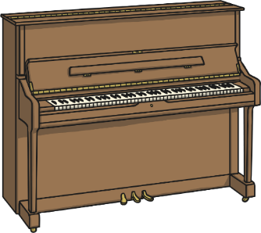
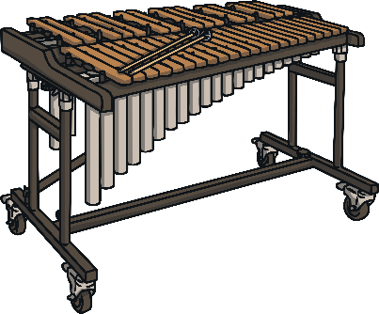
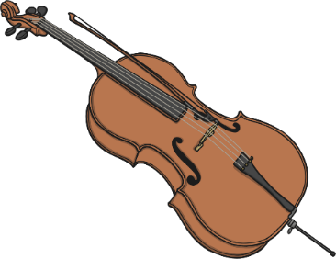
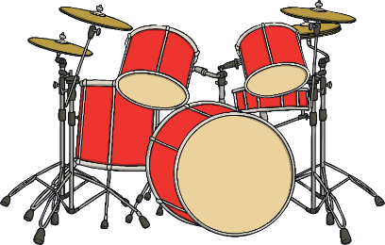
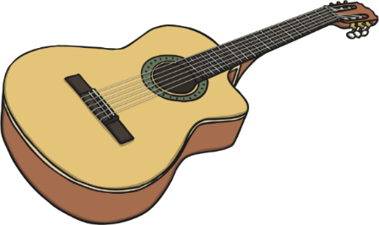
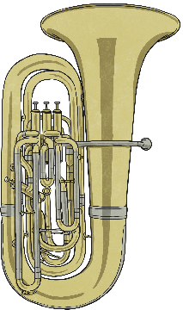
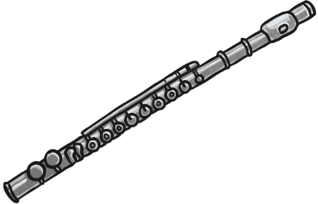
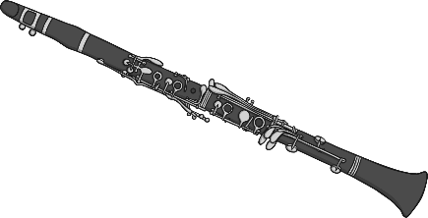
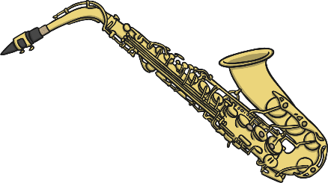
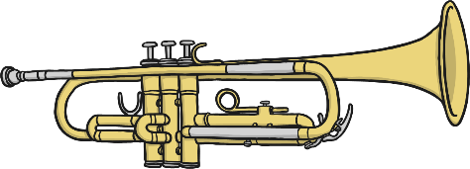
Click an instrument to watch a video:
percussion
strings
piano
xylophone
cello
violin
guitar
drums
woodwind
brass
flute
tuba
clarinet
trumpet
saxophone
Notes:
Teacher Note - Please check the content in this link, including any comments, is suitable for your educational environment before showing. Twinkl accepts no responsibility for the content of third-party websites.

Slide 3
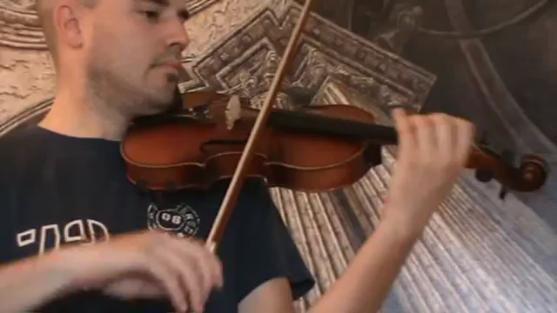
back
Notes:
Teacher Note - Please check the content in this link, including any comments, is suitable for your educational environment before showing. Twinkl accepts no responsibility for the content of third-party websites.

Slide 4
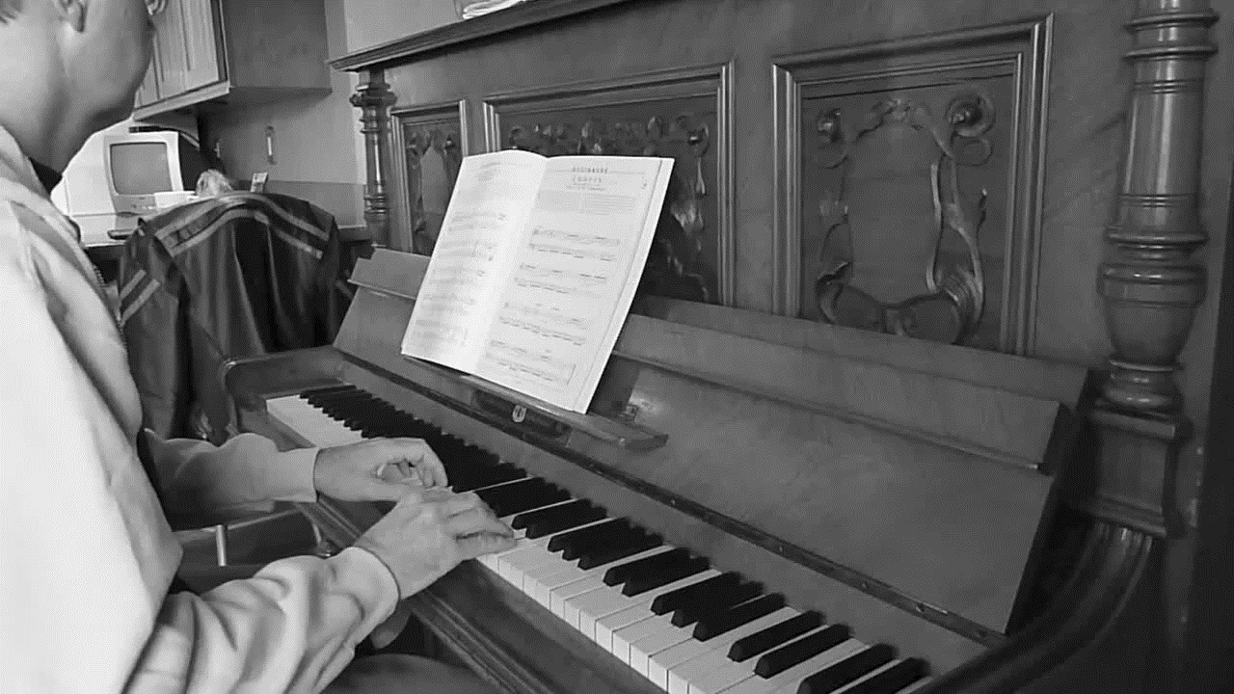
back
Notes:
Teacher Note - Please check the content in this link, including any comments, is suitable for your educational environment before showing. Twinkl accepts no responsibility for the content of third-party websites.

Slide 5
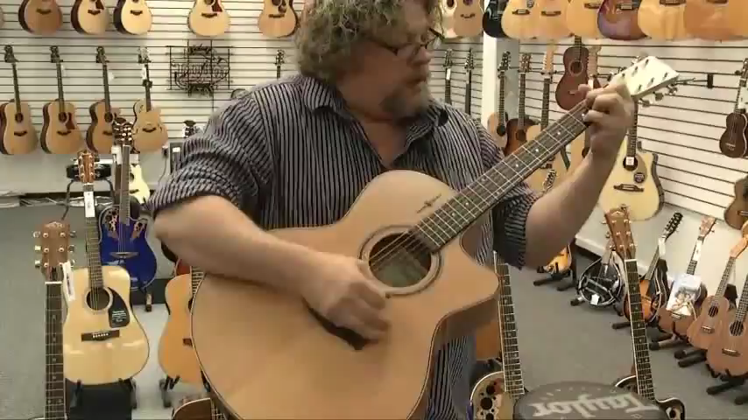
back
Notes:
Teacher Note - Please check the content in this link, including any comments, is suitable for your educational environment before showing. Twinkl accepts no responsibility for the content of third-party websites.

Slide 6
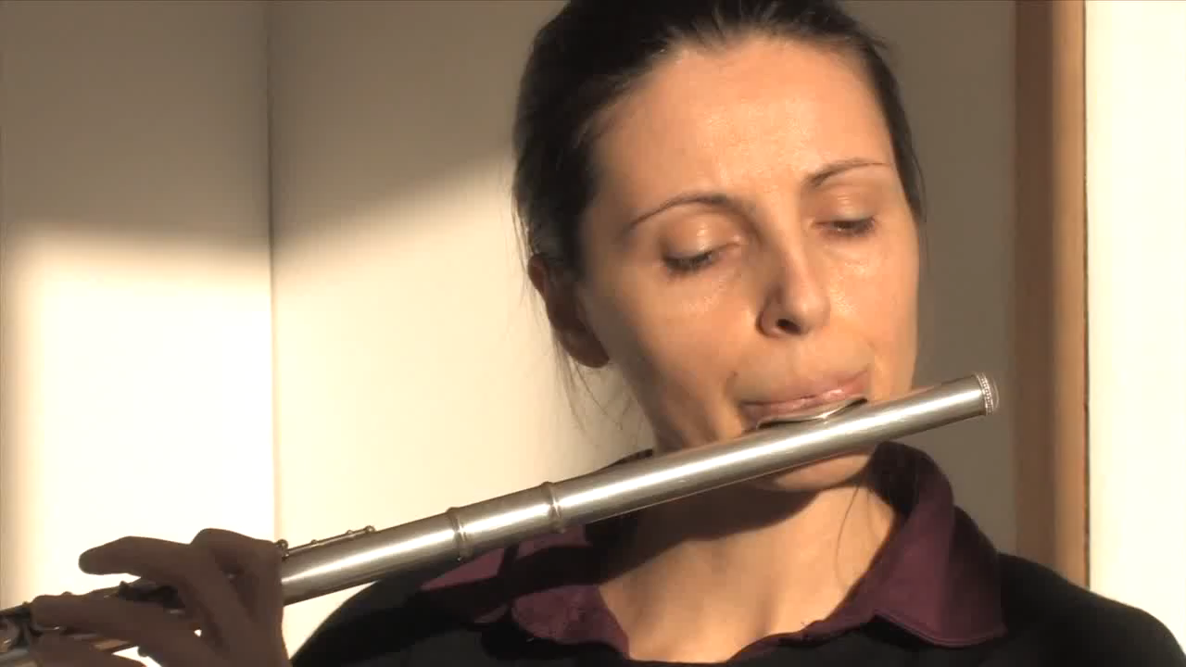
back
Notes:
Teacher Note - Please check the content in this link, including any comments, is suitable for your educational environment before showing. Twinkl accepts no responsibility for the content of third-party websites.

Slide 7
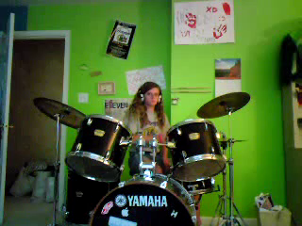
back
Notes:
Teacher Note - Please check the content in this link, including any comments, is suitable for your educational environment before showing. Twinkl accepts no responsibility for the content of third-party websites.

Slide 8
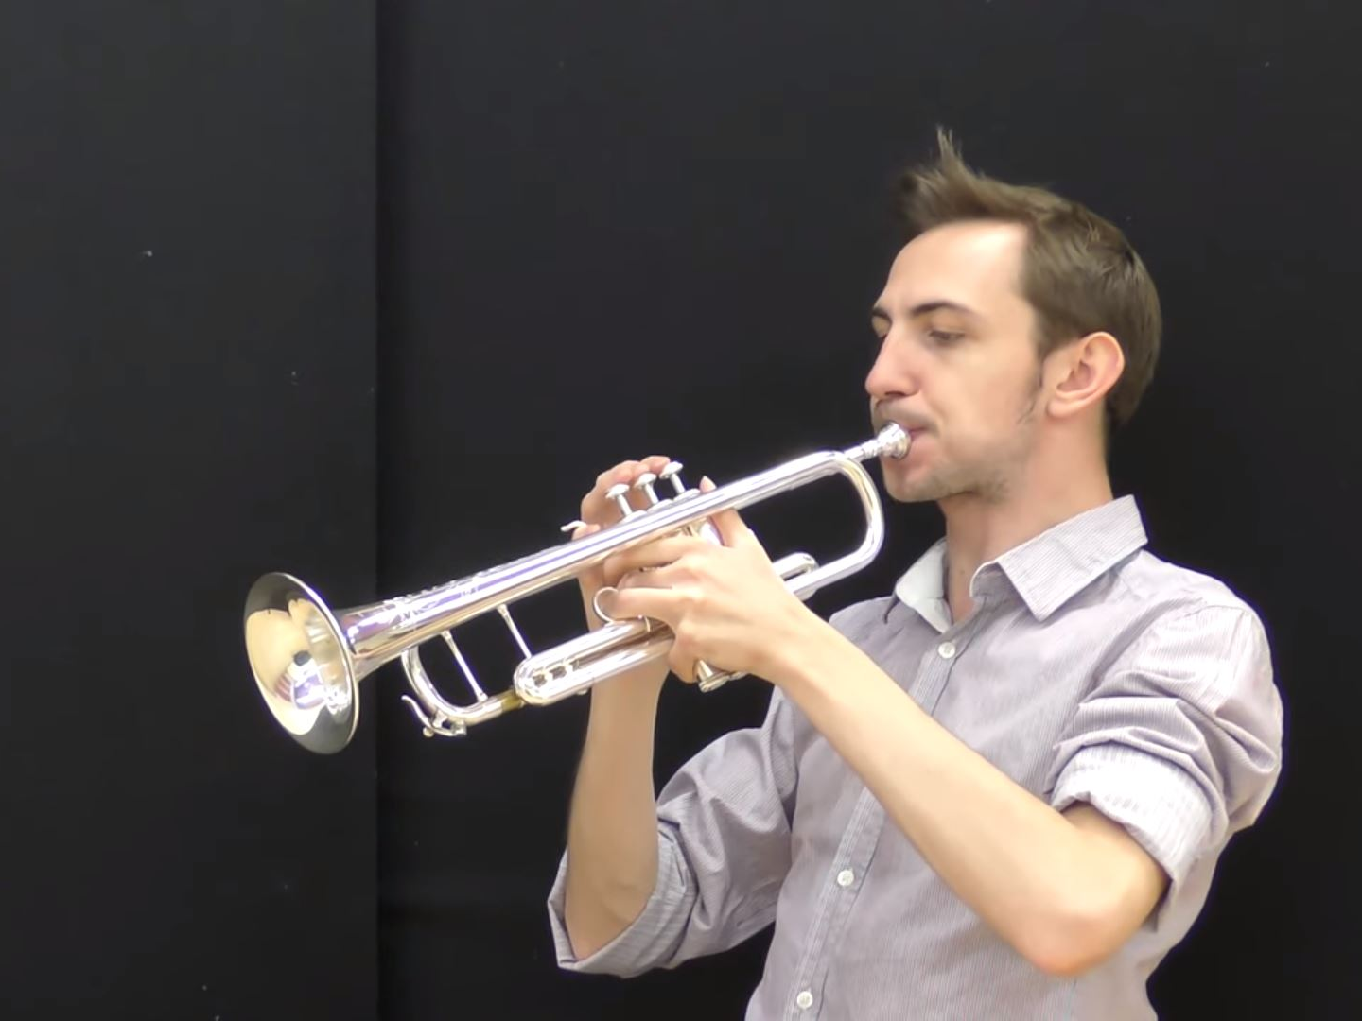
back
Notes:
Teacher Note - Please check the content in this link, including any comments, is suitable for your educational environment before showing. Twinkl accepts no responsibility for the content of third-party websites.

Slide 9
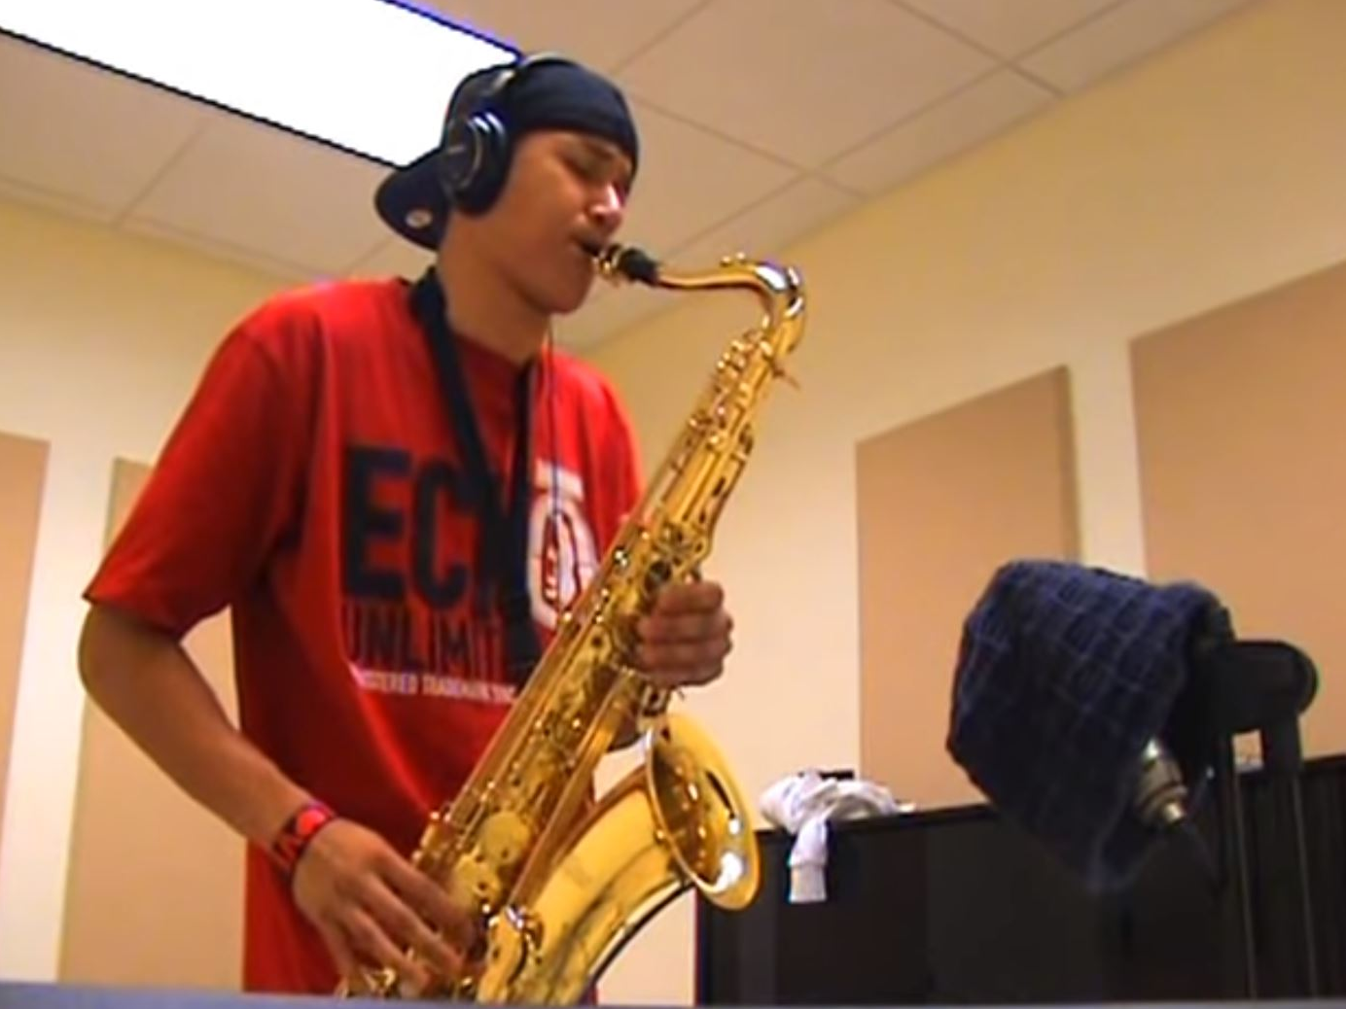
back
Notes:
Teacher Note - Please check the content in this link, including any comments, is suitable for your educational environment before showing. Twinkl accepts no responsibility for the content of third-party websites.

Slide 10
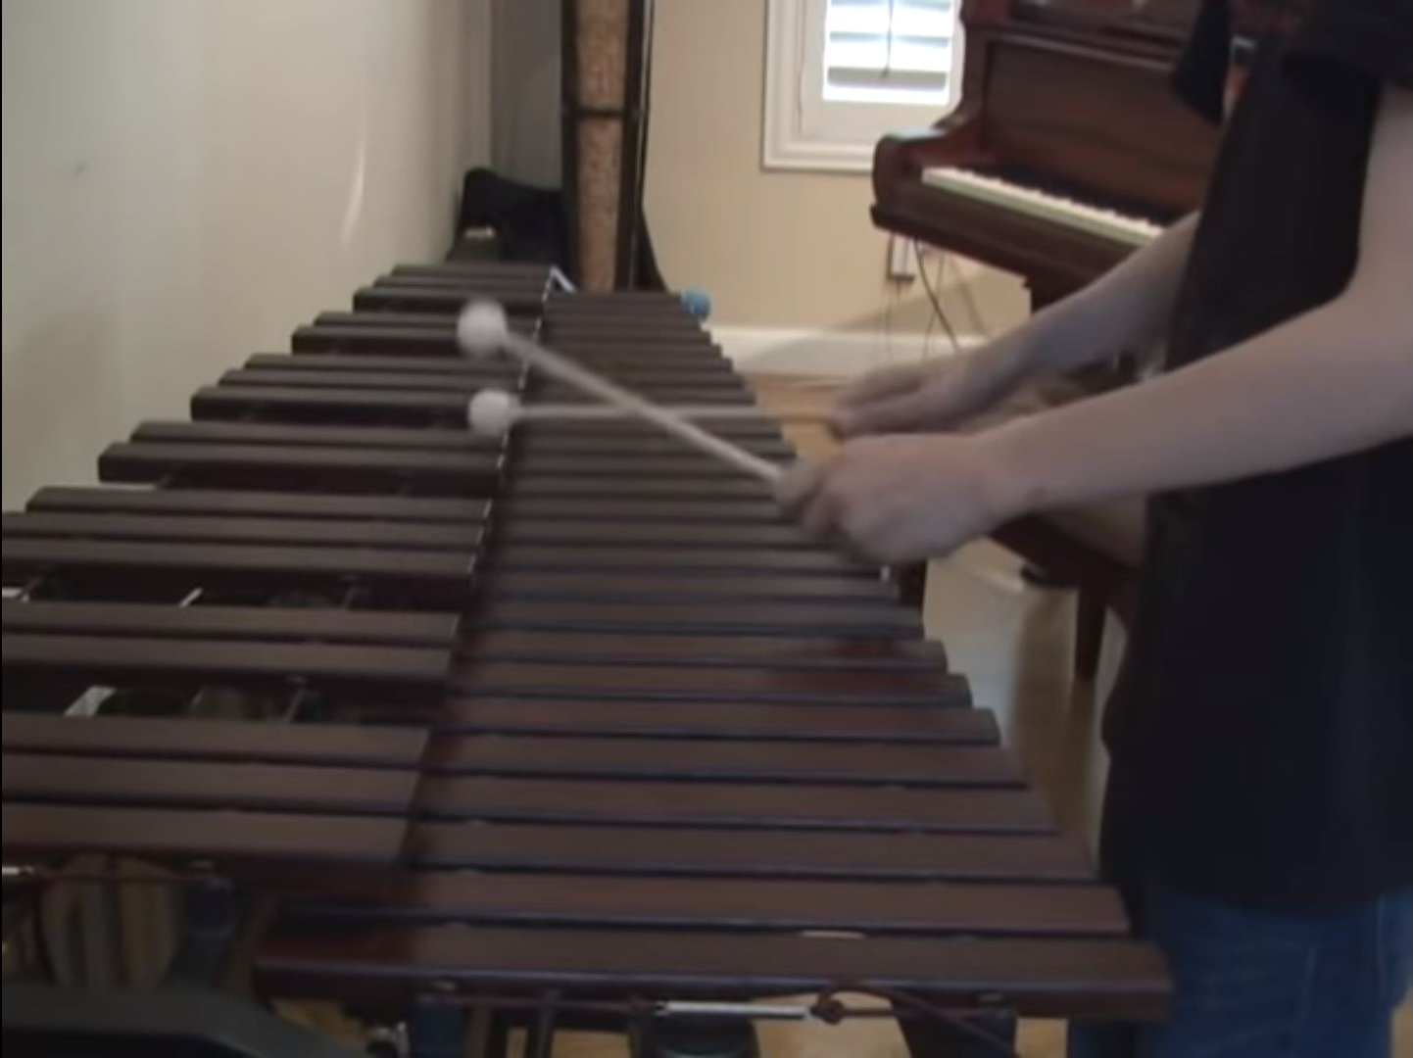
back
Notes:
Teacher Note - Please check the content in this link, including any comments, is suitable for your educational environment before showing. Twinkl accepts no responsibility for the content of third-party websites.

Slide 11
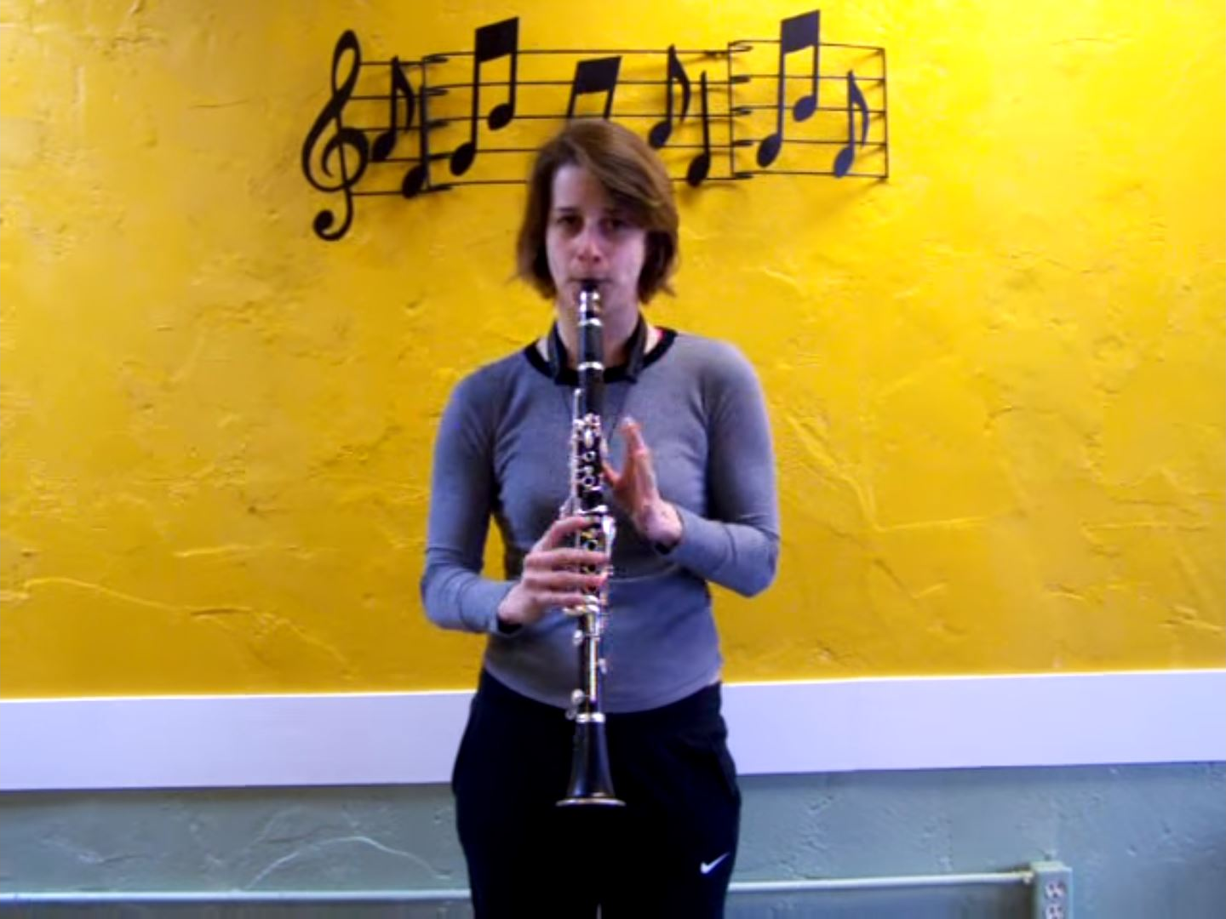
back
Notes:
Teacher Note - Please check the content in this link, including any comments, is suitable for your educational environment before showing. Twinkl accepts no responsibility for the content of third-party websites.

Slide 12
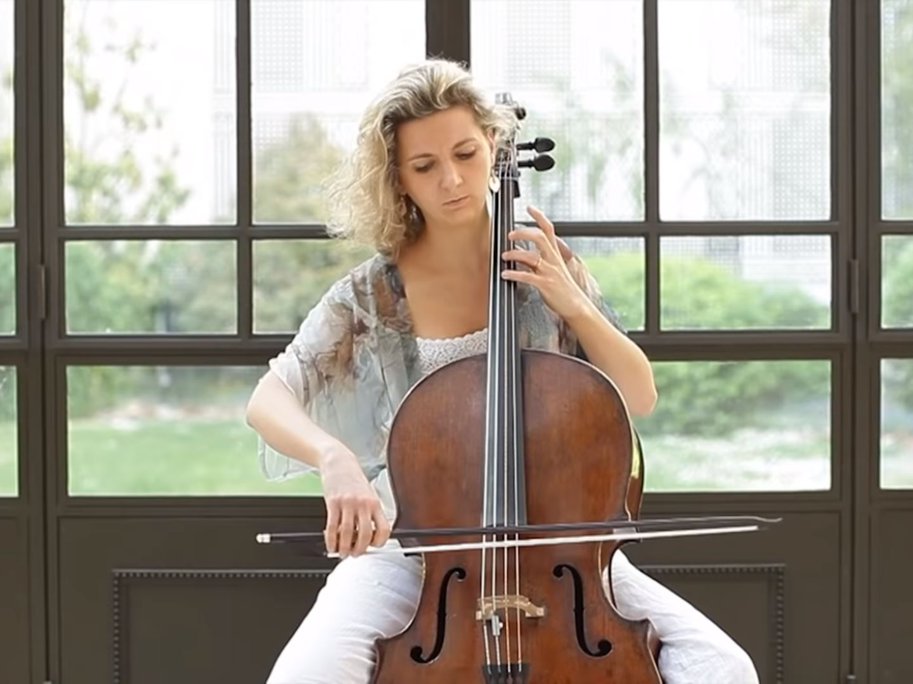
back
Notes:
Teacher Note - Please check the content in this link, including any comments, is suitable for your educational environment before showing. Twinkl accepts no responsibility for the content of third-party websites.

Slide 13
I would like you to make a poster that answers the following questions ☺
What's your favourite musical instrument that you have listened to today and why?
Which musical instrument was your least favourite and why?
Can you play an instrument? If not, what instrument would you like to play and why?!
What type of music do you listen to?
Your poster MUST include pictures and words!
Notes:
Teacher Note - Please check the content in this link, including any comments, is suitable for your educational environment before showing. Twinkl accepts no responsibility for the content of third-party websites.

Slide 14
Notes:
Teacher Note - Please check the content in this link, including any comments, is suitable for your educational environment before showing. Twinkl accepts no responsibility for the content of third-party websites.

