Slide 1
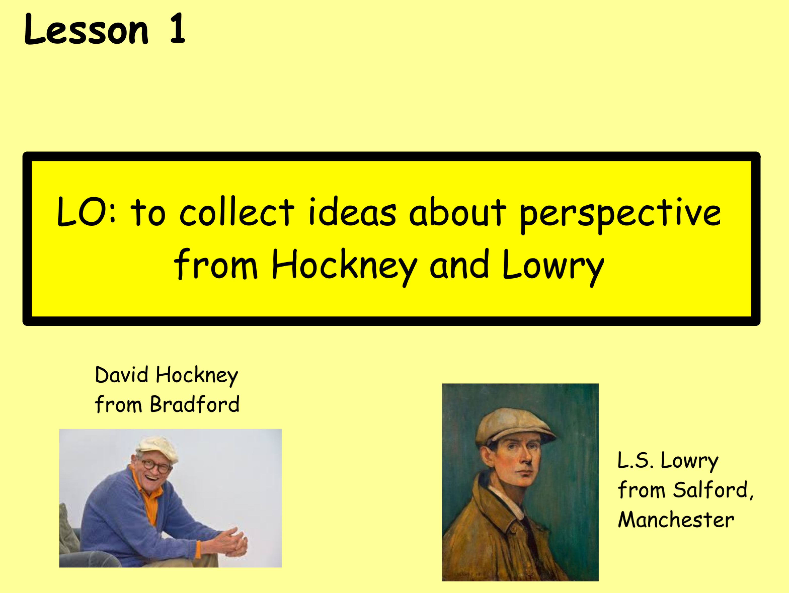

Slide 2
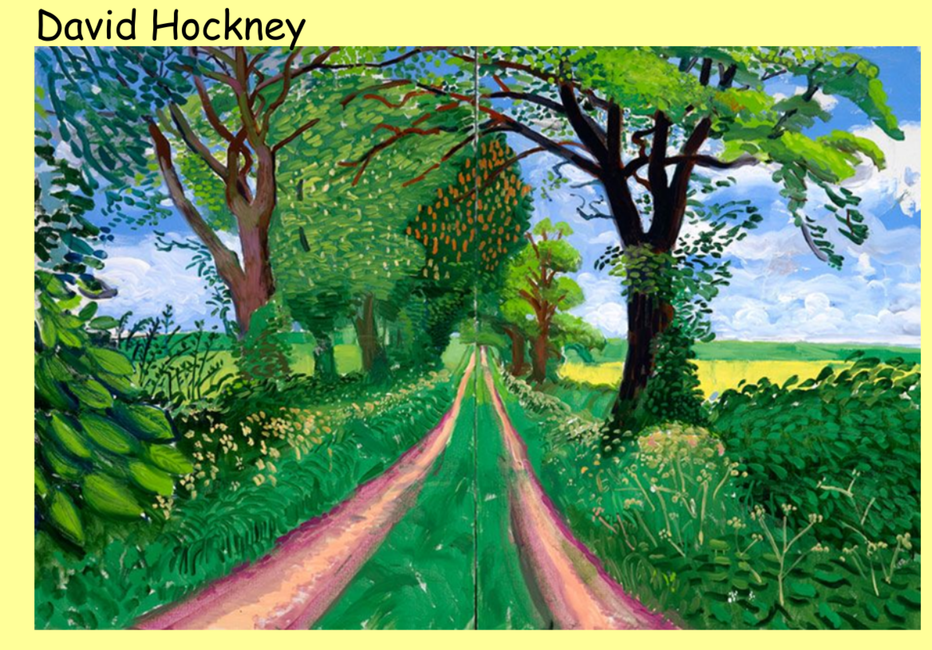
Look carefully at the painting. What do you notice about the leaves, trees, paths and flowers?

Slide 3
Look carefully at the painting. What do you notice about the leaves, trees, paths and flowers?
Everything looks smaller the further away they get.
The paths becomes narrower.
The leaves go from being large and very distinct in the foreground to being just part of a mass of green in the distance with no individual leaf being distinguishable.

Slide 4
Look carefully at the painting. What do you notice about the leaves, trees, paths and flowers?
The flowers go from being large and clear in the foreground to being smaller and less distinct in the background.
The trees in the foreground are very large, bold and clear. In the background, they are smaller, lighter in colour and also not as bold or clear.

Slide 5
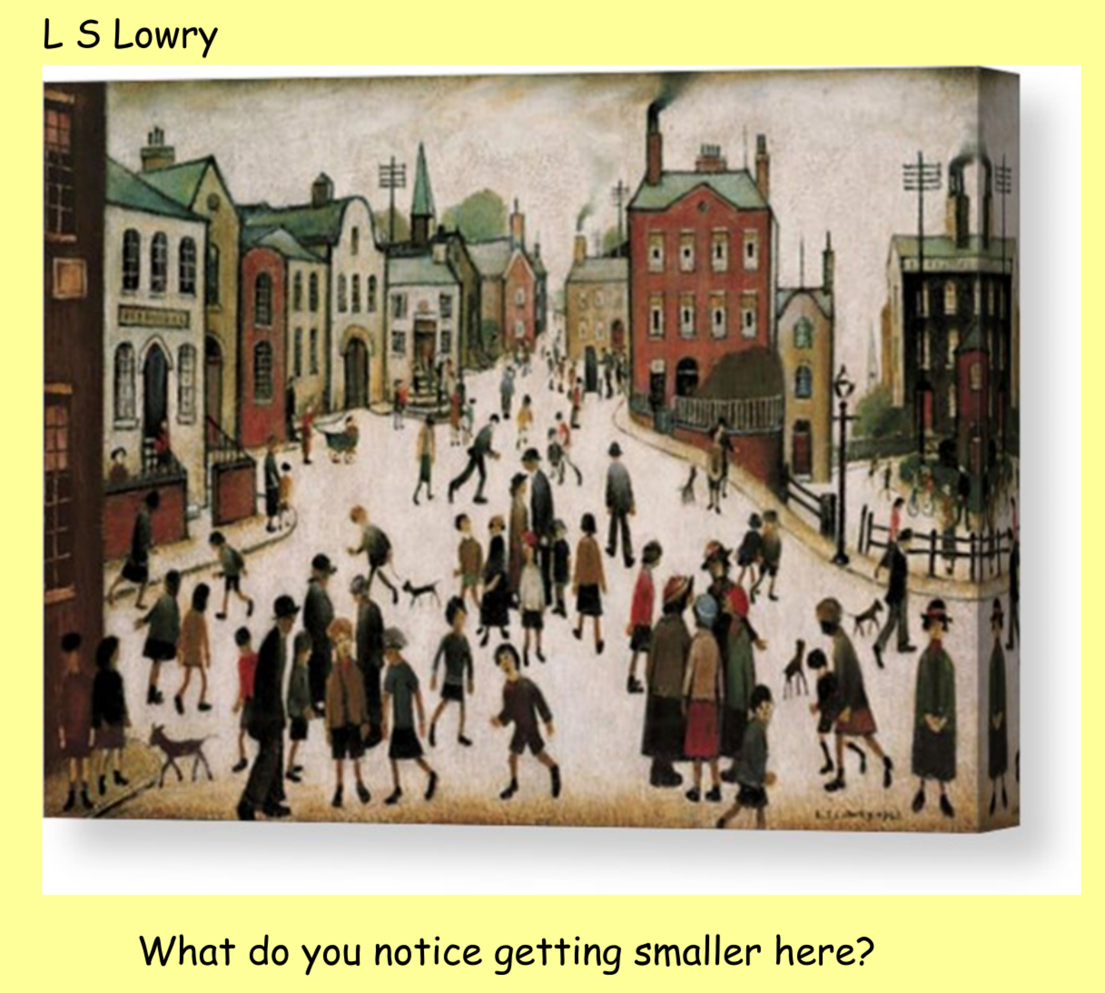
Everything looks smaller the further away it gets.
What do you notice getting smaller in this painting by L S Lowry?

Slide 6
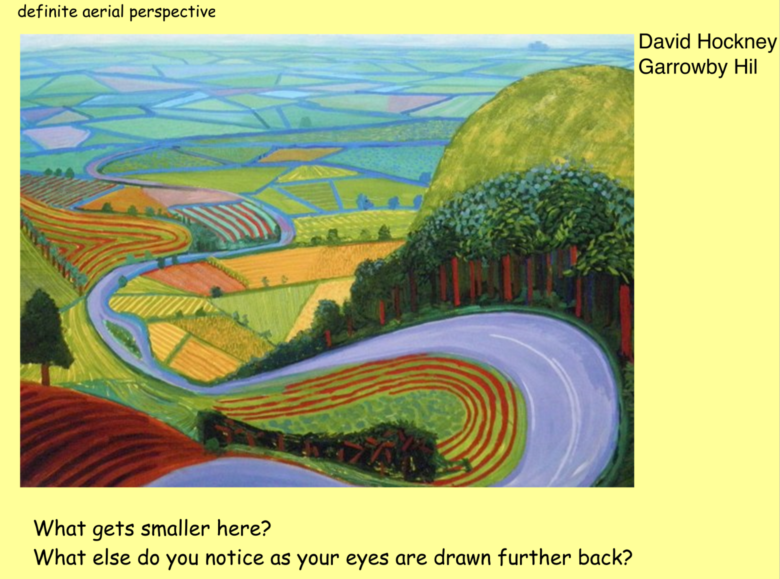

Slide 7
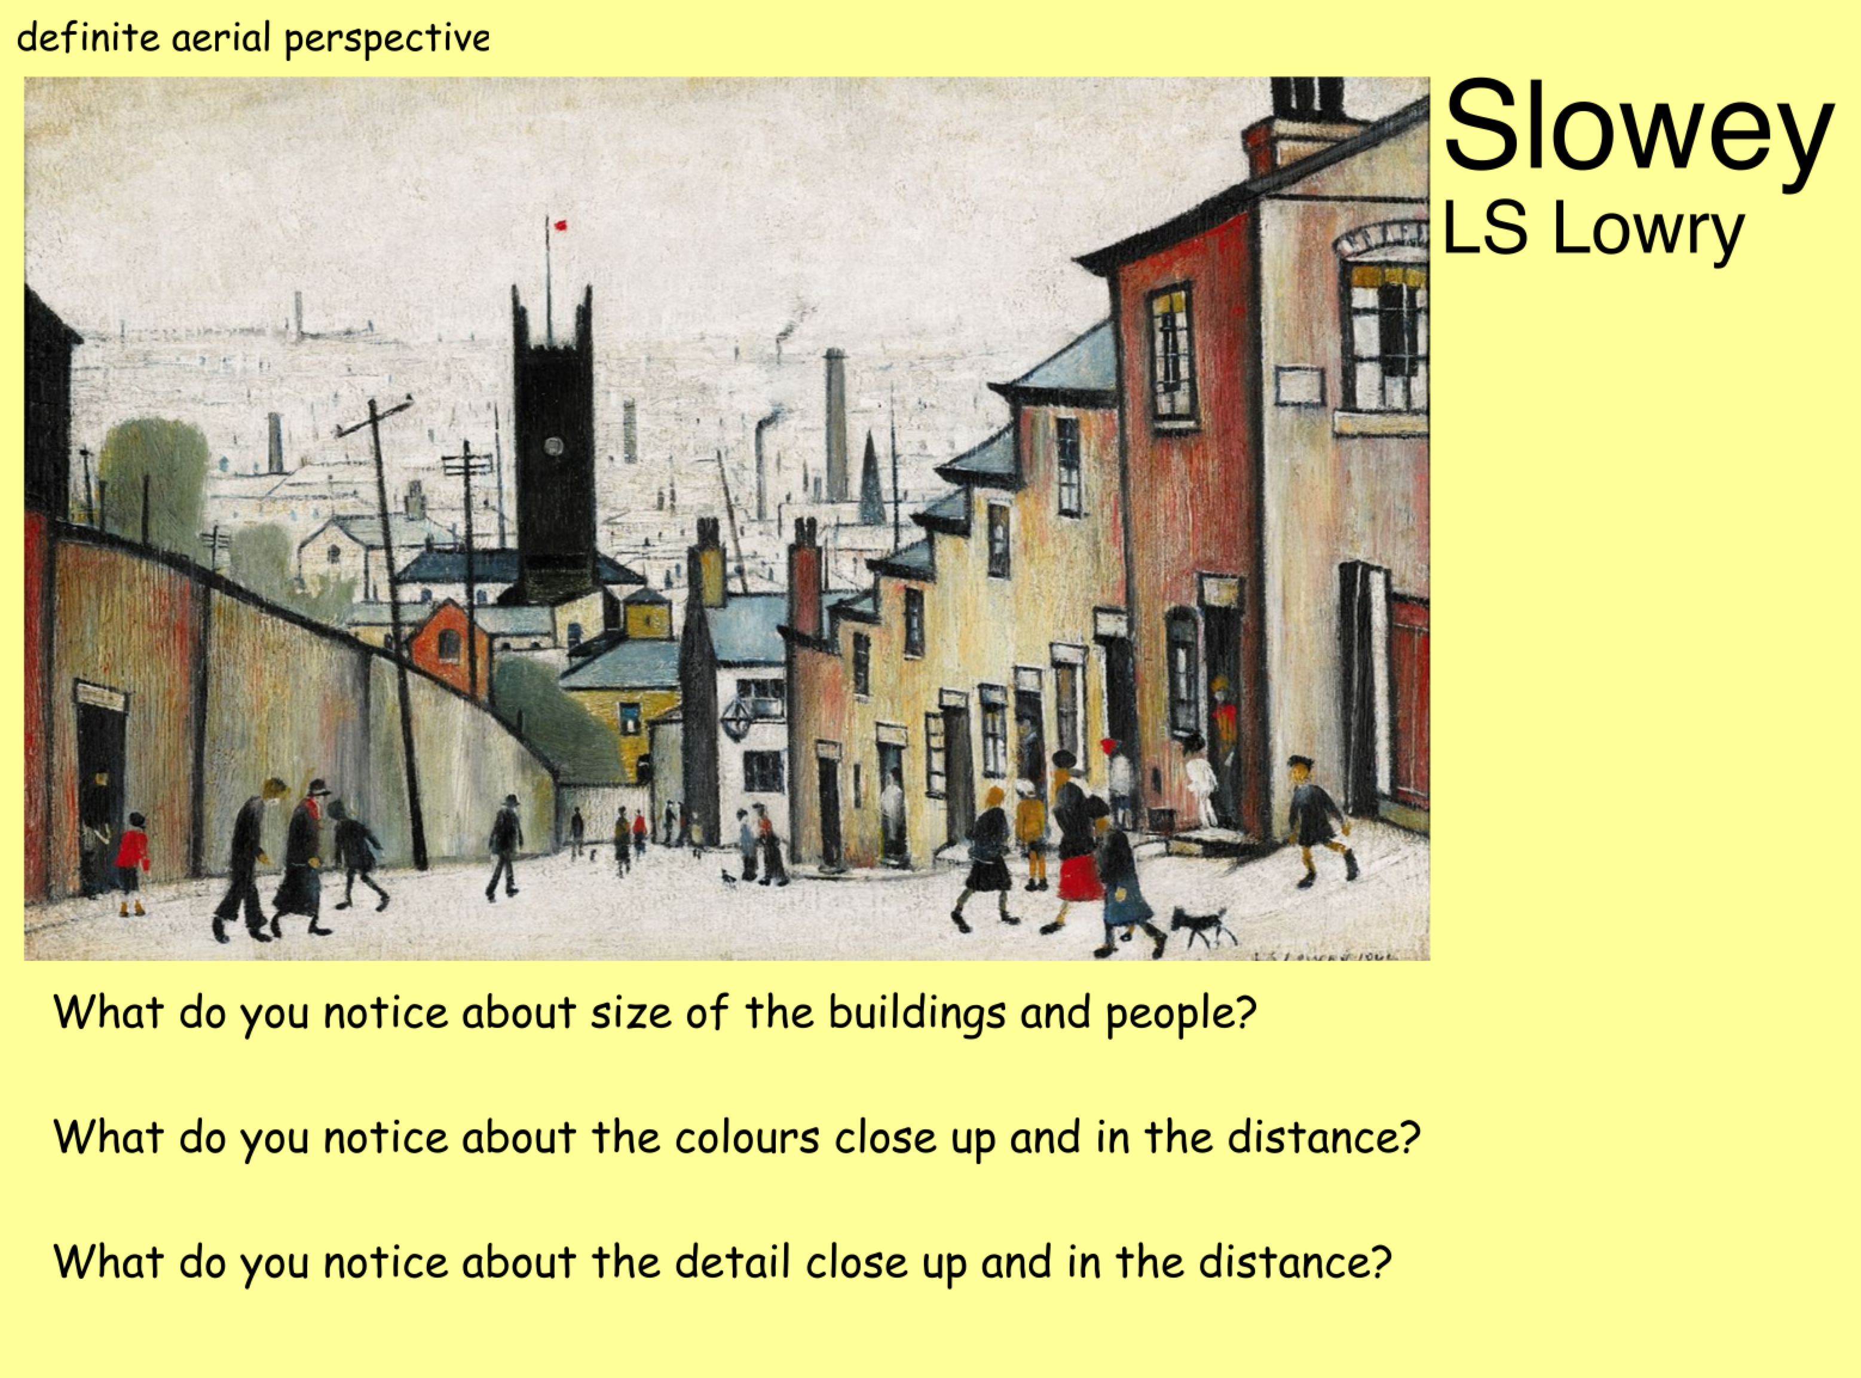

Slide 8
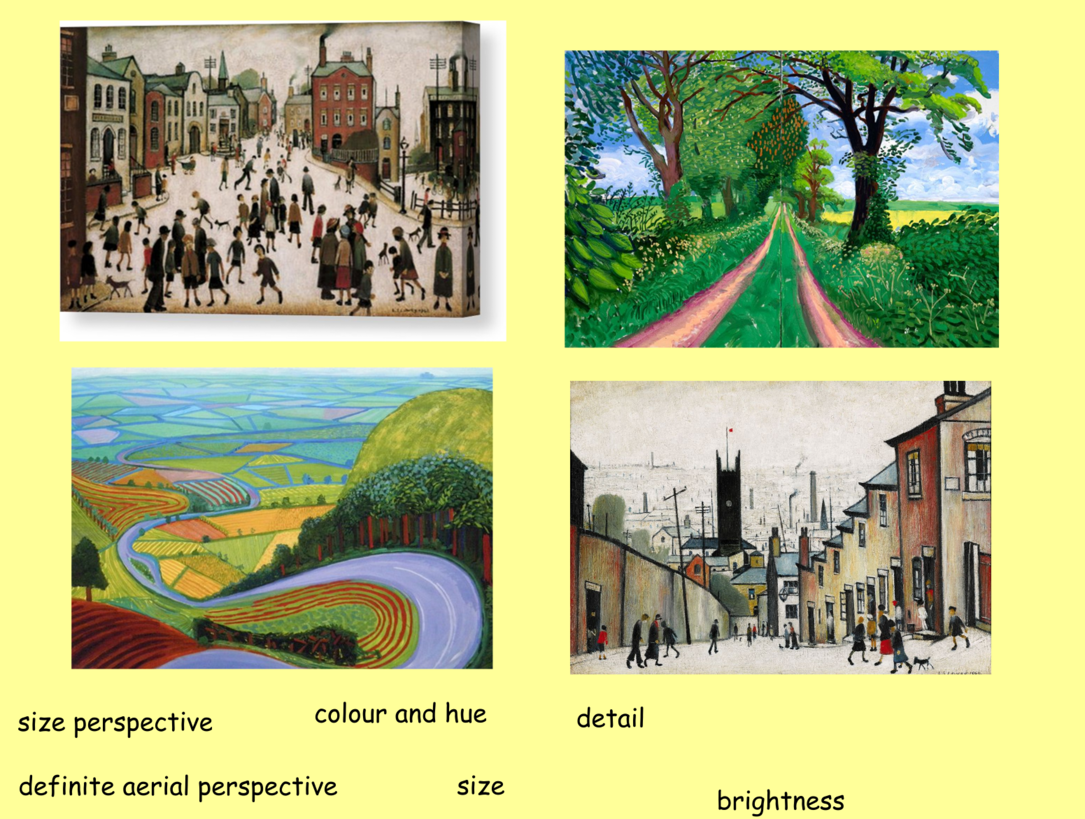
*Choose one image and try to copy parts of it, focusing on size perspective.
**Copy parts of the images, focusing on the ideas of perspective.
*** Copy parts of the images, focusing on the ideas of perspective and then annotate images to show ideas of perspective using the key words.
Click here for lesson 2

Slide 9
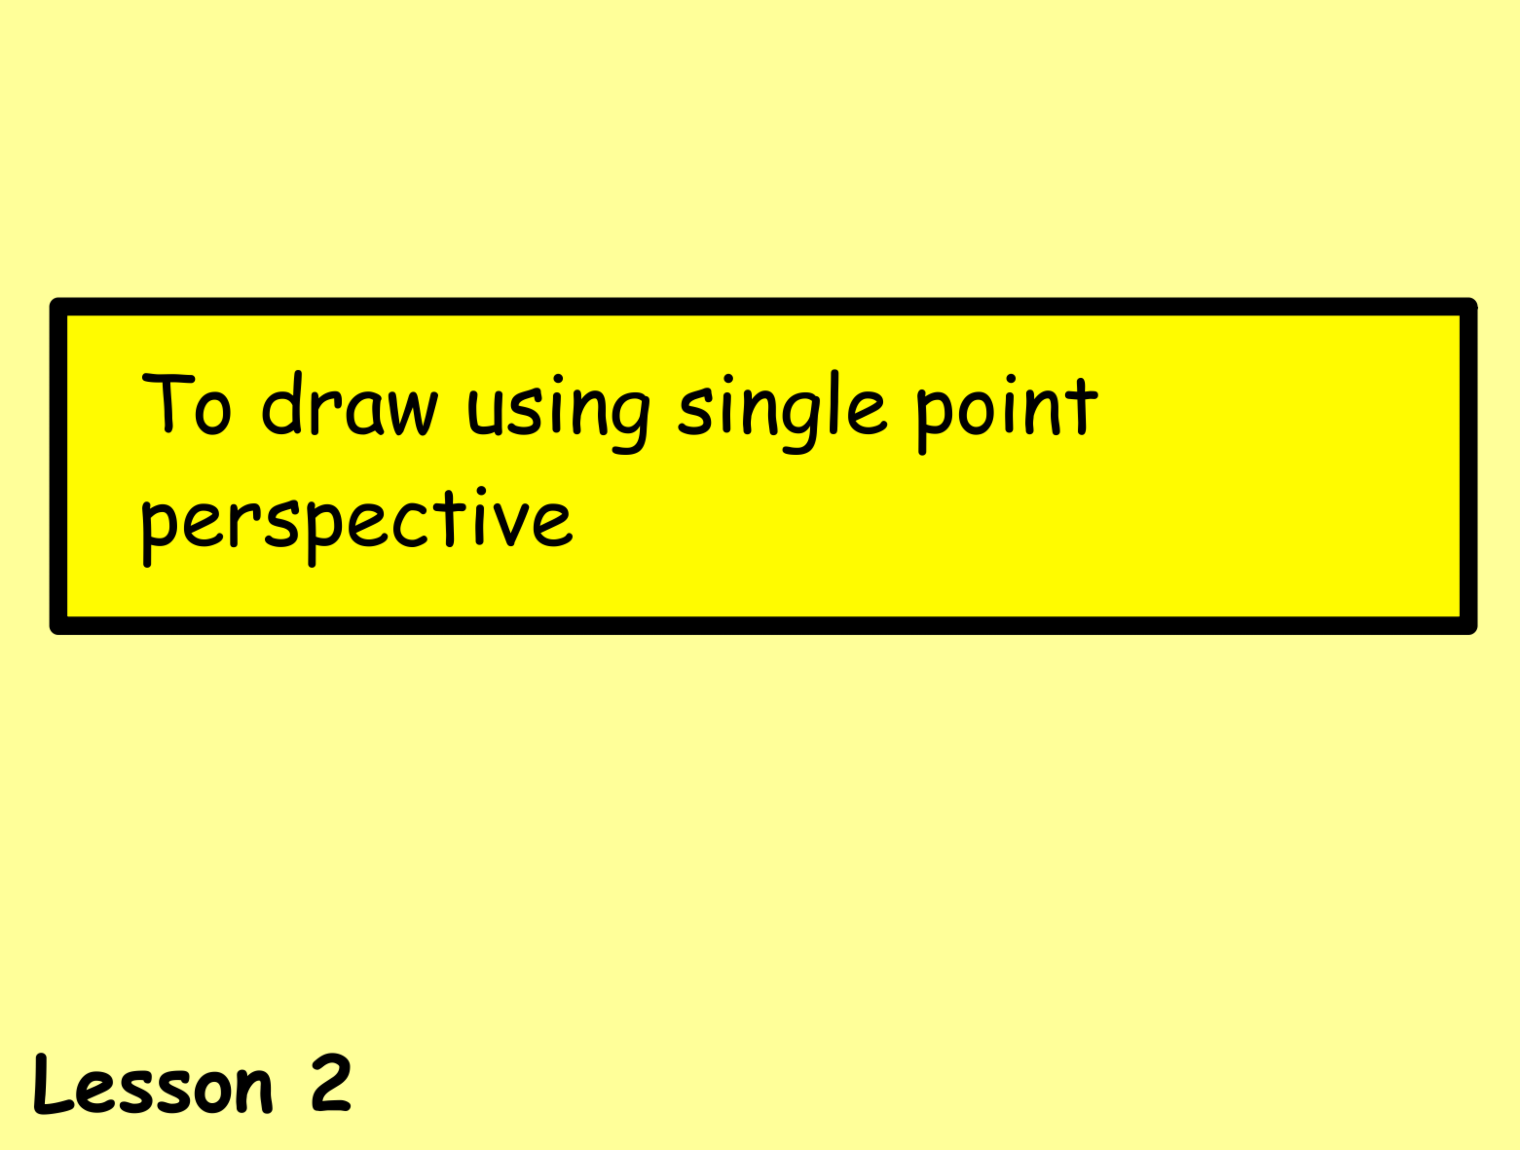

Slide 10
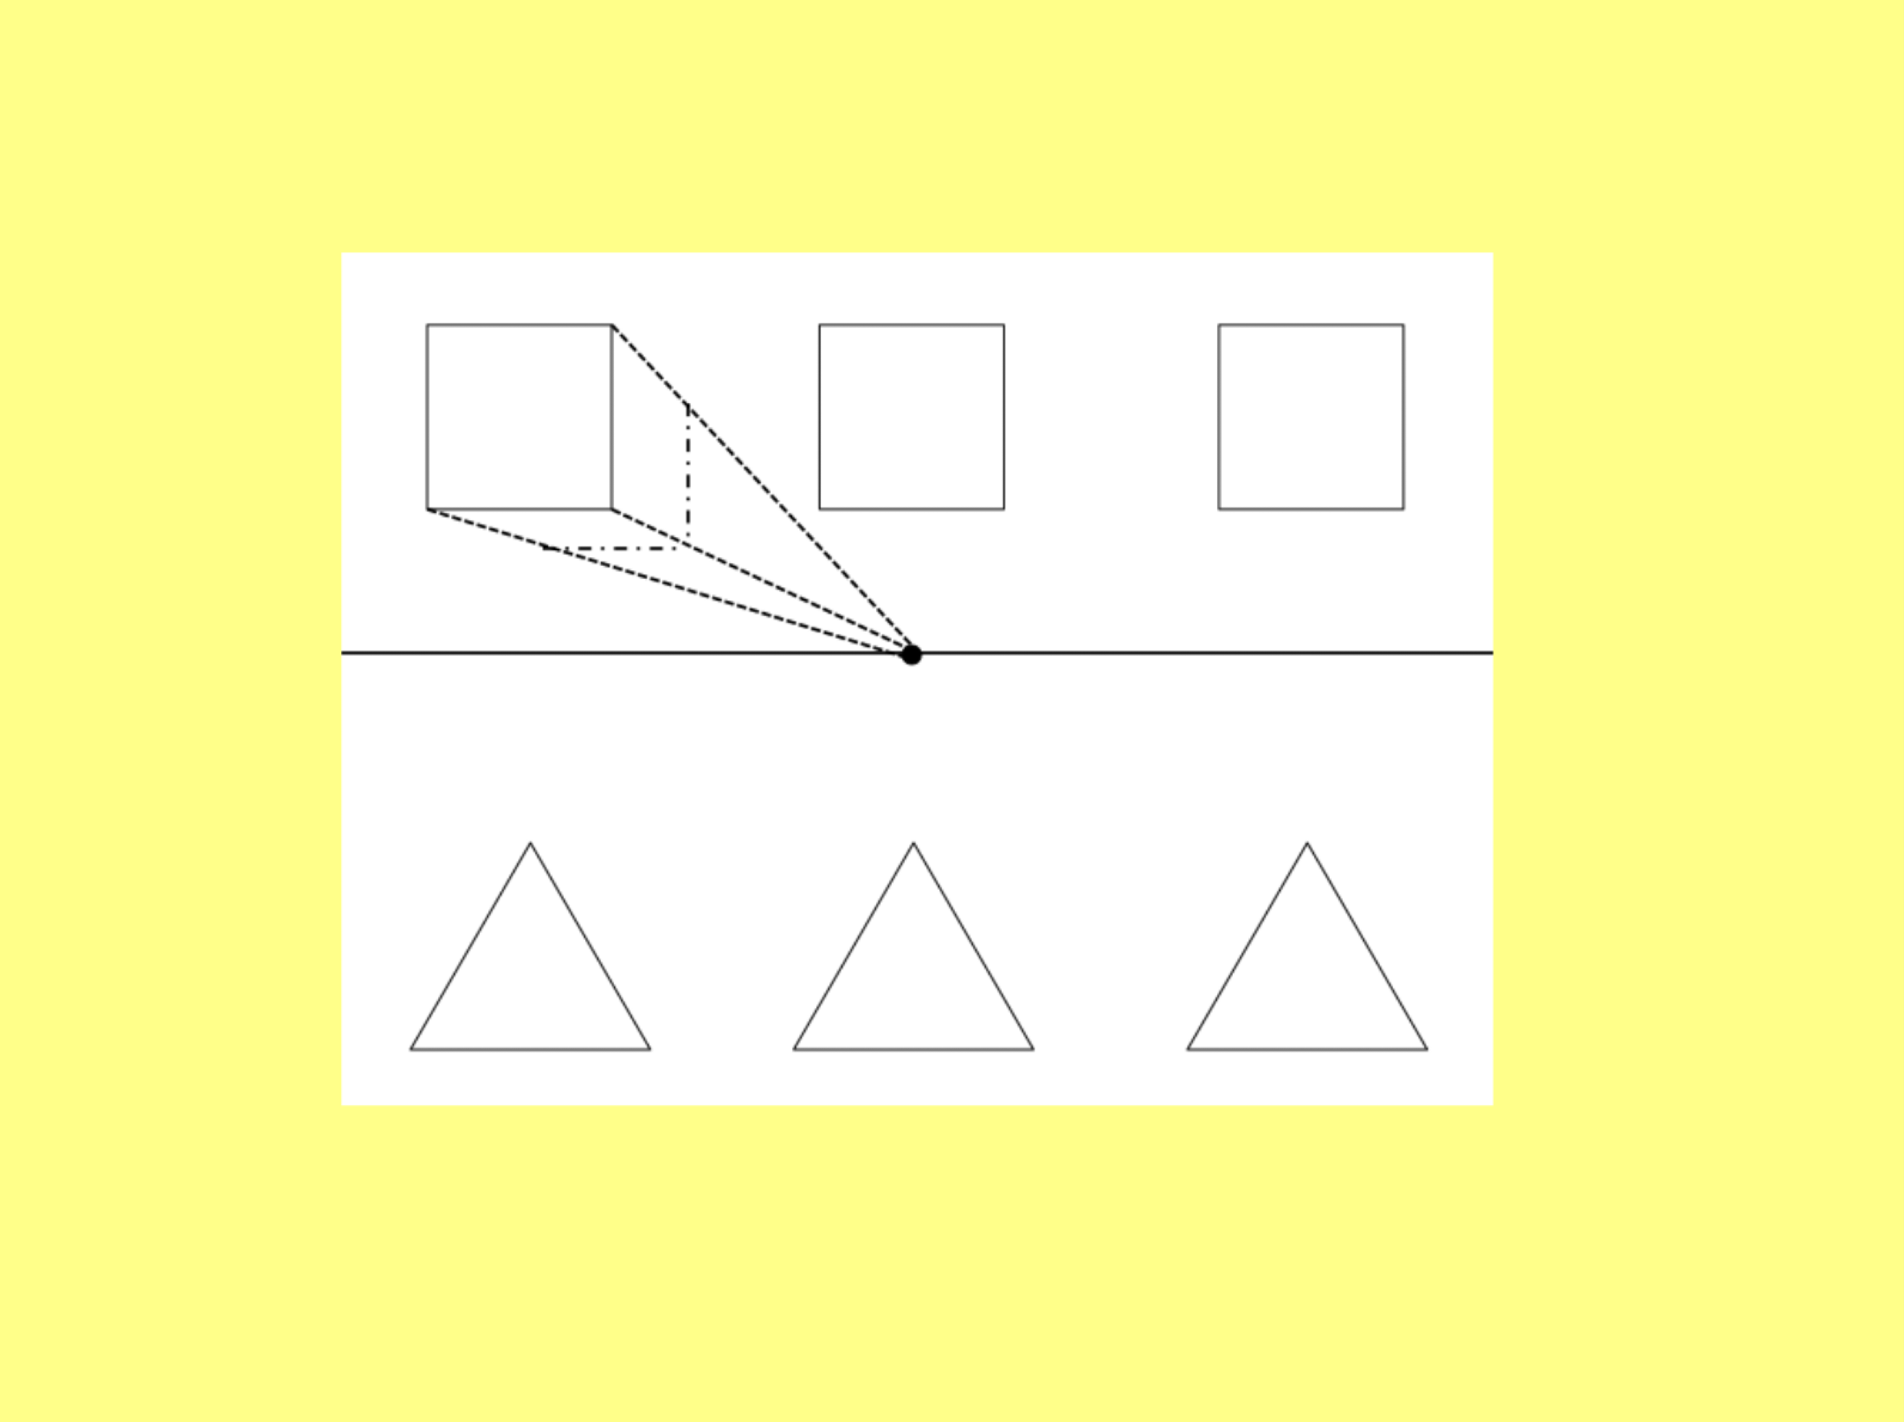
Draw a horizon line and a vanishing point on in.
Draw 3 squares above the horizon line.
Very faintly, draw receding lines from each corner of the 1st square to the vanishing point.
Decide how long you want your cuboid to be and draw parallel lines across the side and bottom of the square between the receding lines.
Repeat with the other squares.
Now try with 3 triangles underneath.
You have just used single point perspective to draw your shapes!

Slide 11
Using single point perspective to draw a street scene.
This time, you will be drawing the horizon, a vanishing point and 2 receding lines to represent the road.
Click on the link below to be directed to a video that will give you step by step instructions on how to draw a street scene. You need to stop and start the video for each step.
Click here for the video.
Click here for lesson 3

Slide 12
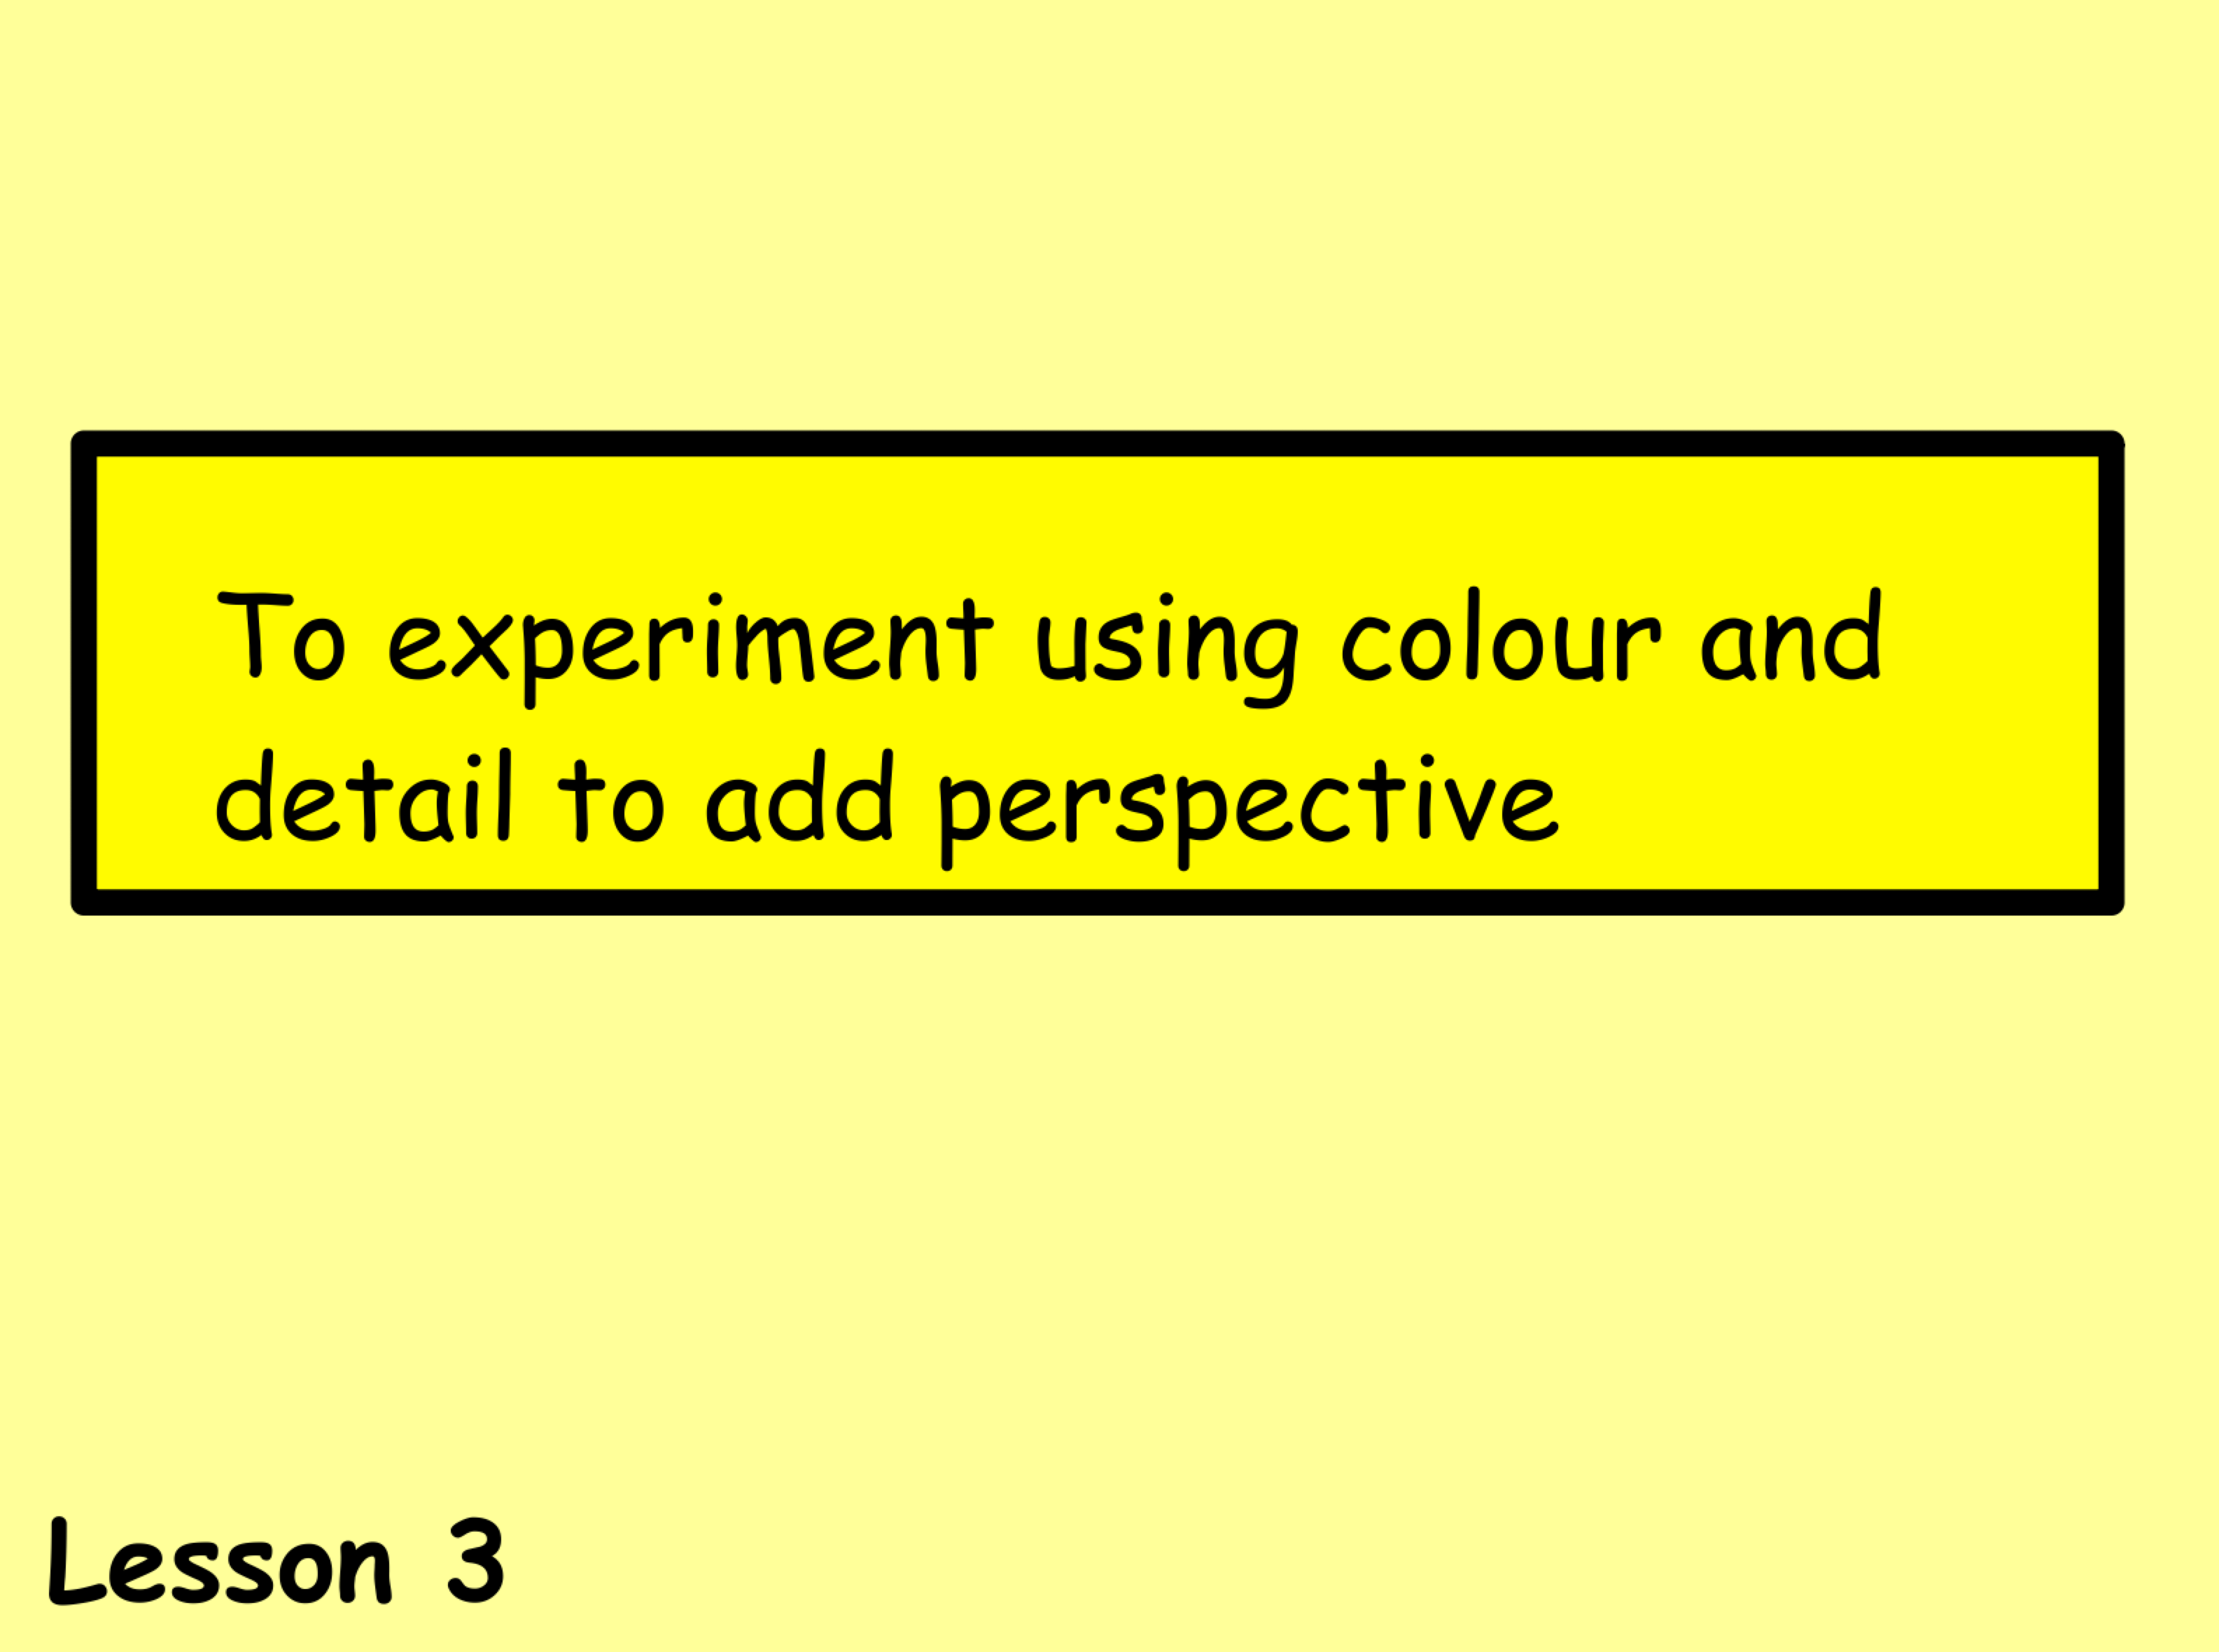

Slide 13
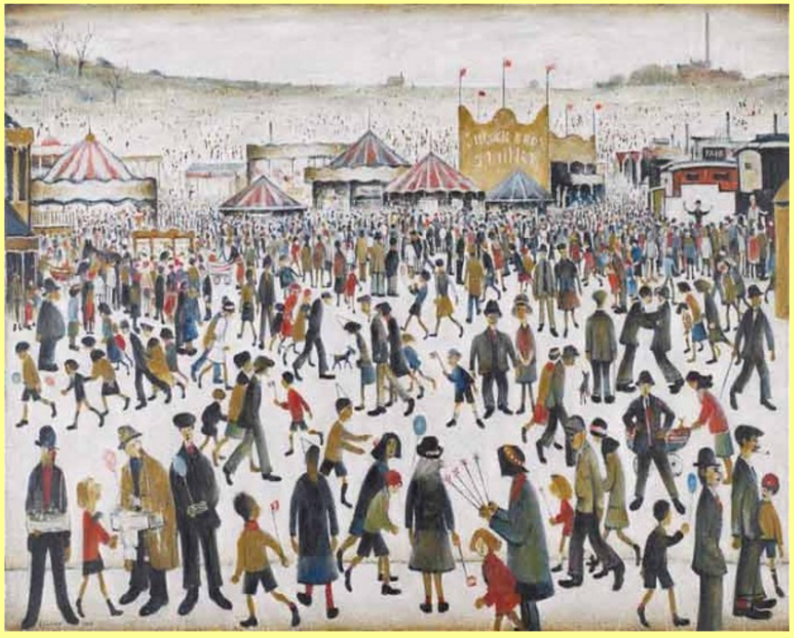
Take a close look at this painting by LS Lowry.
What detail do you see in the people in the foreground?
What about the people in the background?
And the people in the middle?

Slide 14
You should have noticed that the facial features are clearer on those people in the foreground and as you go further back, the facial features fade.
In the foreground, you can see what the people are wearing and what they are carrying and these details become more unclear, the further back you go, until the people are just marks on the paper.
In the foreground, the colours are very vibrant and they fade as you look further towards the background.

Slide 15
Try to create some of your own characters.
How would they look in the foreground?
The middleground?
The background?

Slide 16
Colour and Hue.
Hue - the purest form of a colour with no added whites, blacks or other colours (all the primary and secondary colours).
Colour - the colour which may or may not include whites, blacks or other colours (eg light pink, orangey-red)
Experiment with colour mixing to create paler versions
of a hue that could be used to show an increase in distance.
You can use whatever medium you have; paint, pastel, chalk etc.
Click here for lesson 4

Slide 17
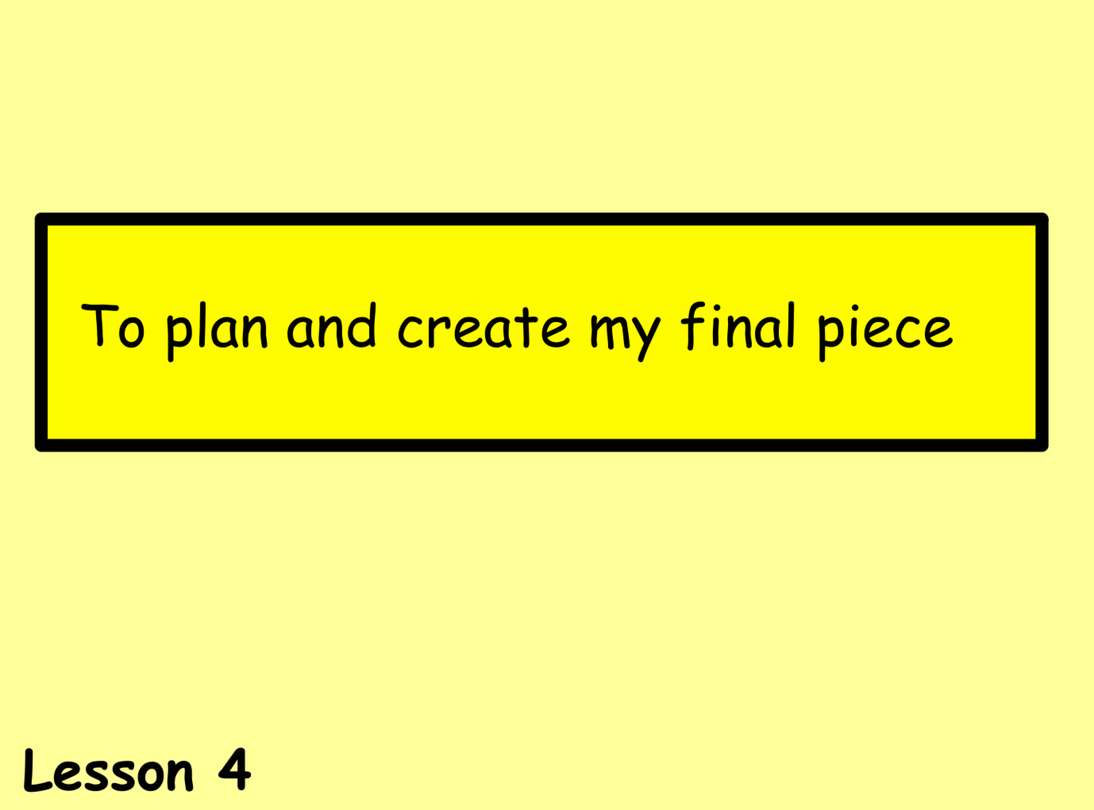

Slide 18
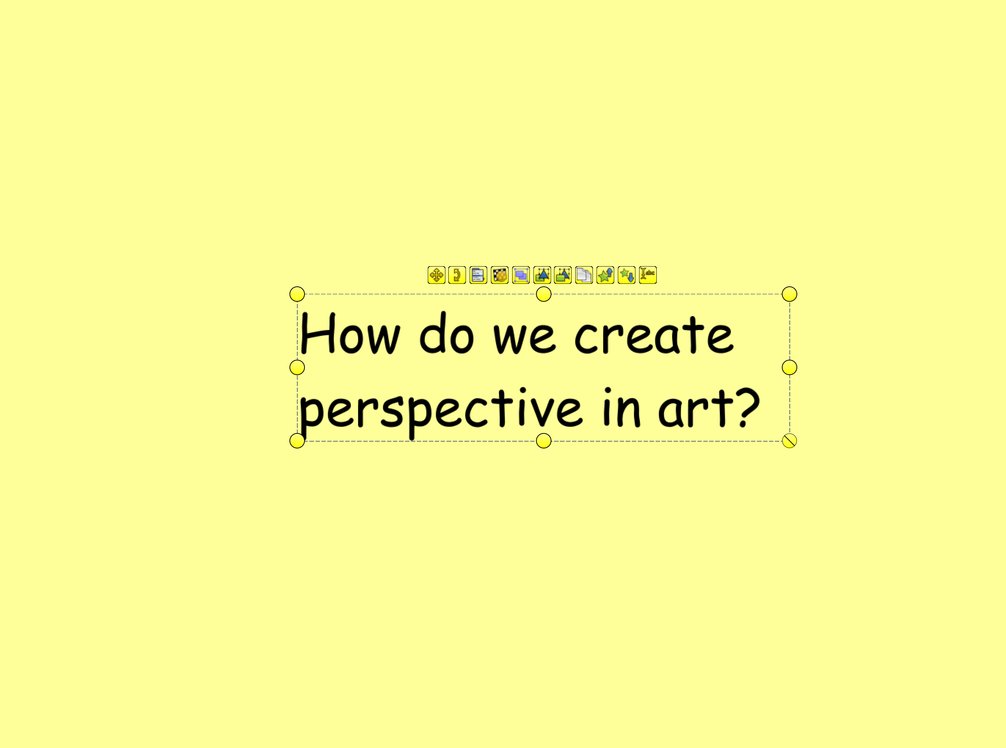
Think about what you have learned and the paintings you have looked at this week and tell someone what we can do to create perspective.

Slide 19
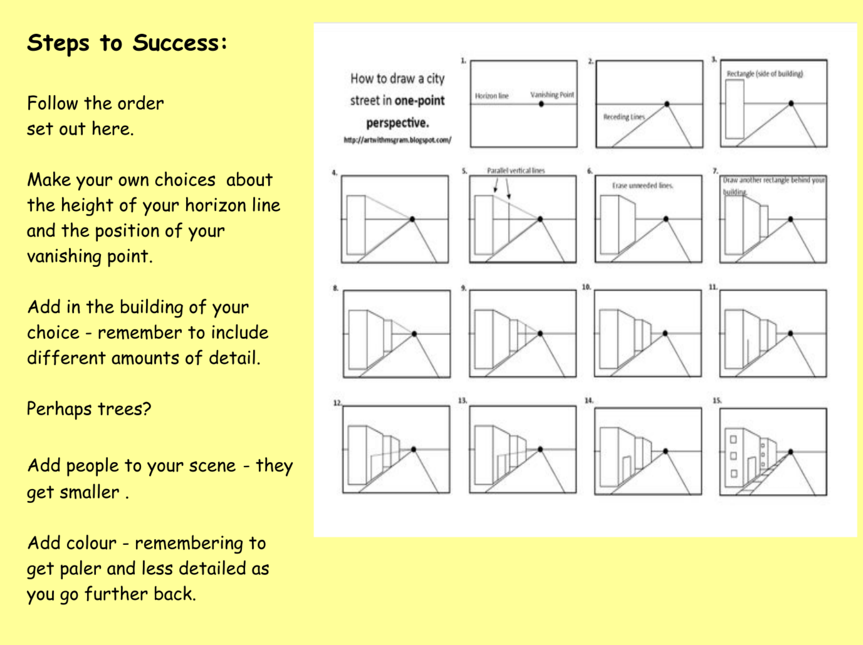
You are going to create your own town scene, using the ideas you have learned this week.
Before you start, go back over the PowerPoint or discuss what you have learned with someone around you.
Follow the Steps to Success and enjoy!!
If you don’t finish it, don’t worry, you can finish it tomorrow.
Click her for lesson 5

Slide 20
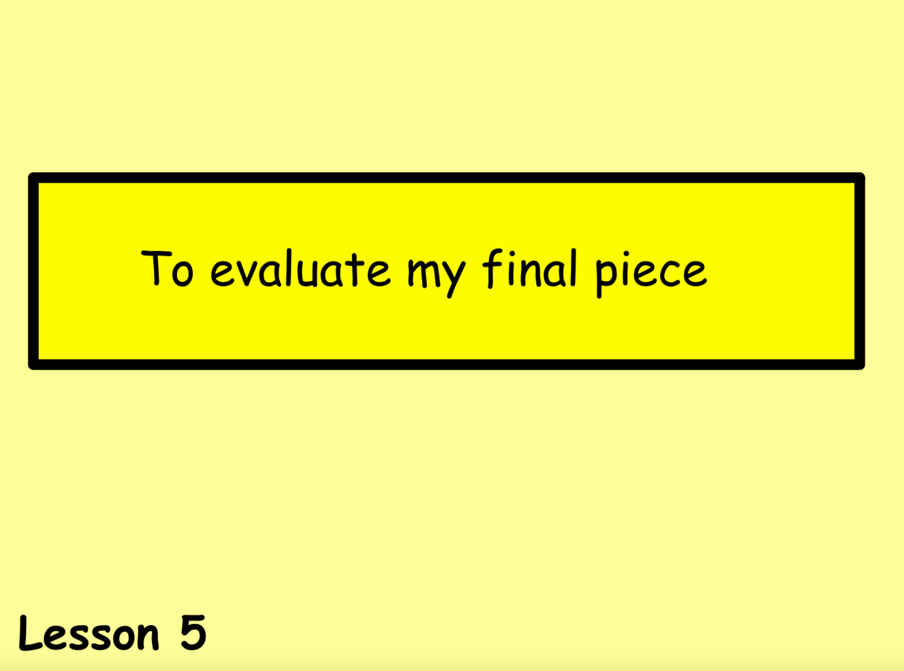

Slide 21
What key skills have we looked at through this topic?
Either write down the key skills we have looked at or talk to someone else at home.

Slide 22
