Slide 1
L.O - To understand ways of expressing feelings and emotions and why this is important.

Slide 2
By the end of the lesson, you will be able to:
name a wide range of feelings and emotions
match feelings to a scale of intensity and identify strong feelings
describe different feelings and how they are experienced in the body
recognise why it is important for people to express their feelings

Slide 3
Warm up
Create a graffiti wall with all the feelings or emotions you can think of.
If you are on the computer: https://graffiter.com/app

Slide 4
Feelings thermometer
Match synonyms to a ‘root’ word, then identify the strong or intense feelings by ranking similar vocabulary on a scale of intensity.
Example:
Sad Miserable Devastated

Slide 5
Feelings change all the time, but sometimes things happen that make our feelings build up and up until they become very strong or intense. Sometimes we get a very strong or intense feeling from just one thing or moment in time. Eventually, for the most part, very strong feelings tend to fade.

Slide 6
Have a look at the following images. Write down what emotions / feelings do you think this picture represents and why?

Slide 7


Slide 8
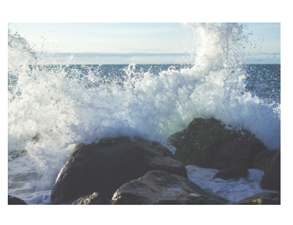

Slide 9
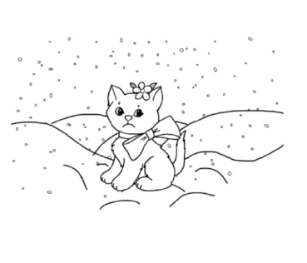

Slide 10


Slide 11
Feelings are often described as similes or metaphors and discuss their meaning, for example:
Colours: ‘she saw red’, ‘feeling blue’, ‘in a black mood’, ‘tickled pink’ or ‘green with envy’
Temperature: ‘fiery temper’, ‘boiling over with rage’ or ‘cool as a cucumber’
Images: ‘over the moon’, ‘shaking like a leaf’ or ‘walking on sunshine’
Can you think of any more?

Slide 12
Choose one of the words from the feelings thermometer activity (it is a good idea to choose a more intense word or feeling) and use the body outline as a basic template on which to draw and write. Respond to the following questions:
If you could explain where in the body someone would experience that feeling, where would it be?
If the feeling had a colour, what colour would it be?
If it had a shape what shape would it be?
If it had a texture, what texture would it be?
If the feeling were an image or a picture, what would this be?
If the feeling had a sound, what sound would this be?

Slide 13
If we allow a feeling (like anger) to build up without expressing it, it can build up so much that it explodes and this may come out in unhealthy or not-very-nice ways, like if someone shouts at someone else for no reason.
Read the following scenario:
Jamie feels worried a lot of the time. Everything seems to worry Jamie. It feels like all the worries in the world are building up into a big pile, sometimes it feels like a wall of worries. Jamie tries not to think about what is happening or the feelings.

Slide 14
What would help Jamie express the feelings?
What might be stopping Jamie from doing this?
What might be the consequences of Jamie not expressing the feelings?
What would most help Jamie in this situation?
Write a short paragraph offering Jamie some advice.

Slide 15
Think about something that you have learnt about feelings today, that they have not thought of before. Go back to their feelings graffiti wall activity – add or amend it in light of your new learning.

