Slide 1


Maths
Measurement
Year One
Maths | Year 4 | Measurement | Estimate, Compare and Calculate | Lesson 9 of 9: Money Matters

Slide 3
Aim
I can compare amounts of money written in pence and pounds.
Success Criteria
I can compare amounts of money using <, > and = signs.

Slide 4

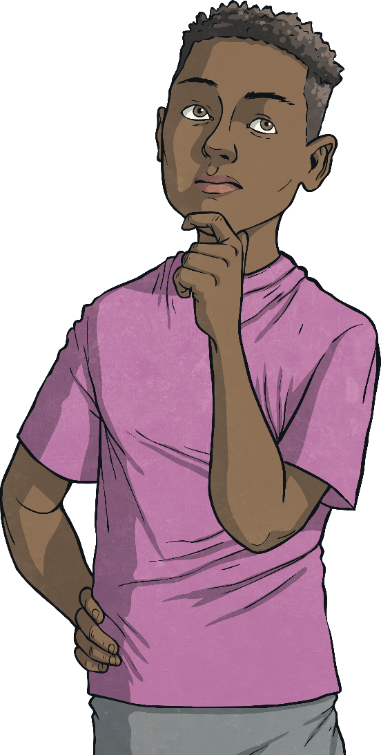

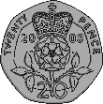
Who Has More?
Use <, > or = to compare the amounts of money.
I have 75p!
I have these coins:
<

Slide 5
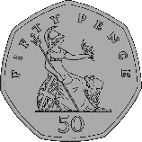

Who Has More?
Use <, > or = to compare the amounts of money.
I have these coins:
I have £1.65
>

Slide 6


Who Has More?
Use <, > or = to compare the amounts of money.
I have £1.09
I have these coins:
=

Slide 7


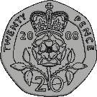
Who Has More?
Use <, > or = to compare the amounts of money.
I have these coins:
I have £2.89
>

Slide 8

Who Has More?
Use <, > or = to compare the amounts of money.
I have £3.08
I have these coins:
=

