Slide 1


Maths
Statistics
Year One
Maths | Year 6 | Statistics | Interpret and Construct Charts and Graphs | Lesson 6 of 6: Class Pet Pie Charts

Slide 2
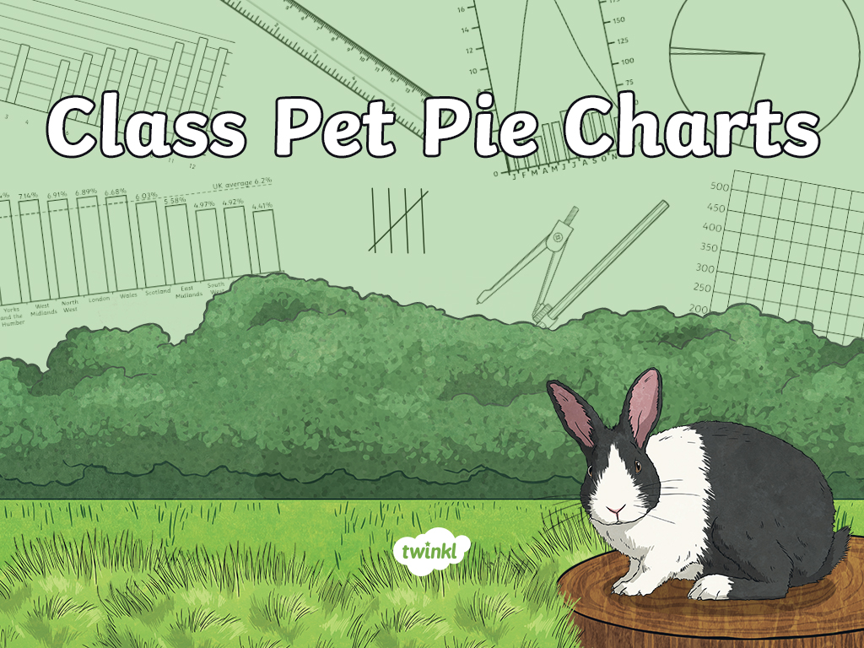

Slide 3
Aim
I can draw pie charts.
Success Criteria
I can use my knowledge of angles and degrees to construct pie charts.
I can convert data to degrees in order to represent it in a pie chart.
I can represent percentages in a pie chart.

Slide 4







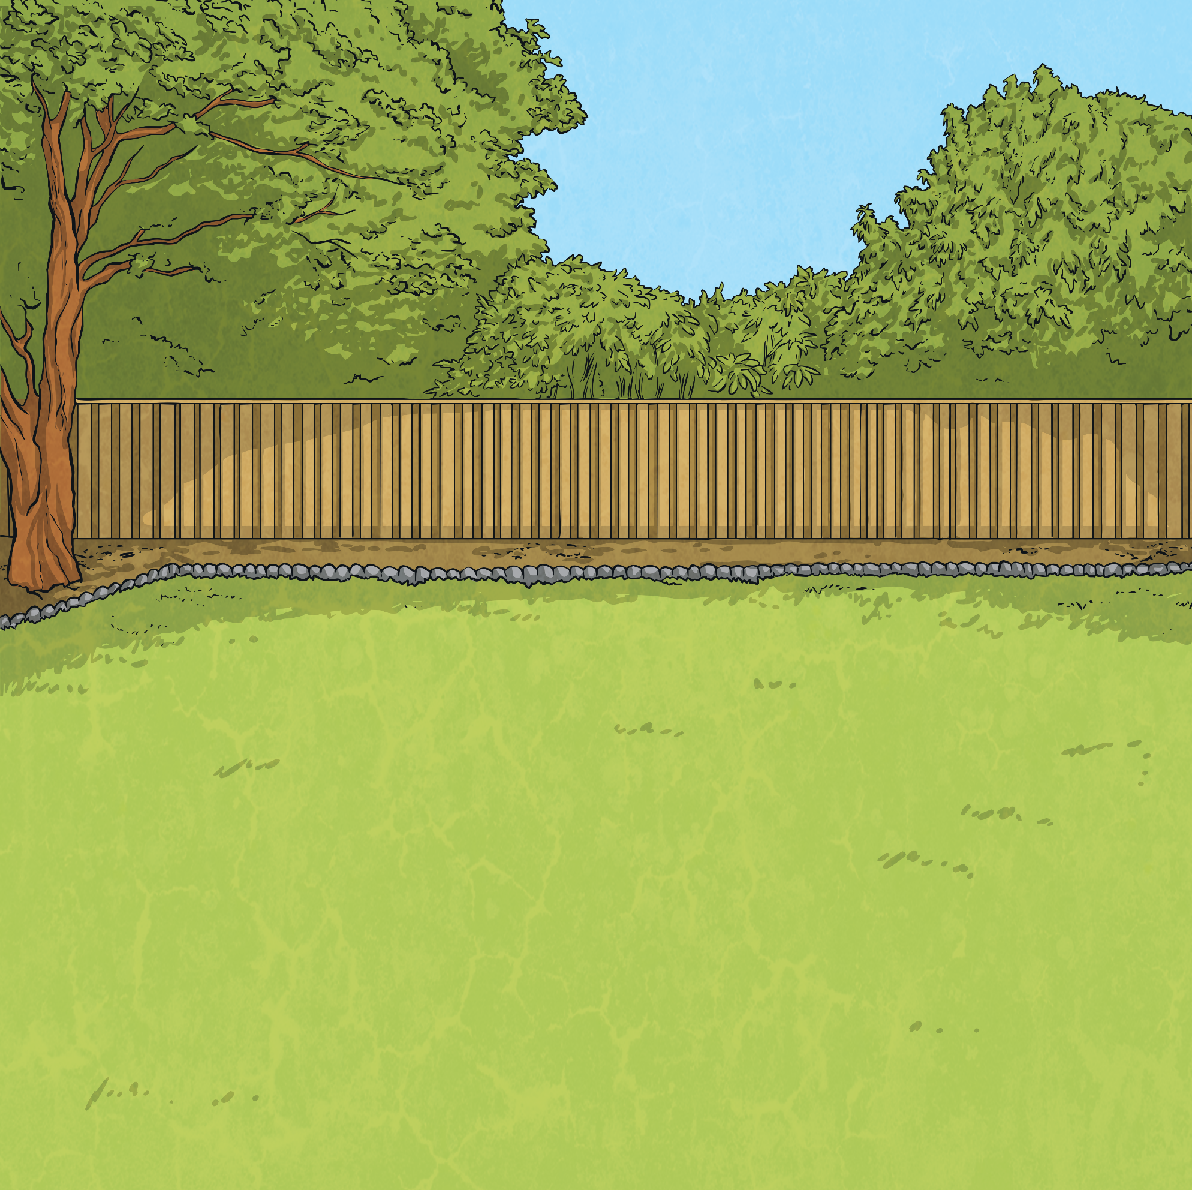

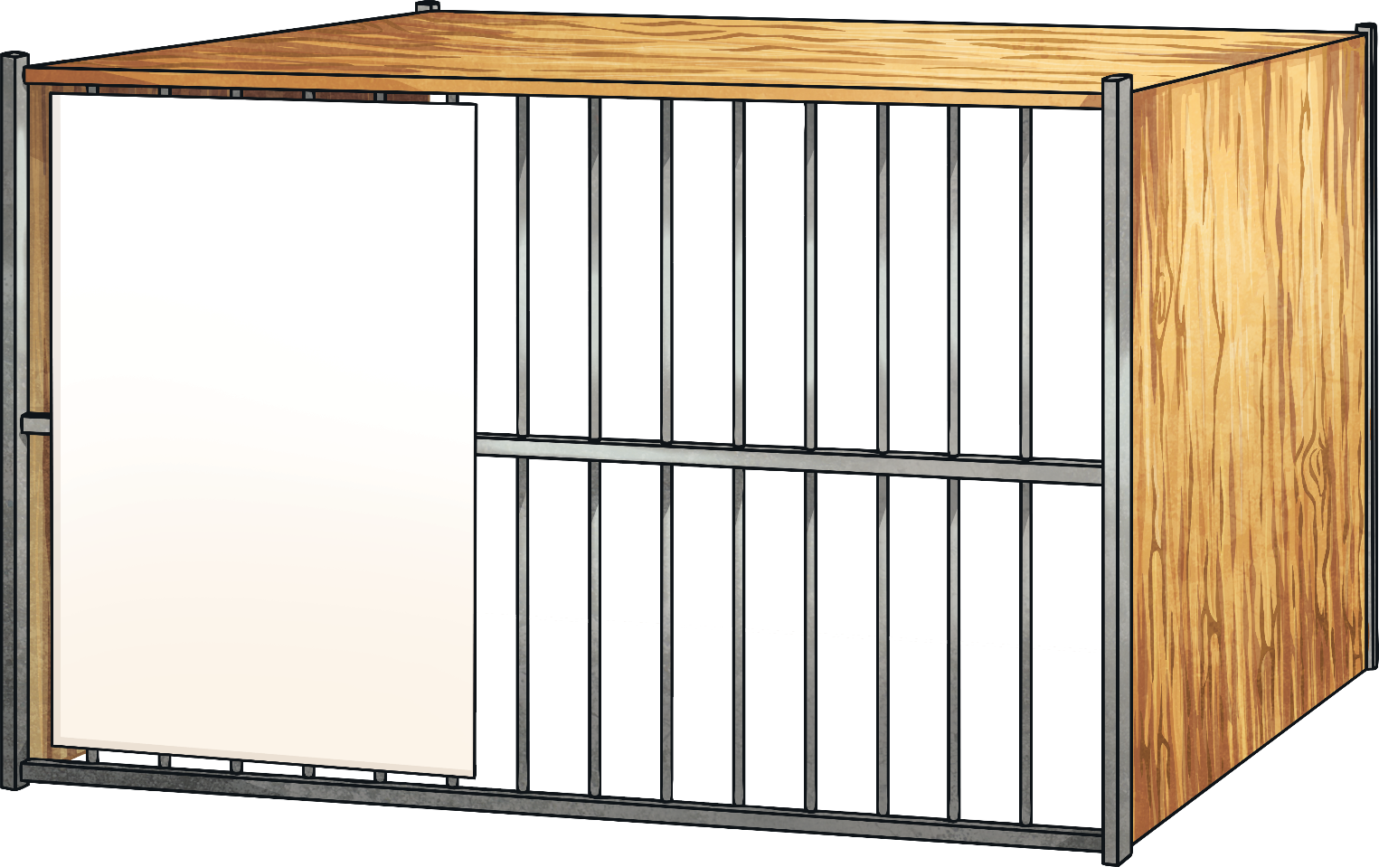

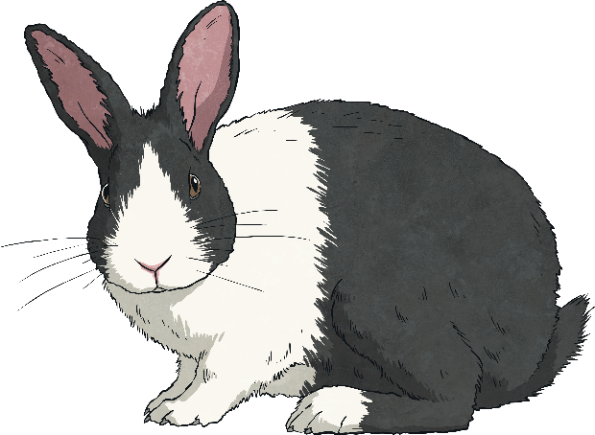
Angles, Degrees, Circles and Turns
Use the word bank to complete these sentences.
An angle measures a .
Angles are measured
in .
A circle is a
turn.
Word Bank
degrees
full
turn
turn
degrees
full

Slide 5
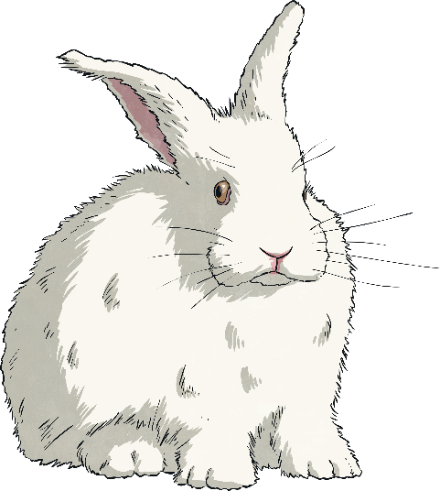
Angles, Degrees, Circles and Turns
Use the word bank to complete these sentences.
360
There are
degrees in a full turn.

Slide 6



Angles, Degrees, Circles and Turns
We can split a full turn into angles and measure the amount of turn in
each angle. This full turn has been split into four equal angles.
How many degrees are there in each of the four angles?
Full turn = 360°
90°
90°
One full turn is always 360°. The angles in a full turn must always add up to 360°.
Each angle measures 90°
.
4 × 90° = 360°.
90°
90°

Slide 7

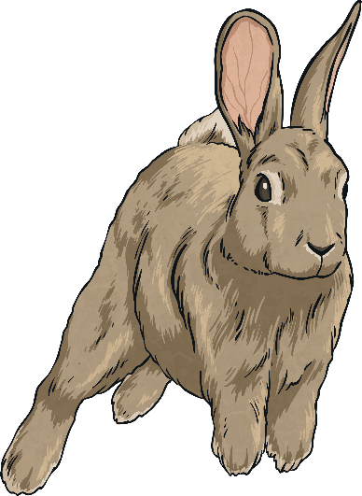
Angles, Degrees, Circles and Turns
Use your knowledge of angles in a full turn to work out
the missing angle in each full turn below.
A
B
C
50°
218°
52°
296°
?°
19°
?°
?°
100°
45°
120°
100° + 120° + 90° = 310°
360° - 310° = 50°
52°+ 90° = 142°
360° - 142° = 218°
19°+ 45° = 64°
360° - 64° = 296°

Slide 8
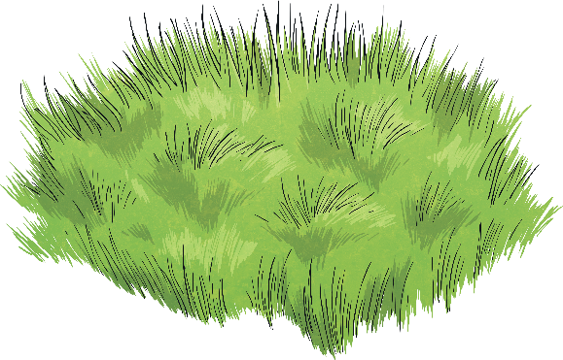
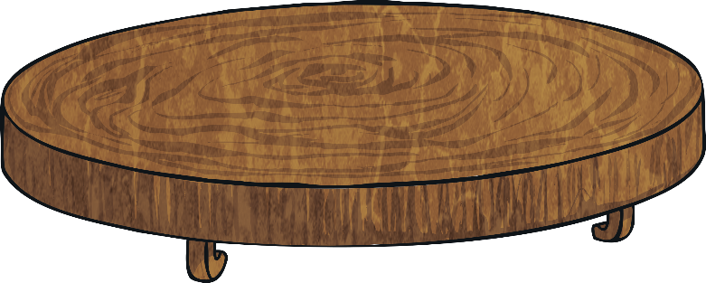
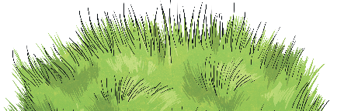
Class Pet Vote
The children in Class 6 have voted on which
animal they would like as their class pet.
This table shows the number of votes for each animal.
Animal | Number of Votes
hamster | 4
rabbit | 10
budgie | 7
guinea pig | 12
fish | 3
Total | 36

Slide 9
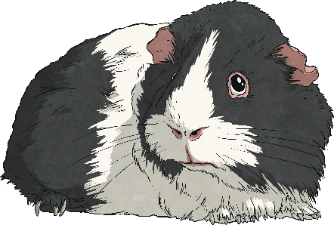
Class Pet Vote
Which animal was voted the favourite choice for a class pet?
Animal | Number of Votes
hamster | 4
rabbit | 10
budgie | 7
guinea pig | 12
fish | 3
Total | 36
The favourite choice for
class pet was a guinea pig.

Slide 10

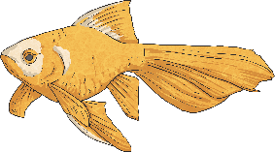
Class Pet Vote
Which animal received the fewest votes?
Animal | Number of Votes
hamster | 4
rabbit | 10
budgie | 7
guinea pig | 12
fish | 3
Total | 36
The animal with the
fewest votes was a fish.

Slide 11

Converting to Degrees
There are 36 votes in total, so the whole pie chart needs to represent 36.
As we know that a full turn is 360°,
we know that each vote is worth
10° on the pie chart.
Can you explain how we know this?
Animal | Number of Votes
hamster | 4
rabbit | 10
budgie | 7
guinea pig | 12
fish | 3
Total | 36
Therefore, each of the 36 votes is worth 10° on
the pie chart.
360 = 10 × 36
or 360 ÷ 36 = 10

Slide 12
Converting to Degrees
Now that we know that one vote is worth 10°, we can convert the raw
data into degrees, ready to draw the data on the pie chart.
We can do this by multiplying the number of votes for each animal by 10.
Animal | Number of Votes | Convert to Degrees
hamster | 4 | 4 × 10 = 40°
rabbit | 10 | 10 × 10 = 100°
budgie | 7 | 7 × 10 = 70°
guinea pig | 12 | 12 × 10 = 120°
fish | 3 | 3 × 10 = 30°
Total | 36 | 36 × 10 = 360°

Slide 13
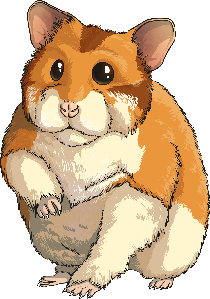
Draw a Pie Chart 1
We can now take this data and draw it onto a pie chart.
We will start off by using a pie chart that is split into 36 angles of 10° each.
Animal | Number of Votes | Convert to Degrees
hamster | 4 | 4 × 10 = 40°
rabbit | 10 | 10 × 10 = 100°
budgie | 7 | 7 × 10 = 70°
guinea pig | 12 | 12 × 10 = 120°
fish | 3 | 3 × 10 = 30°
Total | 36 | 36 × 10 = 360°
Each segment is worth 10°. How many segments should we shade to represent the votes for a hamster?

Slide 14

Draw a Pie Chart 1
We can now take this data and draw it onto a pie chart.
We will start off by using a pie chart that is split into 36 angles of 10° each.
Animal | Number of Votes | Convert to Degrees
hamster | 4 | 4 × 10 = 40°
rabbit | 10 | 10 × 10 = 100°
budgie | 7 | 7 × 10 = 70°
guinea pig | 12 | 12 × 10 = 120°
fish | 3 | 3 × 10 = 30°
Total | 36 | 36 × 10 = 360°
Animal | Number of Votes | Convert to Degrees
hamster | 4 | 4 × 10 = 40°
rabbit | 10 | 10 × 10 = 100°
budgie | 7 | 7 × 10 = 70°
guinea pig | 12 | 12 × 10 = 120°
fish | 3 | 3 × 10 = 30°
Total | 36 | 36 × 10 = 360°
We shade 4 segments to represent the votes for a hamster.
This is 40°.

Slide 15

Draw a Pie Chart 1
We can now take this data and draw it onto a pie chart.
We will start off by using a pie chart that is split into 36 angles of 10° each.
Animal | Number of Votes | Convert to Degrees
hamster | 4 | 4 × 10 = 40°
rabbit | 10 | 10 × 10 = 100°
budgie | 7 | 7 × 10 = 70°
guinea pig | 12 | 12 × 10 = 120°
fish | 3 | 3 × 10 = 30°
Total | 36 | 36 × 10 = 360°
Animal | Number of Votes | Convert to Degrees
hamster | 4 | 4 × 10 = 40°
rabbit | 10 | 10 × 10 = 100°
budgie | 7 | 7 × 10 = 70°
guinea pig | 12 | 12 × 10 = 120°
fish | 3 | 3 × 10 = 30°
Total | 36 | 36 × 10 = 360°
We shade a further 10 segments to represent the
votes for a rabbit.
This is 100°.

Slide 16
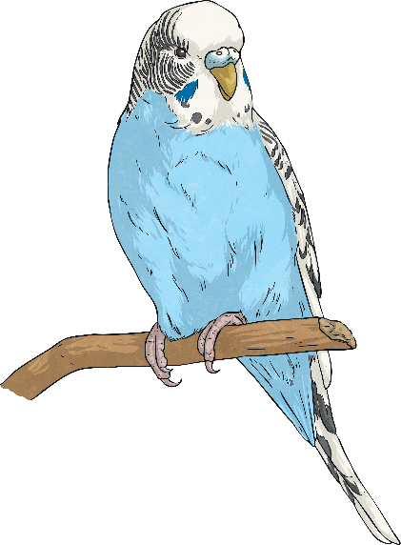
Draw a Pie Chart 1
We can now take this data and draw it onto a pie chart.
We will start off by using a pie chart that is split into 36 angles of 10° each.
Animal | Number of Votes | Convert to Degrees
hamster | 4 | 4 × 10 = 40°
rabbit | 10 | 10 × 10 = 100°
budgie | 7 | 7 × 10 = 70°
guinea pig | 12 | 12 × 10 = 120°
fish | 3 | 3 × 10 = 30°
Total | 36 | 36 × 10 = 360°
Animal | Number of Votes | Convert to Degrees
hamster | 4 | 4 × 10 = 40°
rabbit | 10 | 10 × 10 = 100°
budgie | 7 | 7 × 10 = 70°
guinea pig | 12 | 12 × 10 = 120°
fish | 3 | 3 × 10 = 30°
Total | 36 | 36 × 10 = 360°
We shade a further 7 segments to represent the votes for a budgie.
This is 70°.

Slide 17
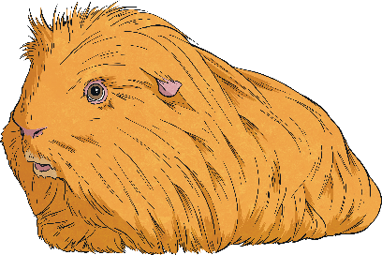
Draw a Pie Chart 1
We can now take this data and draw it onto a pie chart.
We will start off by using a pie chart that is split into 36 angles of 10° each.
Animal | Number of Votes | Convert to Degrees
hamster | 4 | 4 × 10 = 40°
rabbit | 10 | 10 × 10 = 100°
budgie | 7 | 7 × 10 = 70°
guinea pig | 12 | 12 × 10 = 120°
fish | 3 | 3 × 10 = 30°
Total | 36 | 36 × 10 = 360°
Animal | Number of Votes | Convert to Degrees
hamster | 4 | 4 × 10 = 40°
rabbit | 10 | 10 × 10 = 100°
budgie | 7 | 7 × 10 = 70°
guinea pig | 12 | 12 × 10 = 120°
fish | 3 | 3 × 10 = 30°
Total | 36 | 36 × 10 = 360°
We shade a further 12 segments to represent the votes for a guinea pig. This is 120°.

Slide 18
Draw a Pie Chart 1
We can now take this data and draw it onto a pie chart.
We will start off by using a pie chart that is split into 36 angles of 10° each.
Animal | Number of Votes | Convert to Degrees
hamster | 4 | 4 × 10 = 40°
rabbit | 10 | 10 × 10 = 100°
budgie | 7 | 7 × 10 = 70°
guinea pig | 12 | 12 × 10 = 120°
fish | 3 | 3 × 10 = 30°
Total | 36 | 36 × 10 = 360°
Animal | Number of Votes | Convert to Degrees
hamster | 4 | 4 × 10 = 40°
rabbit | 10 | 10 × 10 = 100°
budgie | 7 | 7 × 10 = 70°
guinea pig | 12 | 12 × 10 = 120°
fish | 3 | 3 × 10 = 30°
Total | 36 | 36 × 10 = 360°
Lastly, we shade the final 3 segments to represent the votes for a fish.
This is 30°.

Slide 19
Draw a Pie Chart 1
To finish the pie chart, we need to give it a title and a key to show
what each segment represents. What title would you suggest?
A Pie Chart to Show Class 6’s Votes for Their Class Pet
Hamster
Rabbit
Budgie
Guinea pig
Fish

Slide 20
Draw a Pie Chart 2
We have looked at representing data on a pie chart with segments of 10°.
Now, let's look at how to draw a pie chart on a blank circle.
Animal | Number of Votes | Convert to Degrees
hamster | 4 | 4 × 10 = 40°
rabbit | 10 | 10 × 10 = 100°
budgie | 7 | 7 × 10 = 70°
guinea pig | 12 | 12 × 10 = 120°
fish | 3 | 3 × 10 = 30°
Total | 36 | 36 × 10 = 360°

Slide 21
Draw a Pie Chart 2
Begin by drawing a line from the top edge of the circle to the centre.
This is known as the radius of the circle.
Animal | Number of Votes | Convert to Degrees
hamster | 4 | 4 × 10 = 40°
rabbit | 10 | 10 × 10 = 100°
budgie | 7 | 7 × 10 = 70°
guinea pig | 12 | 12 × 10 = 120°
fish | 3 | 3 × 10 = 30°
Total | 36 | 36 × 10 = 360°

Slide 22
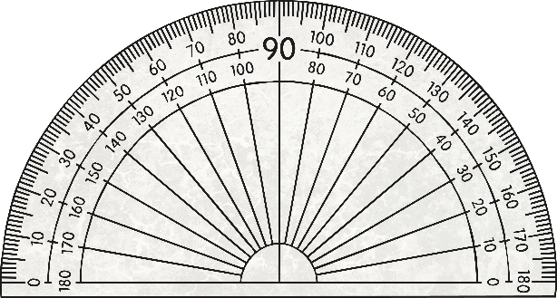
Draw a Pie Chart 2
Use a protractor to measure the first angle. Looking at the
table, we know that the first angle should be 40°.
Animal | Number of Votes | Convert to Degrees
hamster | 4 | 4 × 10 = 40°
rabbit | 10 | 10 × 10 = 100°
budgie | 7 | 7 × 10 = 70°
guinea pig | 12 | 12 × 10 = 120°
fish | 3 | 3 × 10 = 30°
Total | 36 | 36 × 10 = 360°

Slide 23
Draw a Pie Chart 2
The next angle we need to draw represents the votes for a rabbit.
This angle is 100°.
Animal | Number of Votes | Convert to Degrees
hamster | 4 | 4 × 10 = 40°
rabbit | 10 | 10 × 10 = 100°
budgie | 7 | 7 × 10 = 70°
guinea pig | 12 | 12 × 10 = 120°
fish | 3 | 3 × 10 = 30°
Total | 36 | 36 × 10 = 360°
We measure this from the line we have just drawn, so we need to move the protractor onto the 40° line and measure the 100° angle from there.

Slide 24
Draw a Pie Chart 2
We now need to measure a 70° angle to represent the votes for a budgie. Remember to move the protractor onto the line you have just drawn.
Animal | Number of Votes | Convert to Degrees
hamster | 4 | 4 × 10 = 40°
rabbit | 10 | 10 × 10 = 100°
budgie | 7 | 7 × 10 = 70°
guinea pig | 12 | 12 × 10 = 120°
fish | 3 | 3 × 10 = 30°
Total | 36 | 36 × 10 = 360°

Slide 25
Draw a Pie Chart 2
We can now move the protractor to measure the
120° angle for the guinea pig votes.
Animal | Number of Votes | Convert to Degrees
hamster | 4 | 4 × 10 = 40°
rabbit | 10 | 10 × 10 = 100°
budgie | 7 | 7 × 10 = 70°
guinea pig | 12 | 12 × 10 = 120°
fish | 3 | 3 × 10 = 30°
Total | 36 | 36 × 10 = 360°

Slide 26
Draw a Pie Chart 2
Finally, we will use the protractor to check that the remaining
angle is 30° to represent the votes for a fish.
Animal | Number of Votes | Convert to Degrees
hamster | 4 | 4 × 10 = 40°
rabbit | 10 | 10 × 10 = 100°
budgie | 7 | 7 × 10 = 70°
guinea pig | 12 | 12 × 10 = 120°
fish | 3 | 3 × 10 = 30°
Total | 36 | 36 × 10 = 360°

Slide 27
Draw a Pie Chart 2
We can now shade the segments and add a title and a key.
A Pie Chart to Show Class 6’s Votes for Their Class Pet
Hamster
Rabbit
Budgie
Guinea pig
Fish

Slide 28

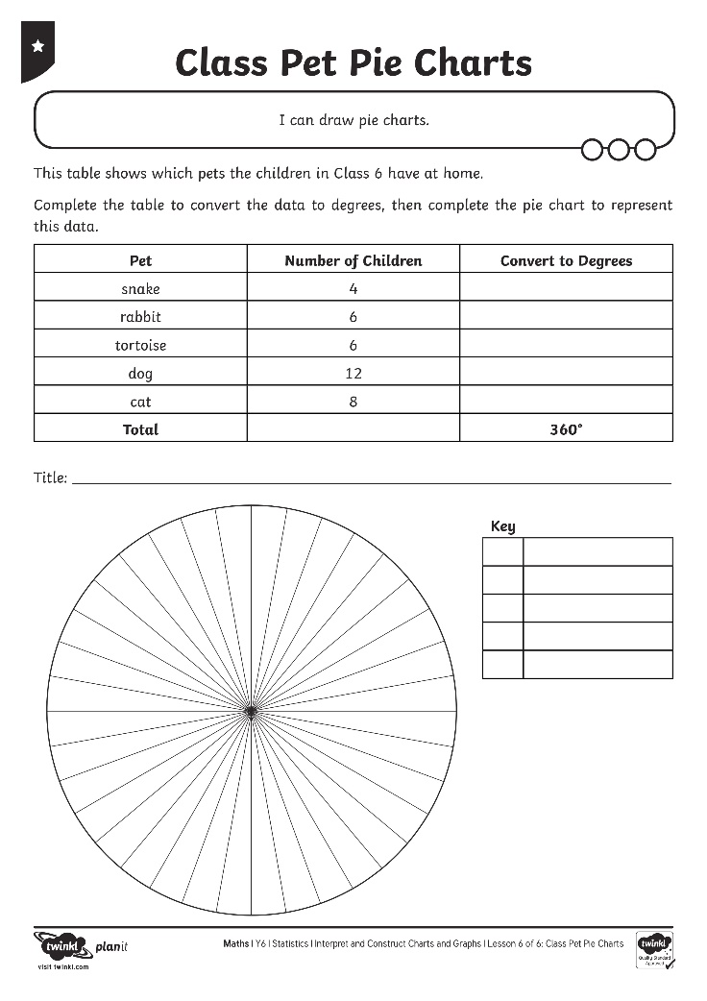
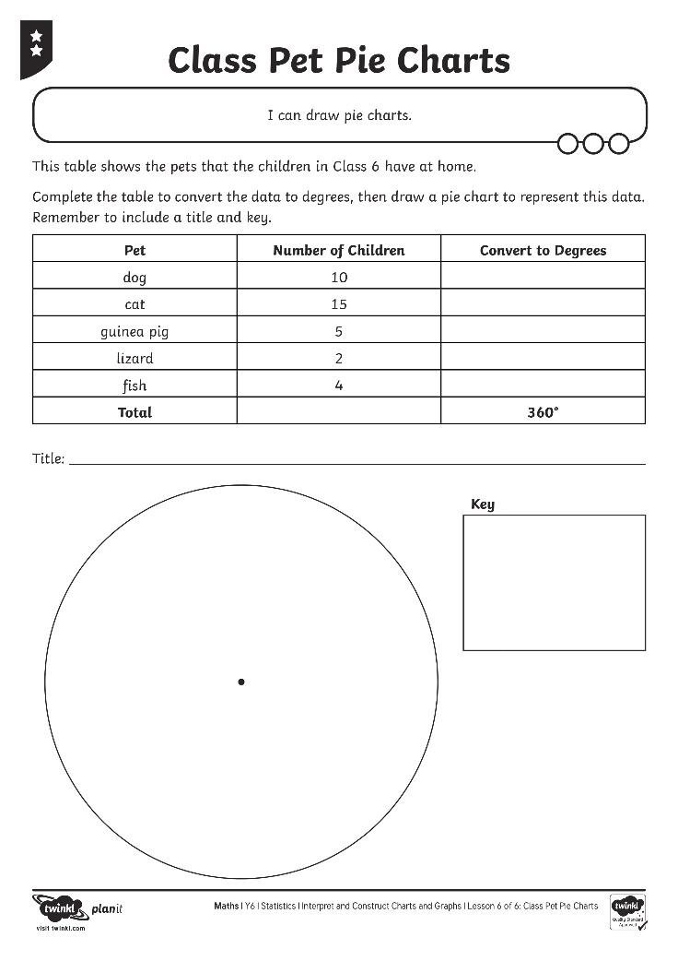
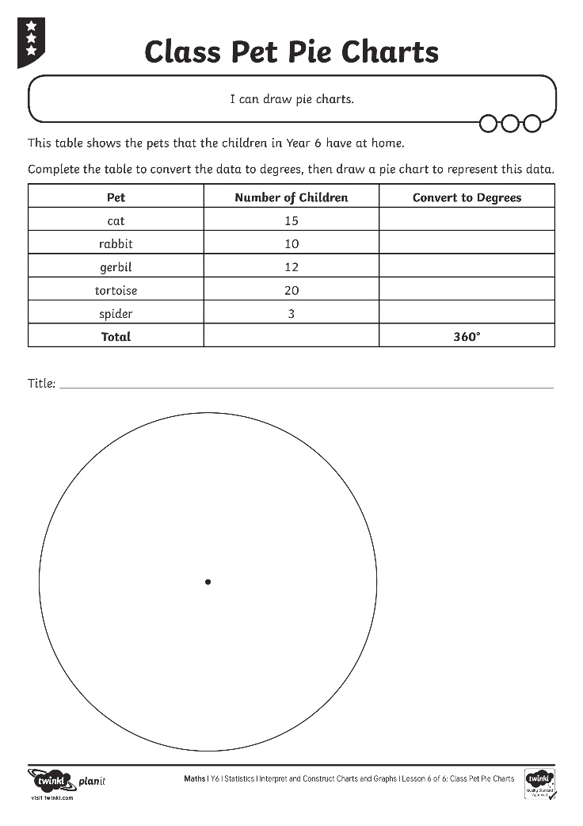
Class Pet Activity Sheets

Slide 29



Percentages in a Pie Chart
Can you work with a partner to represent the data in this
table on the percentage pie chart you have been given?
Class 5’s Votes on the Easiest Pet to Look After
Pet | Number of Votes | Percentage
fish | 15 | 15 × 2 = 30%
lizard | 10 | 10 × 2 = 20%
stick insect | 20 | 20 × 2 = 40%
hamster | 5 | 5 × 2 = 10%
Total | 50 | 100%

Slide 30
Percentages in a Pie Chart
First, work out the percentage of each animal’s votes.
Class 5’s Votes on the Easiest Pet to Look After
Pet | Number of Votes | Percentage
fish | 15 | 15 × 2 = 30%
lizard | 10 | 10 × 2 = 20%
stick insect | 20 | 20 × 2 = 40%
hamster | 5 | 5 × 2 = 10%
Total | 50 | 100%

Slide 31
Percentages in a Pie Chart
Then, shade in the segments of the circle
to represent each percentage.
Pet | Number of Votes | Percentage
fish | 15 | 15 × 2 = 30%
lizard | 10 | 10 × 2 = 20%
stick insect | 20 | 20 × 2 = 40%
hamster | 5 | 5 × 2 = 10%
Total | 50 | 100%

Slide 32
Percentages in a Pie Chart
Finally, add the title and the key.
A Pie Chart to Show Class 6’s Votes for Their Class Pet
Fish
Lizard
Stick insect
Hamster

Slide 33
Aim
I can draw pie charts.
Success Criteria
I can use my knowledge of angles and degrees to construct pie charts.
I can convert data to degrees in order to represent it in a pie chart.
I can represent percentages in a pie chart.

Slide 34


