Slide 2



Diving into Mastery Guidance for Educators
Each activity sheet is split into three sections, diving, deeper and deepest, which are represented by the following icons:
These carefully designed activities take your children through a learning journey, initially ensuring they are fluent with the key concept being taught; then applying this to a range of reasoning and problem-solving activities.
These sheets might not necessarily be used in a linear way. Some children might begin at the ‘Deeper’ section and in fact, others may ‘dive straight in’ to the ‘Deepest’ section if they have already mastered the skill and are applying this to show their depth of understanding.
Diving
Deeper
Deepest

Slide 3
Aim
Interpret and construct pie charts and line graphs and use these to solve problems.

Slide 4

Pie Charts with Percentages
Diving
300 children were asked to choose their favourite ice cream flavour.
This pie chart shows the results:
How many children chose chocolate as their favourite flavour?
75
Favourite Ice Cream Flavour
5%
How many more children chose strawberry than raspberry as their favourite flavour?
60
10%
25%
How many children in total
chose either mint choc chip, vanilla or honeycomb as their favourite flavour?
105
30%
20%
10%
What percentage of children chose raspberry and chocolate altogether?
35%

Slide 5

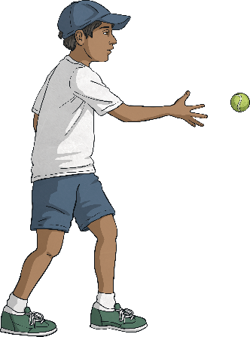
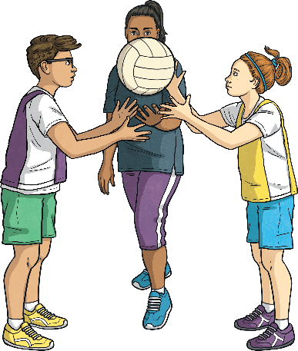
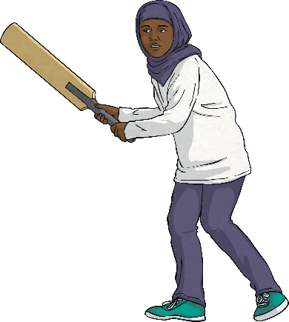
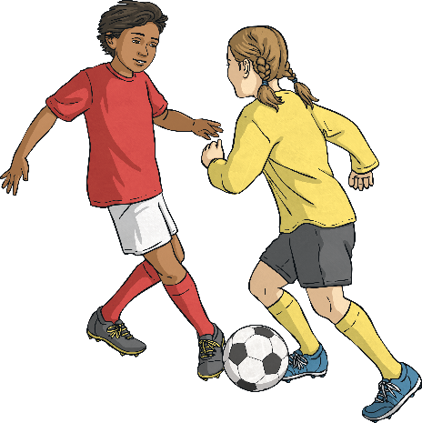
Pie Charts with Percentages
Deeper
140 year 5 children and 160 year 6 children were asked to name their favourite sports. The results are shown in these pie charts:
Favourite Sports in Year 5
Favourite Sports in Year 6
10%
Football
5%
Netball
30%
40%
25%
50%
Tennis
15%
Cricket
25%
The number of children in year 5 who chose tennis as their favourite sport is equal to the number of children in year 6 who chose netball as their favourite sport.
10 more children chose football in year 5 than in year 6.
Twice as many children in year 5 chose cricket as did in year 6.
Explain whether or not you agree with each of these statements about the pie charts, giving reasons.
This is incorrect. Only 6 more children chose football in year 5 compared to year 6
This is incorrect. 35 children in year 5 chose tennis whereas 40 children in year 6 chose netball.
This is incorrect. 14 children in year 5 chose cricket and 8 children in year 6 chose cricket.

Slide 6

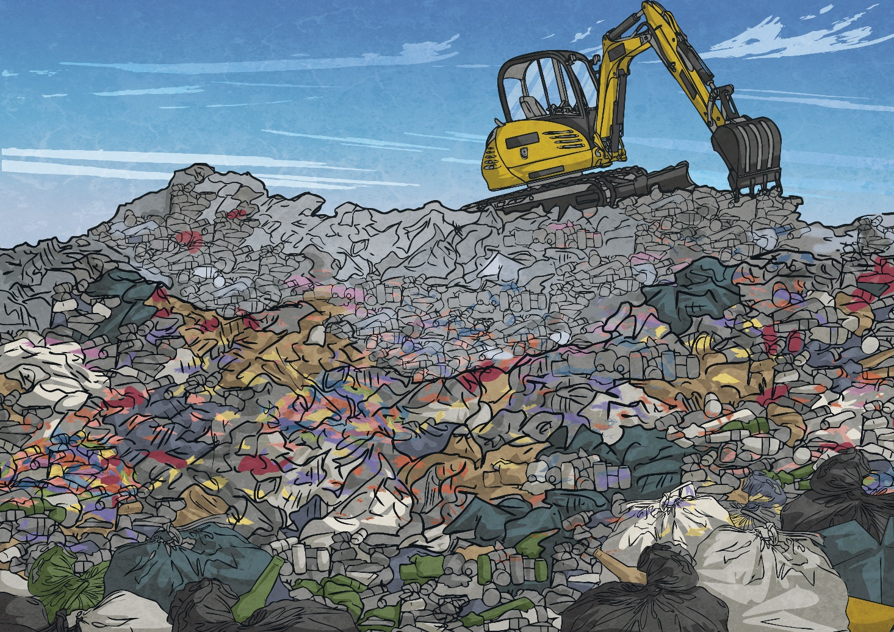
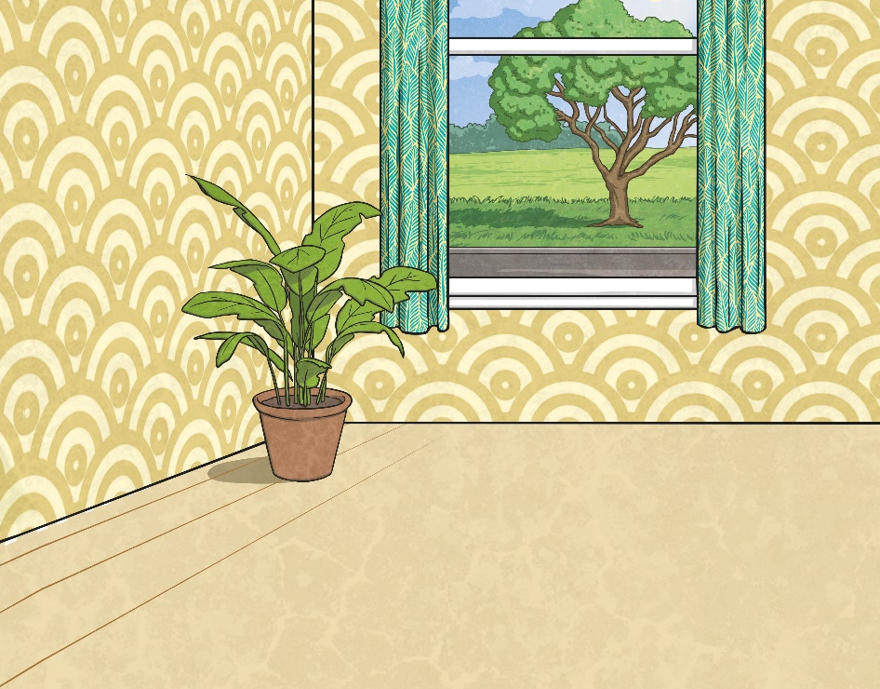

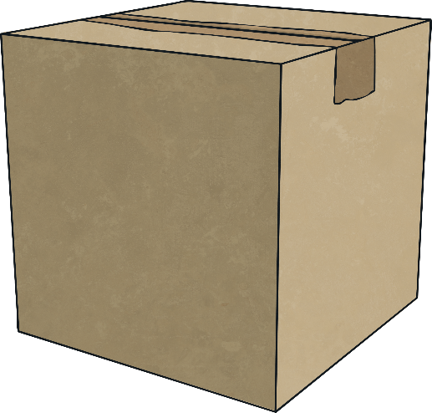
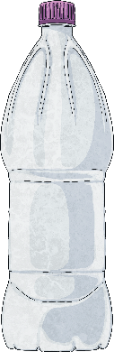
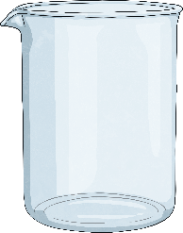

Pie Charts with Percentages
Deepest
This pie chart shows the different percentages of recycled materials that were collected in 2019:
If 250 tonnes of recycling was ‘other’
materials, how many tonnes of
recycling were collected in total
during 2019?
2019 Recycling
5000 tonnes
5%
25%
Calculate the quantities collected of
the following materials:
33%
15%
1250 tonnes
cardboard
22%
plastic
750 tonnes
glass
1100 tonnes
fabric
1650 tonnes

Slide 7
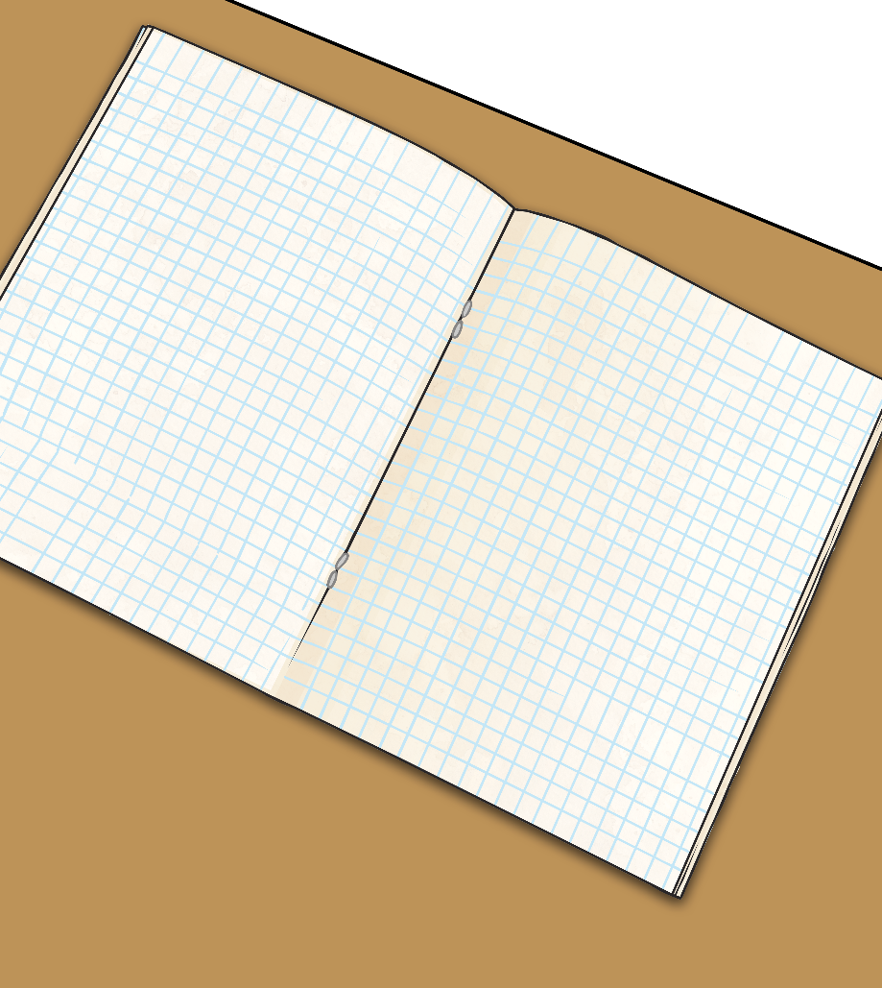
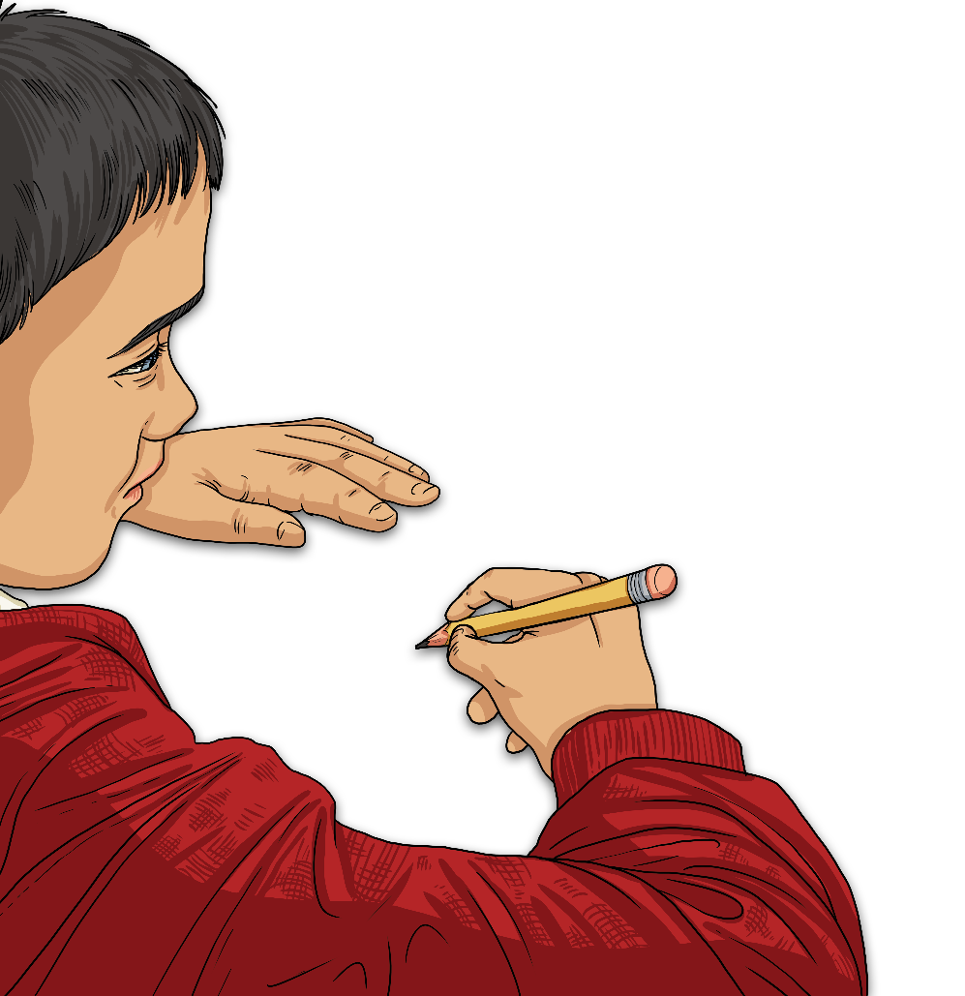
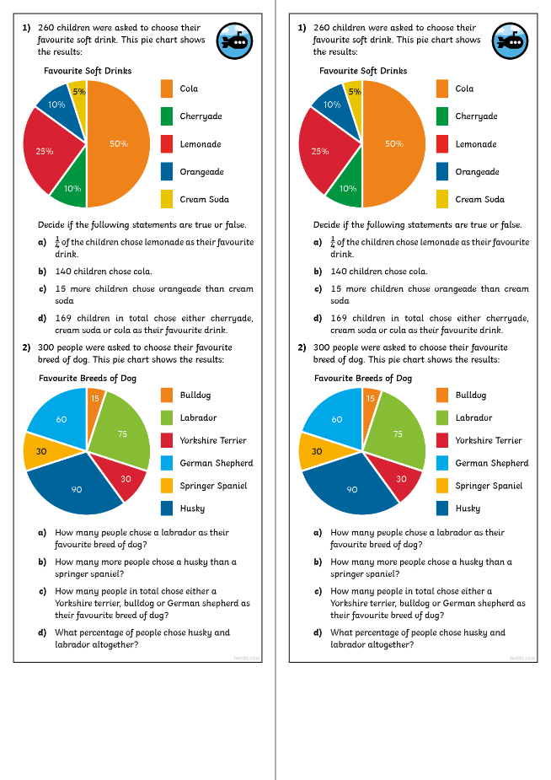
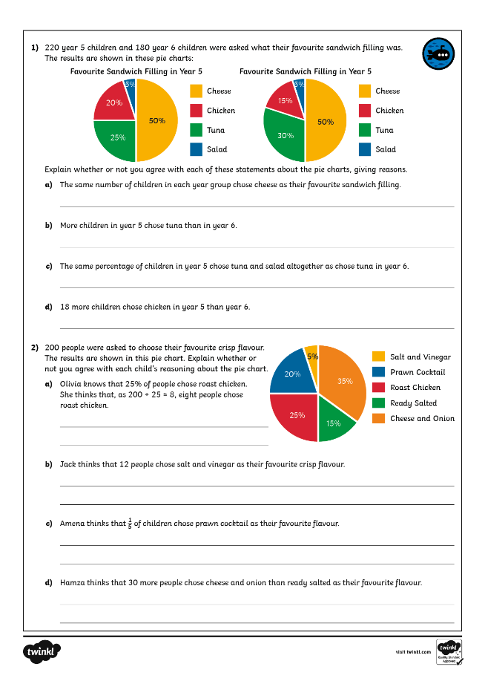
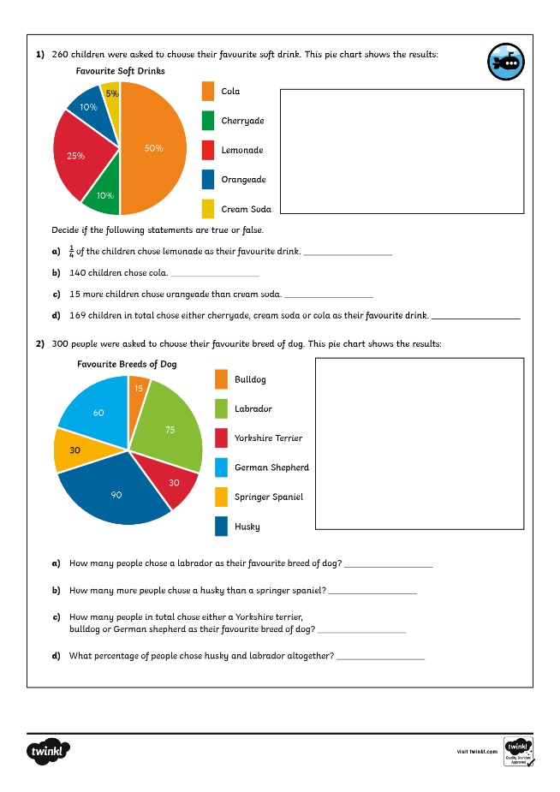

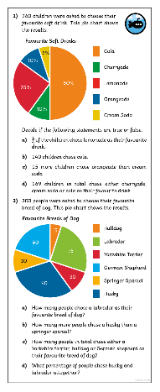
Pie Charts with Percentages
Dive in by completing your own activity!

