Slide 2



Diving into Mastery Guidance for Educators
Each activity sheet is split into three sections, diving, deeper and deepest, which are represented by the following icons:
These carefully designed activities take your children through a learning journey, initially ensuring they are fluent with the key concept being taught; then applying this to a range of reasoning and problem-solving activities.
These sheets might not necessarily be used in a linear way. Some children might begin at the ‘Deeper’ section and in fact, others may ‘dive straight in’ to the ‘Deepest’ section if they have already mastered the skill and are applying this to show their depth of understanding.
Diving
Deeper
Deepest

Slide 3
Aim
To read and interpret pie charts

Slide 4

Read and Interpret Pie Charts
Diving
This pie chart shows the holiday destinations for 480 people.
A
How many people went to France on holiday?
Greece
120
Portugal
B
What fraction of the people chose to go to Spain and Portugal?
Spain
5
8
C
France
How many more people went to Spain than Greece?
Spain = 480 ÷ 2 = 240
France = 60 × 2 = 120
Greece = 60
Portugal = 60
Spain = 240 people Greece = 60 people
240 - 60 = 180 more people went
to Spain than Greece.

Slide 5


Read and Interpret Pie Charts
Deeper
A Netball team played 42 games and a Cricket team played 24 games in a season.
Their results are shown in these pie charts:
Look at the statements and explain if you agree or disagree with each child.
Cricket
Netball
Looking at the pie charts, it seems like both teams won the same number of games.
Henry
Henry is incorrect. The netball team has won half of their games (21 games won) and the cricket team has won half of their games (12 games won). The netball team has therefore won more games than the cricket team because they played a greater number of games.
Win
Loss
Draw

Slide 6

Read and Interpret Pie Charts
Deeper
A Netball team played 42 games and a Cricket team played 24 games in a season.
Their results are shown in these pie charts:
Look at the statements and explain if you agree or disagree with each child.
Cricket
Netball
I think the cricket team must have drawn more games
than the netball team.
Daria
Daria is incorrect. Although the draw section looks larger for the cricket team, they have played fewer games than the netball team. The netball team has drawn 7 games and the cricket team has drawn 6 games so the netball team has drawn more games.
Win
Loss
Draw

Slide 7
Read and Interpret Pie Charts
Deeper
A Netball team played 42 games and a Cricket team played 24 games in a season.
Their results are shown in these pie charts:
Use the pie chart to find the number of wins, losses and draws that each team had.
Cricket
Netball
Cricket
Win = 12
Draw = 6
Loss = 6
Netball
Win = 21
Draw = 7
Loss = 14
Win
Loss
Draw

Slide 8


Read and Interpret Pie Charts
Deepest
This pie chart shows the numbers of different insects that were found in a back garden.
Insects in a garden
A
If the number of bees found in the garden was 6, how many insects were found in the garden altogether?
B
How many more woodlice were found than wasps?
C
6 × 16 = 96
Bee
The butterflies that were found were either Red Admirals or Painted Ladies. $\frac{1}{4}$ were Painted Ladies. How many Red Admirals were found?
4 × 6 = 24 24 - 6 = 18
Wasp
D
The next day the total number of insects found was the same. 12 of these insects were grasshoppers. What fraction of the chart would be grasshoppers?
Worm
Butterfly
Woodlouse
96 ÷ 2 = 48 48 ÷ 4 = 12 12 × 3 = 36
Dragonfly
2
16
1
8
6 × 2 = 12 or .

Slide 9


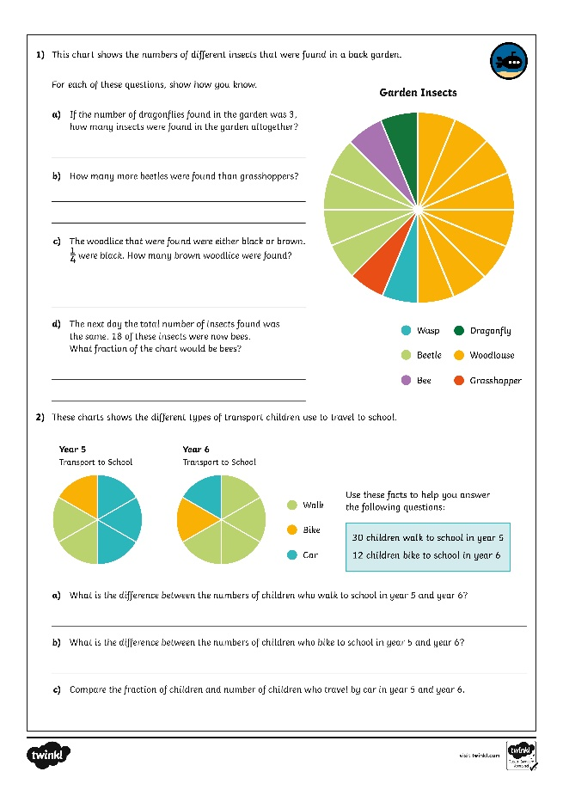
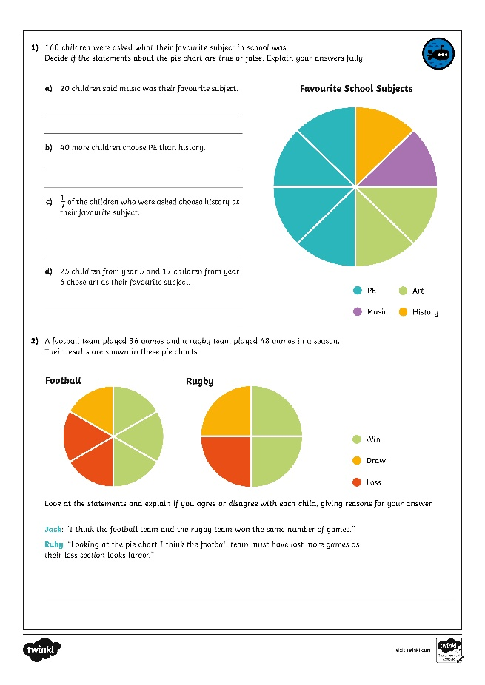

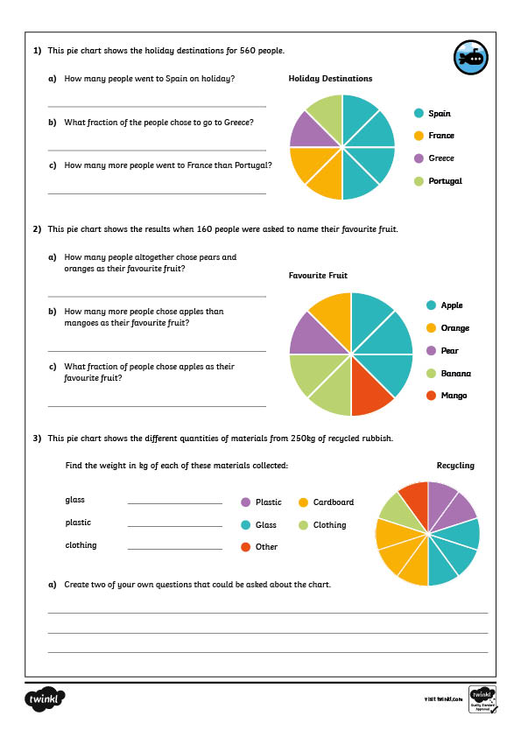
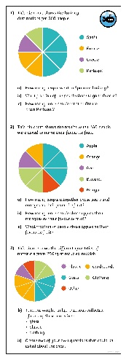
Read and Interpret Pie Charts
Dive in by completing your own activity!

