Slide 2



Diving into Mastery Guidance for Educators
Each activity sheet is split into three sections, diving, deeper and deepest, which are represented by the following icons:
These carefully designed activities take your children through a learning journey, initially ensuring they are fluent with the key concept being taught; then applying this to a range of reasoning and problem-solving activities.
These sheets might not necessarily be used in a linear way. Some children might begin at the ‘Deeper’ section and in fact, others may ‘dive straight in’ to the ‘Deepest’ section if they have already mastered the skill and are applying this to show their depth of understanding.
Diving
Deeper
Deepest

Slide 3
Aim
Interpret and construct pie charts and line graphs and use these to solve problems.

Slide 4


Use Line Graphs to Solve Problems
Diving
Line Graph to Show the Growth in Height of a Sunflower
20
18
16
14
12
Height (cm)
10
8
6
4
2
0
Sat
30th
Mon
1st
Weds
3rd
Fri
5th
Sun
7th
Tues
9th
Thurs
11th
Sat
13th
Mon
15th
Weds
17th
Fri
19th
Sun
21st
Tues
23rd
Thurs
25th
Sat
27th
Mon
29th
Weds
31st
Date
How much did the sunflower grow
from Monday 15th to Thursday 25th?
How long did it take for the sunflower to grow
twice as tall as it was on the Thursday 11th?
Between which two days did
the sunflower grow the most?
How many days did it take for the sunflower to grow to 20cm from when the first shoot appeared?
Tuesday 23rd and Thursday 25th
9cm
10 days
26 days

Slide 5

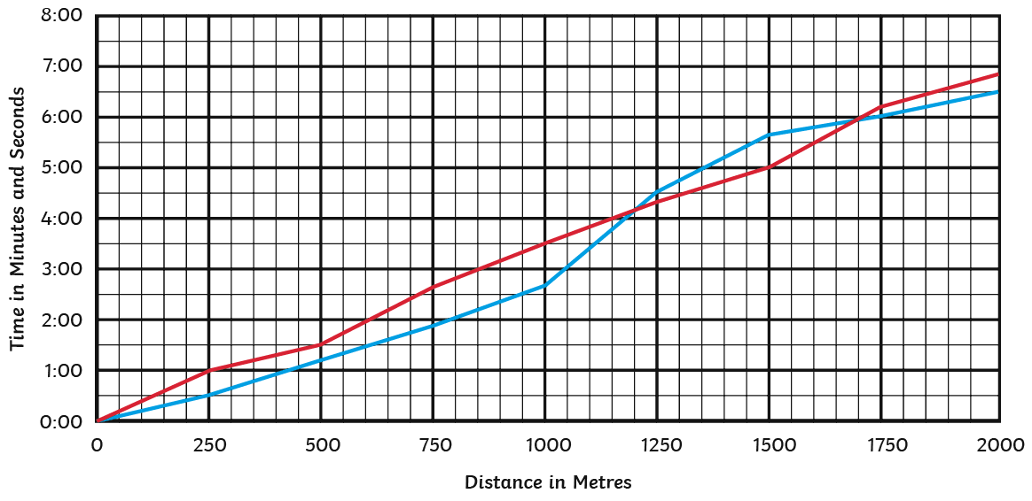
Use Line Graphs to Solve Problems
Deeper
A Line Graph to Show Angus and Magda's 2000m Running Times
= Angus’ Race Time = Magda’s Race Time
It took Angus approximately two minutes longer to reach the 1000m mark than it did Magda.
Decide if each statement about the
line graph is true or false. If it is false,
explain the reason why.
The two runners never reached the same distance at the same time.
After two minutes, Magda had run 200m further than Angus.
False. At approximately 4:00 and 6:00 minutes into the race, the distance covered by both runners was the same.
True. After two minutes, Angus had run 600m and Magda had run 800m.
False. It took Angus approximately one minute longer to reach 1000m.
The faster runner to complete
the 2000m was Angus.
False. Angus took longer to complete the race than Magda.

Slide 6

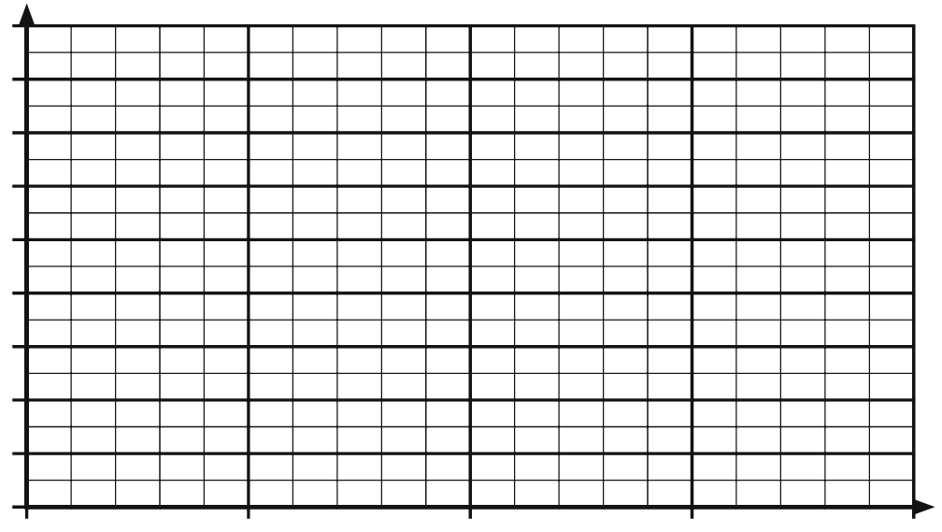
Use Line Graphs to Solve Problems
Deepest
Time
Some children described a line graph before the title and the label of the y-axis were removed.
Give reasons to explain why you think each child’s description either matches or does not match the line graph.

Slide 7



Use Line Graphs to Solve Problems
Deepest
Sofia’s description does not match the line graph because you would expect the temperature to decrease (not increase)
as the drinks were allowed to cool.
Time
My line graph shows the temperatures of a mug of hot chocolate and a cup of tea that I made. The y-axis is labelled ‘Temperature’. I made both drinks from boiling the water in a kettle.
Then, I allowed them both to cool for 30 minutes.
Sofia

Slide 8



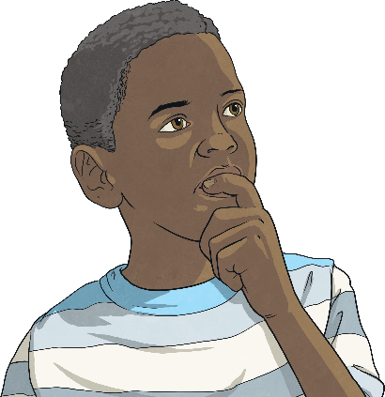
Use Line Graphs to Solve Problems
Deepest
Ola’s description could match this line graph as one of the lines shows that one of the balloons climbed more quickly and reached a greater height before the other one.
Time
My line graph shows the journey of two hot-air balloons. The y-axis is labelled ‘Height’.
Both balloons took off at the same time. One of the balloons climbed higher into the air more quickly than the other.
Ola

Slide 9
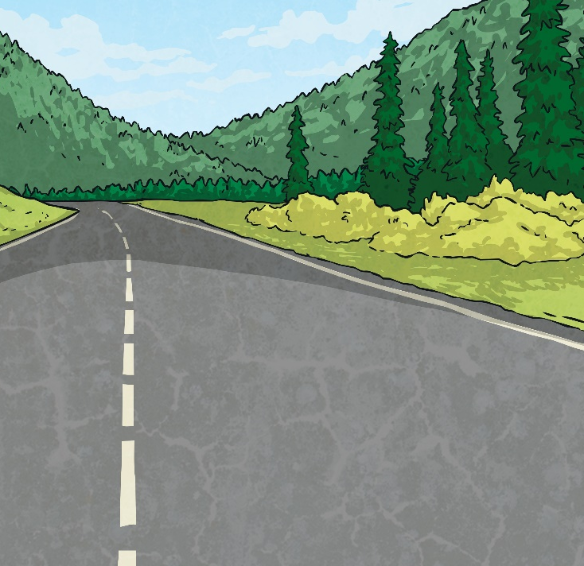



Use Line Graphs to Solve Problems
Deepest
William’s description does not match the line graph. If one of the cyclists had stopped for a rest, it would mean that, for that period of time, the distance would not have increased but the time would have. This would result in a flat line for a section of the graph.
Time
My line graph shows the race between two cyclists. The y-axis is labelled ‘Distance’.
Both cyclists rode off at the same time.
One of the cyclists stopped for a five-minute rest.
William

Slide 10

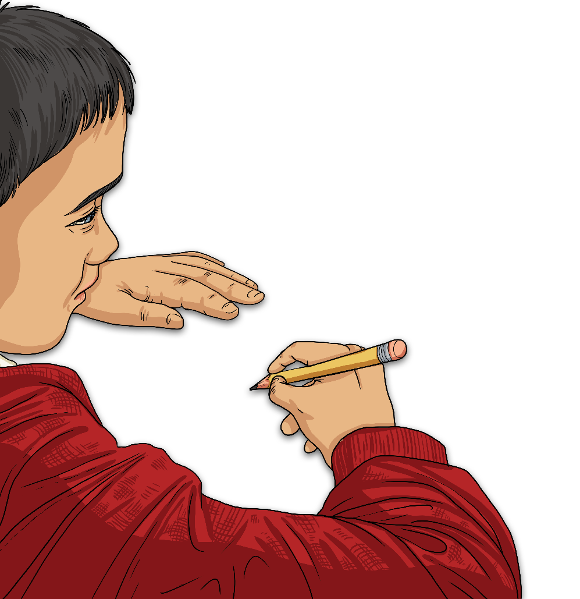
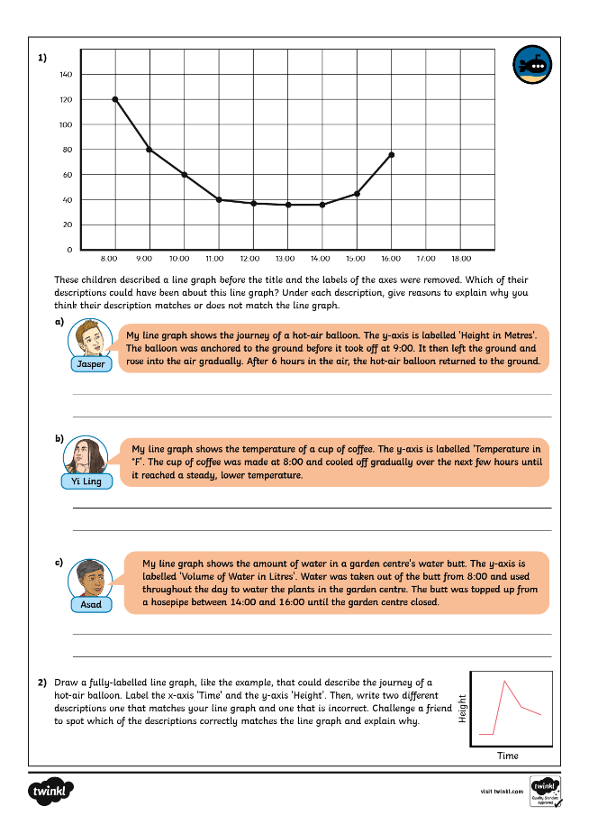
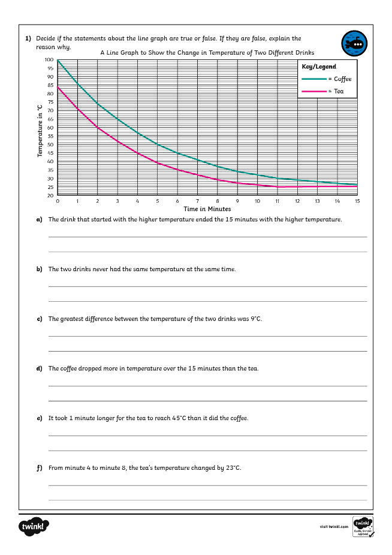
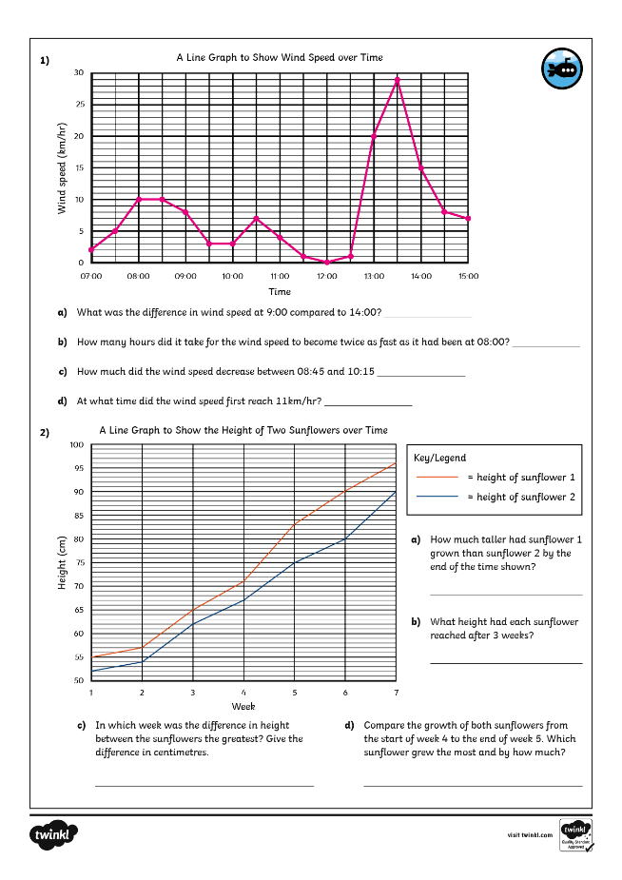
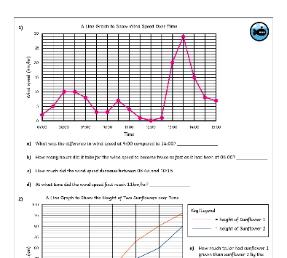
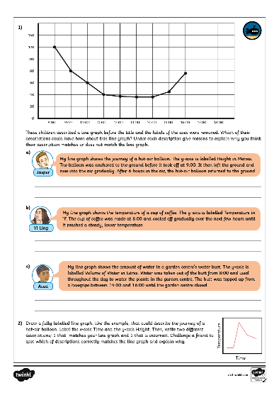
Use Line Graphs to Solve Problems
Dive in by completing your own activity!

