Slide 1
L.O – To recognise some of the ways humans are supporting endangered species.

Slide 2
In yesterday`s lesson, we learnt about many different species that are currently endangered.
Recap:
An endangered animal is:
A species that is at risk of extinction – VOCABULARY - extinction - when there are no more individuals of that species alive anywhere in the world.
A species with a small or declining population, or a very small range.

Slide 3
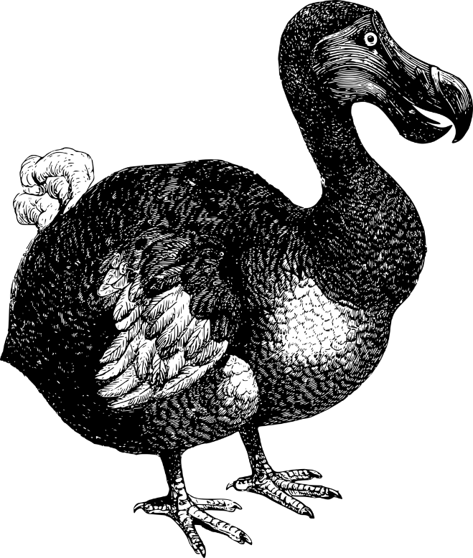
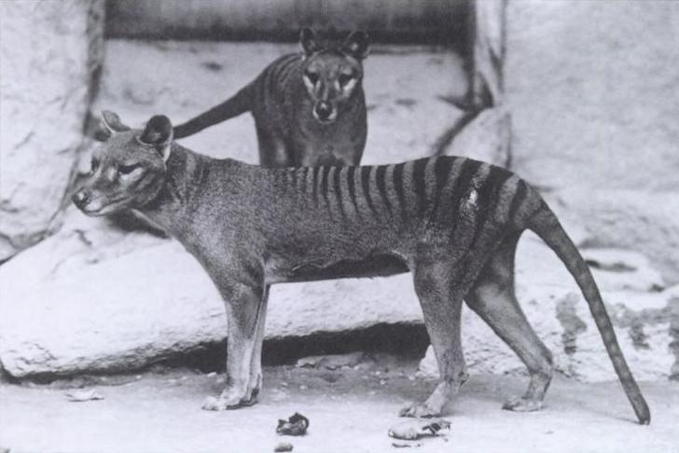
Extinct!
Do you know what these animals are? Click to reveal!
Tasmanian Tiger (Thylacine)
Dodo
Both species were hunted to extinction. The Tasmanian tiger was seen as a pest by farmers and the dodo, a flightless bird, was an easy target for hunters.

Slide 4




Slide 5
What is being done?
Considerable time, effort and money is put into saving endangered animals, but why? Extinction is a natural process that would happen with or without humans. But, while that is the case, research shows that extinctions are happening quicker now than ever before. And, loss of habitat is by far the biggest cause. This is a problem that we need to address, and here are a few reasons why.

Slide 6
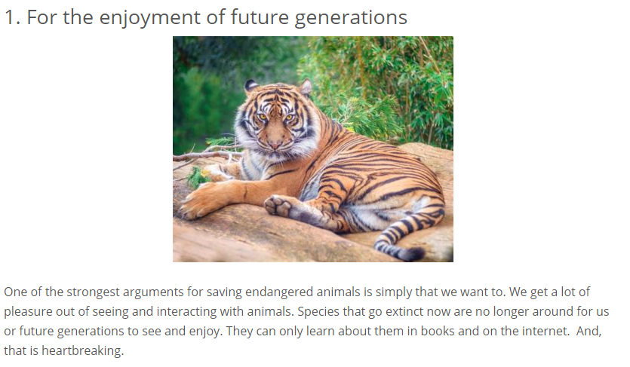

Slide 7
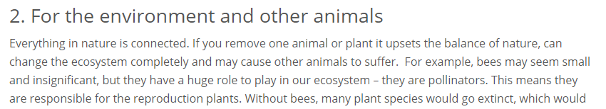
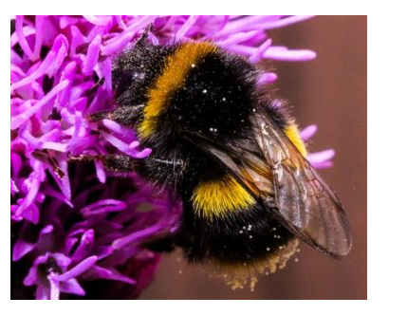
VOCABULARY - An ecosystem is a large community of living organisms (plants, animals and microbes) in a particular area.

Slide 8
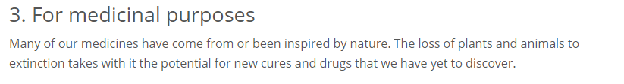

Slide 9
There are lots of people working to protect and conserve endangered species.
VOCAB - Conserve – to protect.
There are a number of things that they are doing…

Slide 10
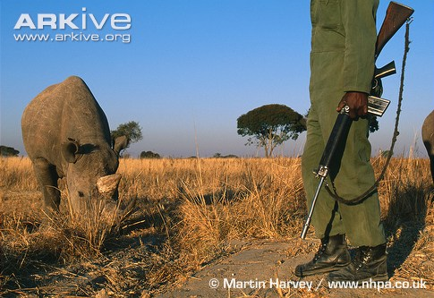
Protect remaining populations
This black rhino is under protection of a guard in a fenced sanctuary because black rhinos are hunted for their horn and this is one of the best ways of protecting them.
It is estimated that between 1970 and 1992, when hunting was at its worst, around 96% of the black rhinoceros population was lost.

Slide 11
Captive breeding can be used to help enhance wild populations, particularly if the individuals bred in captivity can then be released into the wild
VOCABULARY - Captive breeding is the process of maintaining plants or animals in controlled environments, such as wildlife reserves, zoos, botanic gardens, and other conservation facilities.

Slide 12
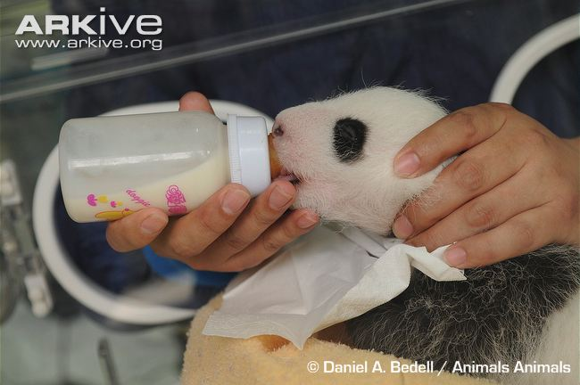
Giant panda – they are protected by law in China and anyone found killing a giant panda or smuggling panda skins can be sent to prison for life. They don’t breed very well in captivity so sometimes humans have to lend a hand with the feeding.

Slide 13

WWF is the world's leading independent conservation organisation. They are determined to ensure that people and nature can thrive together, for generations to come.
From elephants to polar bears, WWF fights to secure a future for animals on the planet we all share. WWF helped bring back the Amur tiger and Africa’s black rhinos from the edge of extinction. They are giving isolated, dwindling populations of black footed ferrets and river dolphins a second chance.

Slide 14
TASK
Complete the worksheet named ‘endangered animals’. You must pick one of the problems that
endangered species face and think about what is/ can be done about it.
Challenge – Use the Tower Hamlets language card within your poster.

