Slide 1
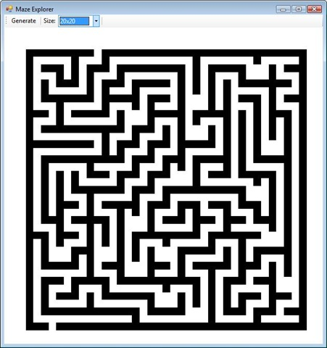

Drawing your own
Mazes and Labyrinths
Notes:
Font: Calibri

Slide 2


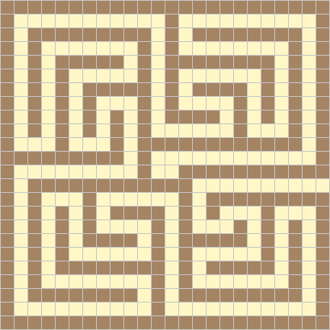
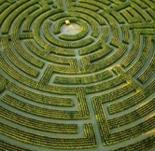
Mazes and labyrinths
According to one definition, mazes have many branching paths, with only one path leading to the centre or exit, whereas labyrinths are unicursal (or single-pathed).
Some of the earliest mazes and labyrinths we know of were found in Egypt and in Crete, dating back over 4000 years.
One of the most famous of these is the seven-circuit Cretan labyrinth, which we shall be learning how to draw.
In Greek mythology the Cretan king Minos owned a labyrinth in which lurked the Minotaur – a half man, half bull creature who ate anyone lost in the labyrinth...
The Romans built many mosaic labyrinths, which were
typically found in the entrance halls of their villas.
Mazes are still very popular today, with many large ones
found in the grounds of parks and stately homes.

Slide 3
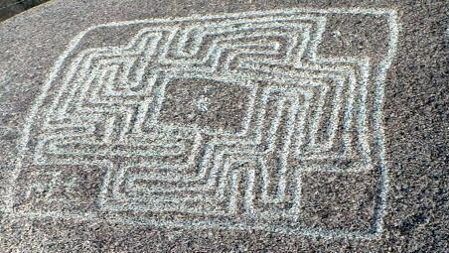
Mazes and labyrinths
A prehistoric petroglyph near Hemet, Riverside County, California

Slide 4
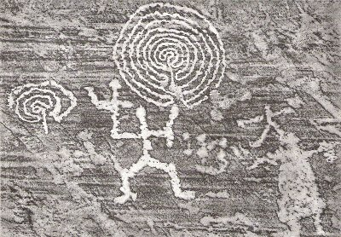
Mazes and labyrinths
Bronze Age labyrinth, Val Camonica, Italy

Slide 5
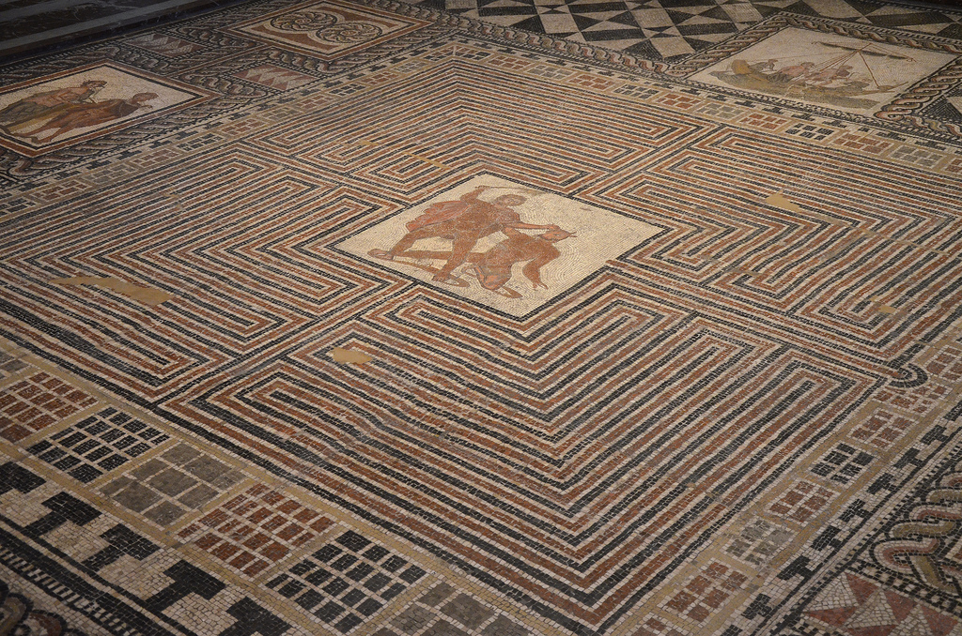
Mazes and labyrinths
Roman mosaic of Theseus and the Minotaur, Salzburg

Slide 6
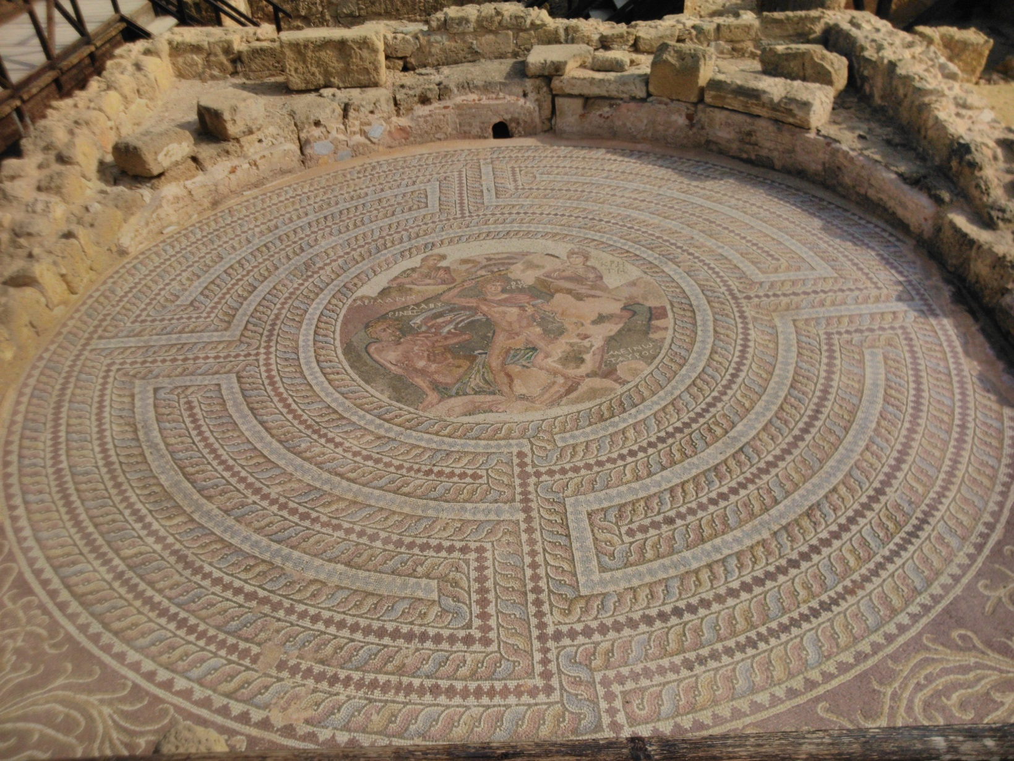
Mazes and labyrinths
Roman mosaic of Theseus and the Minotaur, Cyprus

Slide 7
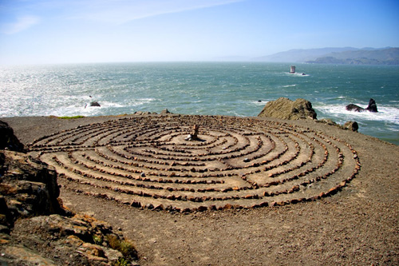
Mazes and labyrinths
Labyrinth of stones, Land’s End, San Francisco

Slide 8
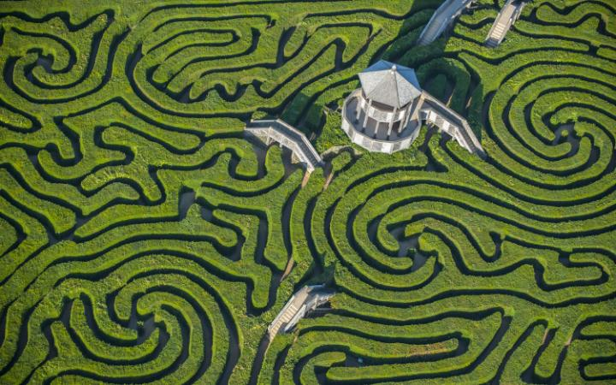
Mazes and labyrinths
Longleat Safari Park, Wiltshire

Slide 9

Mazes and labyrinths
Thinker’s brain as a maze of choices, by Bill Sanderson

Slide 10
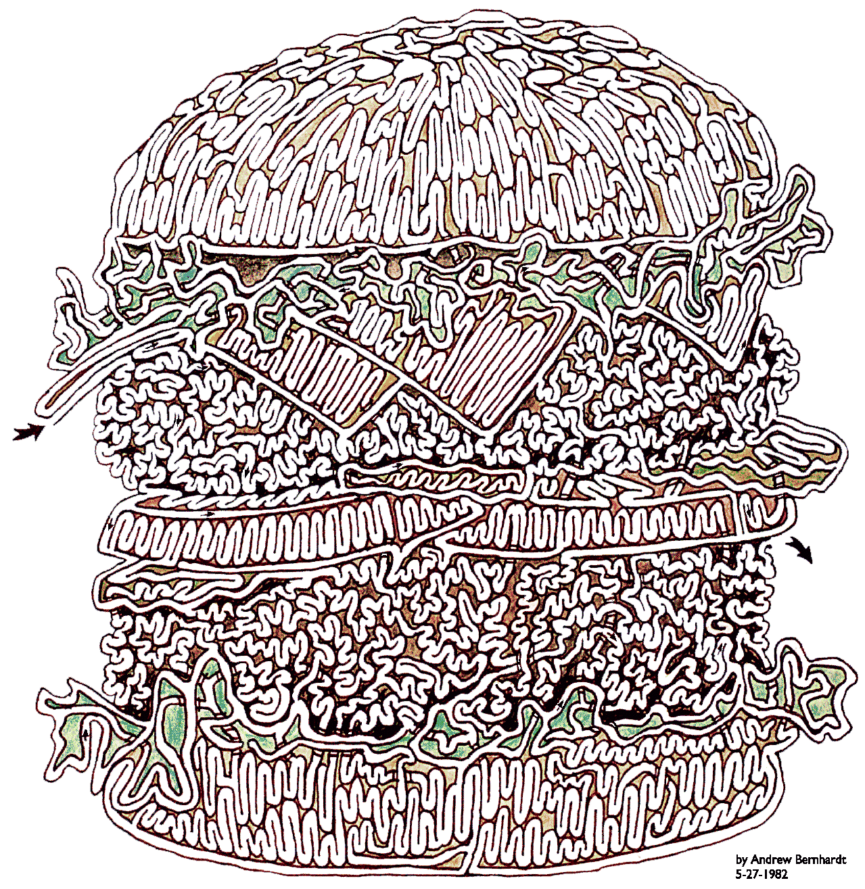
Mazes and labyrinths
Big Burger Maze, by Andrew Bernhardt

Slide 11

Mazes and labyrinths
Maze of 250,000 books, South Bank Centre, 2012

Slide 12
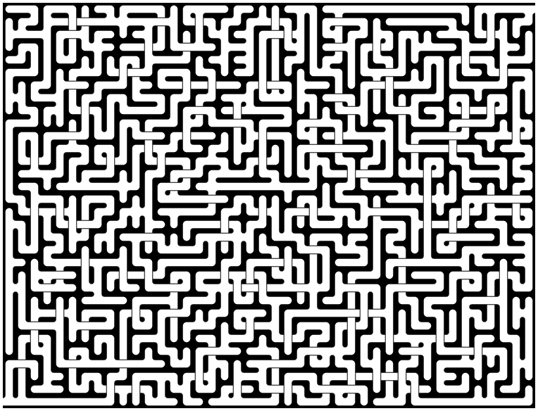
Mazes and labyrinths
Computer generated maze, Stephen D Collins

Slide 13
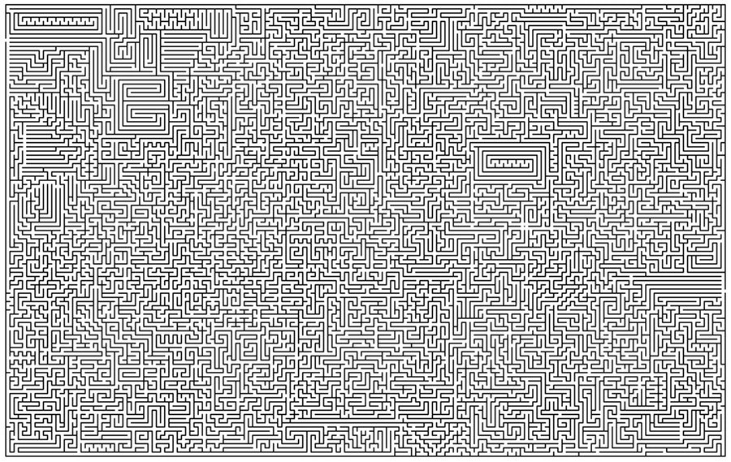
Mazes and labyrinths
Supermaze, by TGF Writter

Slide 14
Drawing a branching maze
You will need:
some squared paper
a pencil
a good eraser
and a ruler

Slide 15
Drawing a branching maze
Using squared paper and a pencil, draw out a rectangle with an odd number of squares on each side, e.g:
15 squares
11 squares

Slide 16
Drawing a branching maze
Then, using your pencil, heavily shade in alternate squares on every other row..
These squares will become part of the walls of your maze.

Slide 17
Drawing a branching maze
Next, very lightly shade in the next set of alternate squares, but on every row this time.
These squares will either be part of the paths, or part of the walls.

Slide 18
Drawing a branching maze
Next, very lightly shade in the next set of alternate squares, but on every row this time.
The white squares will be part of the paths.

Slide 19
Drawing a branching maze
Time to create the path! Make an entrance by erasing one of the lightly shaded squares on the edge.
Then continue erasing lightly shaded squares to make a winding path to an exit.

Slide 20
Drawing a branching maze
Now to fool people. Start creating new paths coming off this first path, but make them lead to dead ends.

Slide 21
Drawing a branching maze
Next heavily shade in the remaining lightly shaded wall squares.
Finally label the entrance and exit.
Start
Finish

Slide 22
Drawing a branching maze
Your branching maze is complete! Now to test it on unsuspecting victims ☺
The larger your maze is, the more difficult you can make it…
Start
Finish

Slide 23
Drawing a labyrinth
You will need:
some plain paper
a pencil
a good eraser
and a pair of compasses

Slide 24
Drawing a labyrinth
Using plain paper, a pencil and a ruler, and starting in the middle, make a set of 9 tiny vertical dots 1 cm apart from each other.

Slide 25
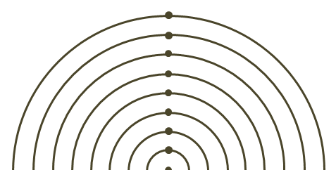
Drawing a labyrinth
Placing your compass point on the bottom dot, make a set of 8 concentric semi-circles.

Slide 26
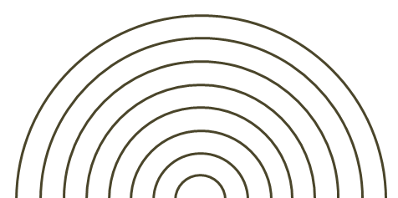
Drawing a labyrinth
Now place your compass point on the bottom right-hand edge of the second smallest semicircle.

Slide 27
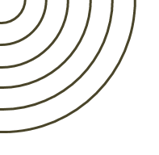
Drawing a labyrinth
Make a set of 6 concentric quarter circles using this point as the centre and extending the original 6 outer circles.

Slide 28
Drawing a labyrinth
Now place your compass point on the bottom left-hand edge of the third smallest semicircle.

Slide 29
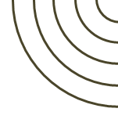
Drawing a labyrinth
This time make a set of 5 concentric quarter circles using this point as the centre and extending the original 5 outer circles.

Slide 30
Drawing a labyrinth
Now join the edges of the second smallest quarter circles with a straight horizontal line.

Slide 31
Drawing a labyrinth
And draw a vertical straight line down from the right hand edge of the smallest semicircle.

Slide 32
Drawing a labyrinth
Carefully curve this round to meet the edge of the bottom right-hand quarter circle.

Slide 33
Drawing a labyrinth
Finally, complete the remaining four semi-circles.

Slide 34
Drawing a labyrinth
Your labyrinth is complete! Now test it out: is there one single path to the centre?

Slide 35
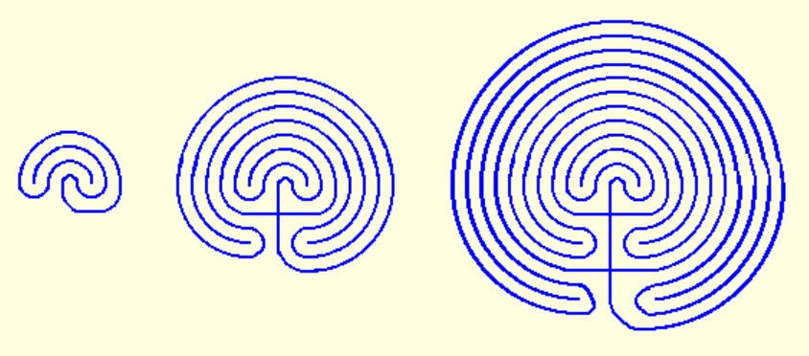
Drawing a labyrinth
Can you work out how to scale your labyrinth up or down?

