Slide 1
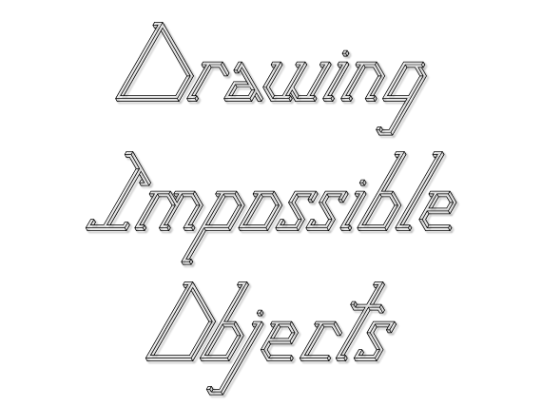
Notes:
Fonts: Illusion Letters, Times New Roman, Calibri

Slide 2
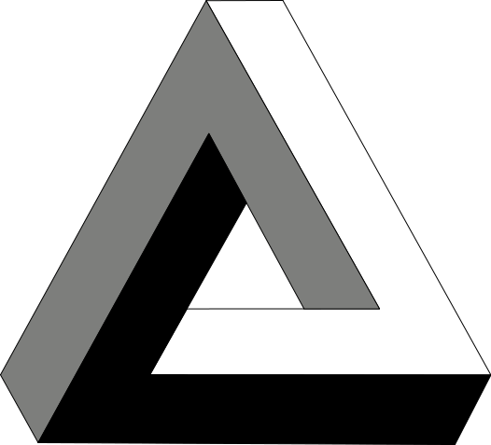
The Penrose Triangle

Slide 3
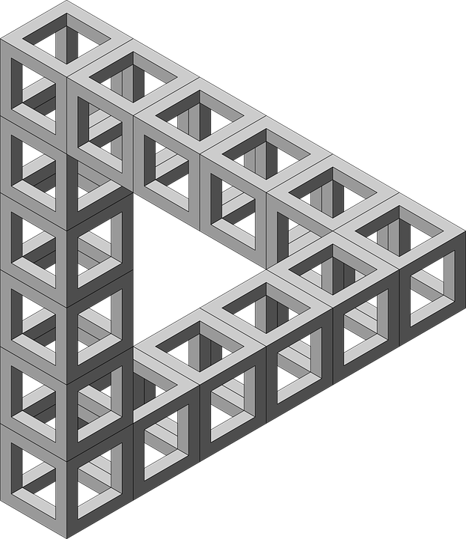
Impossible triangle structure

Slide 4
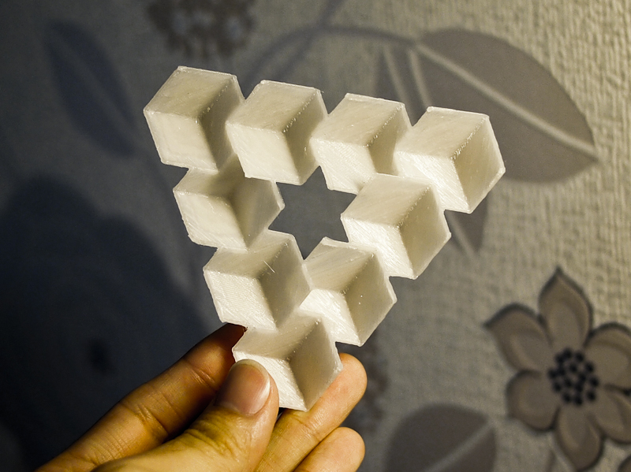
A 3D-printed version of the Reutersvaard Triangle illusion

Slide 5
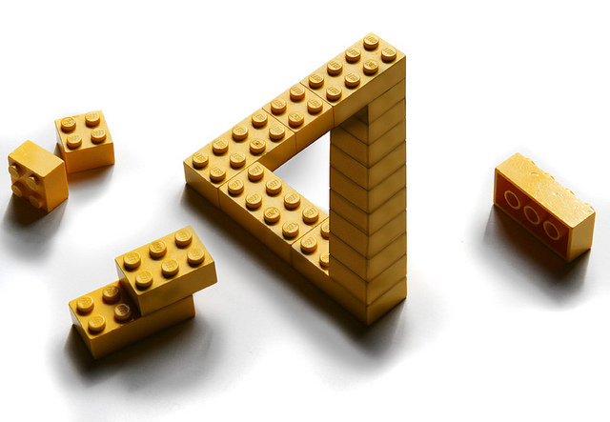
Penrose Triangle lego illusion by Erik Johansson

Slide 6
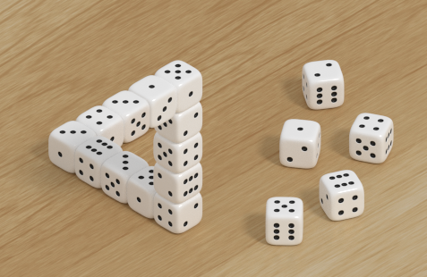
Penrose Triangle dice illusion

Slide 7
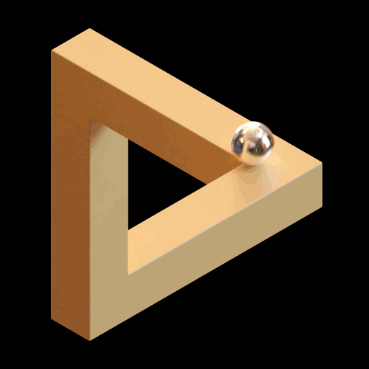
Penrose Triangle gif

Slide 8
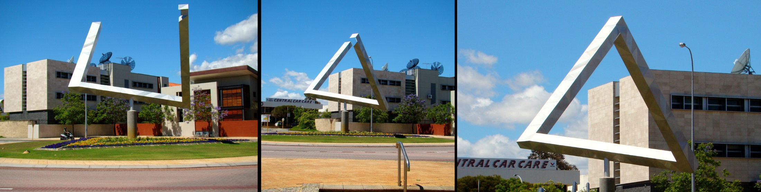
Impossible triangle sculpture as an optical illusion, East Perth, Western Australia

Slide 9
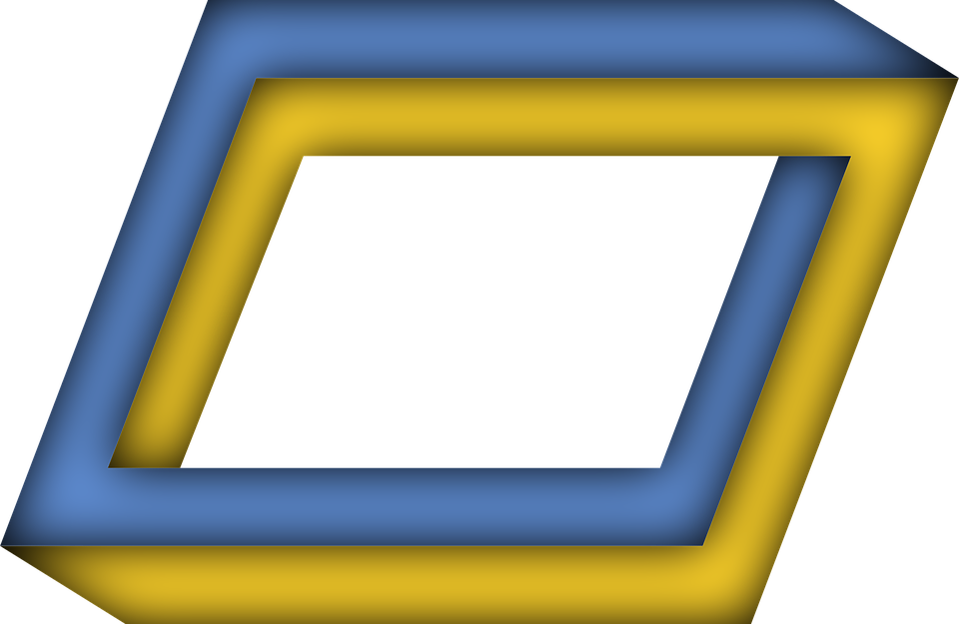
Impossible rectangle

Slide 10
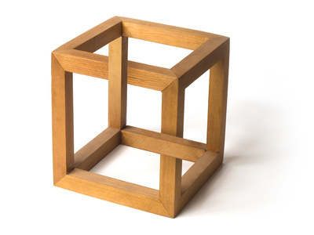
Impossible wooden cuboid

Slide 11
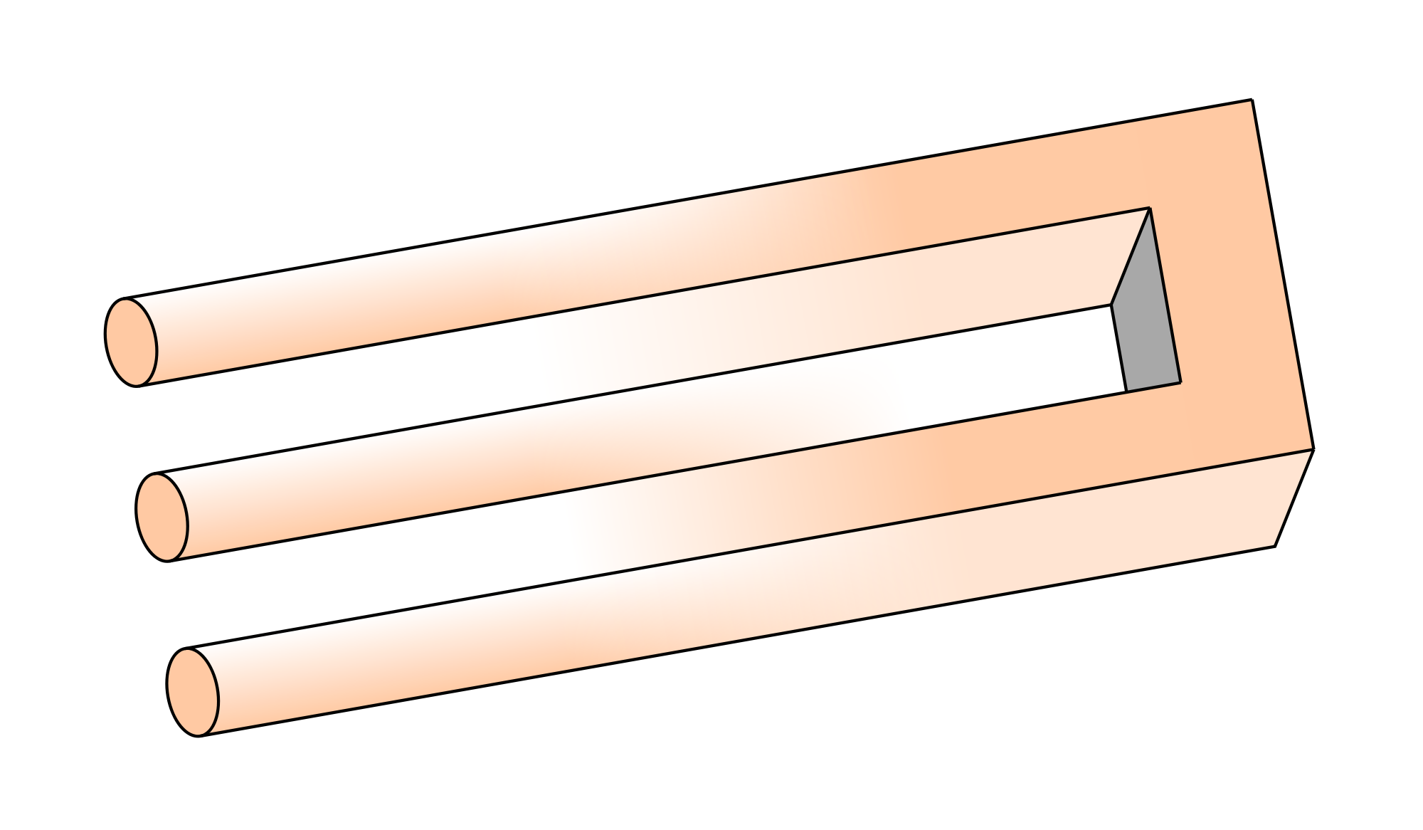
The Blivet

Slide 12
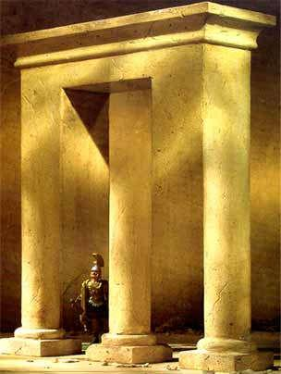
Impossible columns

Slide 13
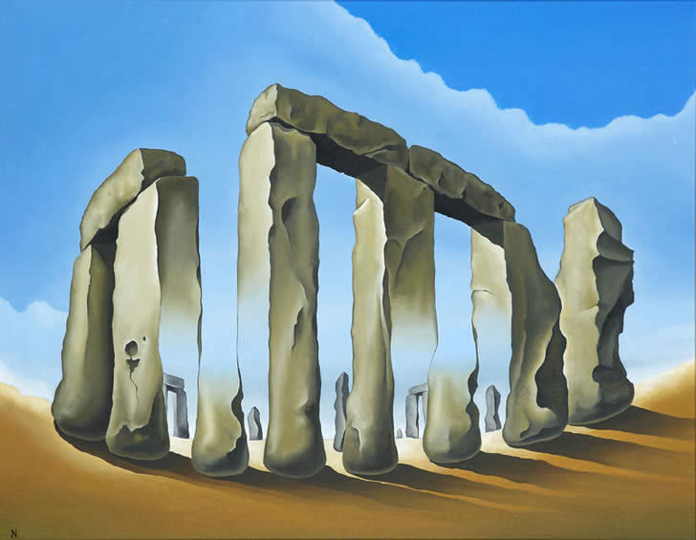
Stonehenge Optical Illusion, by Norman Parker

Slide 14
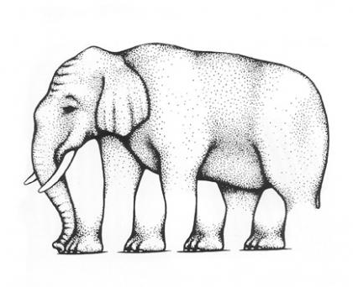
The Elephant Illusion by R Shepard

Slide 15
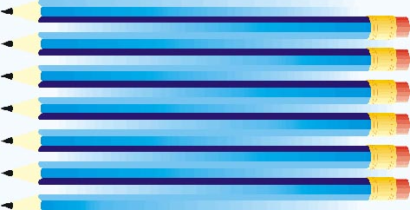
Impossible pencils!

Slide 16
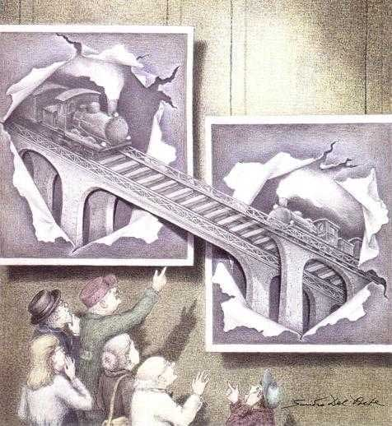
The Railway Bridge, Sandro Del Prete

Slide 17
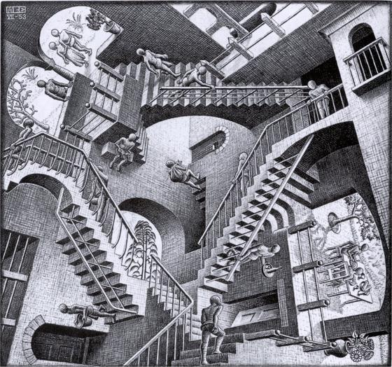
Relativity, MC Escher, 1953

Slide 18
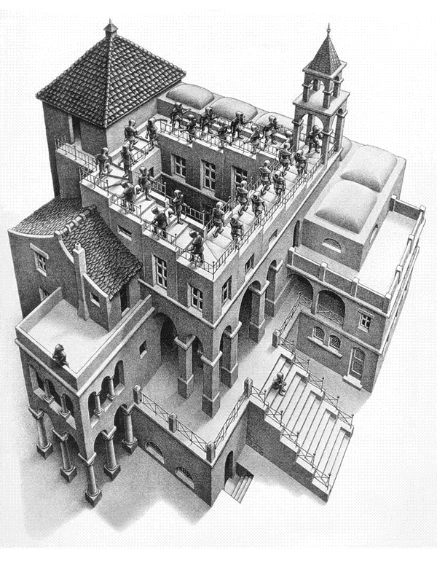
Ascending and Descending, MC Escher, 1960

Slide 19
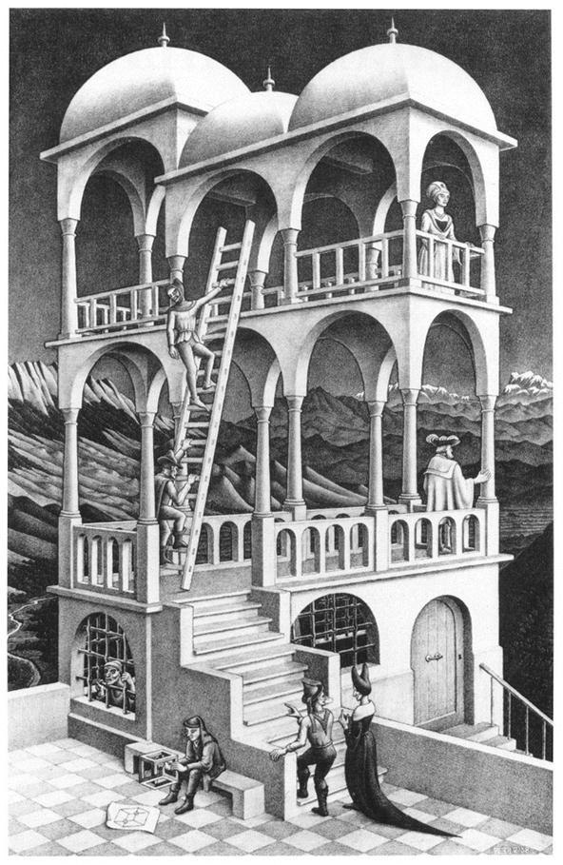
Belvedere, MC Escher, 1958

Slide 20
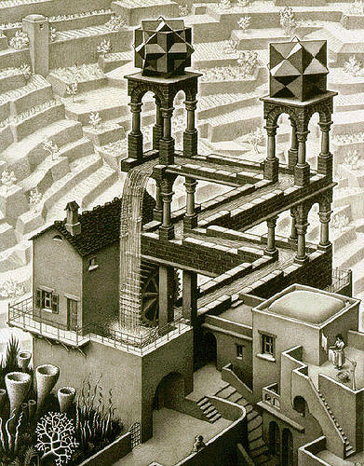
Waterfall, MC Escher, 1961

Slide 21
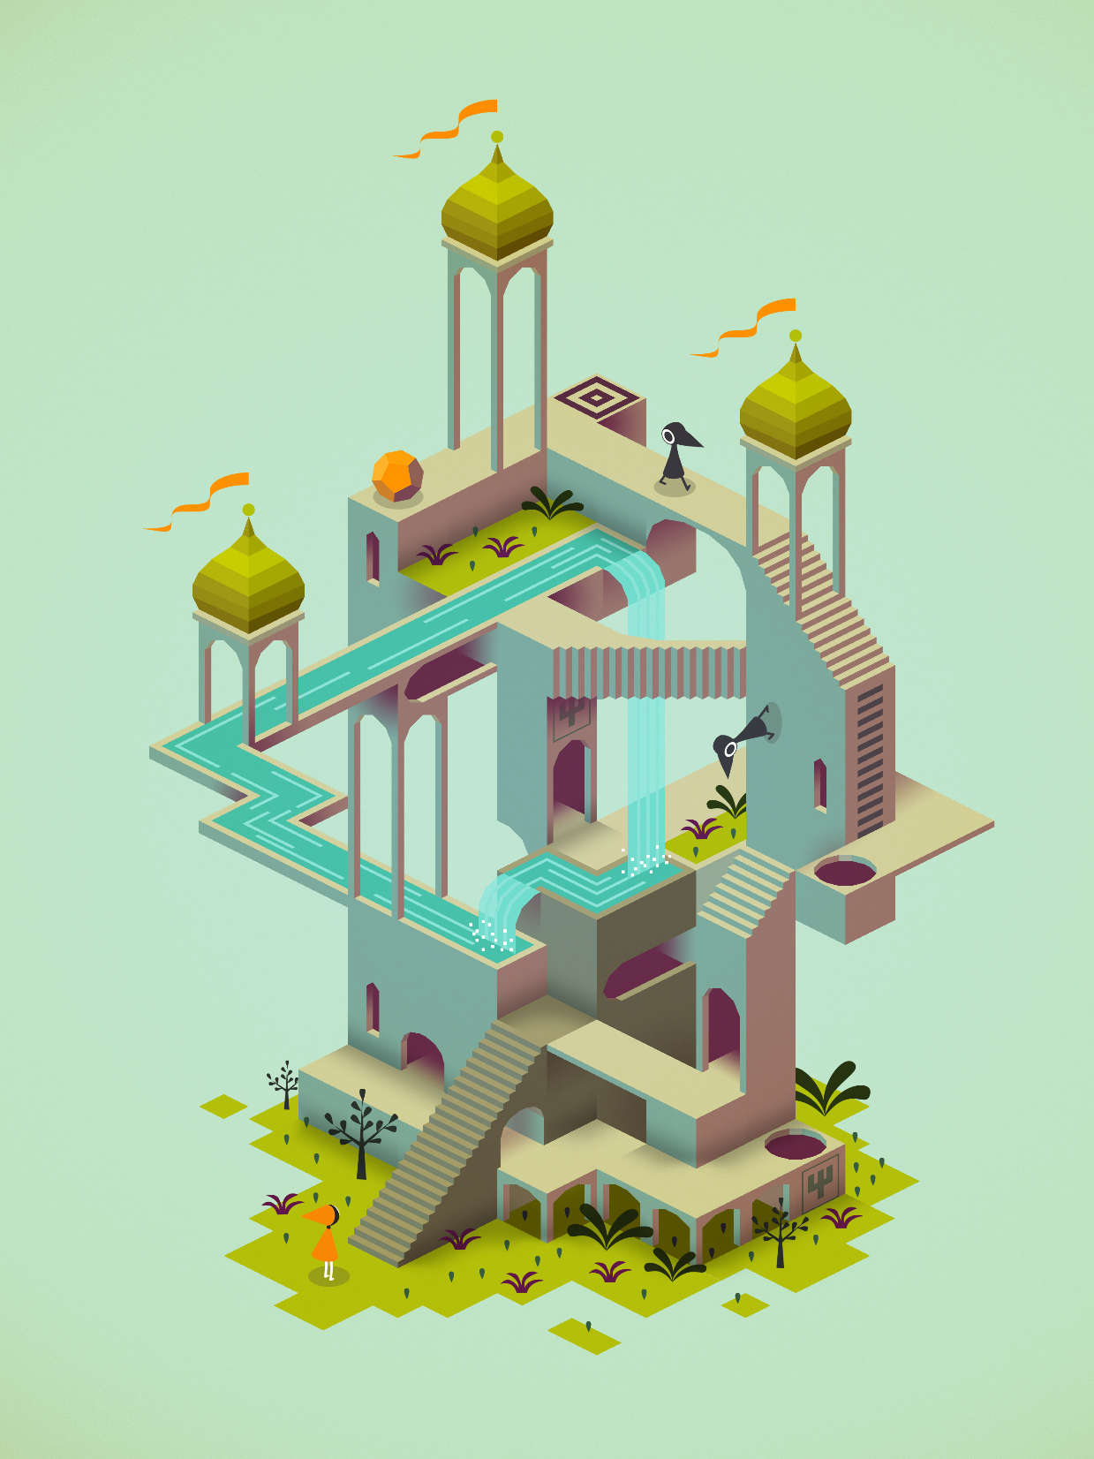
Monument Valley Game, 2014

Slide 22
Real-life Escher’s waterfall: http://www.youtube.com/watch?v=0v2xnl6LwJE
Real-life Escher’s waterfall explanation 1: http://www.youtube.com/watch?v=jpcIIa2hKRo&NR=1&feature=fvwp
Real-life Escher’s waterfall explanation 2: http://www.youtube.com/watch?v=Z6OeQtnultc

Slide 23

Now to construct your own
The following instructions are taken from the SMP 11-16 booklet entitled ‘Impossible Objects’, and are reproduced with the kind permission of the Cambridge University Press.

Slide 24
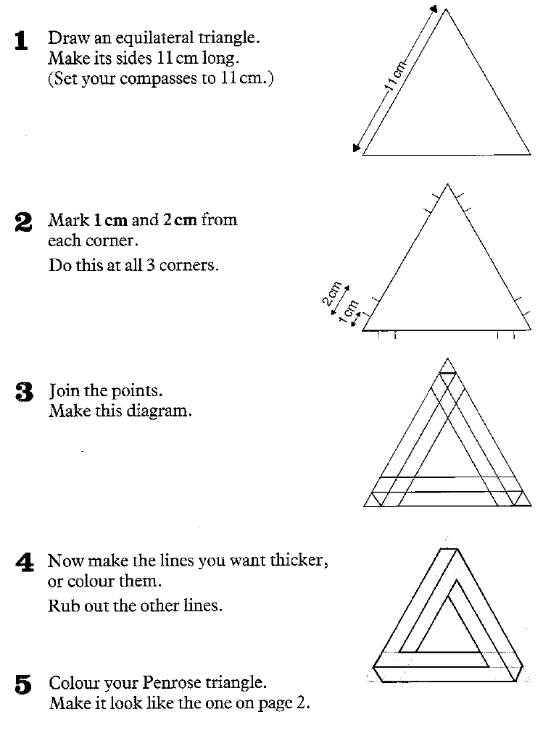
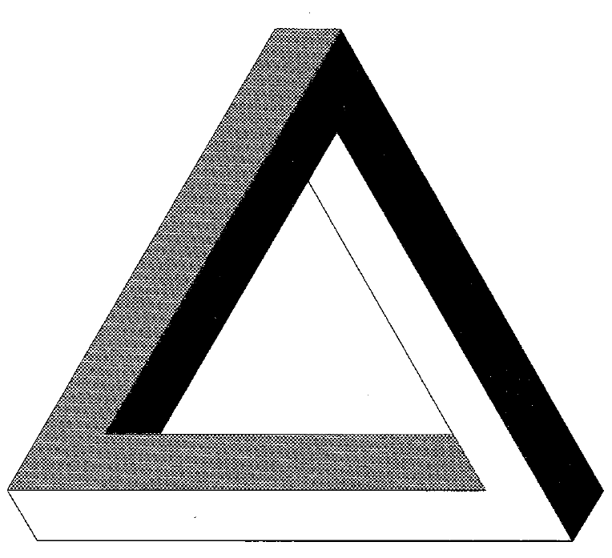
© Cambridge University Press 1985

Slide 25
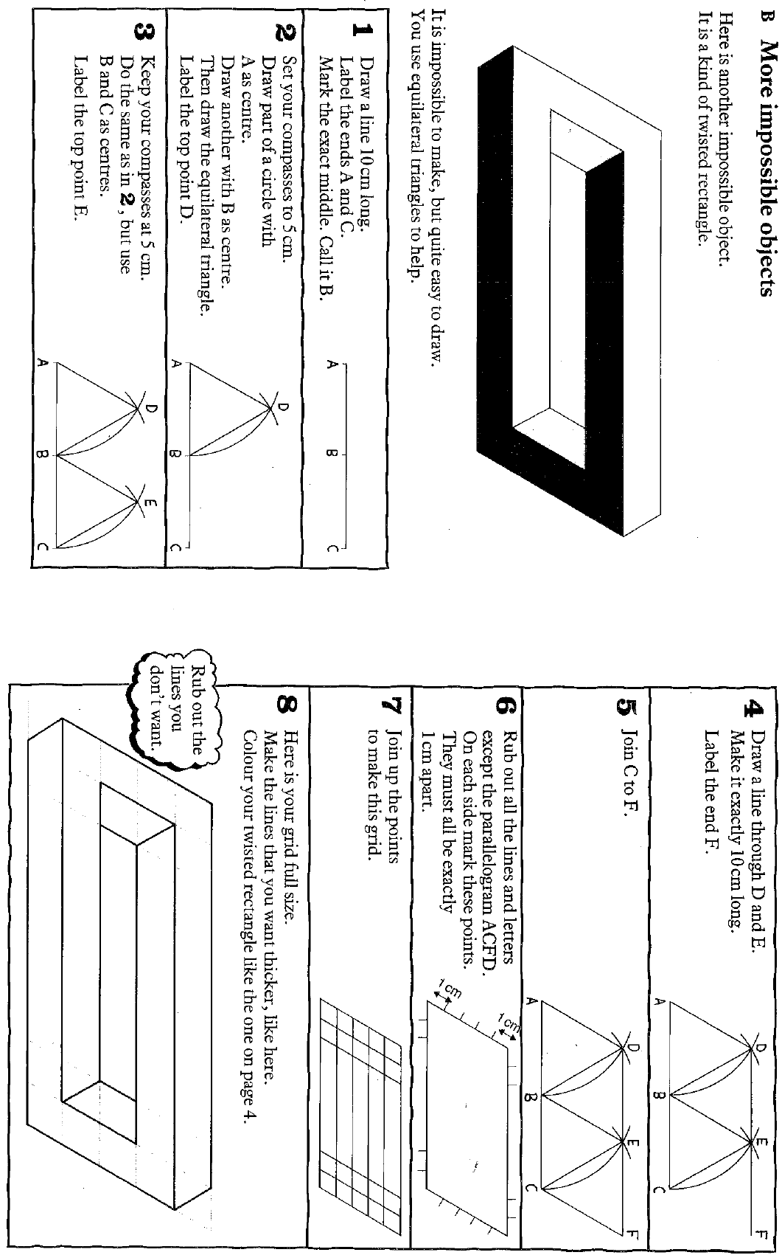
© Cambridge University Press 1985

Slide 26
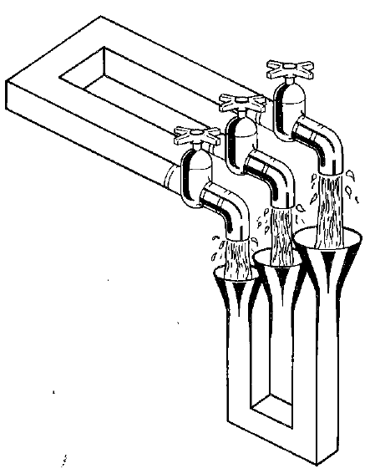
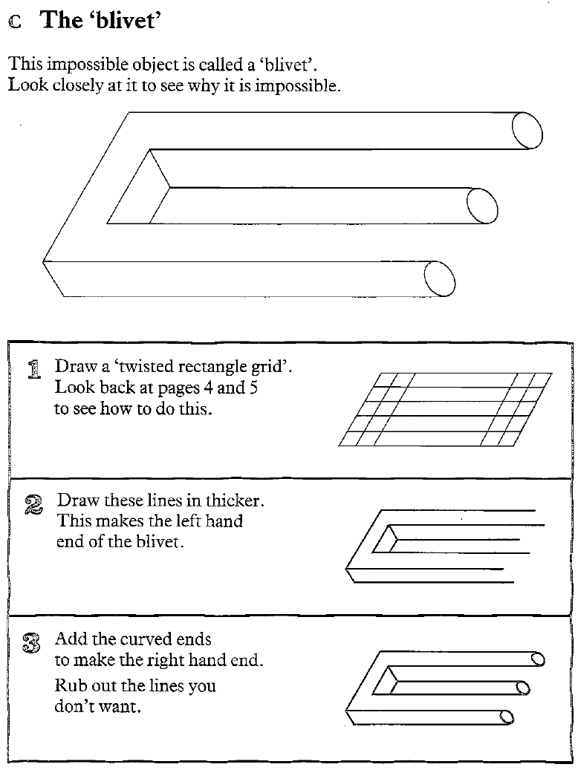
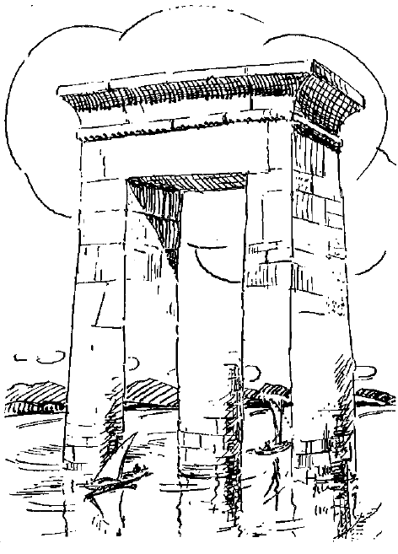
© Cambridge University Press 1985

