Slide 2


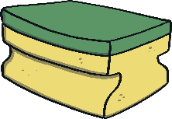

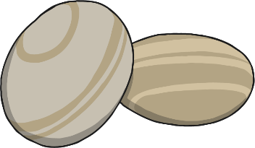
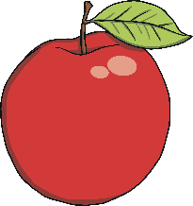


Float or Sink?
How do we know if an object will float or sink?
Let’s try these objects in a container of water and see what happens.
a lolly stick
a bouncy ball
a cork
a sponge
a stone
a marble
an apple
Make a prediction before you try each object. It might help to hold and feel each object. Then, see if you were right.
Does it float or sink?

Slide 3


Why Do Some Objects Sink?
Which items sank? Which floated?
Density
Objects like marbles, coins and stones are more dense than water. Their tiny molecules are really close together. When you put them in water, they sink to the bottom.
But objects like corks, wood and sponges are less dense than water. Their tiny molecules are further apart so they float on water. Objects that are hollow (with air inside) also float. This is because air is less dense than water.
What about shape?
The shape of an object matters too. When more of the surface of an object is touching the water, the object floats better. Let’s try that next.

Slide 4
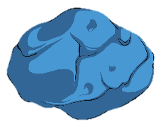
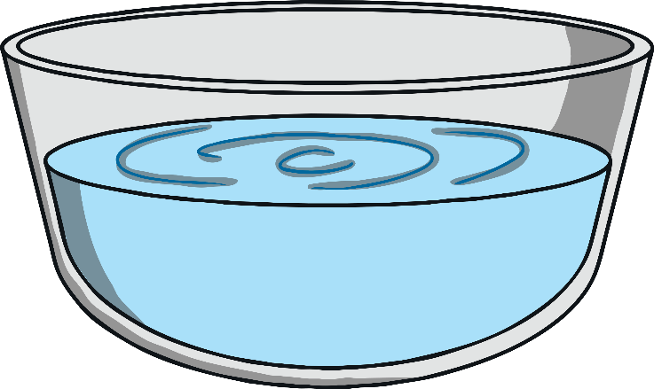
Does the Shape Matter?
What do you think will happen if you drop a ball of plasticine into water?
Yes! It sinks because the material is more dense than water.
This time, change the shape of the ball into a boat shape. Can you make it float?
Buoyancy
When more of the shape is touching the water it is more likely to float. The object pushes against the water, but the water pushes back! If lots of the object is touching the water, the water will push back enough to make the object float! This means the object
is buoyant (even if the material is dense).
Can you make the boat sink by adding stones or marbles to it? How many does it need to make it sink?

Slide 5
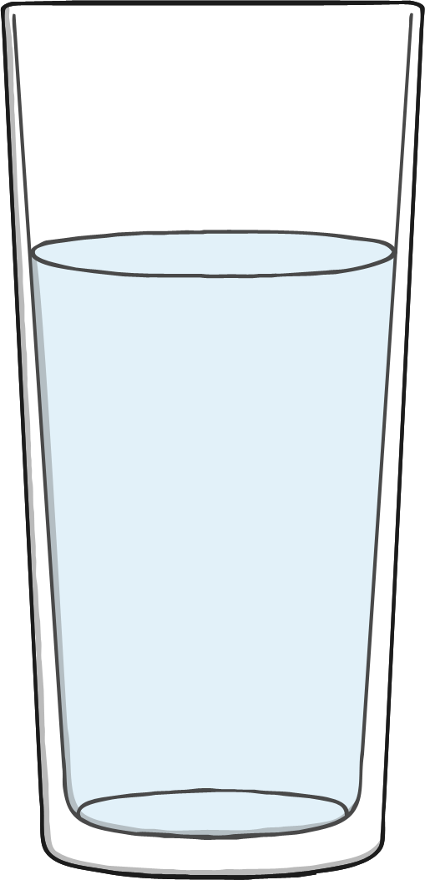
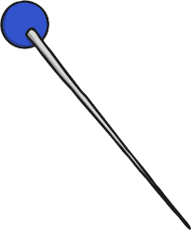
Let’s Look at Surface Tension
Now let’s investigate what happens when you put a metal pin or paperclip into water.
Will it sink or will it float?
Metal is more dense than water so perhaps it will sink…
Let’s find out!

Slide 6
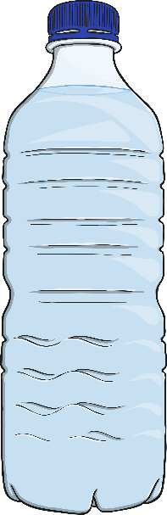
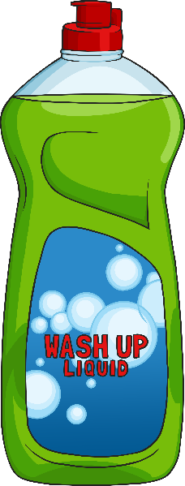
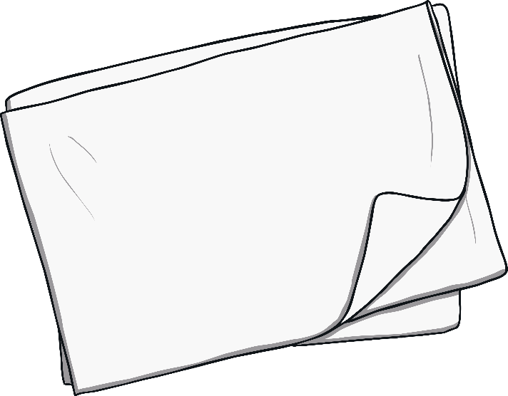
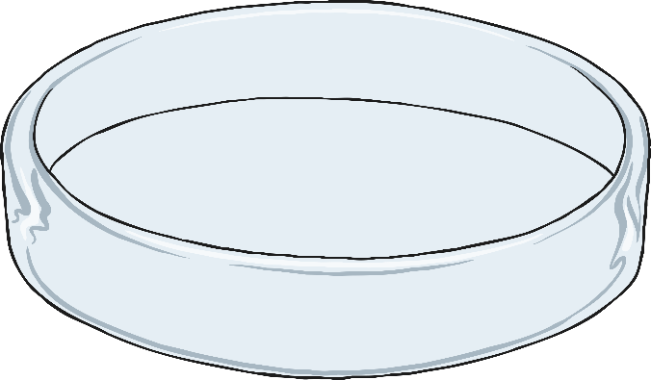
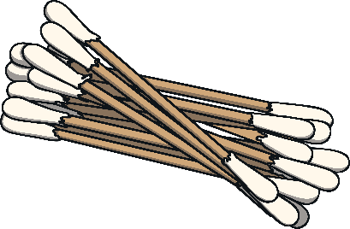
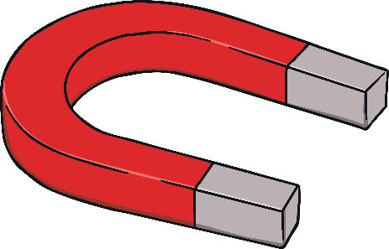

What You Need
A large container to hold water
Water
Tissue paper
Metal pins or metal paperclips
Washing-up liquid or soap
Cotton bud
Optional: a magnet

Slide 7
What to Do
Gently place a sheet of tissue paper on the water surface. Then put the metal pin or paperclip on top.
1
Fill the bowl full of water and let the water settle.
2
Now, carefully remove the tissue paper. The pin or paperclip should remain floating on the surface.
(You could use a magnet to pull it across the surface to show how it moves around on top of the water!)
3
Now, dip one end of the cotton bud in the washing up liquid.
Put the end without the washing up liquid on the surface of the water first. Nothing should happen.
4
5
6
Now, with the other end, touch the water surface. The pin or paperclip should now drop suddenly to the bottom.

Slide 8

Here’s What’s Happening…
Surface Tension
The surface tension of the water is holding its molecules together strongly. The pin floats on top of the surface!
Soap, detergent and washing up liquid break up the bonds between the molecules and makes the surface tension weaker.
The surface tension breaks and the pin can fall through!
How strong is surface tension? Investigate how many pins can float on the water’s surface at once.

Slide 9
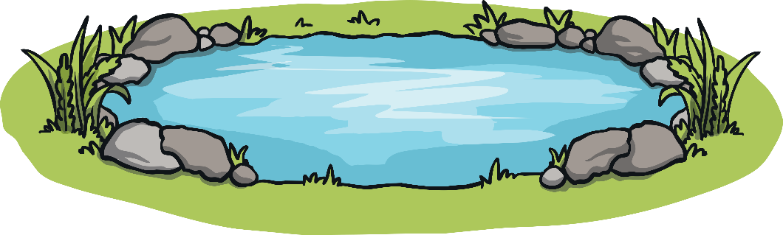



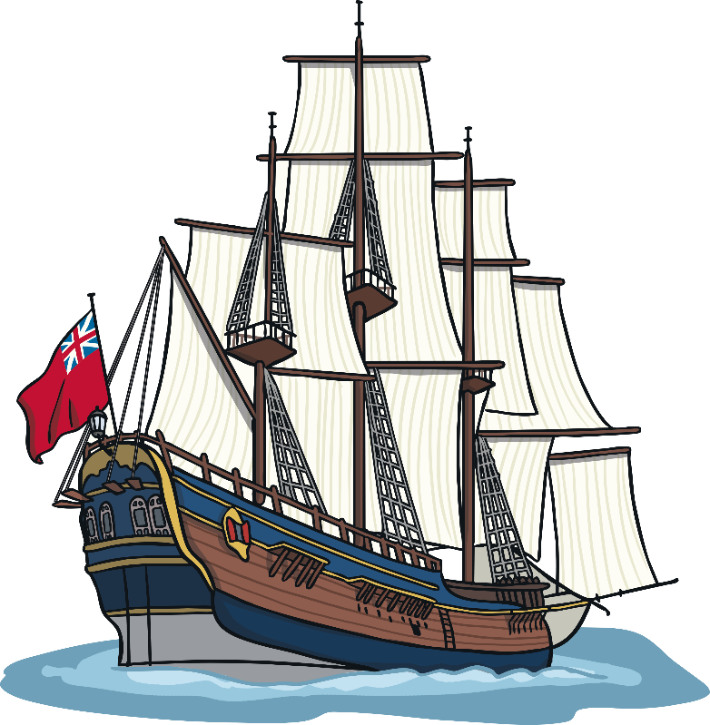
Real Life Examples
Pond skaters and other pond creatures use surface tension to stay on top of the water.
Boats can float on the water because they are less dense than water. The hull of a boat is hollow and the shape helps it to stay buoyant as well.

Slide 10
Float or Sink?
What have you learned about floating and sinking?
True or False?
If a material is more dense than water it will usually sink.
True
Answer
Answer
False. Changing its shape may make it more buoyant so it will float.
You can’t make an object float by changing its shape.
Answer
False. Washing up liquid or soap weakens surface tension so objects floating on the surface will sink.
Washing up liquid or soap helps objects float.

