Slide 1
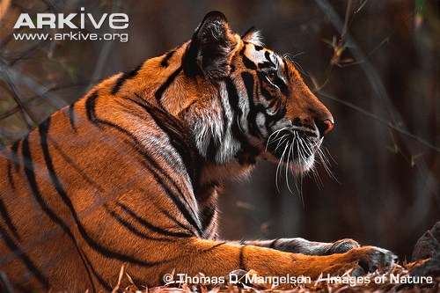
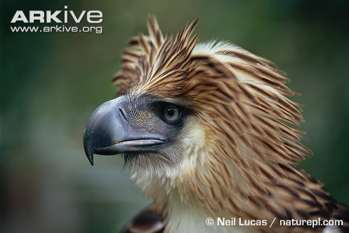
What is an Endangered Species?

Slide 2
What is an endangered species?
A species that is at risk of extinction – extinction - when there are no more individuals of that species alive anywhere in the world.
A species with a small or declining population, or a very small range.

Slide 3
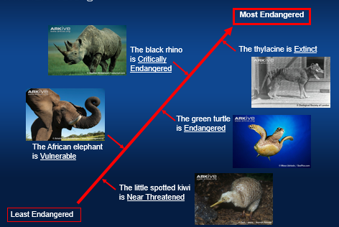
There are lots of different endangered species and some are more endangered than others.
Scientists have created a scale which measures how endangered (or at risk) individual species are.
Can you think of any other animals that could appear on this scale?

Slide 4
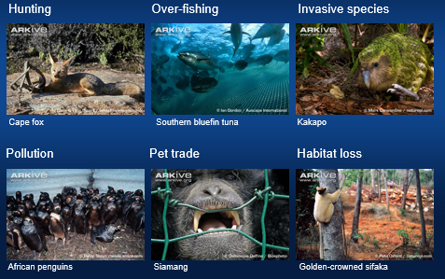
Why are some species endangered?
- hunting/poaching (caught for fur or because they are seen as pests)
- over-fishing (eg. tuna caught for food)
- invasive species (can carry diseases that threaten native species or can become predators of native species)
- pollution (can be oil, pesticide or fertiliser run off from farmland)
- pet trade (people want to keep rare and exotic animals and plants in their homes)
- habitat loss/deforestation (trees cut down to be used for building, or to convert the land to farmland)

Slide 5
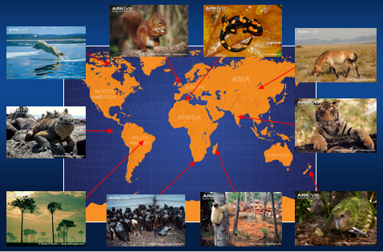
Where are endangered species found?
Unfortunately, endangered species can be found worldwide, the problems that affect species can be seen on all continents and in all seas.

Slide 6
TASK
Today`s task will allow you to have a clearer understanding of the threats that are affecting different species.
TASK:
Choose 10-15 cards (or more if you would like!).
Read the card in order to find out which threat is an issue for this particular species.
Place your species in the right ‘threat group’.
TIP – Some species may fit into more than one threat group.
Challenge – Start with the ‘BLANK activity cards – can you guess what the threat is to this species? Sort them into threat groups and you can check your answers after.

