Slide 1


Year 4 – Summer Block 2 – Measurement: Money – Pounds and Pence
About This Resource:
This PowerPoint has been designed to support your learning of this small step. It includes a starter activity and an example of each question from the Varied Fluency and Reasoning and Problem Solving resources also provided in this pack. You can choose to work through all examples provided or a selection of them depending on the needs of your child.
National Curriculum Objectives:
Mathematics Year 4: (4M1) Compare different measures including money in pounds and pence
Mathematics Year 4: (4M2) Estimate different measures including money in pounds and pence
Mathematics Year 4: (4M9) Calculate different measures including money in pounds and pence
Mathematics Year 4: (4F10b) Solve simple measure and money problems involving fractions and decimals to two decimal places
© Classroom Secrets Limited 2018

Slide 2
Year 4 – Summer Block 2 – Measurement: Money
Step 1: Pounds and Pence
© Classroom Secrets Limited 2018

Slide 3
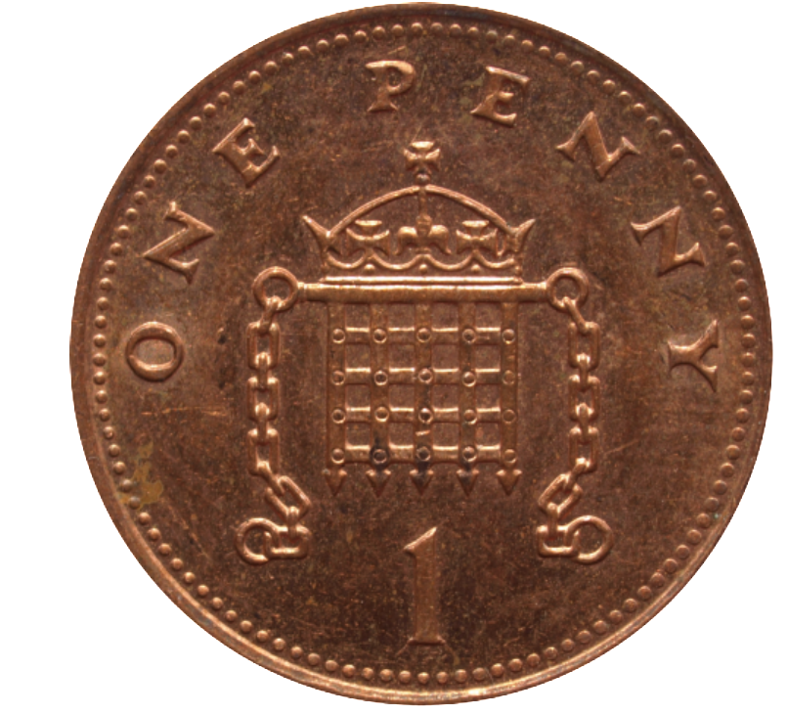
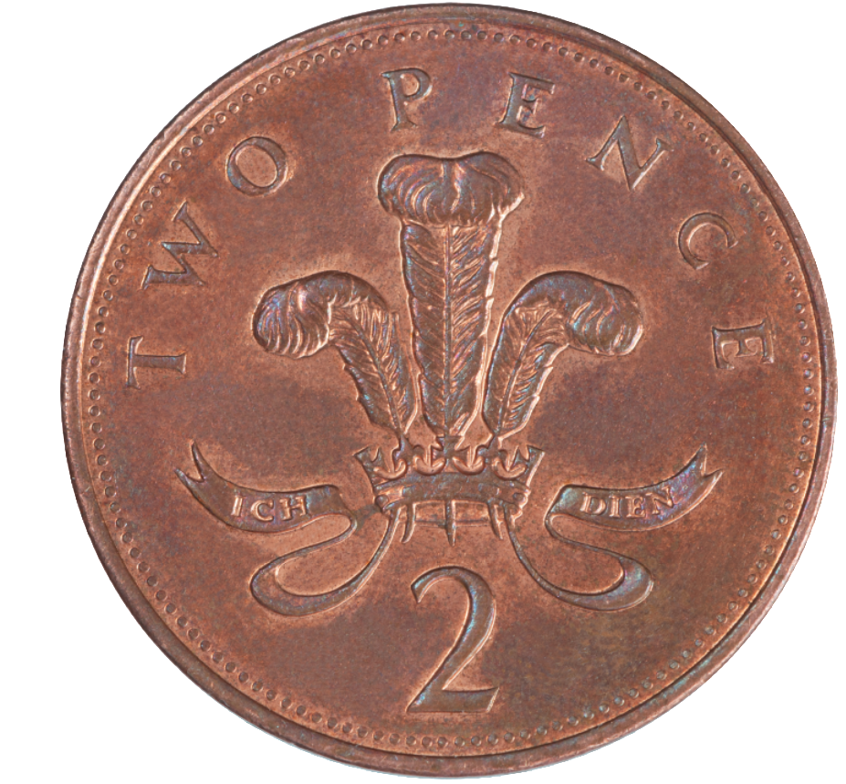
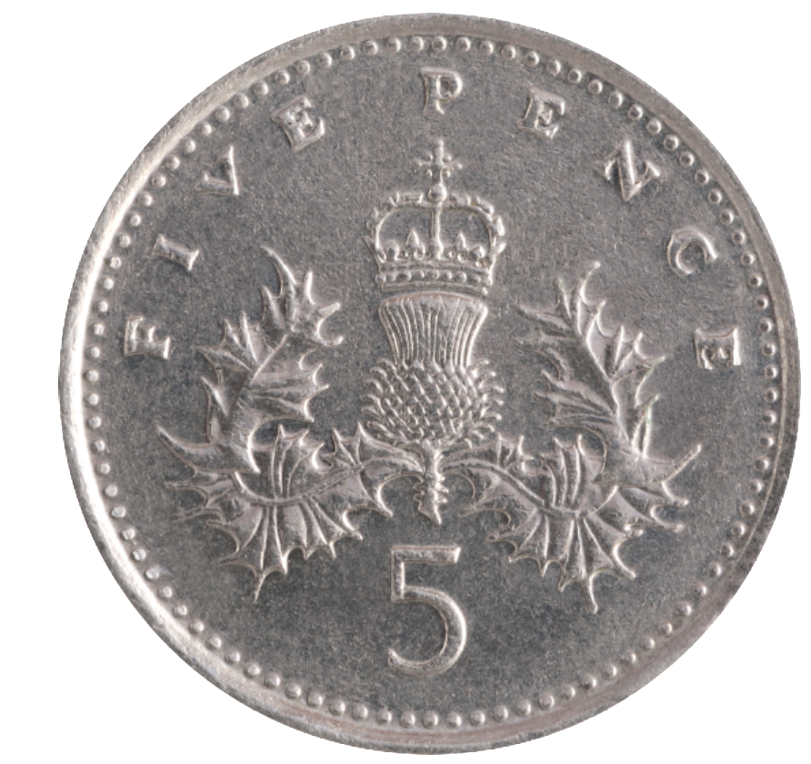
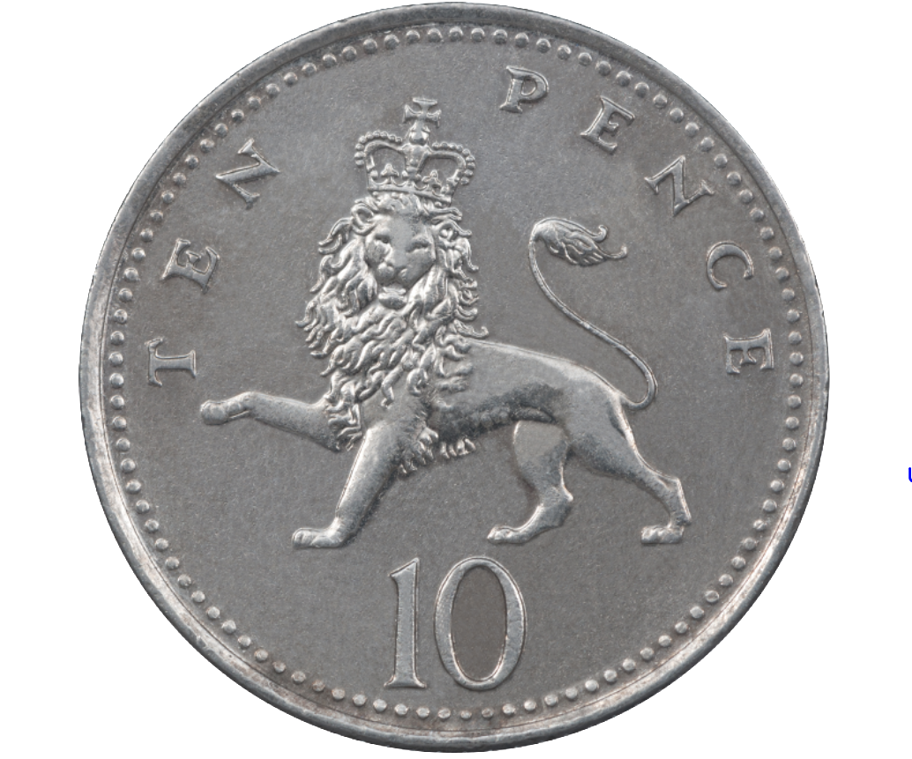
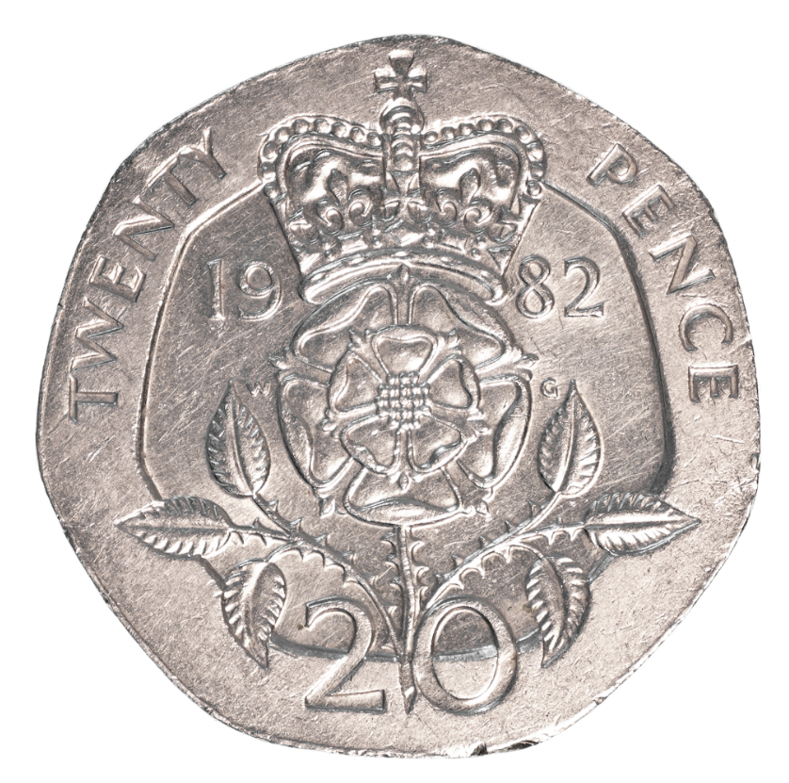
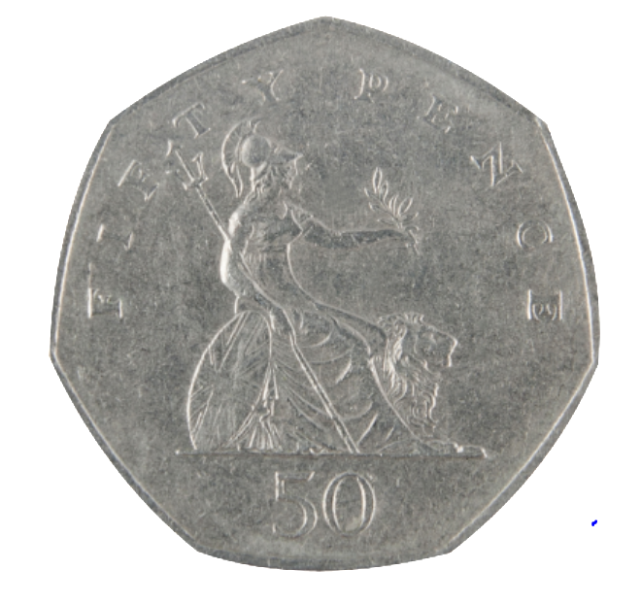
Introduction
Make 10p using only bronze coins.
Make 50p using only silver coins.
Make £1 using only silver coins.
Is there more than one way of doing it?
© Classroom Secrets Limited 2018

Slide 4
Introduction
Make 10p using only bronze coins.
Make 50p using only silver coins.
Make £1 using only silver coins.
Here is a selection of answers.
© Classroom Secrets Limited 2018

Slide 5
Varied Fluency 1
Complete the table.
£ | p | £ and p
2 | 26
 | 907
 |  | £3.55
© Classroom Secrets Limited 2018

Slide 6
Varied Fluency 1
Complete the table.
£ | p | £ and p
2 | 26 | £2.26
 | 907 | £9.07
3 | 55 | £3.55
© Classroom Secrets Limited 2018

Slide 7
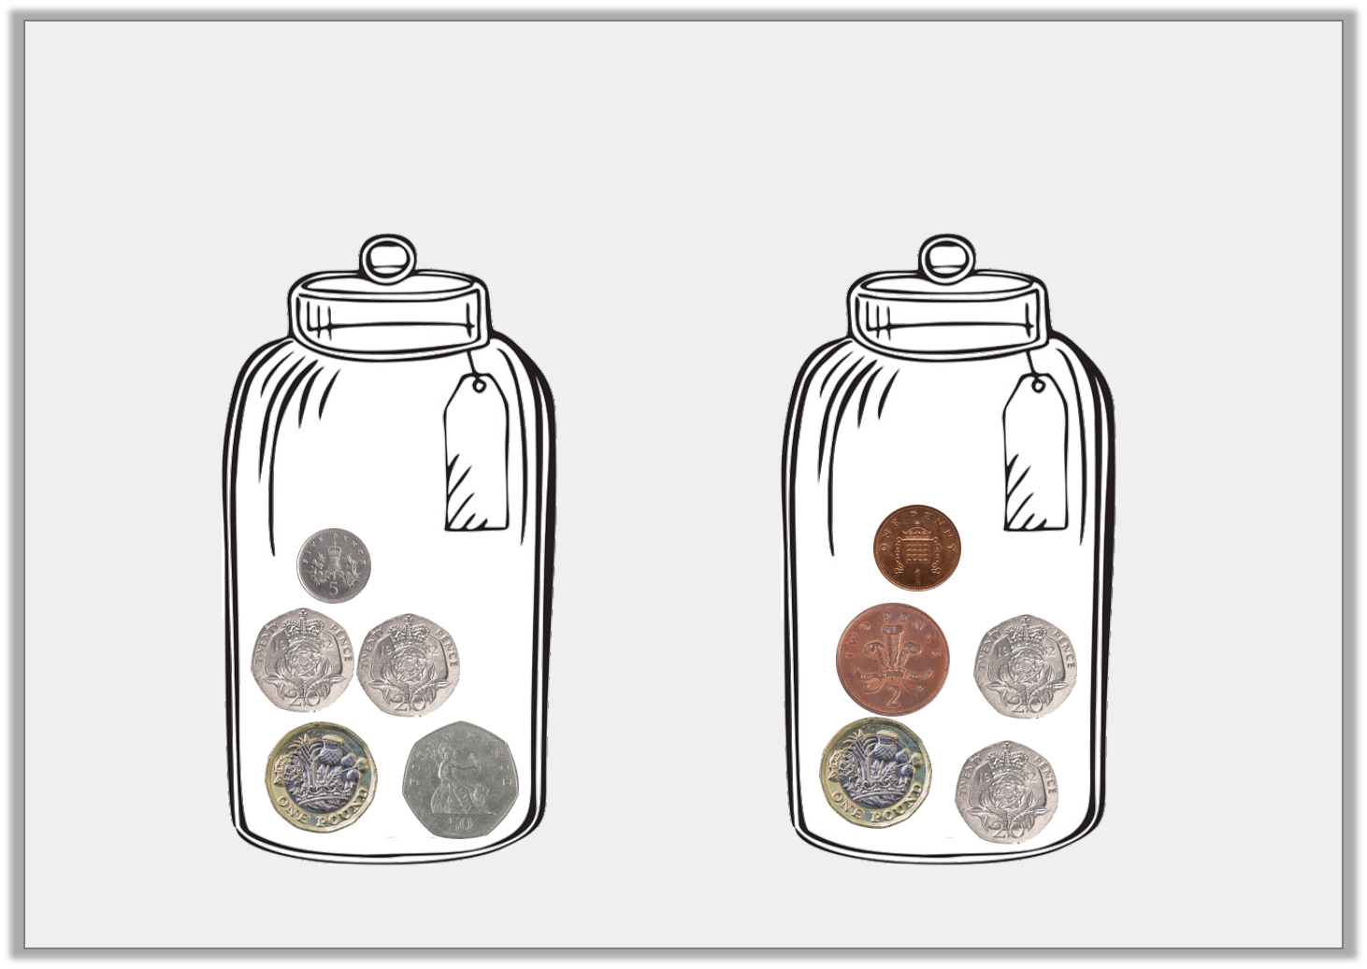
Varied Fluency 2
How much money is in each jar?
A
B
© Classroom Secrets Limited 2018

Slide 8
Varied Fluency 2
How much money is in each jar?
A
B
£1.95
£1.43
© Classroom Secrets Limited 2018

Slide 9
Varied Fluency 3
I have five pound coins, a fifty pence coin and 2 ten pence coins. How much money do I have altogether?
© Classroom Secrets Limited 2018

Slide 10
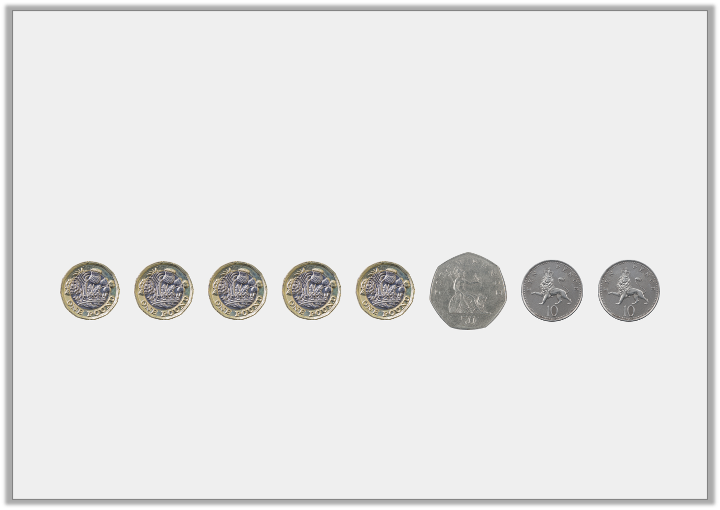
Varied Fluency 3
I have five pound coins, a fifty pence coin and 2 ten pence coins. How much money do I have altogether?
£5.70
© Classroom Secrets Limited 2018

Slide 11
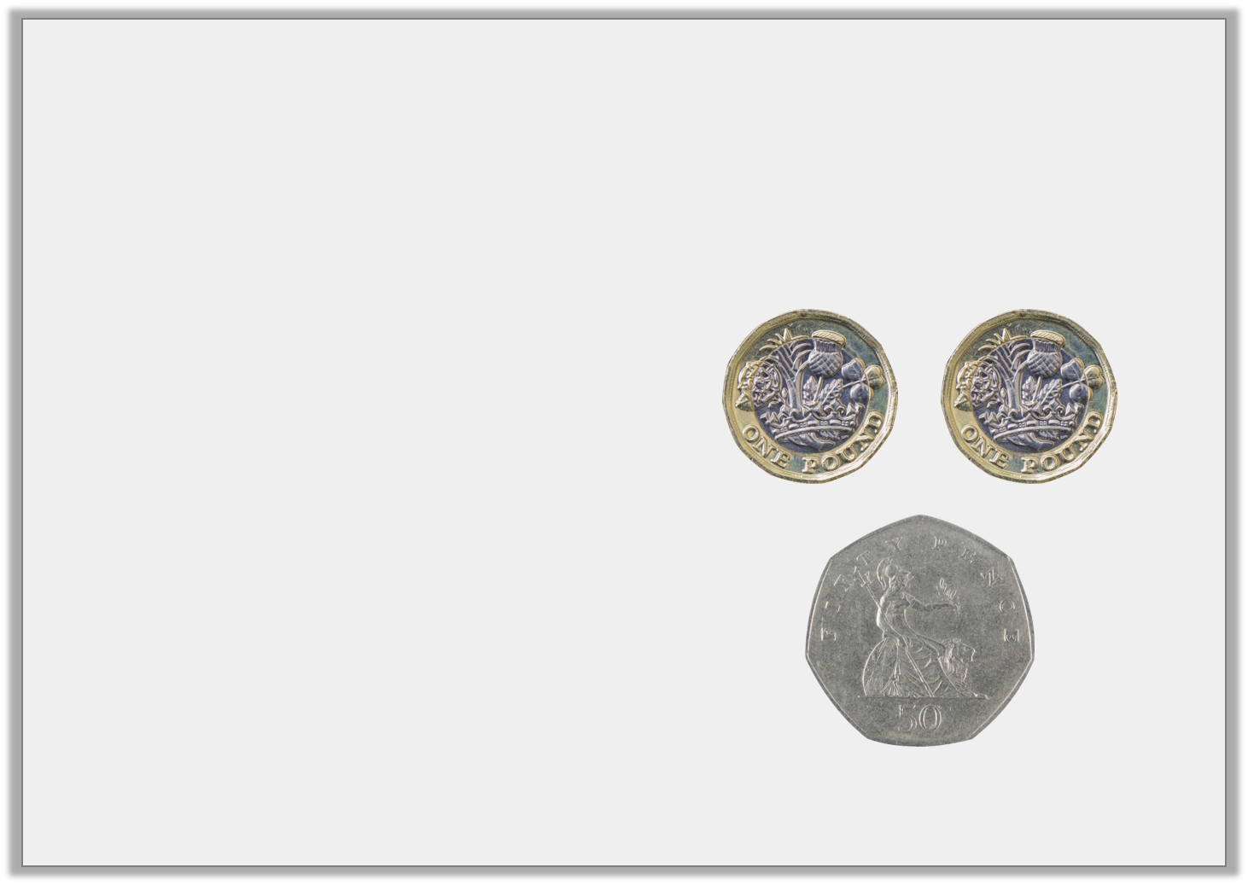
Varied Fluency 4
Which is the correct written version for the amount of coins shown?
A) £2.05
B) £2.5
C) £2.50
© Classroom Secrets Limited 2018

Slide 12
Varied Fluency 4
Which is the correct written version for the amount of coins shown?
A) £2.05
B) £2.5
C) £2.50
© Classroom Secrets Limited 2018

Slide 13
Varied Fluency 5
What is the value of the underlined digit?
a) £11.65 | b) £4.09 | c) £11.20
© Classroom Secrets Limited 2018

Slide 14
Varied Fluency 5
What is the value of the underlined digit?
a) £11.65 60p | b) £4.09 9p | c) £11.20 £10
© Classroom Secrets Limited 2018

Slide 15
Reasoning 1
Imran and Beth both want to buy a burger.
A burger costs £1.60.
Imran says, “I have a 50p coin, three 20p coins and four 5p coins.”
Beth says, “I have a £1 coin, two 20p coins and two 10p coins.”
Who can afford to buy a burger?
Explain how you know.
© Classroom Secrets Limited 2018

Slide 16
Reasoning 1
Imran and Beth both want to buy a burger.
A burger costs £1.60.
Imran says, “I have a 50p coin, three 20p coins and four 5p coins.”
Beth says, “I have a £1 coin, two 20p coins and two 10p coins.”
Who can afford to buy a burger?
Explain how you know.
Beth can afford it because…
© Classroom Secrets Limited 2018

Slide 17
Reasoning 1
Imran and Beth both want to buy a burger.
A burger costs £1.60.
Imran says, “I have a 50p coin, three 20p coins and four 5p coins.”
Beth says, “I have a £1 coin, two 20p coins and two 10p coins.”
Who can afford to buy a burger?
Explain how you know.
Beth can afford it because she has £1.60. Imran only has £1.30.
© Classroom Secrets Limited 2018

Slide 18
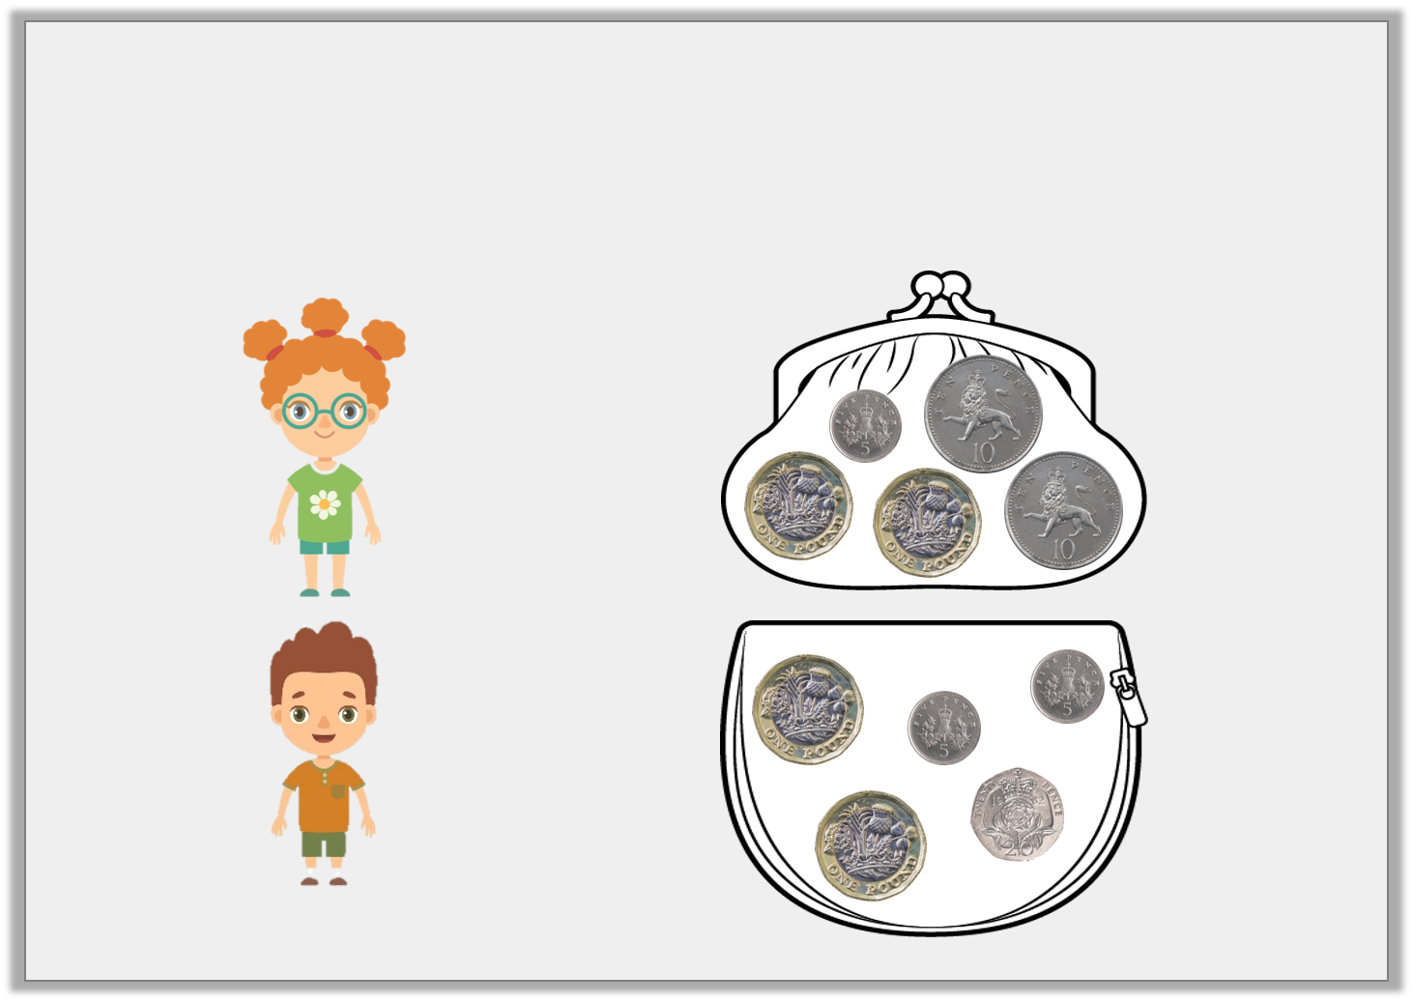
Problem Solving 1
Manon has 5p more than Jon. Match each child to their correct money purse. Write down how much they each have in pence and decimals.
Manon
Jon
© Classroom Secrets Limited 2018

Slide 19
Problem Solving 1
Manon has 5p more than Jon. Match each child to their correct money purse. Write down how much they each have in pence and decimals.
Manon
230p
£2.30
Jon
225p
£2.25
© Classroom Secrets Limited 2018

Slide 20
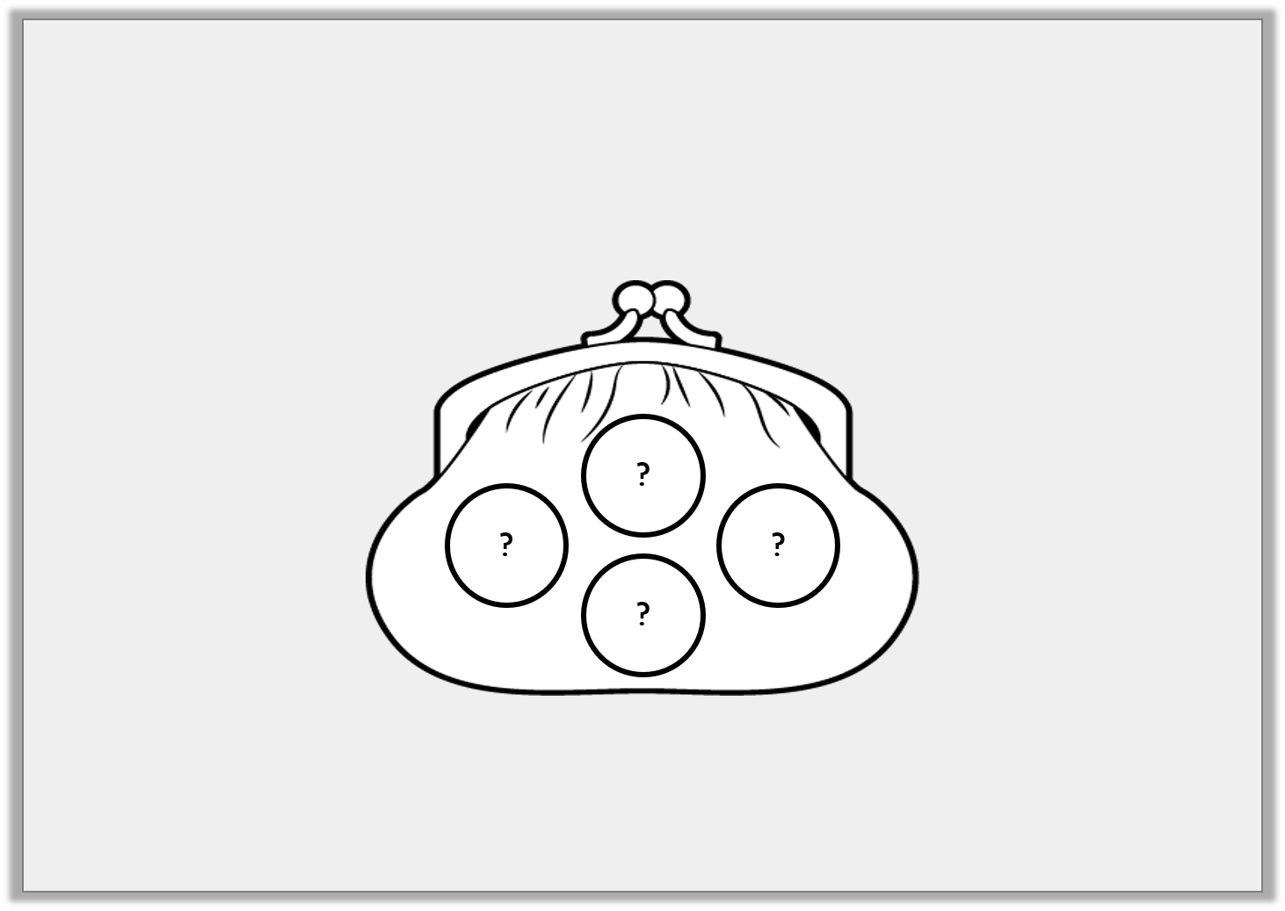
Problem Solving 2
Andrew has £2.10 in his wallet. He has four coins.
What coins could Andrew have?
© Classroom Secrets Limited 2018

Slide 21
Problem Solving 2
Andrew has £2.10 in his wallet. He has four coins.
What coins could Andrew have?
Multiple answers, e.g.
2 x £1 coin and 2 x 5p coin
A £1 coin, 2 x 50p coin and a 10p coin
© Classroom Secrets Limited 2018

