Slide 1


Maths
Measurement
Year One
Maths | Year 4 | Measurement | Converting Units of Measurement | Lesson 5 of 5: Converting Units of Time

Slide 3
Aim
I can convert between units of time.
Success Criteria
I can convert from seconds to minutes by dividing by 60.
I can convert from minutes to seconds by multiplying by 60.
I can convert from minutes to hours by dividing by 60.
I can convert from hours to minutes by multiplying by 60.

Slide 4

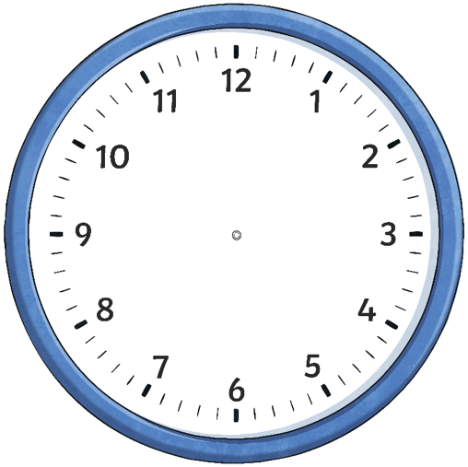

How Many Minutes?
Calculate how many minutes between the time on the first clock and the time on the second clock.
25 minutes
5 past 9
half past 9

Slide 5
How Many Minutes?
Calculate how many minutes between the time on the first clock and the time on the second clock.
20 minutes
20 past 7
20 to 8

Slide 6
How Many Minutes?
Calculate how many minutes between the time on the first clock and the time on the second clock.
25 minutes

Slide 7
How Many Minutes?
Calculate how many minutes between the time on the first clock and the time on the second clock.
40 minutes

Slide 8
How Many Minutes?
Calculate how many minutes between the time on the first clock and the time on the second clock.
30 minutes

Slide 9
How Many Minutes?
Calculate how many minutes between the time on the first clock and the time on the second clock.
35 minutes

Slide 10
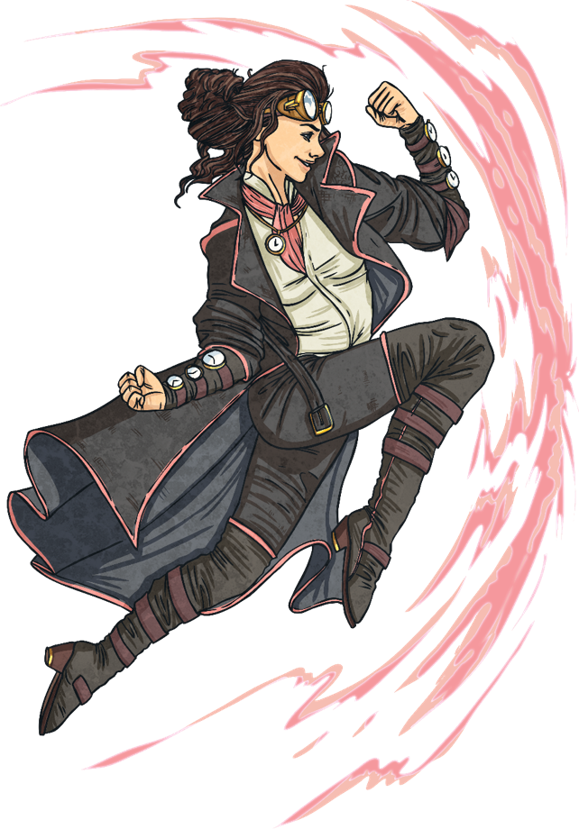

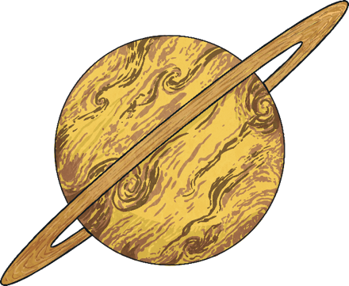
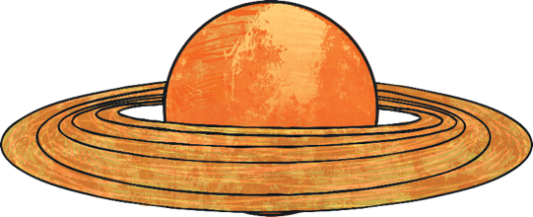
Counting in 60s
To count in 60s, we can count in 6s, then multiply by 10:
6s
60s
6
12
18
24
30
36
42
60
120
180
240
300
360
420

Slide 11

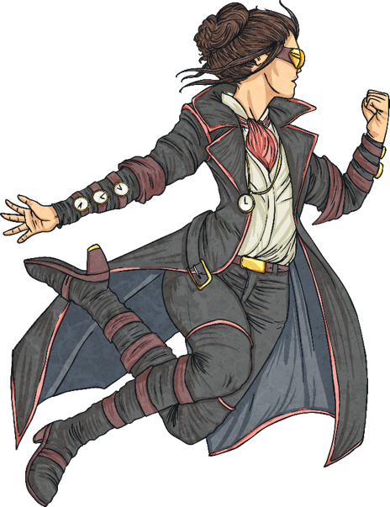

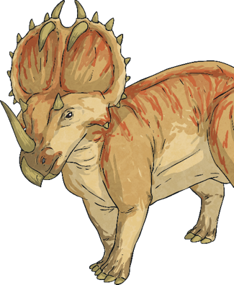
Counting in 60s
To count in 60s, we can count in 6s, then multiply by 10:
6s
60s
6
12
18
24
30
36
42
60
120
180
240
300
360
420
120
What is 2 × 60?

Slide 12
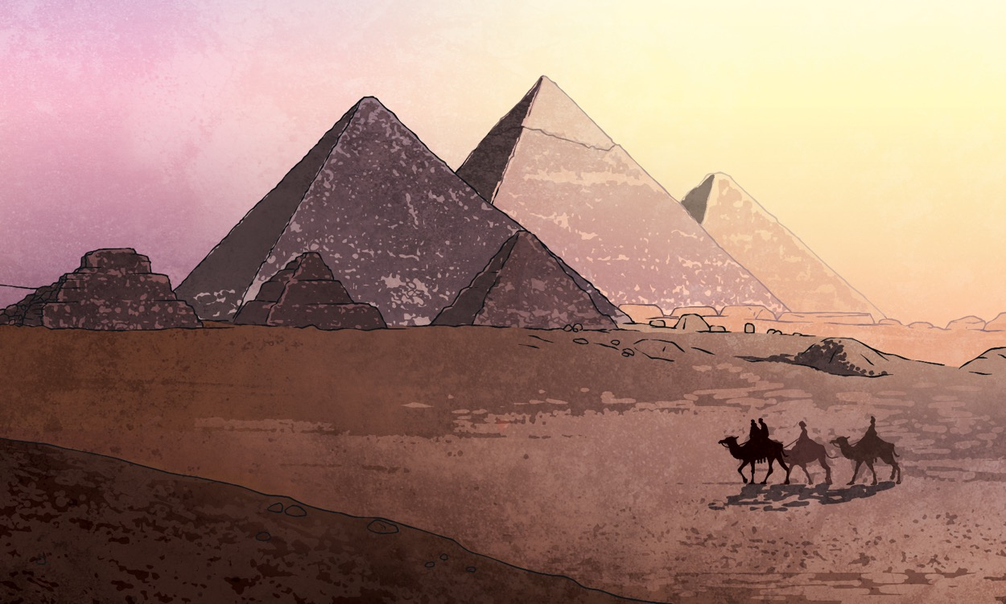
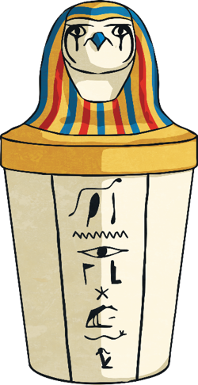
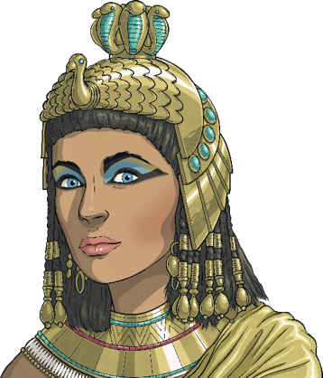
Counting in 60s
To count in 60s, we can count in 6s, then multiply by 10:
6s
60s
6
12
18
24
30
36
42
60
120
180
240
300
360
420
300
What is 5 × 60?

Slide 13
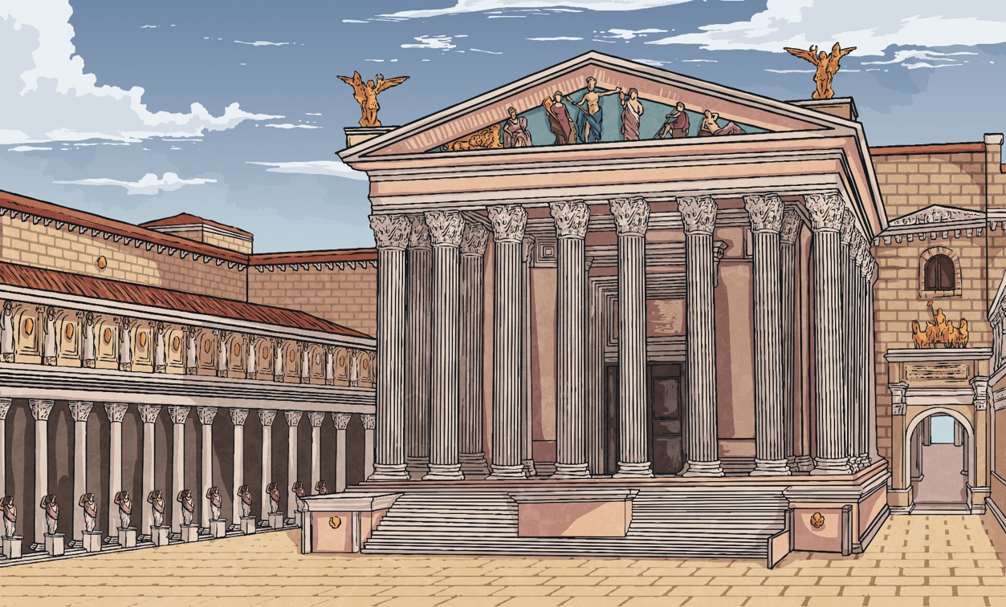

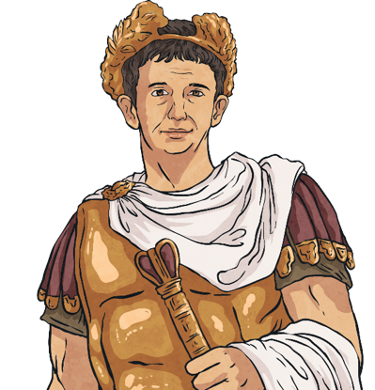
Counting in 60s
To count in 60s, we can count in 6s, then multiply by 10:
6s
60s
6
12
18
24
30
36
42
60
120
180
240
300
360
420
What is 7 × 60?
420

Slide 14
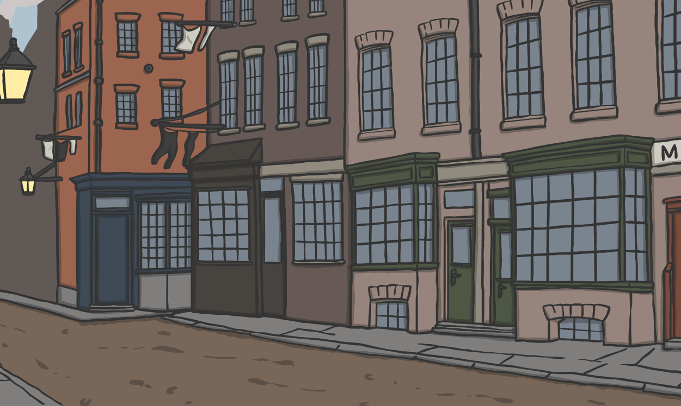
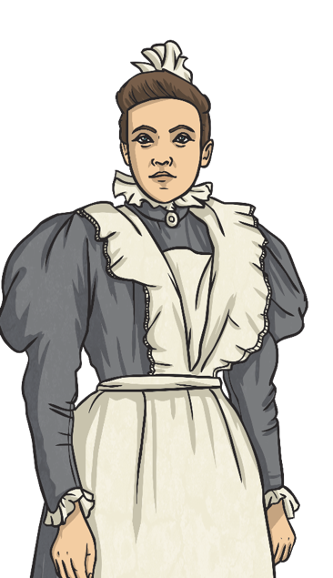

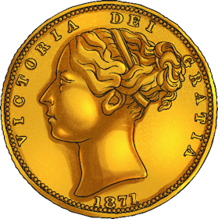
Counting in 60s
To count in 60s, we can count in 6s, then multiply by 10:
What is 6 × 60?
360

Slide 15
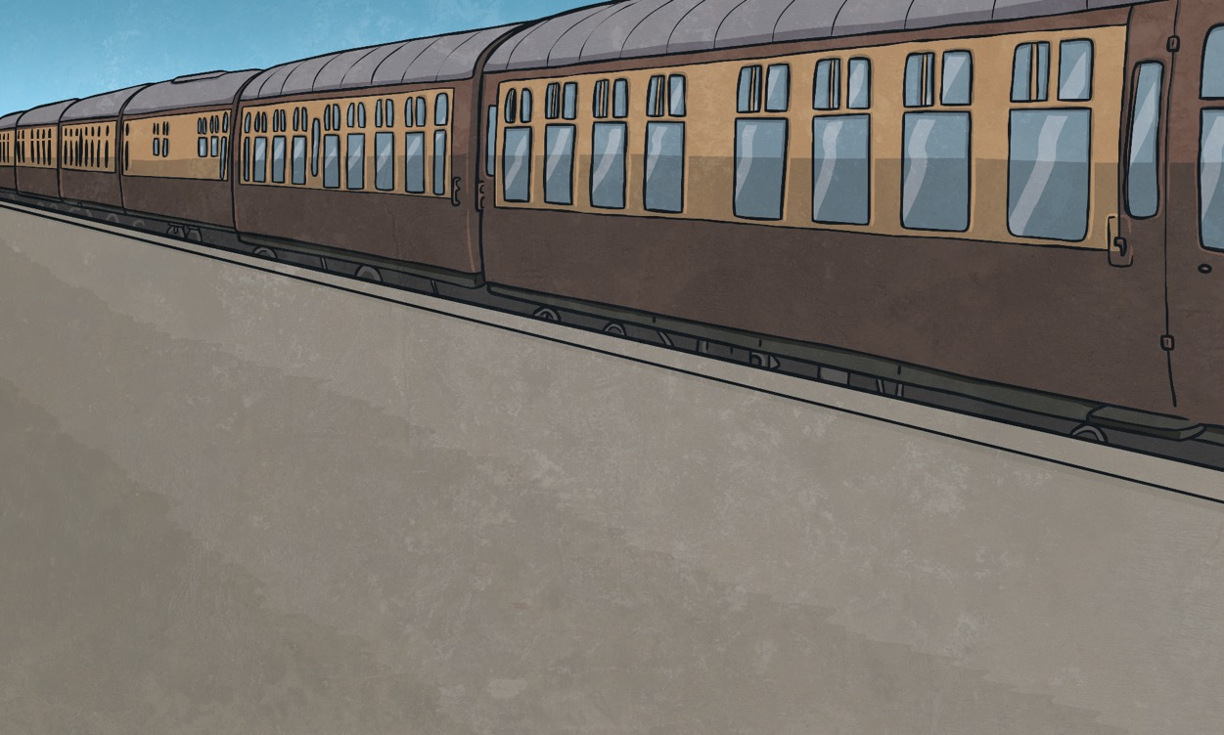
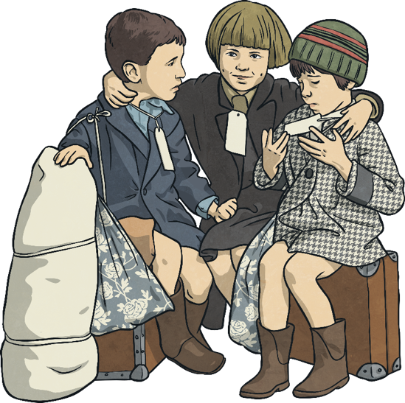
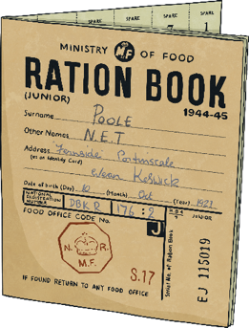
Counting in 60s
To count in 60s, we can count in 6s, then multiply by 10:
What is 3 × 60?
180

Slide 16
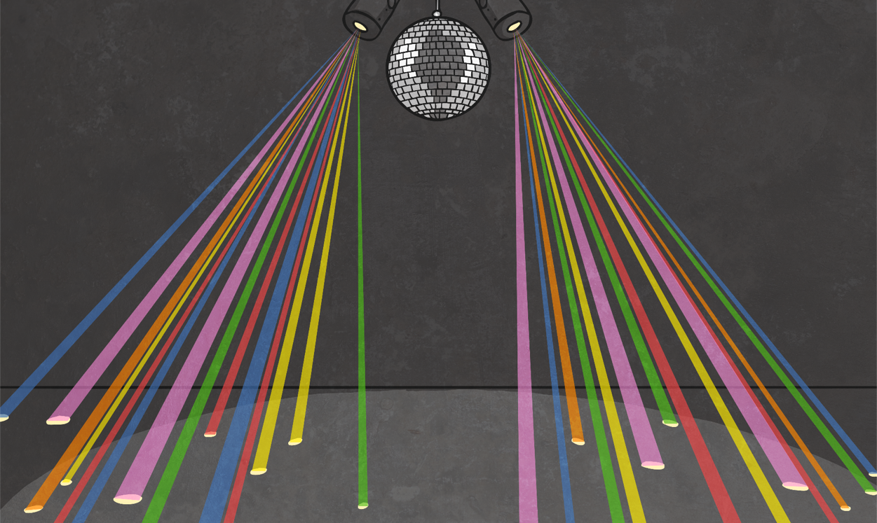
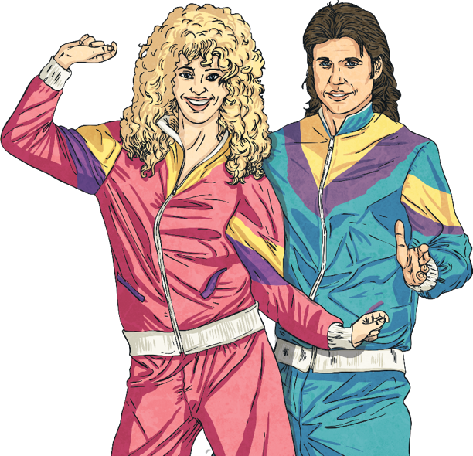
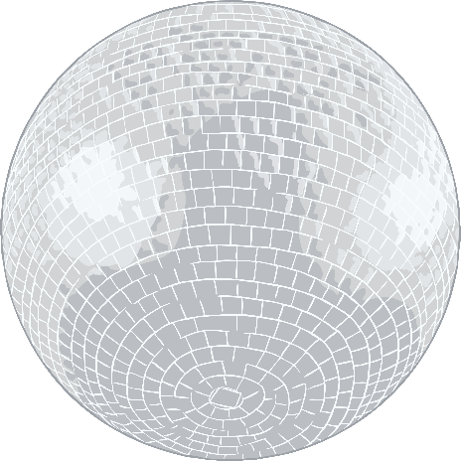
Counting in 60s
To count in 60s, we can count in 6s, then multiply by 10:
What is 4 × 60?
240

Slide 17

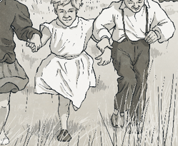

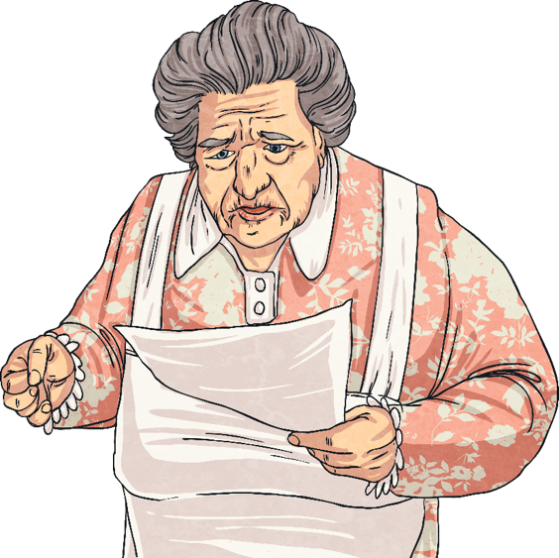

Time Units
?
How many seconds are there in a minute?
1 minute =
60 seconds

Slide 18
Time Units
?
How many minutes are there in an hour?
1 hour =
60 minutes

Slide 19





Time Units
?
How could we work out how many seconds there are in 2 minutes?
60 seconds = 1 minute
60 minutes = 1 hour
We need to count 2 lots of 60, or multiply 2 (the number of minutes) by 60.
2 × 60 = 120
There are 120 seconds in 2 minutes.

Slide 20
Time Units
?
How many seconds are there in 5 minutes?
60 seconds = 1 minute
60 minutes = 1 hour
5 × 60 = 300
There are 300 seconds in 5 minutes.

Slide 21
Time Units
?
How many minutes are there in 2 hours?
60 seconds = 1 minute
60 minutes = 1 hour
2 × 60 = 120
There are 120 minutes in 2 hours.

Slide 22
Time Units
?
How many minutes are there in 4 hours?
60 seconds = 1 minute
60 minutes = 1 hour
4 × 60 = 240
There are 240 minutes in 4 hours.

Slide 23
Time Units
We know that to convert from minutes to seconds or hours to minutes, we need to multiply by 60. What do we need to do to answer this question?
?
60 seconds = 1 minute
60 minutes = 1 hour
How many minutes is 120 seconds?
Converting from minutes to seconds is the opposite of converting from seconds to minutes, so we can use the inverse and divide by 60.
120 ÷ 60 is the same as 12 ÷ 6.
120 ÷ 60 = 2

Slide 24
Time Units
?
How many minutes is 360 seconds?
60 seconds = 1 minute
60 minutes = 1 hour
360 ÷ 60 = 6
360 seconds is 6 minutes.

Slide 25
Time Units
?
How many hours is 180 minutes?
60 seconds = 1 minute
60 minutes = 1 hour
180 ÷ 6 = 3
180 minutes is 3 hours.

Slide 26
Time Units
?
How many hours is 300 minutes?
60 seconds = 1 minute
60 minutes = 1 hour
300 ÷ 60 = 5
300 minutes is 5 hours.

Slide 27

Ordering Time Units
Seconds and Minutes
Here are three time measurements:
75 seconds 1 minute 30 seconds 80 seconds
?
What do we need to do to be able to order these measurements?
We need to make sure that all measurements are in the same unit.
In the example, convert the middle measurement into seconds:
1 minute 30 seconds = 60 seconds + 30 seconds = 90 seconds
75 seconds 90 seconds 80 seconds
The order from shortest to longest time would be:
75 seconds 80 seconds 1 minute 30 seconds

Slide 28

Ordering Time Units
Seconds and Minutes
Order these times from shortest time to longest time:
2 minutes 10 seconds
100 seconds
2 minutes 5 seconds
100 seconds
2 minutes 5 seconds
2 minutes 10 seconds
200 seconds
2 minutes 40 seconds
190 seconds
2 minutes 40 seconds
190 seconds
200 seconds
Key Fact
60 seconds = 1 minute

Slide 29
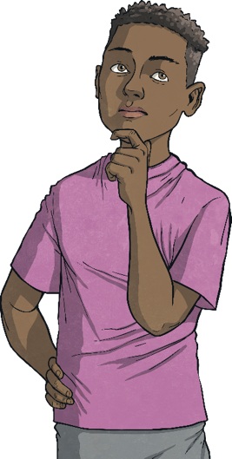
Ordering Time Units
Minutes and Hours
Key Fact
60 minutes = 1 hour
Here are three time measurements:
200 minutes 1 hour 40 minutes 240 minutes
?
How could you put them in order from shortest to longest time?
!
Tip: look for the one that is different from the others.
1 hour 40 minutes = 60 minutes + 40 minutes = 100 minutes
200 minutes 100 minutes 240 minutes
The order from shortest to longest time would be:
1 hour 40 minutes 200 minutes 240 minutes

Slide 30
Ordering Time Units
Minutes and Hours
Order these times from shortest time to longest time:
3 hours 40 minutes
300 minutes
3 hours 15 minutes
3 hours 15 minutes
3 hours 40 minutes
300 minutes
200 minutes
3 hours 50 minutes
220 minutes
200 minutes
220 minutes
3 hours 50 minutes
Key Fact
60 seconds = 1 minute

Slide 31

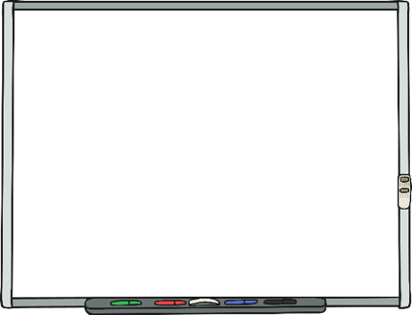
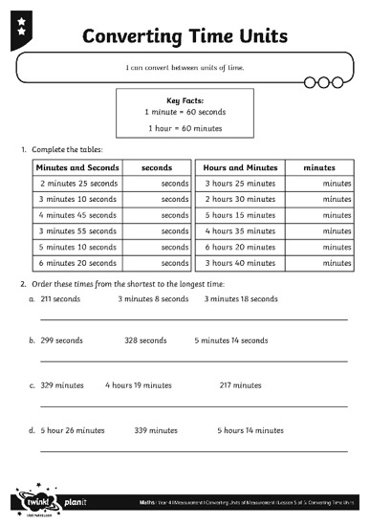
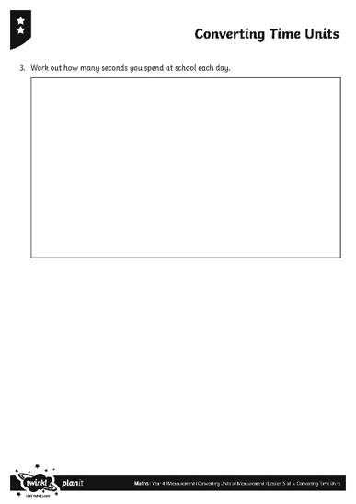

Converting Time Units
Use your captivating conversion skills to complete this activity sheet.

Slide 32

Time Unit Problems
William’s parents have sponsored him 2p per minute for keeping silent. He is silent for 1 hour 15 minutes.
?
How much money do they need to pay?
1 hour 15 minutes = 60 minutes + 15 minutes = 75 minutes
75 × 2p = 150p = £1.50
William’s parents need to pay £1.50.

Slide 33

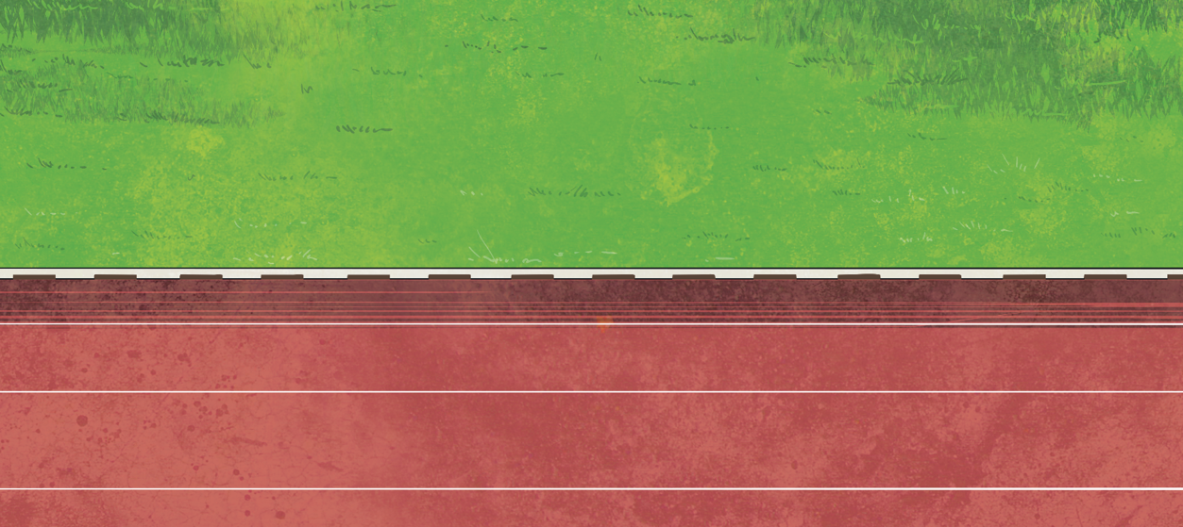
Time Unit Problems
Gina wants to run for 10 minutes. So far, she has run for 400 seconds.
?
How much longer does she need to keep running? Give your answer in seconds.
Method A:
10 minutes = 10 × 60 seconds = 600 seconds
600 seconds - 400 seconds = 200 seconds
Gina needs to keep running for another 200 seconds.

Slide 34
Time Unit Problems
Gina wants to run for 10 minutes. So far she has run for 400 seconds.
?
How much longer does she need to keep running? Give your answer in seconds.
Method B:
400 seconds ÷ 60 = 6 minutes 40 seconds
20 seconds 3 minutes
6 minutes 40 seconds 7 minutes 10 minutes
3 minutes 20 seconds = (3 × 60) + 20 = 180 + 20 = 200 seconds
Gina needs to keep running for another 200 seconds.

Slide 35

Aim
I can convert between units of time.
Success Criteria
I can convert from seconds to minutes by dividing by 60.
I can convert from minutes to seconds by multiplying by 60.
I can convert from minutes to hours by dividing by 60.
I can convert from hours to minutes by multiplying by 60.

