Slide 1

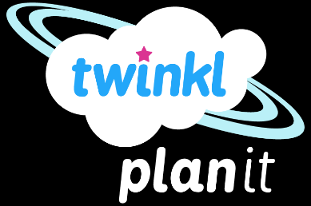
Maths
Measurement
Year One
Maths | Year 4 | Measurement | Solving Time Problems | Lesson 4 of 4: Time Problems Involving Weeks and Days

Slide 3
Aim
I can solve problems that involve converting units of time (weeks
and days).
Success Criteria
I can convert from weeks to days.
I can convert from days to weeks.
I can solve problems that involve converting from weeks to days and days to weeks.

Slide 4

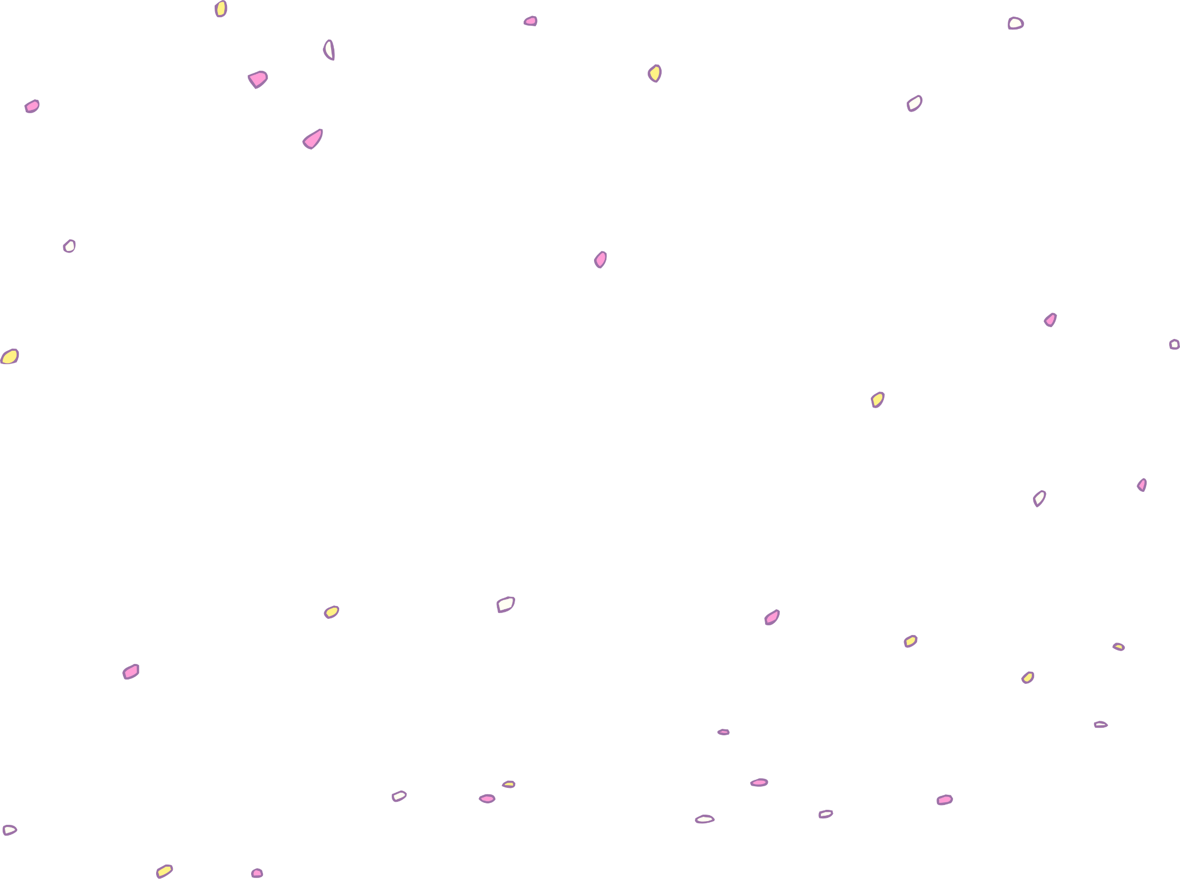

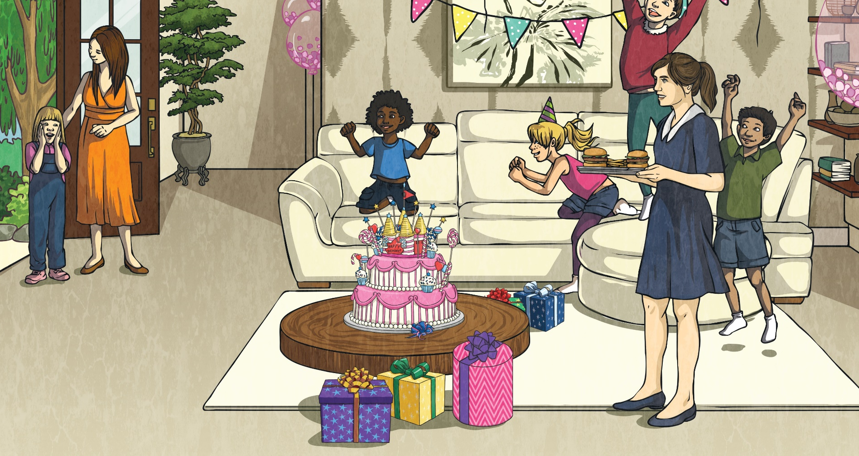
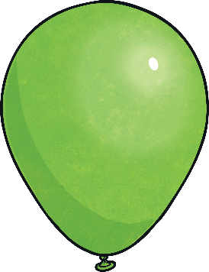

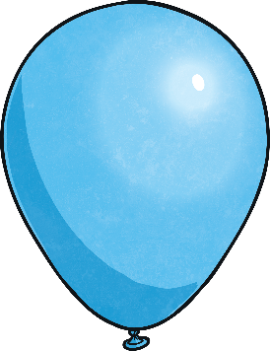
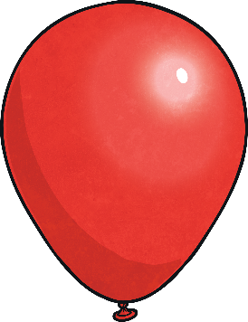
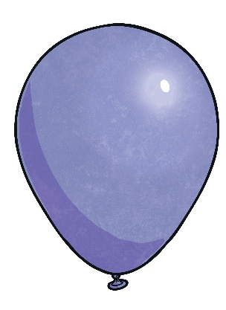
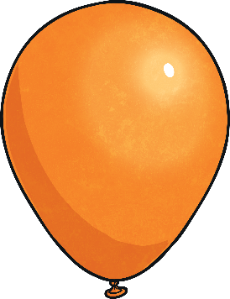

Order It
Here are a variety of units of time. Order them from least to greatest.
1
year
200
seconds
90
minutes
5
hours
4
minutes
2
hours
4
months
least to greatest
1
year
90
minutes
2
hours
4
minutes
200
seconds
4
months
5
hours

Slide 5

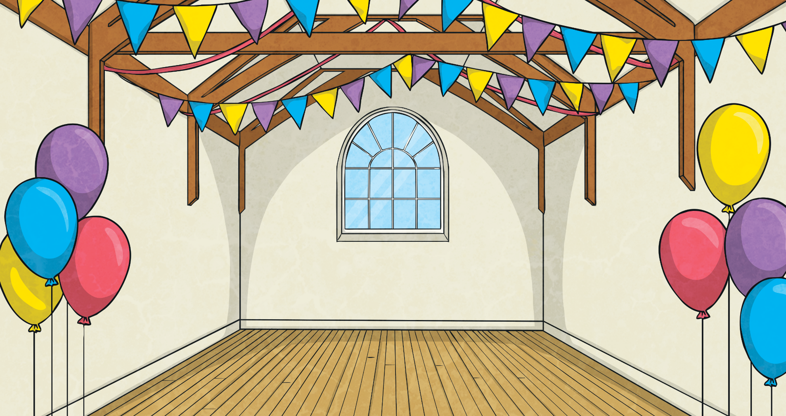
Weeks to Days
Write how many days there are in the number of weeks shown.
7 days
in 1 week
49 days
in 7 weeks
28 days
in 4 weeks
1 week
7 weeks
4 weeks
56 days
in 8 weeks
14 days
in 2 weeks
63 days
in 9 weeks
8 weeks
2 weeks
9 weeks
5 weeks
6 weeks
3 weeks
35 days
in 5 weeks
42 days
in 6 weeks
21 days
in 3 weeks

Slide 6
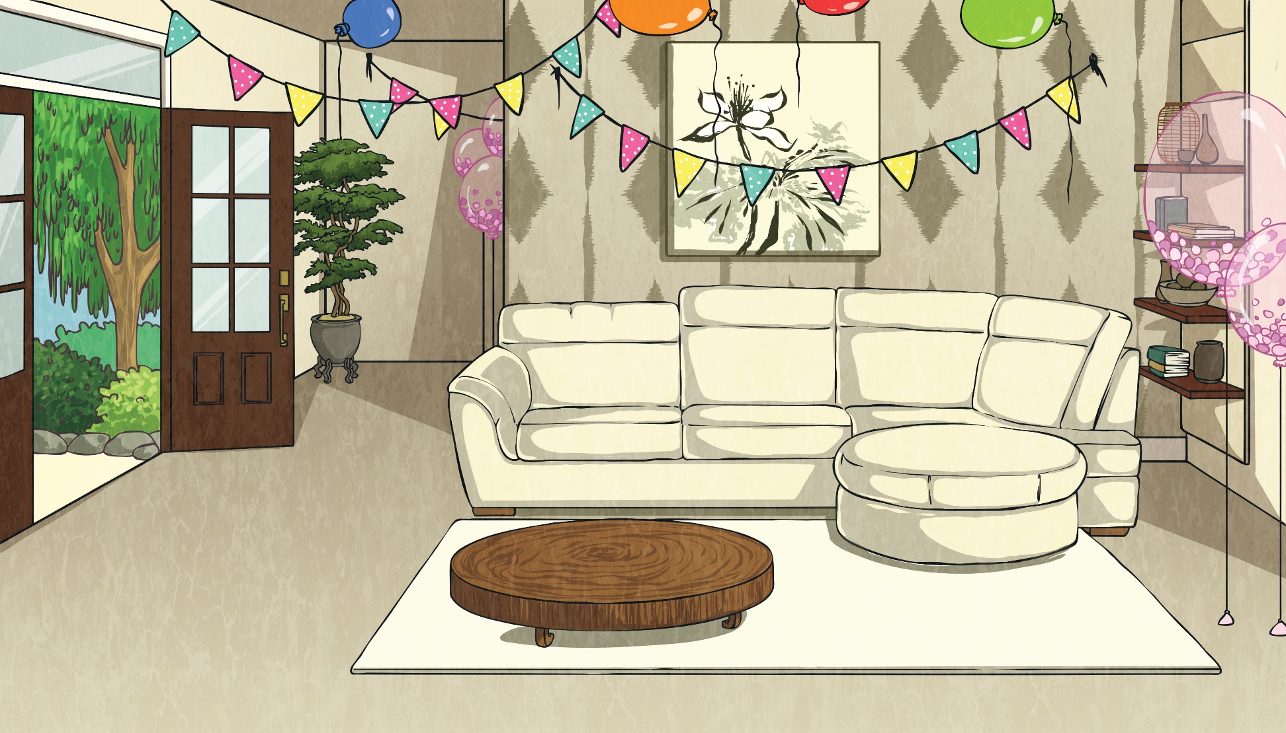

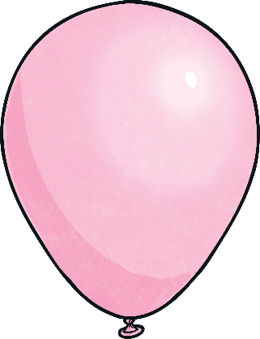
Weeks to Days
How many days are there in 3 weeks and 4 days?
3 × 7 =
21
+ 4 =
25 days
How many days are there in:
a.
b.
2 weeks 3 days?
5 weeks 6 days?
17 days
41 days
c.
d.
4 weeks 2 days?
6 weeks 3 days?
30 days
45 days

Slide 7
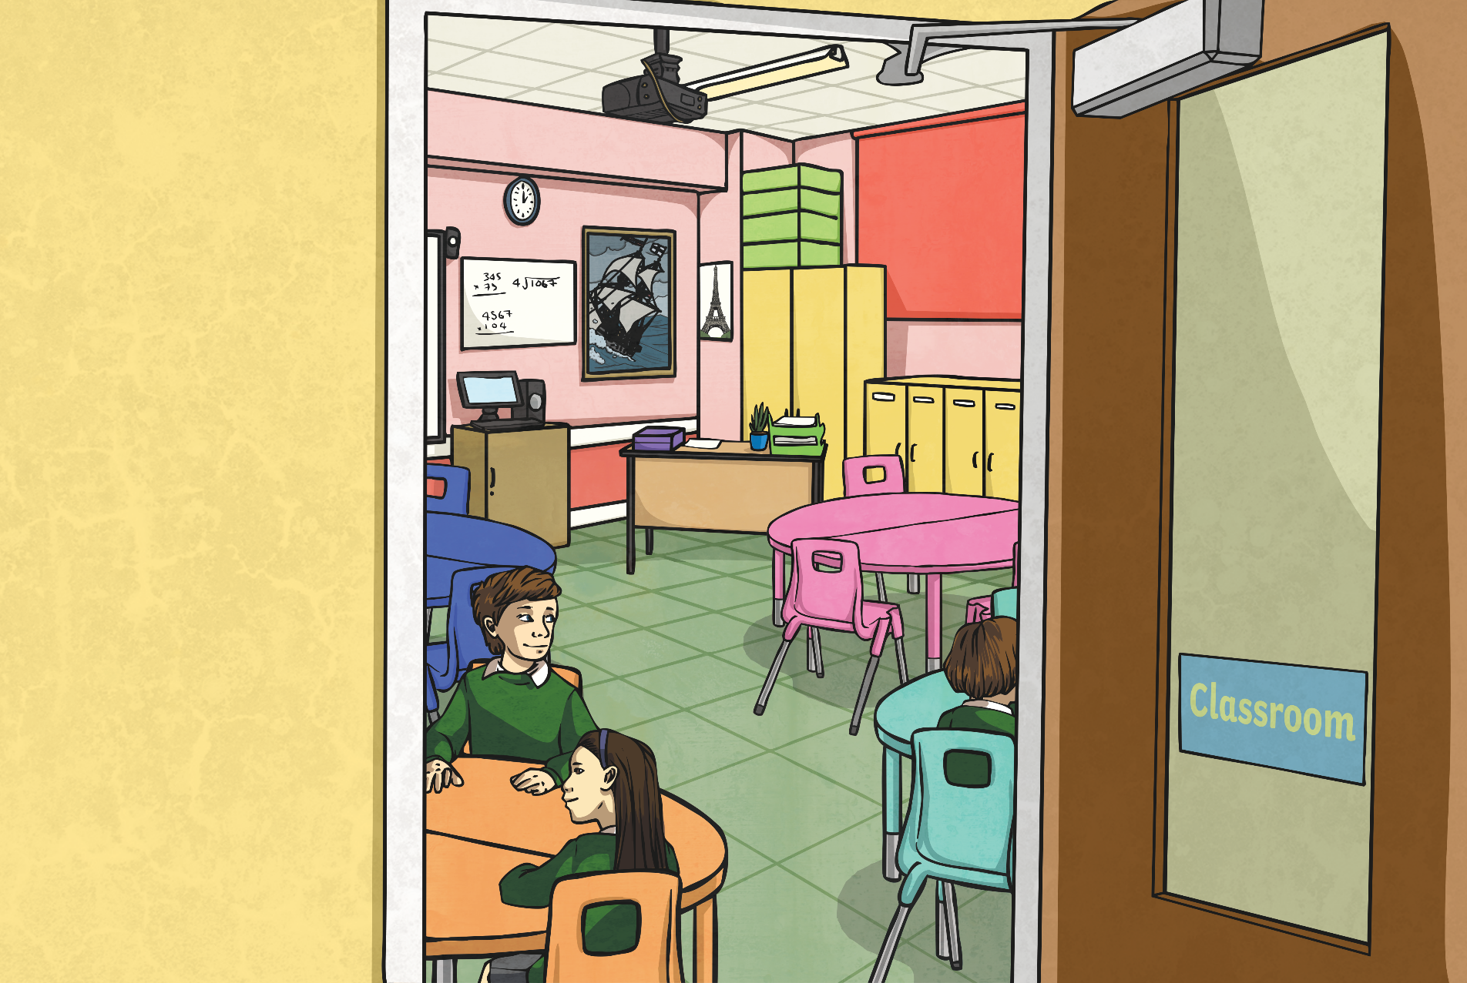
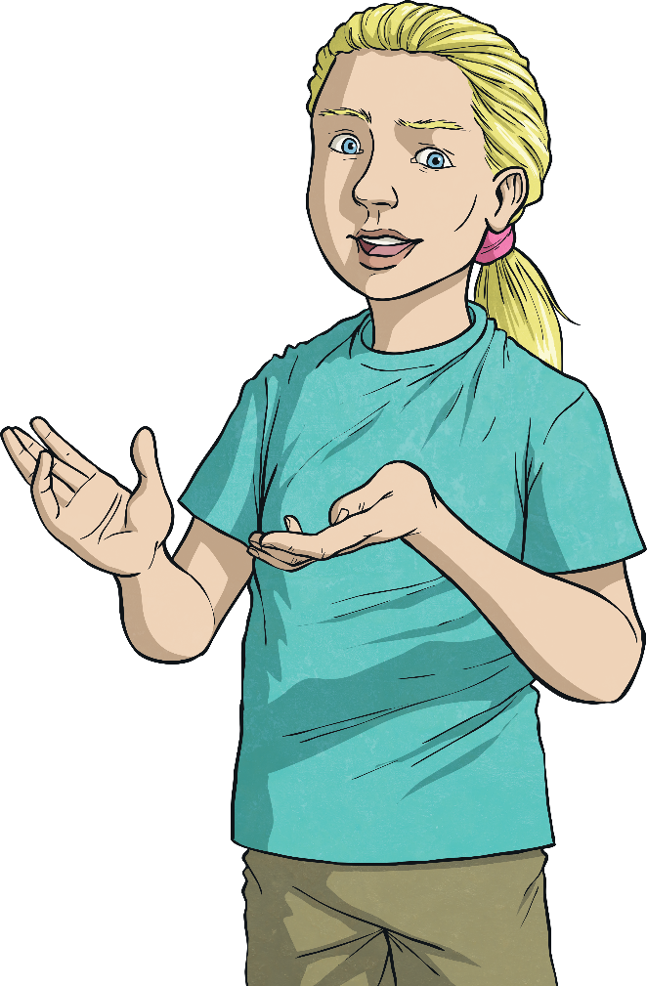
Days to Weeks
To calculate how many weeks there are in a number of days, divide the number by 7:
If there is a remainder, this becomes days.
e.g. 42 days = 42 ÷ 7 = 6
There are
6 weeks in 42 days.
e.g. 50 days = 50 ÷ 7 = 7 remainder 1
There are 7 weeks 1 day in 50 days.

Slide 8
Days to Weeks
How many weeks are there in:
a.
28 days?
b.
35 days?
4 weeks
5 weeks
c.
d.
29 days?
44 days?
4 weeks 1 day
6 weeks 2 days
e.
61 days?
8 weeks 5 days

Slide 9

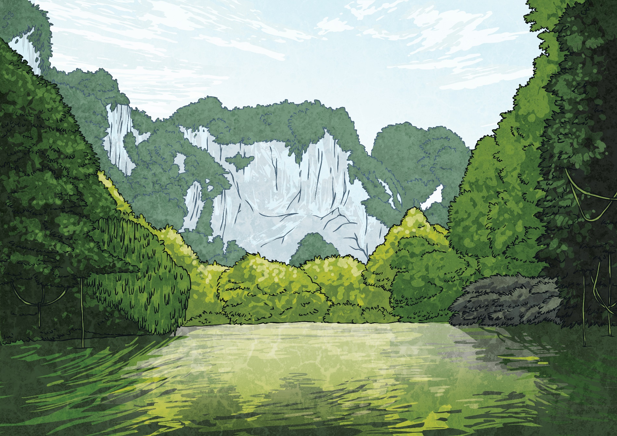
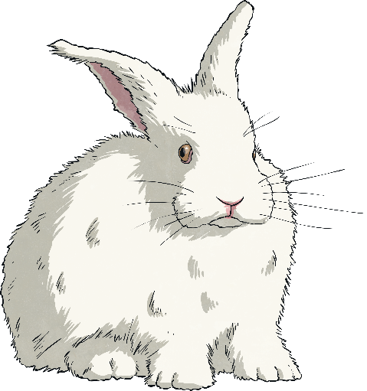
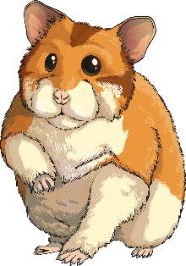

Animal Gestation
Gestation is the number of days that a mammal carries their baby before giving birth. This table shows average gestation periods for
some mammals. Some of the periods are written in days
and some in weeks and days.
Animal | Gestation Period
gerbil | 3 weeks 3 days
fox | 52 days
dog | 8 weeks 5 days
hamster | 2 weeks 6 days
kangaroo | 42 days
rabbit | 31 days

Slide 10
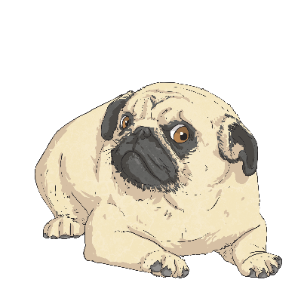
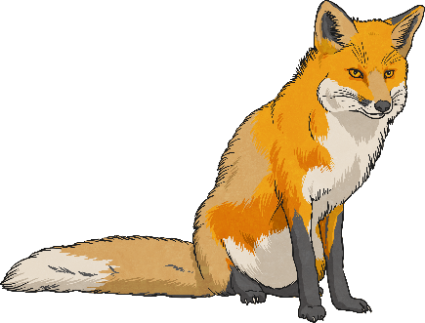
Animal Gestation
Animal | Gestation Period
gerbil | 3 weeks 3 days
fox | 52 days
dog | 8 weeks 5 days
hamster | 2 weeks 6 days
kangaroo | 42 days
rabbit | 31 days
Choose the correct symbol
(< or >) to
compare the animals:
>
<
dog
>
fox

Slide 11
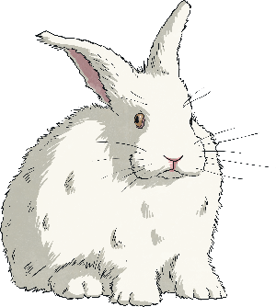
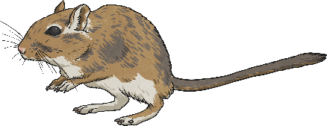
Animal Gestation
Animal | Gestation Period
gerbil | 3 weeks 3 days
fox | 52 days
dog | 8 weeks 5 days
hamster | 2 weeks 6 days
kangaroo | 42 days
rabbit | 31 days
Choose the correct symbol
(< or >) to
compare the animals:
>
<
gerbil
<
rabbit

Slide 12
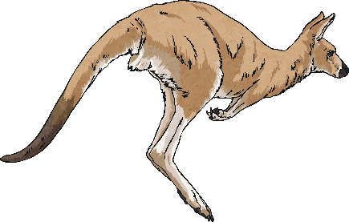
Animal Gestation
Animal | Gestation Period
gerbil | 3 weeks 3 days
fox | 52 days
dog | 8 weeks 5 days
hamster | 2 weeks 6 days
kangaroo | 42 days
rabbit | 31 days
Choose the correct symbol
(< or >) to
compare the animals:
>
<
dog
>
kangaroo

Slide 13
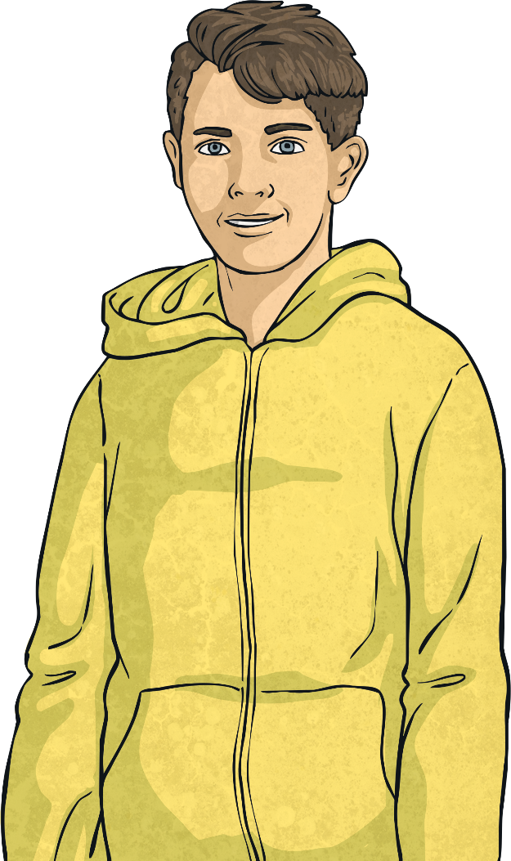
Animal Gestation
Animal | Gestation Period
gerbil | 3 weeks 3 days
fox | 52 days
dog | 8 weeks 5 days
hamster | 2 weeks 6 days
kangaroo | 42 days
rabbit | 31 days
2 weeks 4 days
How much longer is the gestation period of the kangaroo than the gerbil? Write your answer in weeks and days.

Slide 14

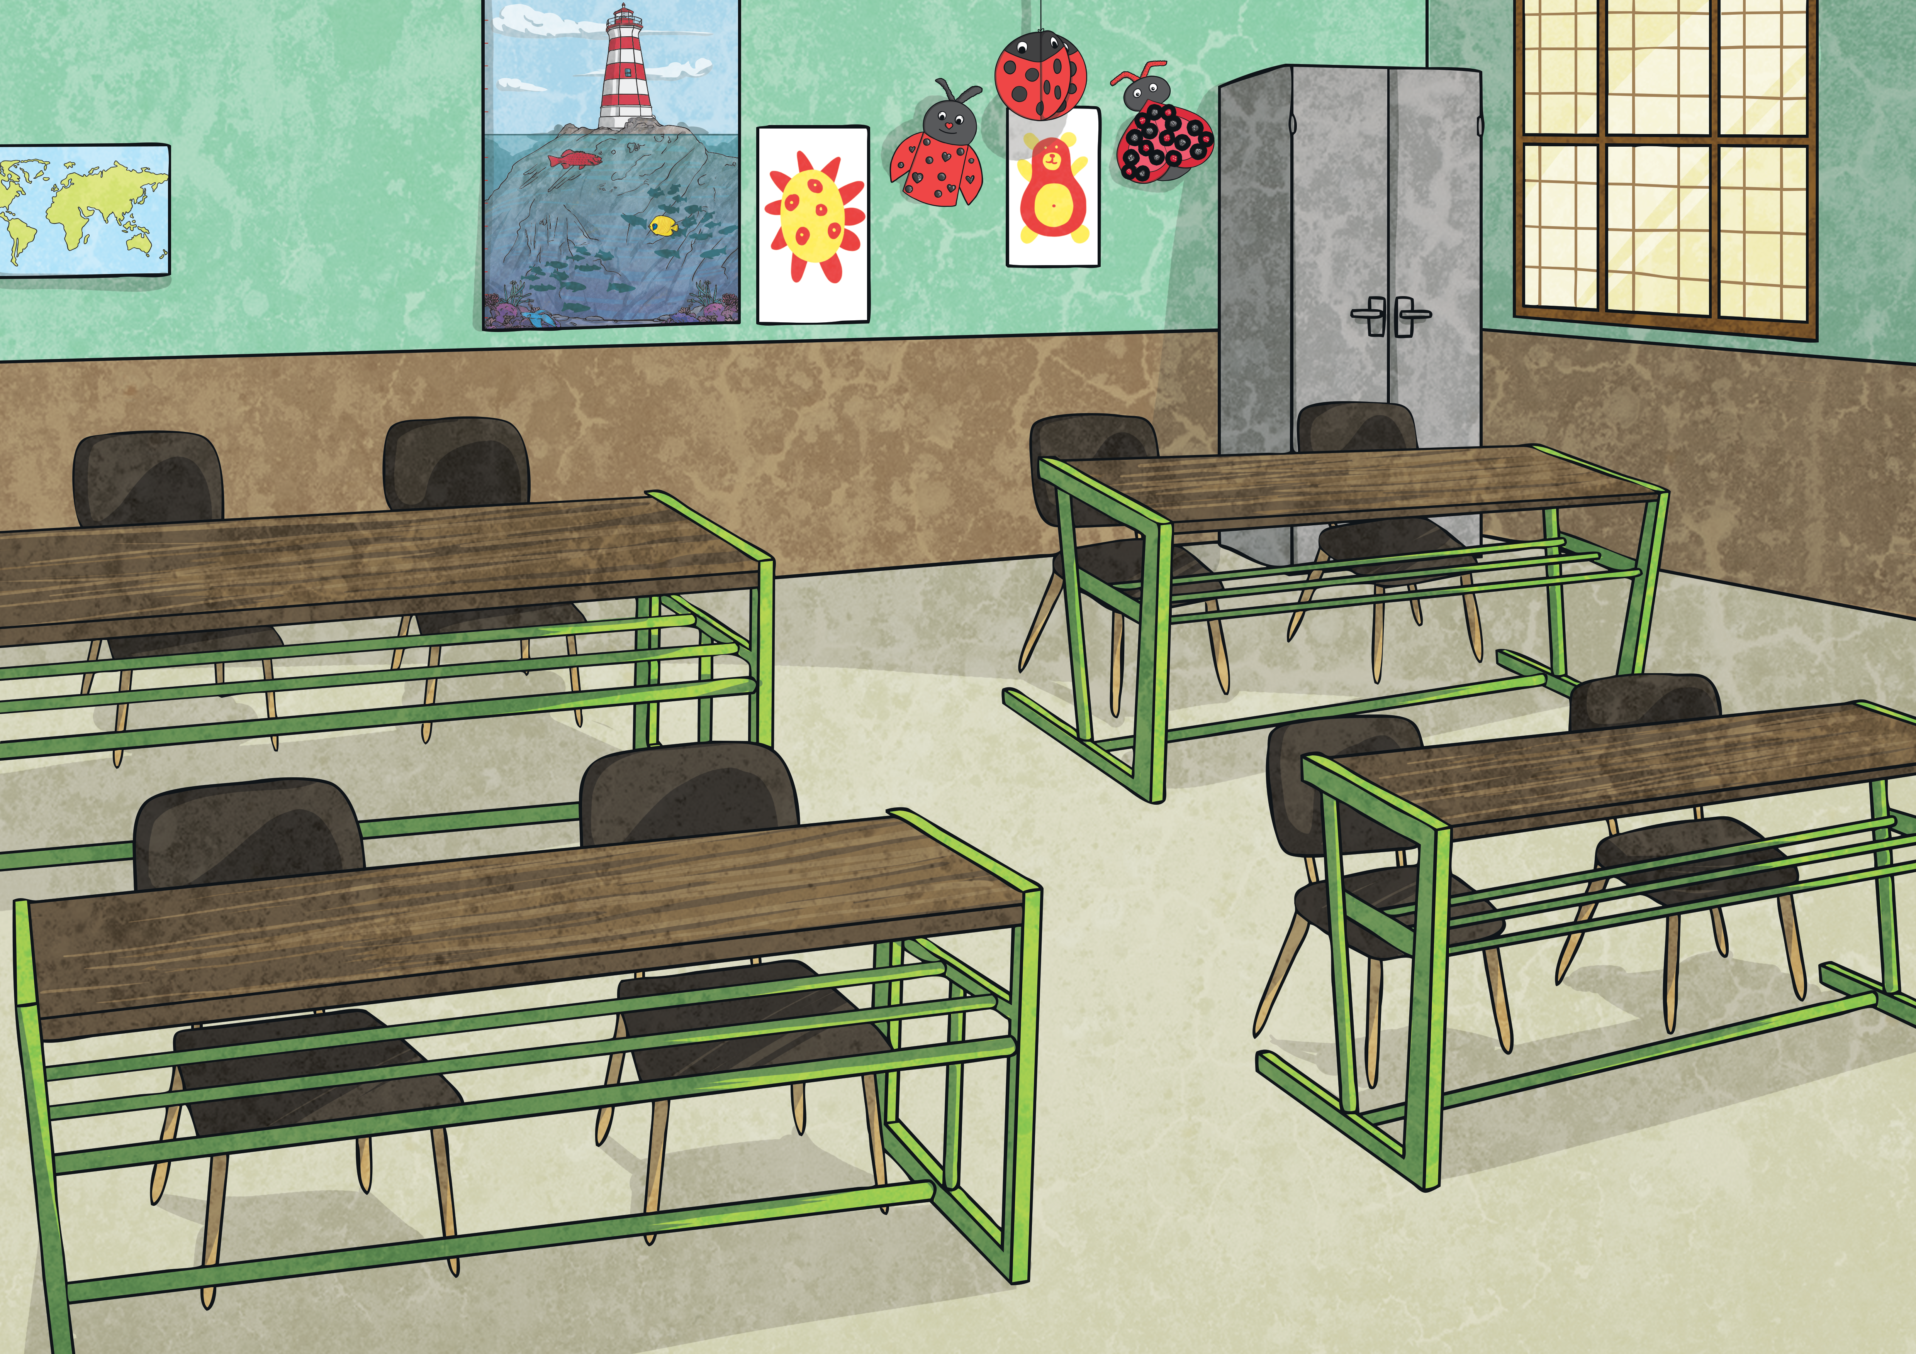
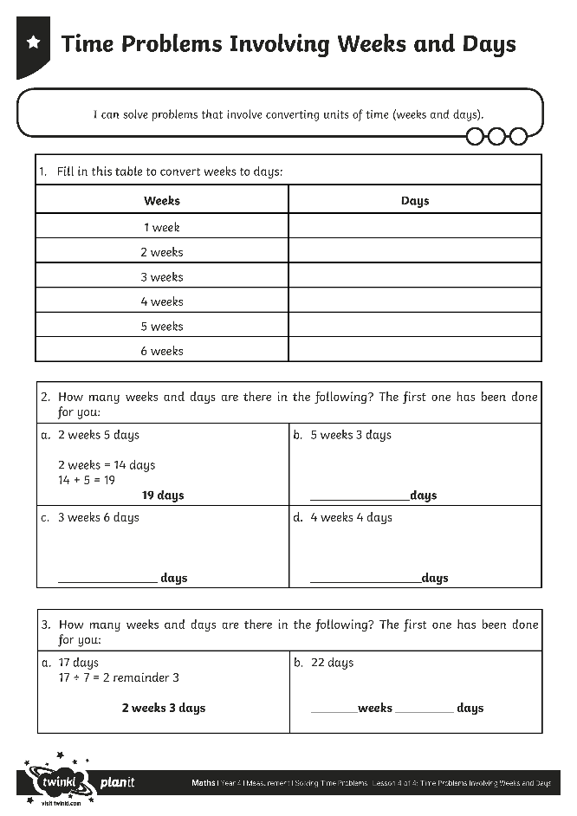
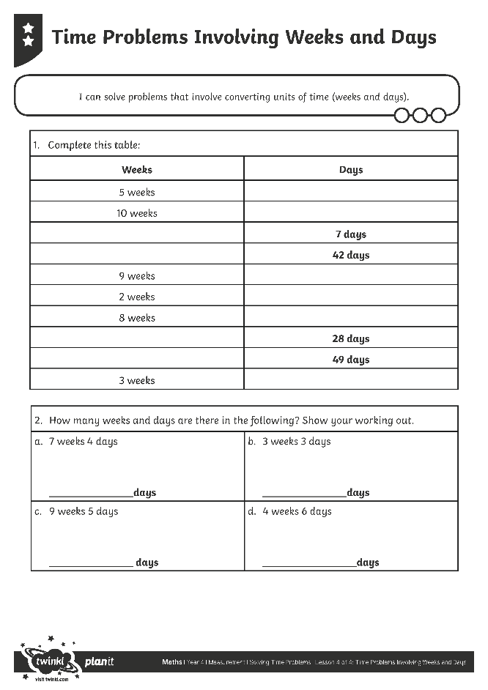
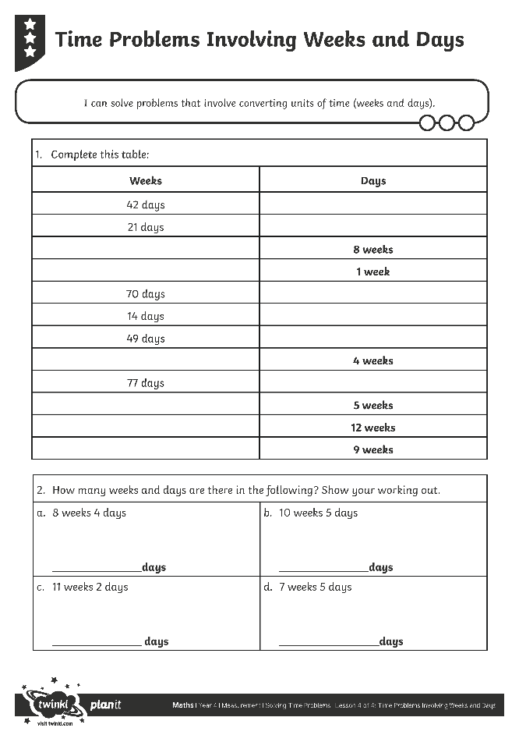
Problems Involving
Weeks and Days
Use your fabulous skills to complete this activity sheet.

Slide 15

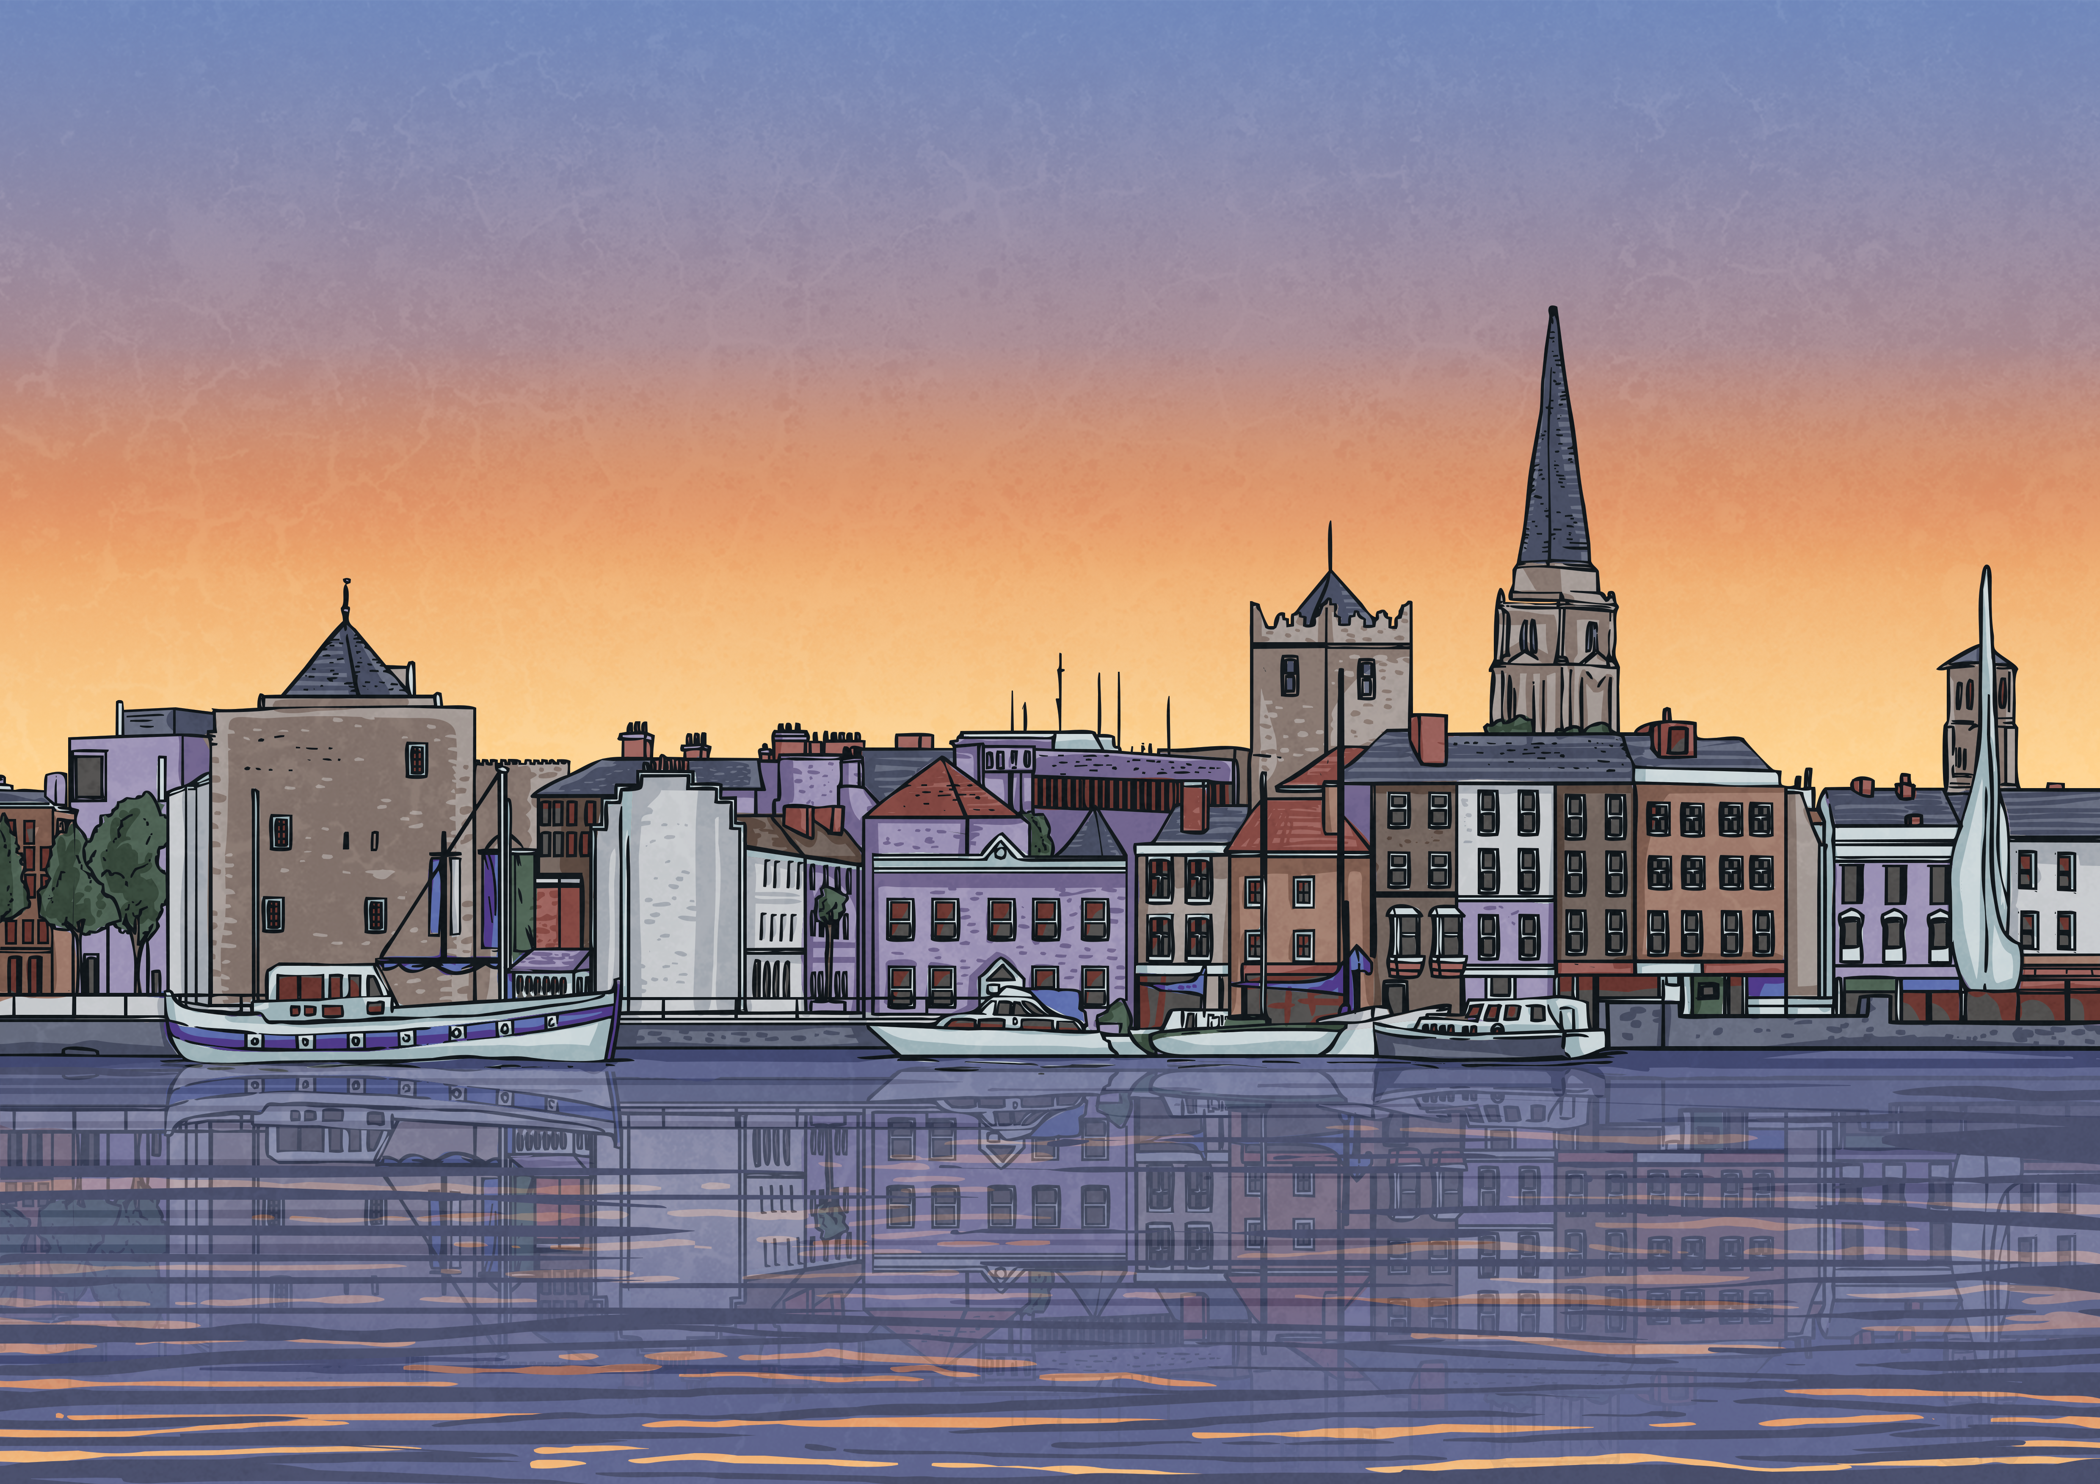
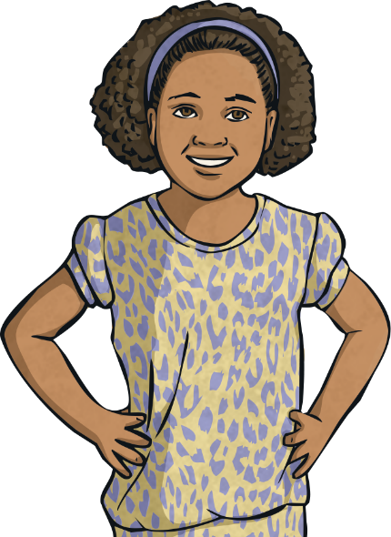
Calendar Problem
Mo | Tu | We | Th | Fr | Sa | Su
 |  |  | 1 | 2 | 3 | 4
5 | 6 | 7 | 8 | 9 | 10 | 11
12 | 13 | 14 | 15 | 16 | 17 | 18
19 | 20 | 21 | 22 | 23 | 24 | 25
26 | 27 | 28 | 29 | 30 | 31
Mo | Tu | We | Th | Fr | Sa | Su
 |  |  |  |  |  | 1
2 | 3 | 4 | 5 | 6 | 7 | 8
9 | 10 | 11 | 12 | 13 | 14 | 15
16 | 17 | 18 | 19 | 20 | 21 | 22
23 | 24 | 25 | 26 | 27 | 28 | 29
30
Today is Tuesday 13th May.
I am going on holiday on Friday 20th June.
How long is it until I go on holiday? Write your answer in both days and in weeks and days.
Answer:
38 days or 5 weeks 3 days

Slide 16

Aim
I can solve problems that involve converting units of time (weeks
and days).
Success Criteria
I can convert from weeks to days.
I can convert from days to weeks.
I can solve problems that involve converting from weeks to days and days to weeks.

