Slide 1


Maths
Measurement
Year One
Maths | Year 4 | Measurement | Solving Time Problems | Lesson 3 of 4: Time Problems Involving Years and Months

Slide 3
Aim
I can solve problems that involve converting units of time (years
and months).
Success Criteria
I can convert from years to months.
I can convert from months to years.
I can solve problems that involve converting from years to months and months to years.

Slide 4

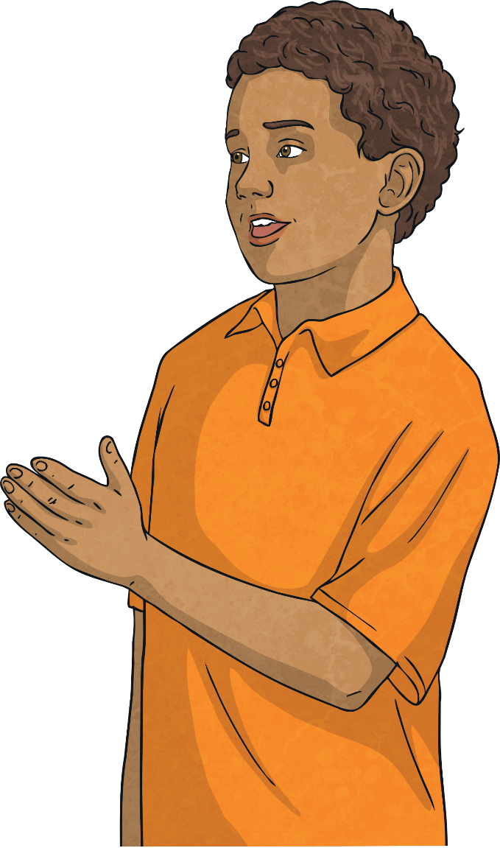
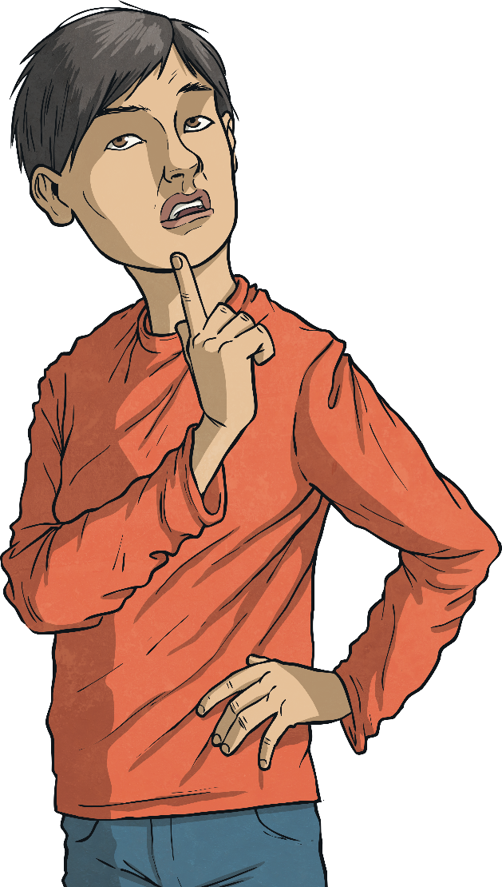
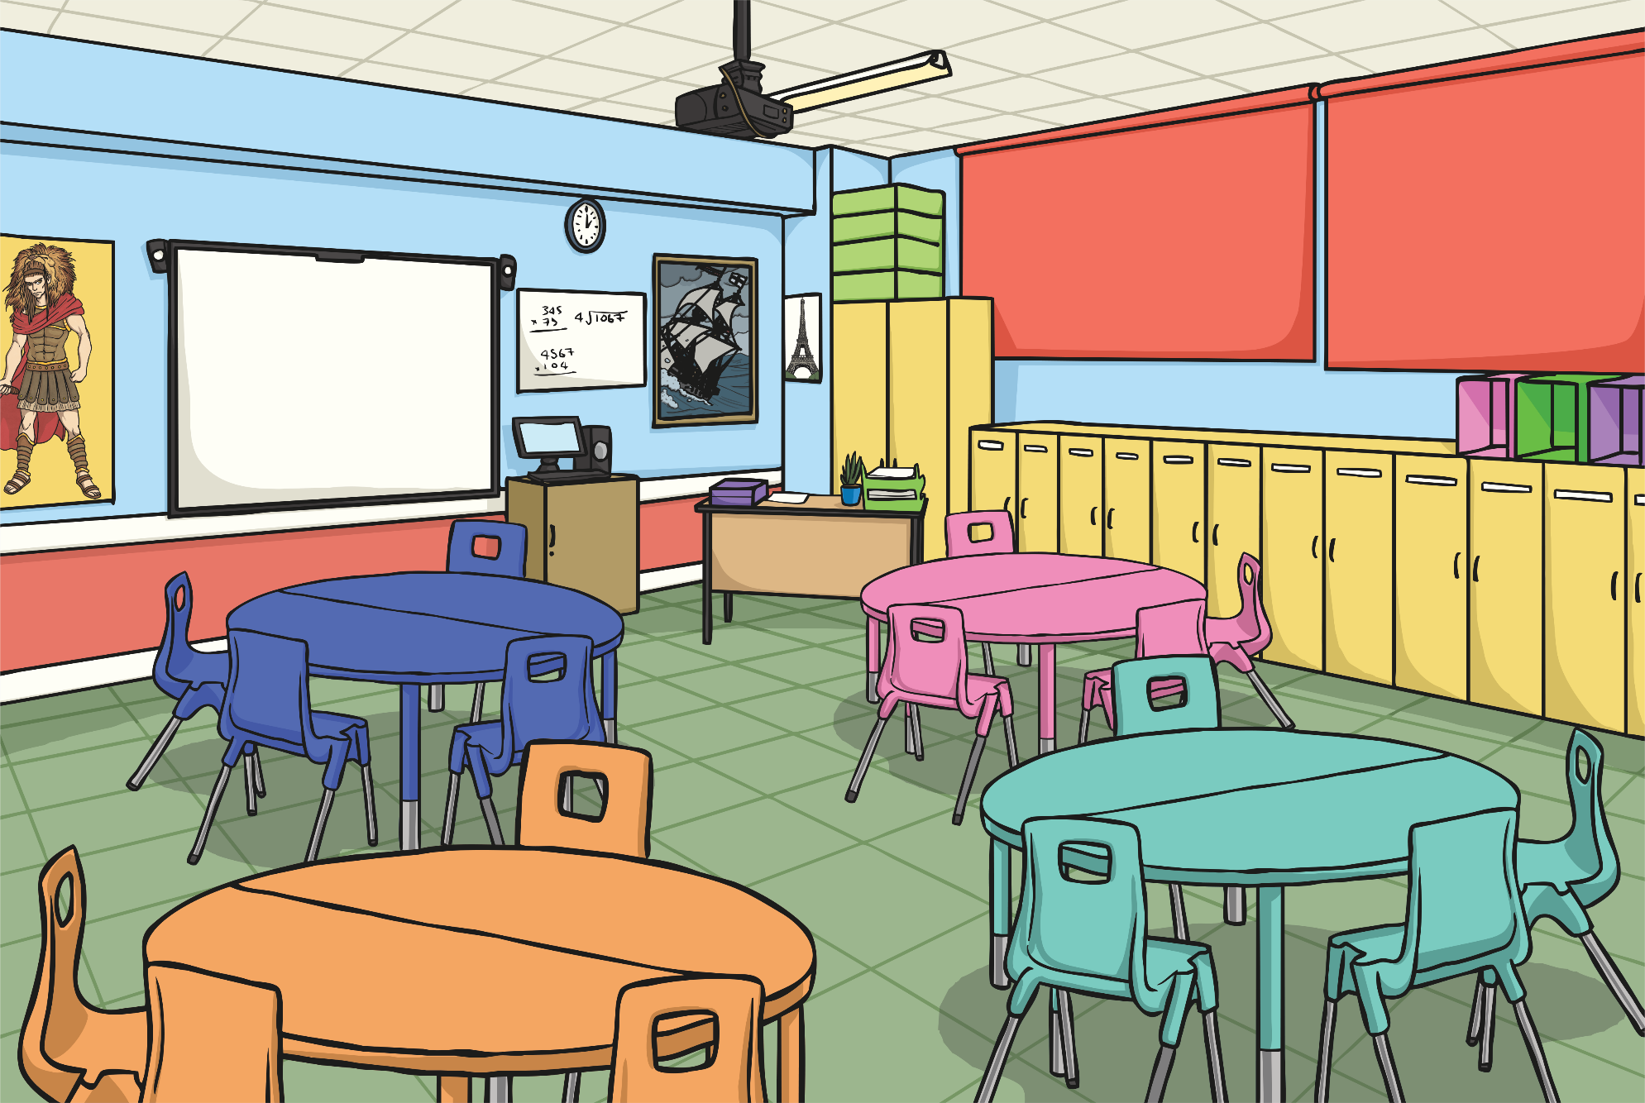
Multiply by 12
To multiply by 12, first multiply by 6, then double the answer:
e.g. 11 × 12 =
11 × 6 = 66
Double 66 = 132
11 × 12 = 132

Slide 5
Multiply by 12
8 × 12 =
6 × 12 =
96
72
4 × 12 =
3 × 12 =
48
36
7 × 12 =
10 × 12 =
84
120
9 × 12 =
5 × 12 =
108
60

Slide 6

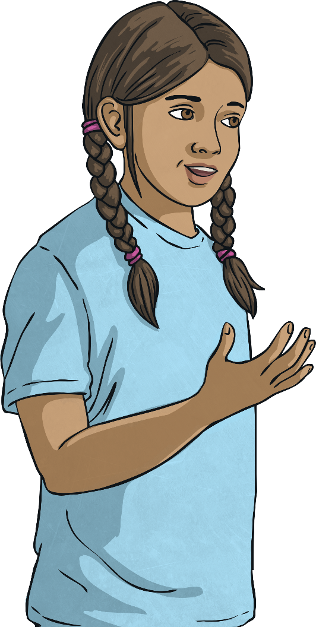
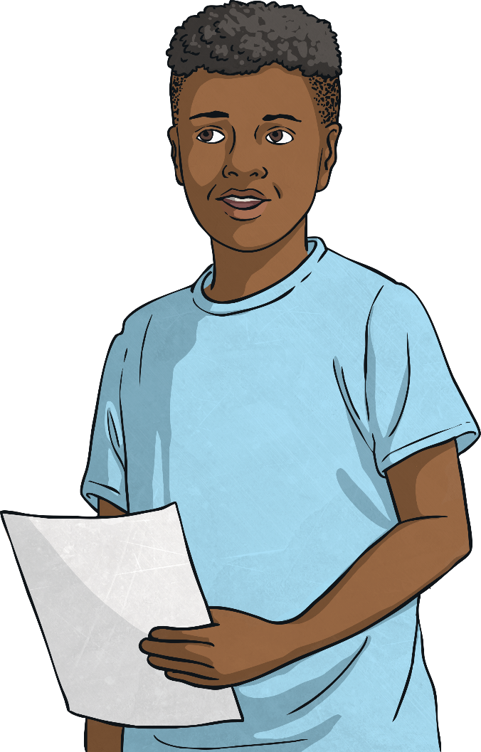
Years to Months
How many months are there in 2 years?
How many months are there in 3 years?
How many months are there in a year?
How many months are there in 6 years?
How many months are there in 10 years?
How many months are there in 4 years?
How many months are there in 8 years?
How many months are there in 5 years?
How many months are there in 9 years?
How many months are there in 7 years?
There are 72 months in 6 years.
There are 120 months in 10 years.
There are 96 months in 8 years.
There are 60 months in 5 years.
There are 108 months in 9 years.
There are 24 months in 2 years.
There are 12 months in a year.
There are 84 months in 7 years.
There are 36 months in 3 years.
There are 48 months in 4 years.

Slide 7
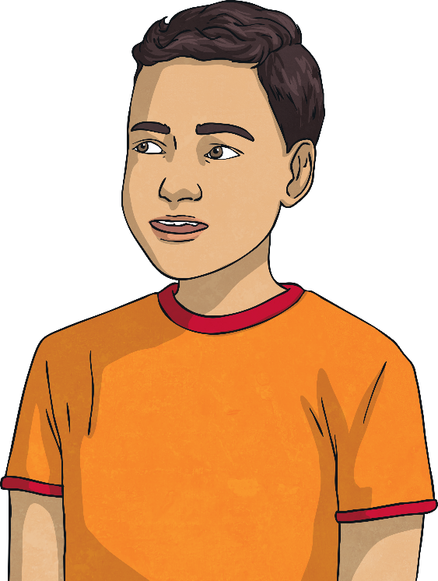
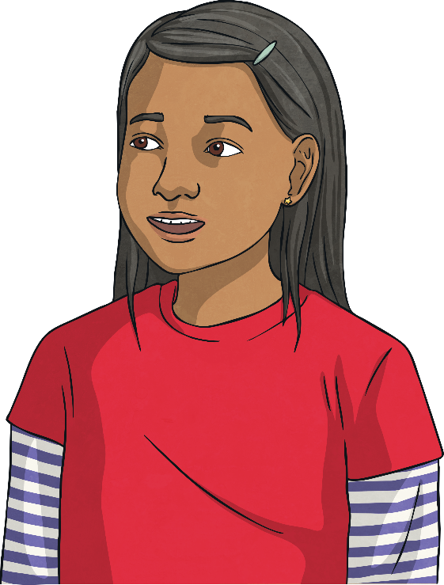
Years to Months
How many months are there in 1 year and 5 months?
1 year = 12 months
+ 5 months =
17 months
How many months are there in 4 years 6 months?
How many months are there in 2 years 10 months?
How many months are there in 3 years
7 months?
There are 54 months in 4 years 6 months.
There are 34 months in 2 years 10 months.
There are 43 months in 3 years
7 months.

Slide 8
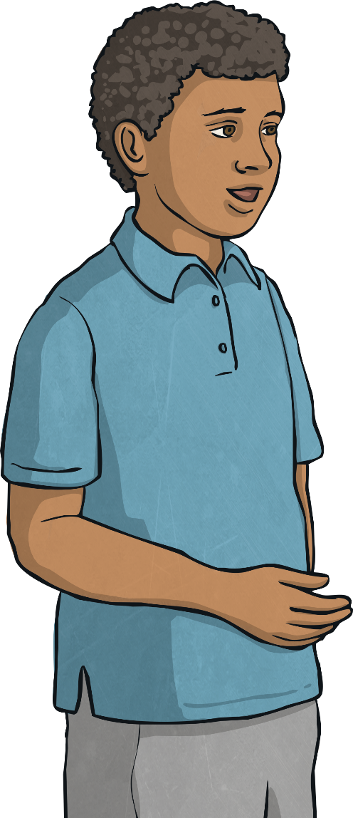

Months to Years
How many years are there in
36 months?
If there is a remainder, this becomes months:
50 ÷ 12 = 4 remainder 2
36 ÷ 12 = 3
50 months = 4 years 2 months
There are 3 years in 36 months.
How many years are there in 50 months?

Slide 9
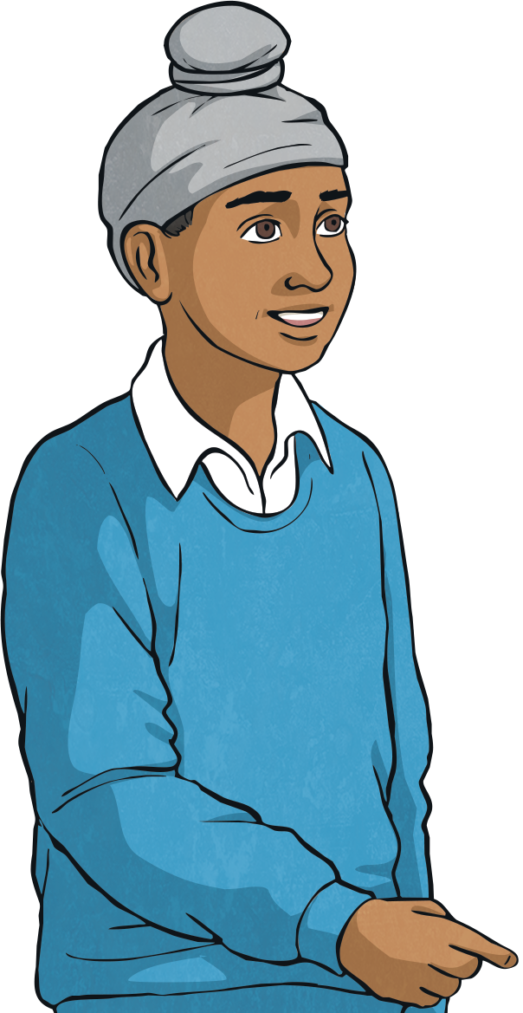

Months to Years
How many years and months are there in 76 months?
How many years and months are there in 38 months?
How many years and months are there in 54 months?
How many years are there in 60 months?
How many years are there in 96 months?
How many years are there in 84 months?
There are 6 years and 4 months in
76 months.
There are 5 years in 60 months.
There are 4 years and 6 months in
54 months.
There are 3 years and 2 months in
38 months.
There are 8 years in 96 months.
There are 7 years in 84 months.

Slide 10

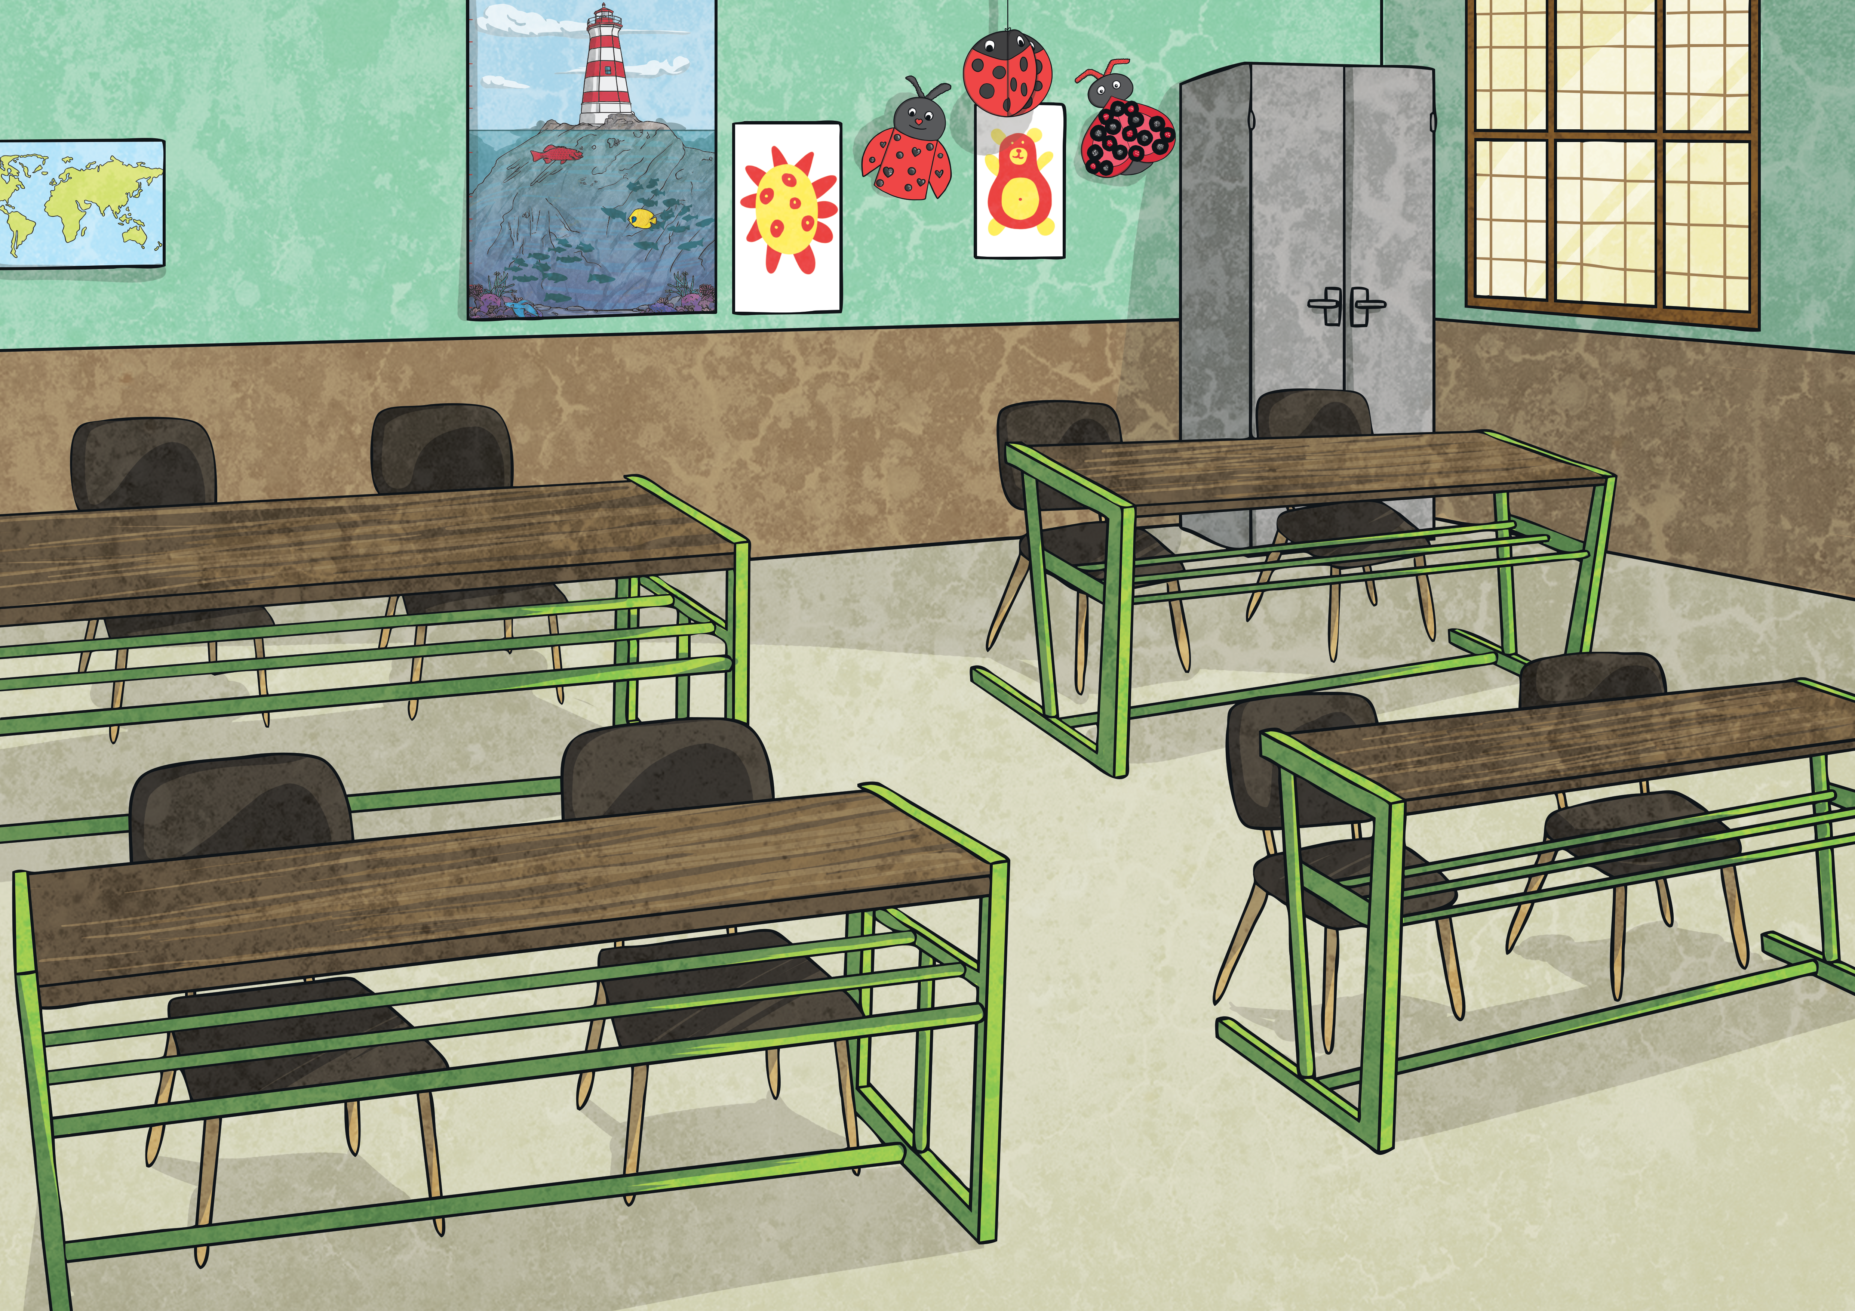
Ages
Some children’s ages are recorded in months and some in years and months. Order the children by age order, from youngest to oldest:
First, change the ages so they are all in months:
Lisa | Claire | Aliyah | Petra | Surinder | Nathan
7 years 2 months | 84 months | 5 years 3 months | 89 months | 6 years 2 months | 79 months
7 × 12 =
84 months
5 × 12 =
89 months
6 × 12 =
79
months
84
60
72
84 + 2 =
60 + 3 =
72 + 2 =
86 months
63 months
74 months
Order from youngest to oldest:
1) Aliyah 2) Surinder 3) Nathan 4) Claire 5) Lisa 6) Petra

Slide 11

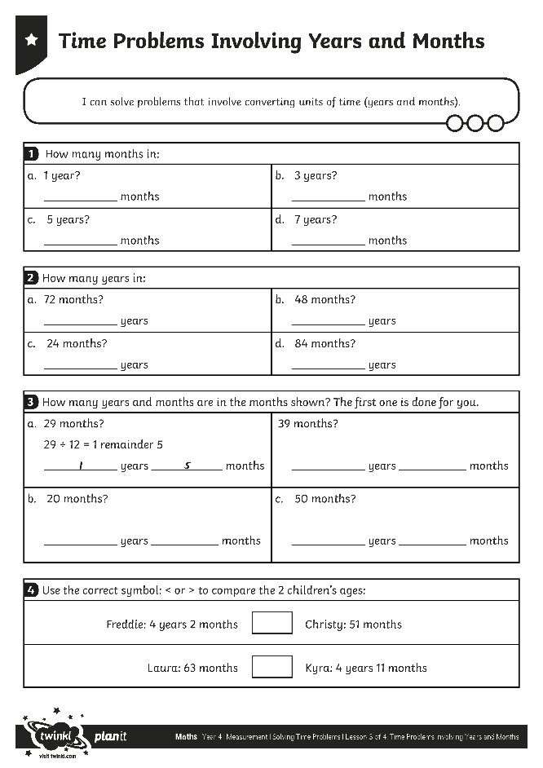
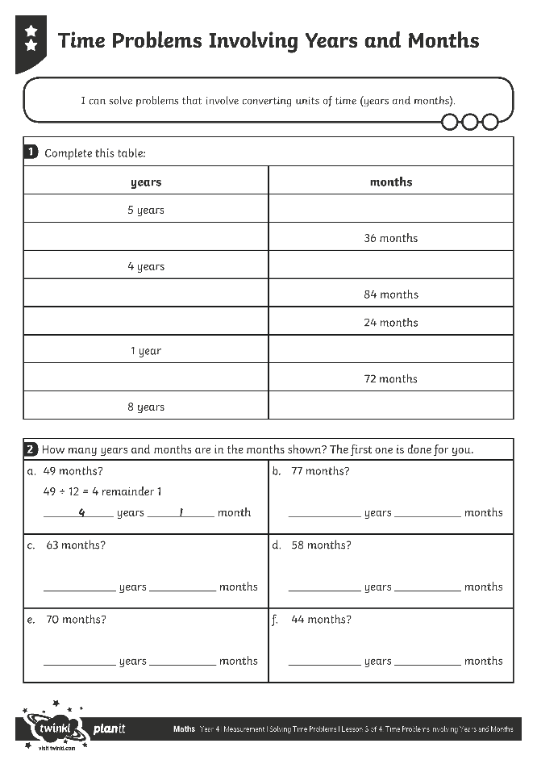
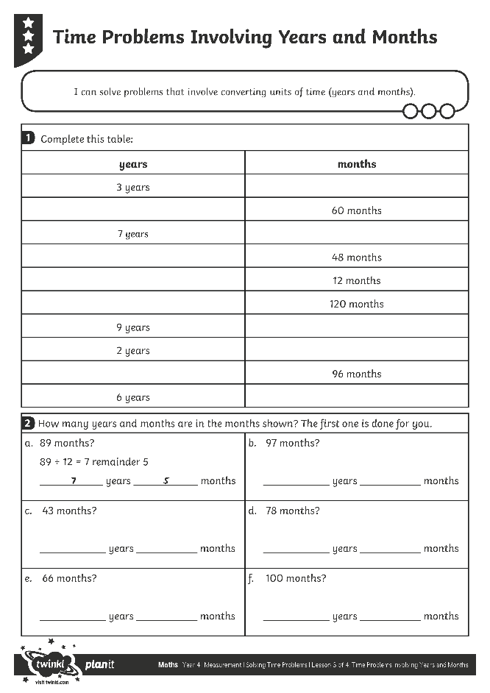
Problems Involving
Years and Months
Use your fabulous mastery skills to complete this activity sheet.

Slide 12
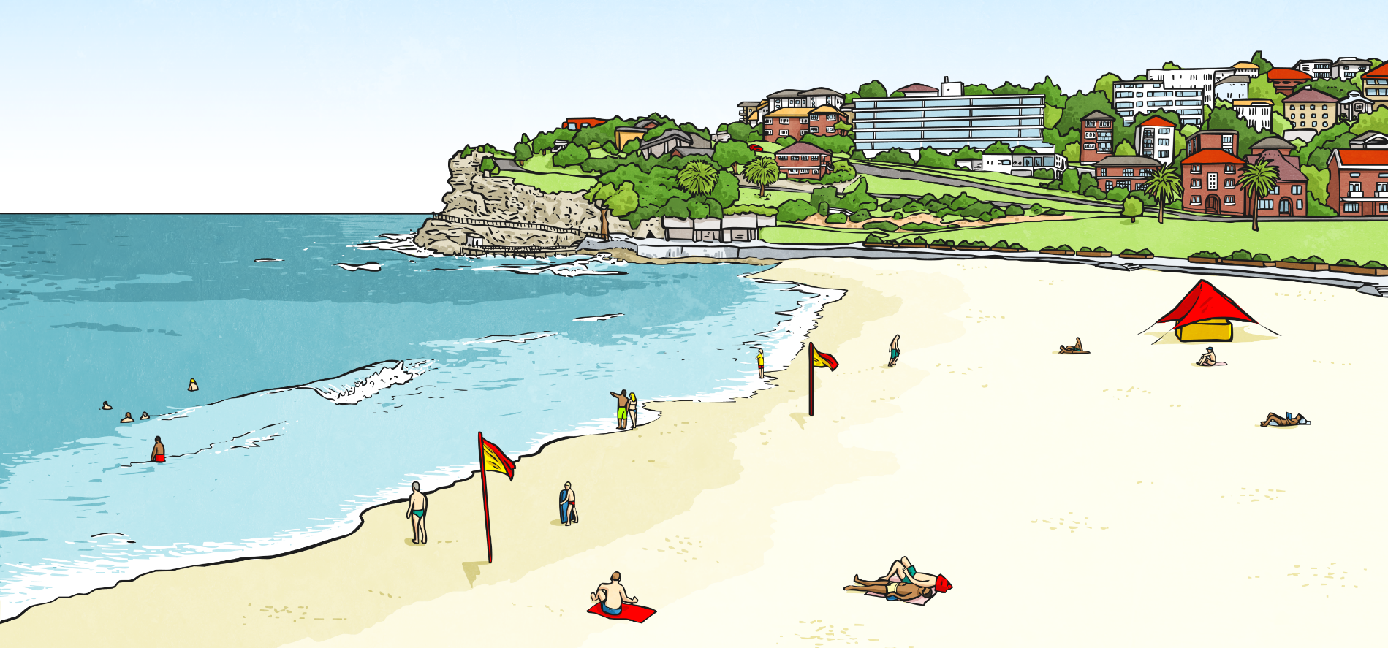
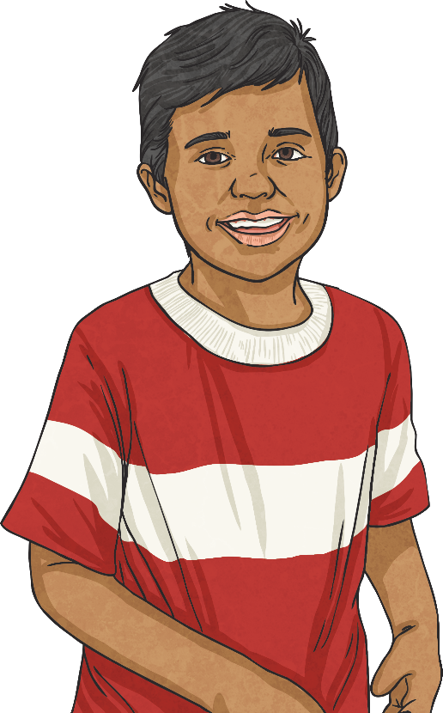
Solve the Problem
In February 2016, Benjamin and his family planned a special holiday for July 2018. How long did he have to wait until they went on holiday? Write your answer in years and months and in months.
2 years 5 months or 29 months

Slide 13

Aim
I can solve problems that involve converting units of time (years
and months).
Success Criteria
I can convert from years to months.
I can convert from months to years.
I can solve problems that involve converting from years to months and months to years.

