Slide 1


Maths
Measurement
Year One
Maths | Year 4 | Measurement | Solving Time Problems | Lesson 2 of 4: Time Problems Involving Minutes and Seconds

Slide 3
Aim
I can solve problems that involve converting units of time (minutes and seconds).
Success Criteria
I can convert from minutes and seconds to seconds.
I can convert from seconds to minutes and seconds.
I can solve problems that involve converting from minutes and seconds to seconds and seconds to minutes and seconds.

Slide 4

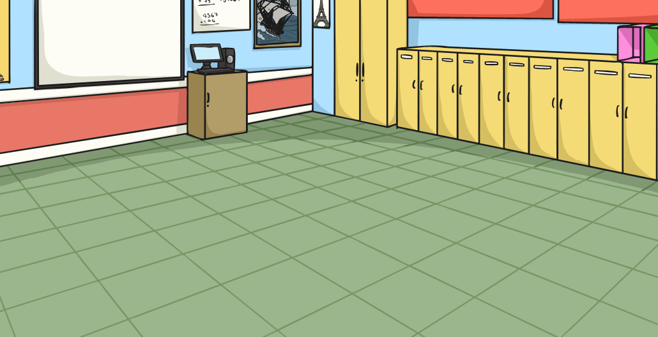

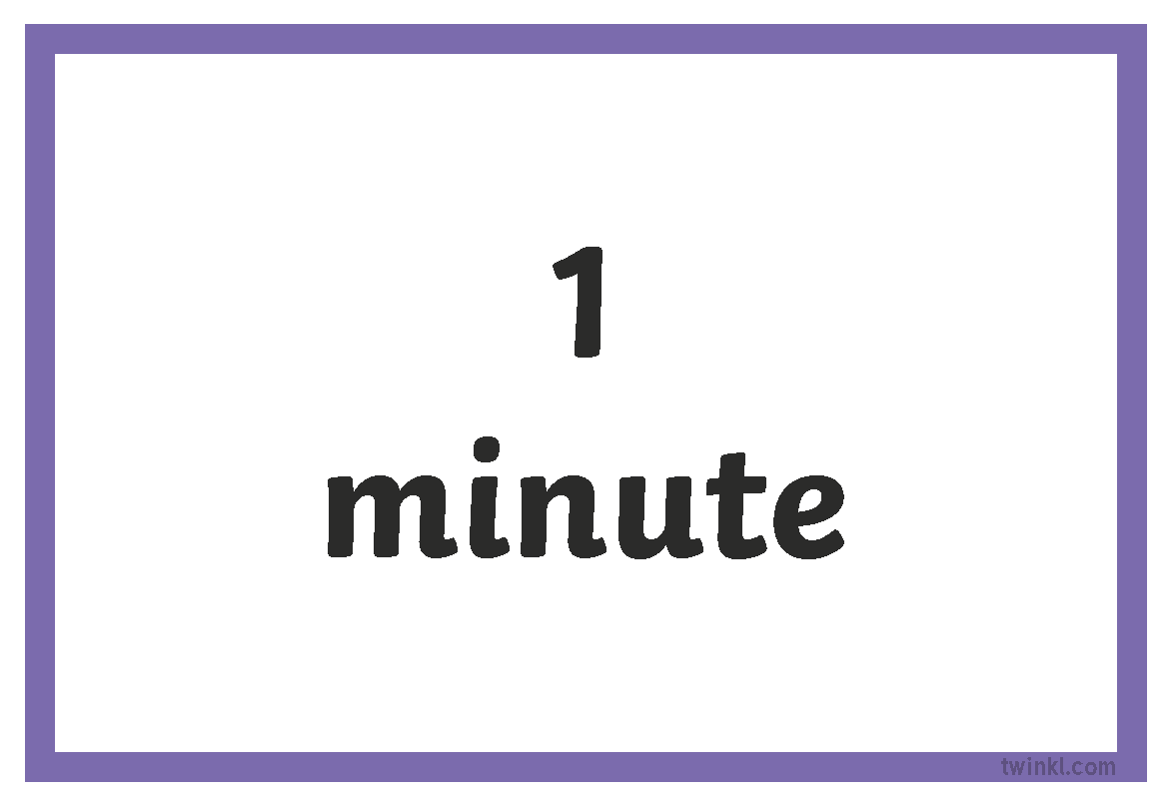
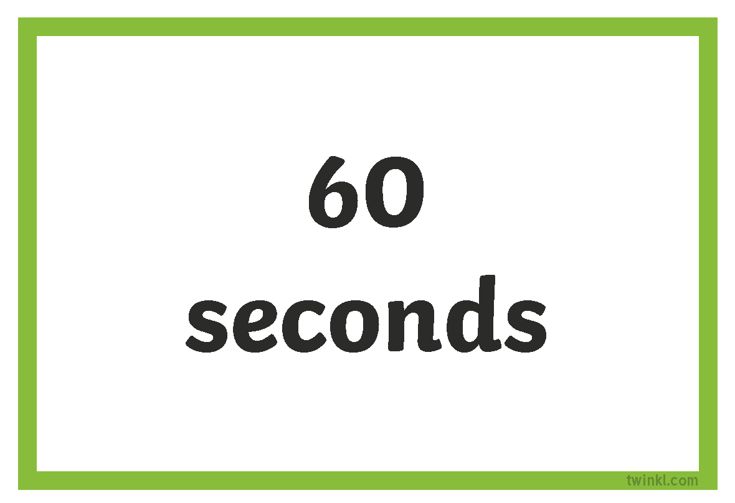
Matching Game
Play the Matching Minutes and Seconds Cards. Place all the cards face down on the table. Turn over 2 at a time to try to find a match. Carry on until you have paired all the cards..

Slide 5

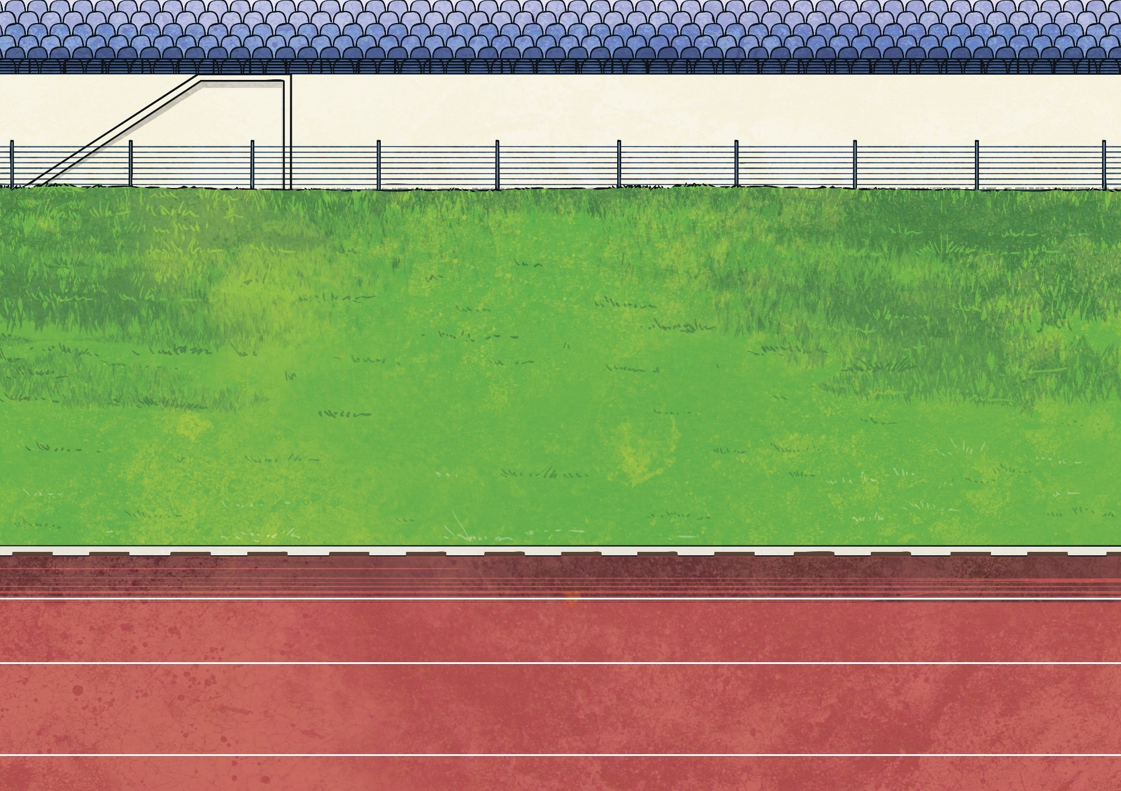
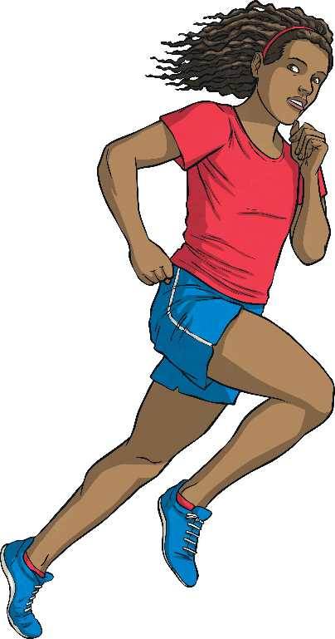
1500 Metre Race
Here are some of the world records for the women’s 1500m running race over the last 100 years. The times have been rounded to the nearest second:
Year | Athlete | Time minutes (m) seconds (s)
1927 | Anna Mushkina (Russia) | 5m 18s
1936 | Lydia Freiberg (Russia) | 5m 2s
1956 | Phyllis Perkins (Great Britain) | 4m 35s
1967 | Maria Gommers (Netherlands) | 4m 16s
1980 | Tatyana Kazankina (Russia) | 3m 55s
2015 | Genzebe Dibaba (Ethiopia) | 3m 50s
Convert the athletes’ times into seconds.

Slide 6
1500 Metre Race
1927 | Anna Mushkina (Russia) | 5m 18s
Answer:
5 minutes =
5 × 60 =
300 seconds
300 seconds + 18 seconds =
318 seconds
5 minutes 18 seconds =
318 seconds

Slide 7
1500 Metre Race
1936 | Lydia Freiberg (Russia) | 5m 2s
Answer:
5 minutes =
5 × 60 =
300 seconds
300 seconds + 2 seconds =
302 seconds
5 minutes 2 seconds =
302 seconds

Slide 8
1500 Metre Race
1956 | Phyllis Perkins (Great Britain) | 4m 35s
Answer:
4 minutes =
4 × 60 =
240 seconds
240 seconds + 35 seconds =
275 seconds
4 minutes 35 seconds =
275 seconds

Slide 9
1500 Metre Race
1967 | Maria Gommers (Netherlands) | 4m 16s
Answer:
4 minutes =
4 × 60 =
240 seconds
240 seconds + 16 seconds =
256 seconds
4 minutes 16 seconds =
256 seconds

Slide 10
1500 Metre Race
1980 | Tatyana Kazankina (Russia) | 3m 55s
Answer:
3 minutes =
3 × 60 =
180 seconds
180 seconds + 55 seconds =
235 seconds
3 minutes 55 seconds =
235 seconds

Slide 11
1500 Metre Race
2015 | Genzebe Dibaba (Ethiopia) | 3m 50s
Answer:
3 minutes =
3 × 60 =
180 seconds
180 seconds + 50 seconds =
230 seconds
3 minutes 50 seconds =
230 seconds

Slide 12

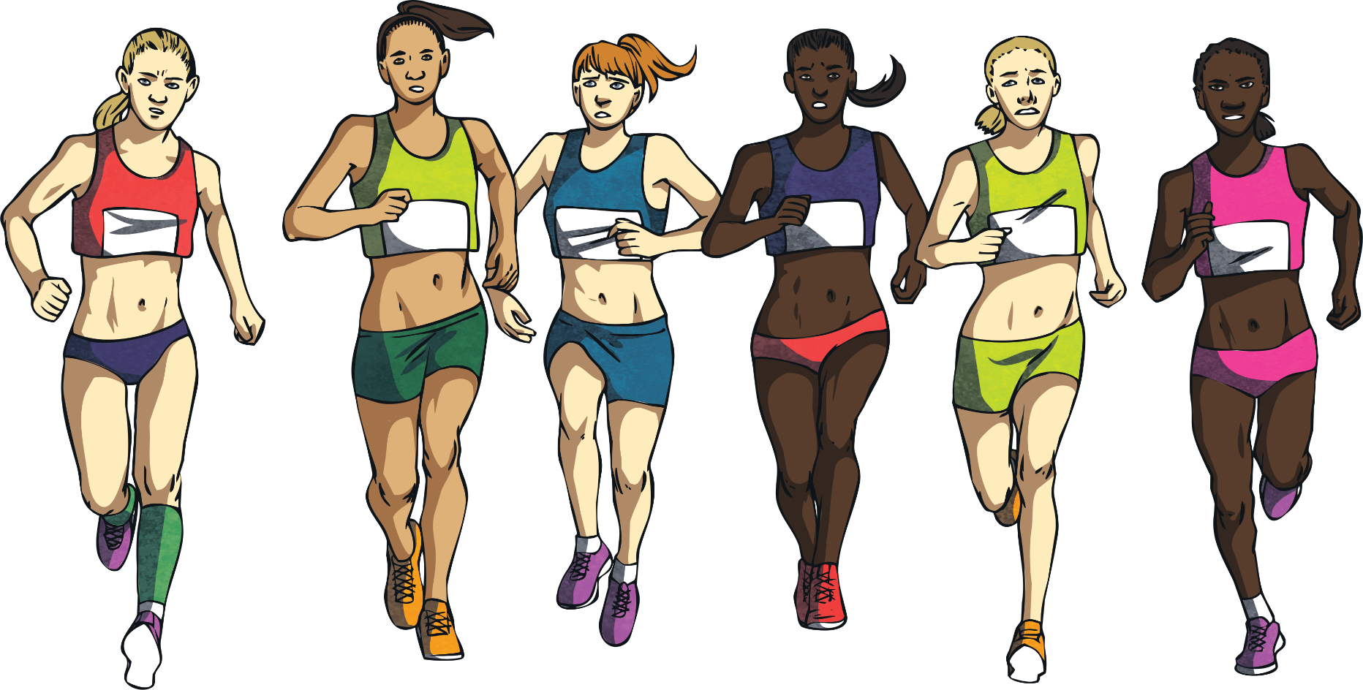
10 000 Metre Race
Here are some of the world records for the 10 000m
running race in the last 100 years:
Years | Athlete | Time minutes (m) seconds (s)
1944 | Viljo Heino (Finland) | 29m 35s
1956 | Sandor Iharos (Hungary) | 28m 43s
1972 | Lasse Virén (Finland) | 27m 38s
1973 | David Bedford (Great Britain) | 27m 31s
1997 | Haile Gebrselassie (Ethiopia) | 26m 31s
2005 | Kenenisa Bekele (Ethiopia) | 26m 18s

Slide 13
10 000 Metres Race
How much faster was Kenenisa Bekele than Lasse Virén ?
1972 | Lasse Virén (Finland) | 27m 38s
2005 | Kenenisa Bekele (Ethiopia) | 26m 18s
+ 42
seconds
+ 38 seconds
26m 18s
27m
27m 38s
42 seconds + 38 seconds =
80 seconds
80 seconds =
1 minute 20 seconds

Slide 14
10 000 Metres Race
How much faster was Haile Gebrselassie than Sandor Iharos?
1956 | Sandor Iharos (Hungary) | 28m 43s
1997 | Haile Gebrselassie (Ethiopia) | 26m 31s
+29
seconds
+ 1 minute
+ 43 seconds
26m 31s
27m
28m
28m 43s
1 minute + 29 seconds + 43 seconds =
1 minute + (29 + 43 seconds = 72 seconds) =
1 minute + 72 seconds
72 seconds = 1 minute 12 seconds
1 minute + 1 minute 12 seconds = 2 minutes 12 seconds

Slide 15
10 000 Metres Race
How much faster was David Bedford than Viljo Heino ?
1973 | David Bedford (Great Britain) | 27m 31s
1944 | Viljo Heino (Finland) | 29m 35s
+29
seconds
+ 1 minute
+ 35 seconds
27m 31s
28m
29m
29m 35s
29 seconds + 1 minute + 35 seconds =
1 minute + (29 seconds + 35 seconds = 64 seconds) =
1 minute + 64 seconds
64 seconds = 1 minute 4 seconds
1 minute + 1 minute 4 seconds = 2 minutes 4 seconds

Slide 16

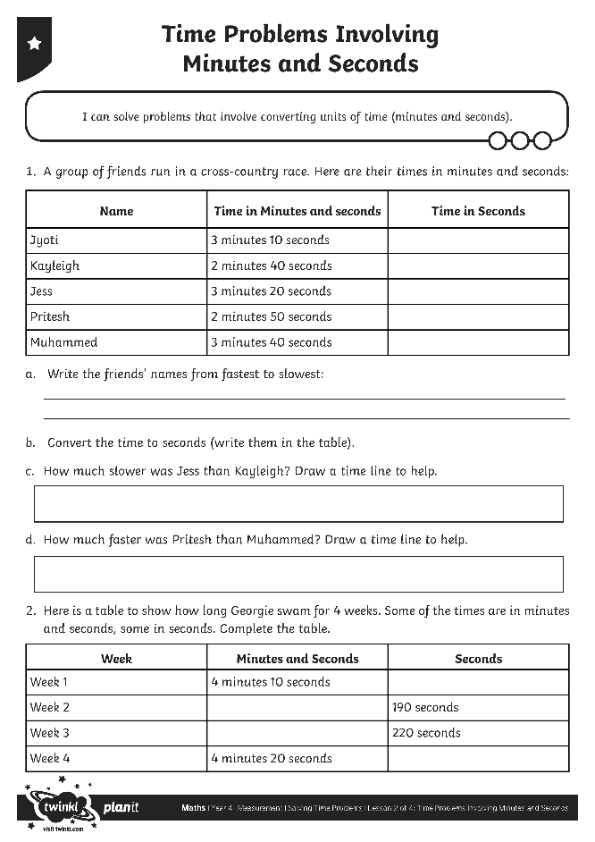
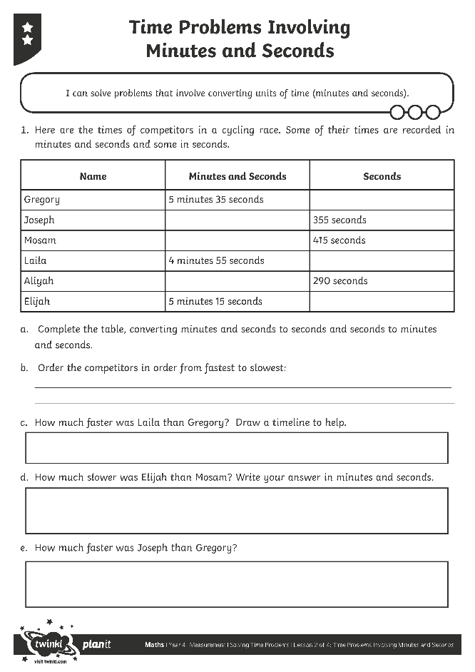
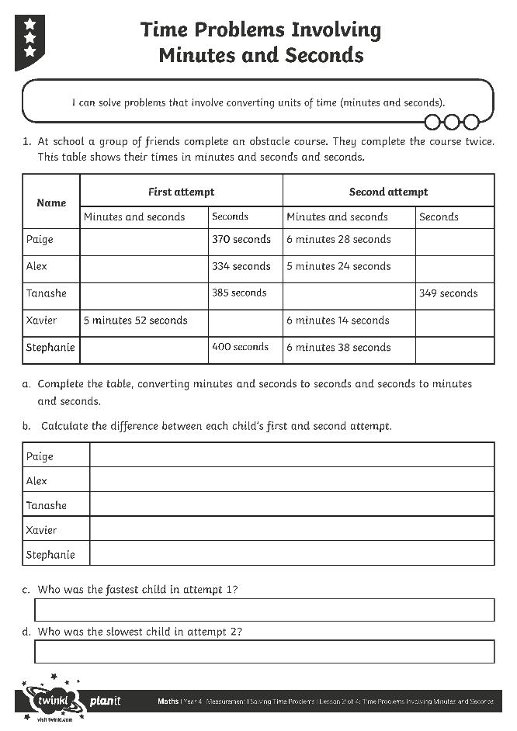
Problems Involving Minutes
and Seconds Activity
Use your wonderful mastery skills to complete this activity sheet.

Slide 17

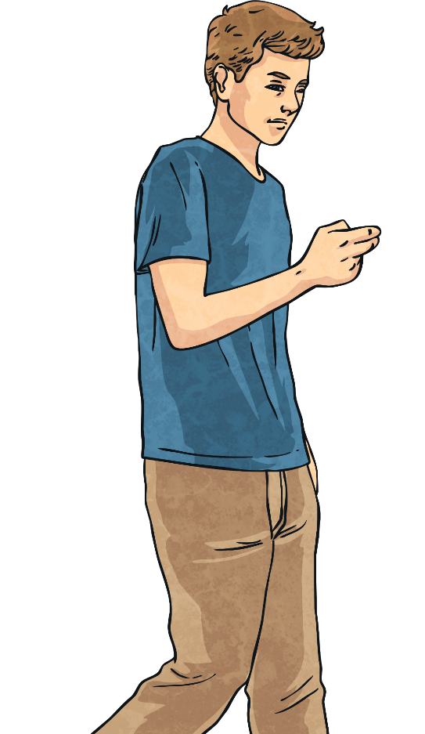
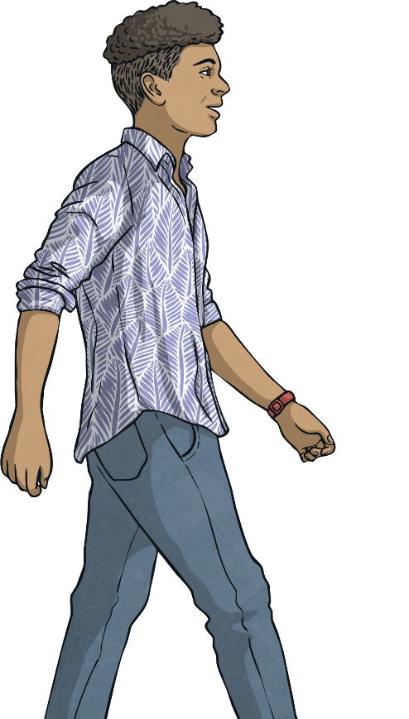
Who Has the Longest Journey?
Harjot and his friend Blake time how long it takes them to walk home. Harjot times himself in minutes and seconds and Blake times himself in seconds.
It takes Harjot 7 minutes 14 seconds and it takes Blake 449 seconds. Who takes the longest to get home and by how much?
Answer:
Harjot = 7 minutes 14 seconds
Blake = 449 seconds
First, change the times into the same unit:
Harjot’s time = 7 × 60 = 420 + 14 = 434 seconds.
449 – 434 = 15
So, Blake’s journey is the longest by 15 seconds.

Slide 18

Aim
I can solve problems that involve converting units of time (minutes and seconds).
Success Criteria
I can convert from minutes and seconds to seconds.
I can convert from seconds to minutes and seconds.
I can solve problems that involve converting from minutes and seconds to seconds and seconds to minutes and seconds.

